Slide 1

Fiber Materials In Optical Fibers
Exploring Materials for Optical Communication Systems
Photo by Pexels

Slide 2
01
Introduction to Fiber Materials
Table of Contents
02
Silica Glass as the Primary Material
03
Core and Cladding Structure
04
Doped Silica Materials
05
Plastic Optical Fibers (POF)
06
Quartz and Other Glass Materials
07
Rare-Earth Doped Fibers
08
Non-Silica Glasses in Specialty Fibers

Slide 3

1
Introduction to Fiber Materials
Overview of Optical Fibers
Optical fibers rely on specialized materials to transmit light efficiently over long distances.
The choice of fiber material affects the fiber's transparency, durability, and performance.
Understanding these materials is crucial for designing effective optical communication systems.
Fiber materials are essential for the core functionality of optical fibers.

Slide 4
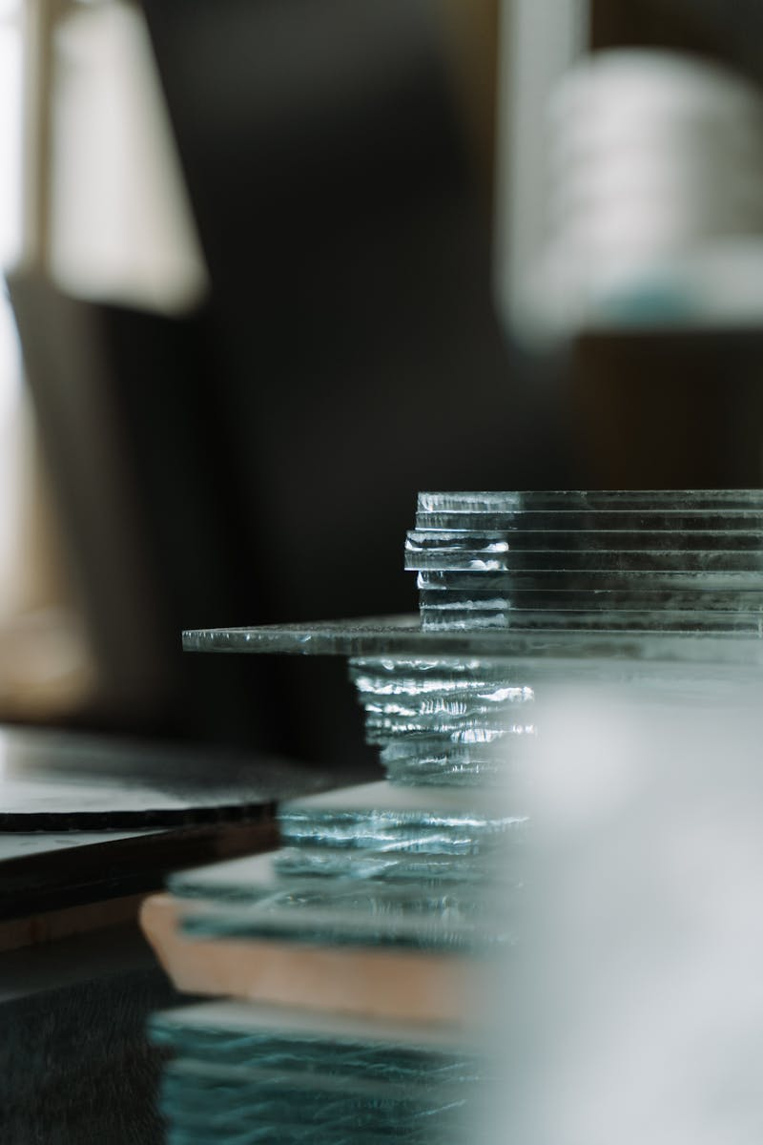
2
Silica Glass as the Primary Material
Properties and Applications
Silica glass is the most commonly used material in optical fibers due to its excellent optical properties.
It offers low attenuation and high transparency in the visible and infrared spectrum.
Its chemical stability makes it suitable for various environmental conditions.
Silica glass ensures reliable performance in optical communication.

Slide 5

3
Core and Cladding Structure
Design of Optical Fibers
Optical fibers consist of a core made of silica glass surrounded by a cladding layer with a lower refractive index.
The core guides light through total internal reflection, enabling efficient data transmission.
The material properties of both core and cladding are critical for minimizing signal loss.
This structure optimizes light transmission in fibers.

Slide 6
4
Doped Silica Materials
Enhancing Fiber Performance
Doping silica with elements like Germanium or Phosphorus can alter its refractive index for better performance.
Doped silica cores enable the creation of single-mode and multi-mode fibers.
Precise control of doping levels improves the fiber's optical properties and signal quality.
Doping enhances overall fiber efficiency.

Slide 7

5
Plastic Optical Fibers (POF)
Alternative Materials for Short-Distance Use
POF uses polymers like PMMA (Polymethyl methacrylate) as the core material.
They are more flexible and easier to handle but have higher attenuation compared to silica fibers.
POF is often used for short-distance communication and consumer applications.
POF offers practicality for specific uses despite higher loss.

Slide 8

6
Quartz and Other Glass Materials
High-Performance Options
Quartz and other specialty glasses are used for high-performance or specialized optical fibers.
These materials can withstand higher temperatures and offer unique optical properties.
They are employed in sensing, laser delivery, and high-power applications.
These glasses provide enhanced durability for demanding environments.

Slide 9

7
Rare-Earth Doped Fibers
Amplification in Optical Systems
Doping silica fibers with rare-earth ions like Erbium, Ytterbium, or Thulium enables amplification of light signals.
These doped fibers are essential components in fiber amplifiers and laser systems.
The choice of doping material influences the wavelength and efficiency of amplification.
Doped fibers improve signal strength in communication.

Slide 10

8
Non-Silica Glasses in Specialty Fibers
Advanced and Infrared Applications
Non-silica glasses, such as fluoride or chalcogenide glasses, are used in mid-infrared and specialized applications.
These glasses are employed for unique optical properties in specific scenarios.
They enable transmission in the mid-infrared spectrum.
Non-silica glasses expand the range of optical fiber uses.

