Slide 1
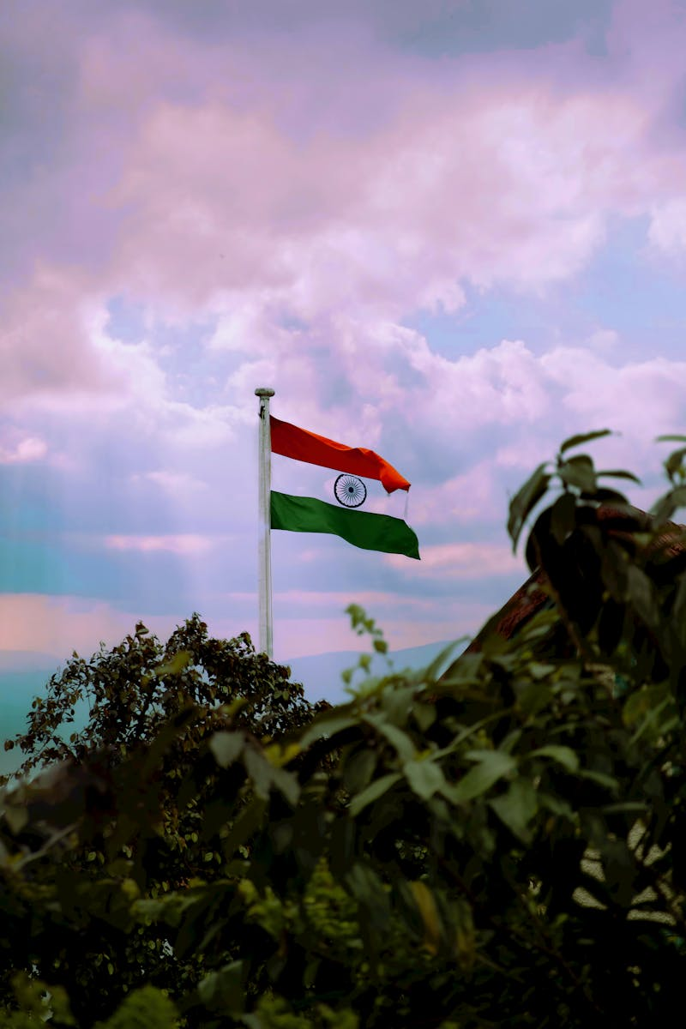
Freedom of Speech Understanding Our Constitutional Right
Photo by Pexels

Slide 2
01
The Fundamental Right
Table of Contents
02
The Power of Expression
03
Understanding the Boundaries
04
Eight Key Restrictions
05
Remaining Restrictions

Slide 3
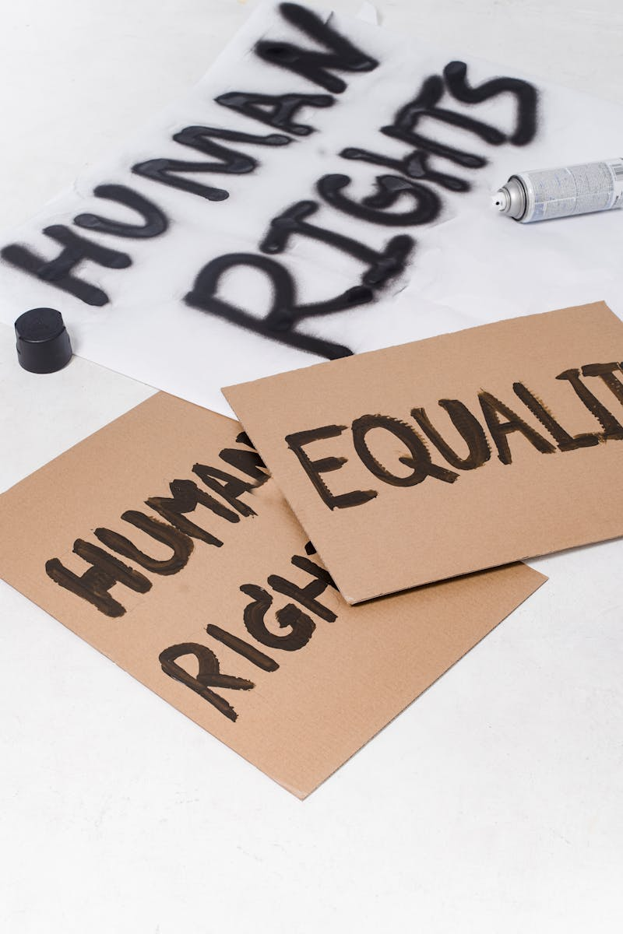
1
The Fundamental Right
Article 19(1)(a) - Our Voice in Democracy
Every citizen enjoys the Right to Freedom of Speech and Expression under Article 19(1)(a) of the Constitution. We can express our thoughts freely — through words, writing, art, or digital media — without fear of censorship. This right is essential to democracy because it allows open discussion, criticism of government, and exchange of ideas. Freedom extends across various platforms from traditional speech to modern digital communication channels.

Slide 4
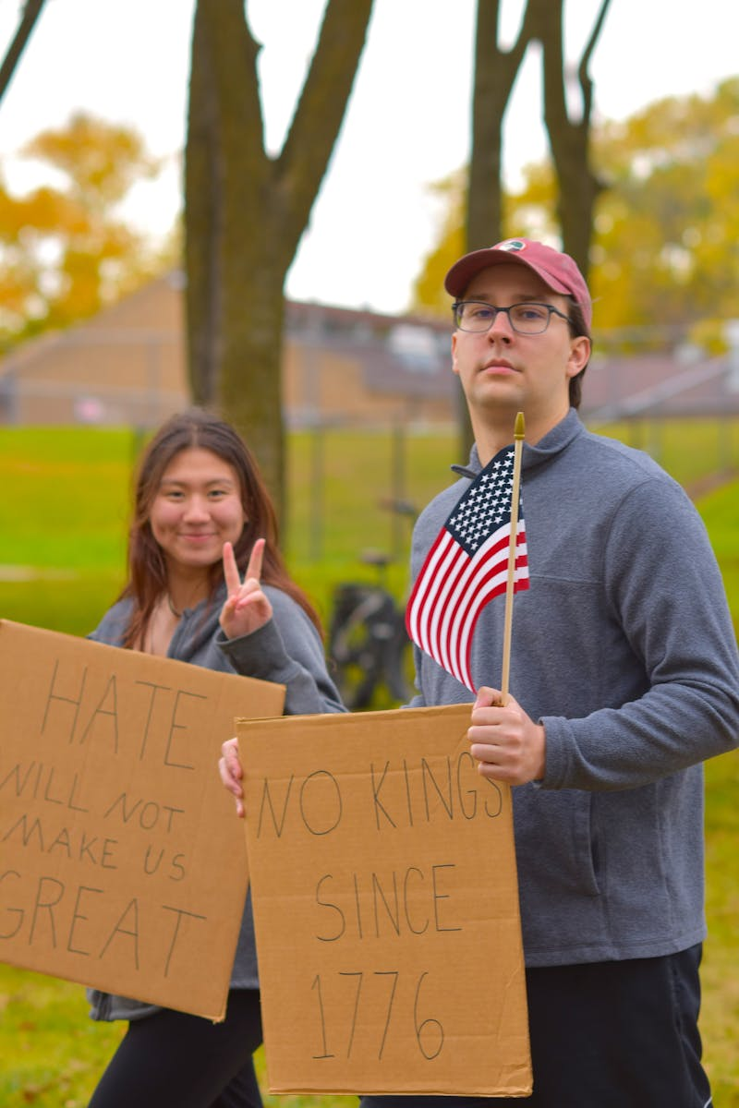
2
The Power of Expression
How Our Voices Shape Society
Freedom of speech gives every Indian the power to speak the truth and challenge injustice. Artists, writers, and creators can express their visions without fear of government interference. Open discussion allows citizens to participate meaningfully in national conversations and decision-making. Modern technology provides new platforms for expressing ideas and connecting with others across the nation.

Slide 5
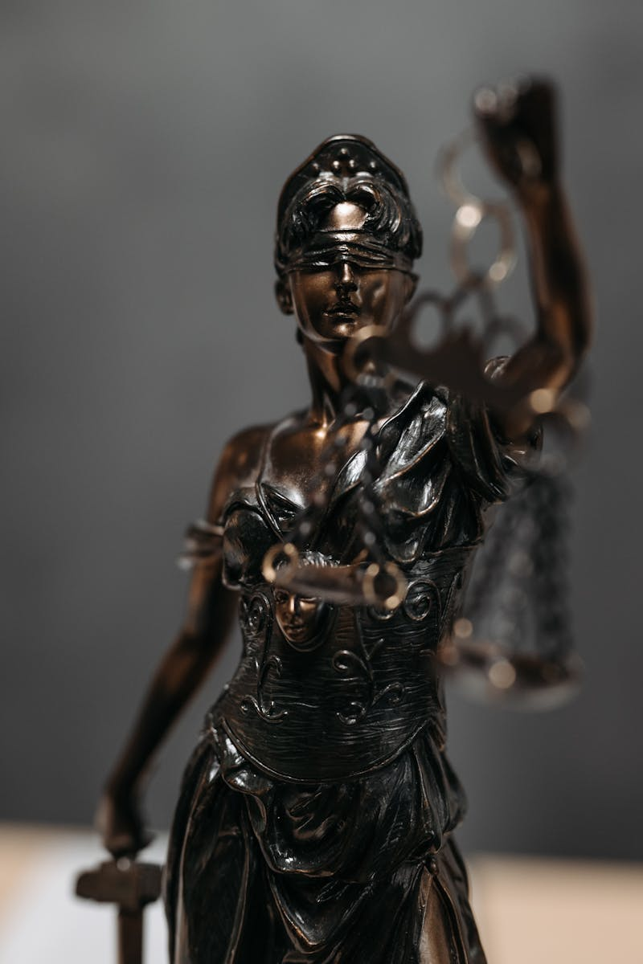
3
Understanding the Boundaries
Article 19(2) - Reasonable Restrictions
But this freedom is not absolute. Article 19(2) allows the government to place reasonable restrictions on speech. The constitution recognizes that individual rights must be balanced with collective welfare and social harmony. These restrictions are carefully designed to protect important societal values while preserving democratic freedoms. The restrictions serve as safeguards against misuse of speech that could harm national interests or public welfare.

Slide 6
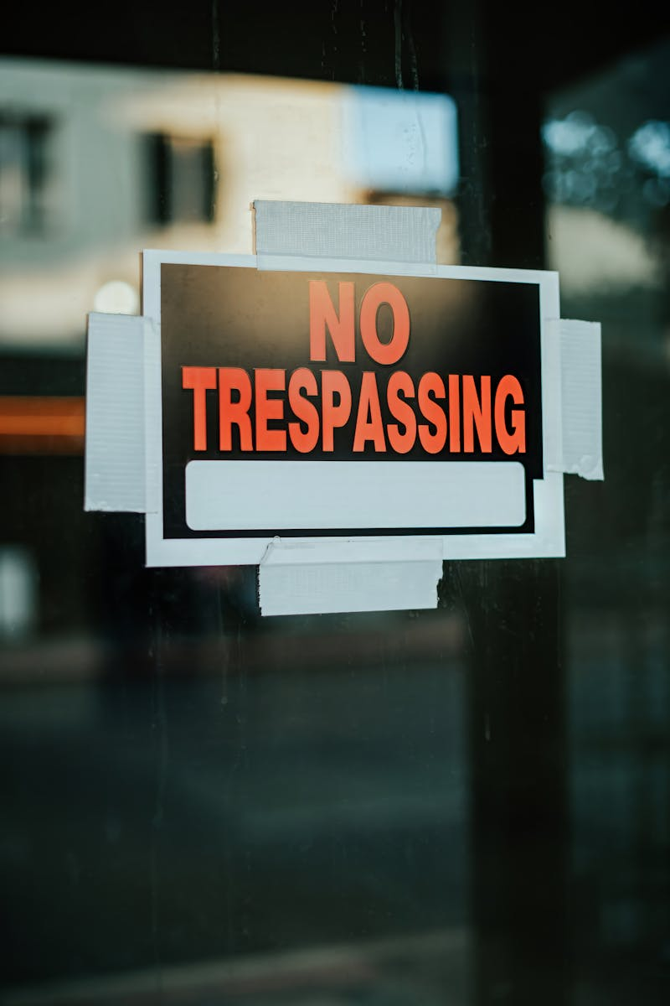
4
Eight Key Restrictions
When Speech Can Be Limited
Security of the State — to prevent threats like rebellion or war and maintain internal stability. Sovereignty and Integrity of India — to protect national unity and territorial boundaries. Friendly relations with foreign states — added by the First Amendment to maintain diplomatic harmony. Public order — when speech disturbs peace or provokes violence and threatens social stability.

Slide 7
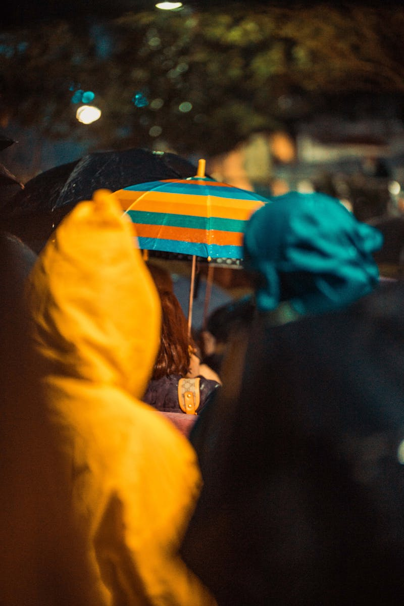
5
Remaining Restrictions
Protecting Society's Values
Decency or morality — to prevent obscene or vulgar content that could harm social values. Contempt of court — protecting judiciary's integrity and maintaining respect for legal processes. Defamation — to safeguard an individual's reputation from false and damaging statements. Incitement to an offense — speech provoking illegal acts that could lead to criminal behavior.

