Slide 1
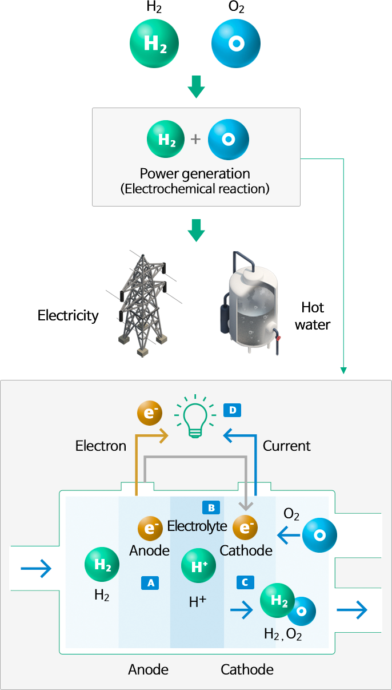
Fuel Cells: Powering the Future
Unlocking Clean Energy Through Electrochemical Reactions
Photo by Google

Slide 2
01
Fuel Cells: An Introduction
Table of Contents
02
Fuel Cell Anatomy: A Closer Look

Slide 3
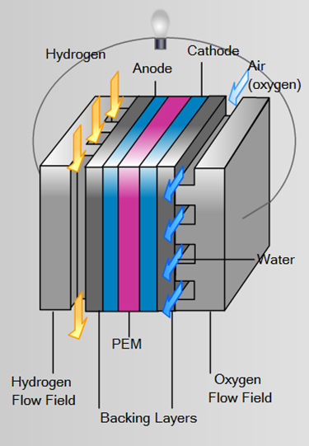
1
Fuel Cells: An Introduction
Discovering the Potential of Electrochemical Energy Conversion
Fuel cells offer a cleaner alternative to traditional combustion, producing only water and heat as byproducts under ideal circumstances. Harnessing clean energy is the future.
Fuel cells convert chemical energy into electrical energy through electrochemical reactions, eliminating the need for burning fuel and reducing pollution.
Fuel cells can power vehicles, buildings, and portable electronics, offering diverse applications and a brighter future to sustainable energy sources.
Fuel cells boast high energy conversion efficiency compared to internal combustion engines, extracting more power from the same amount of fuel.
Photo by Google

Slide 4
2
Fuel Cell Anatomy: A Closer Look
Understanding the Components and Their Functions
The anode is where the fuel, like hydrogen, is oxidized. The general reaction at the anode is: H2 → 2H+ + 2e−. This releases electrons that flow through a circuit.
The electrolyte allows ions (H+ in this case) to pass through to the cathode while blocking electrons, ensuring the flow of electricity. Its role is imperative.
At the cathode, oxygen from the air reacts with the hydrogen ions and electrons to produce water. The general reaction at the cathode is: O2 + 4H+ + 4e− → 2H2O.
The movement of electrons through an external circuit generates electricity, powering devices connected to the fuel cell. The external circuit powers appliances and more.
Photo by Google

