Slide 1
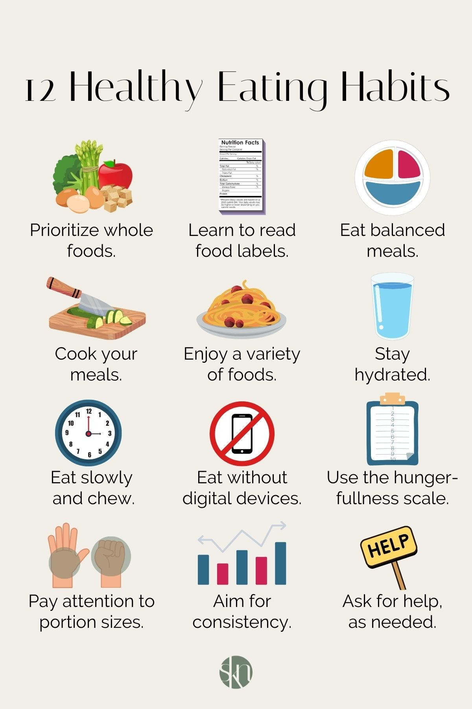
Fuel Your Body, Ignite Your Life!
Unlocking the Power of Food and Nutrition for Optimal Health
Photo by Google

Slide 2
01
The Foundation of Wellness
Table of Contents
02
Macronutrients: The Big Three
03
Micronutrients: Tiny but Mighty
04
Hydration: The Elixir of Life
05
Decoding Food Labels
06
The Power of Portion Control
07
Healthy Eating on a Budget
08
The Importance of Fiber
09
Building Healthy Habits
10
Thank You

Slide 3
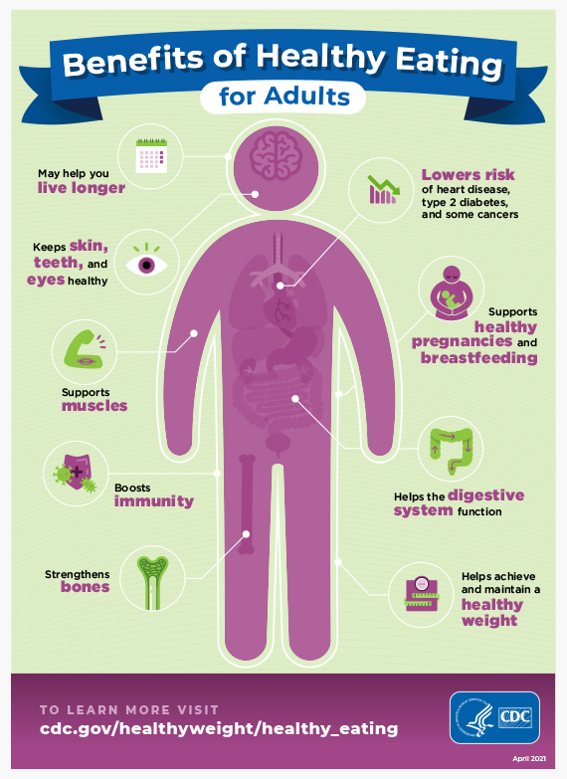
1
The Foundation of Wellness
Why Food and Nutrition Matter More Than You Think
Food provides the energy we need to perform daily activities, from walking and talking to thinking and working. Think of food as fuel!
Nutrients are essential for building and repairing tissues, keeping our bodies strong and resilient throughout our lives.
A healthy diet can significantly reduce the risk of chronic diseases like heart disease, diabetes, and some cancers. Eat smart, live longer!
What we eat directly impacts our mood, focus, and overall mental wellbeing. Nourish your brain for a happier you.
Photo by Google

Slide 4
2
Macronutrients: The Big Three
Understanding the Roles of Protein, Carbohydrates, and Fats
Essential for building and repairing tissues, enzymes, and hormones. Sources include meat, beans, nuts, and dairy. The building blocks of life!
The body's primary source of energy, fueling our brains and muscles. Choose complex carbs like whole grains and vegetables for sustained energy.
Important for hormone production, nutrient absorption, and insulation. Opt for healthy fats like those found in avocados, nuts, and olive oil.
Aim for a balanced intake of all three macronutrients to support optimal health and energy levels. Moderation is the secret!
Photo by Google

Slide 5
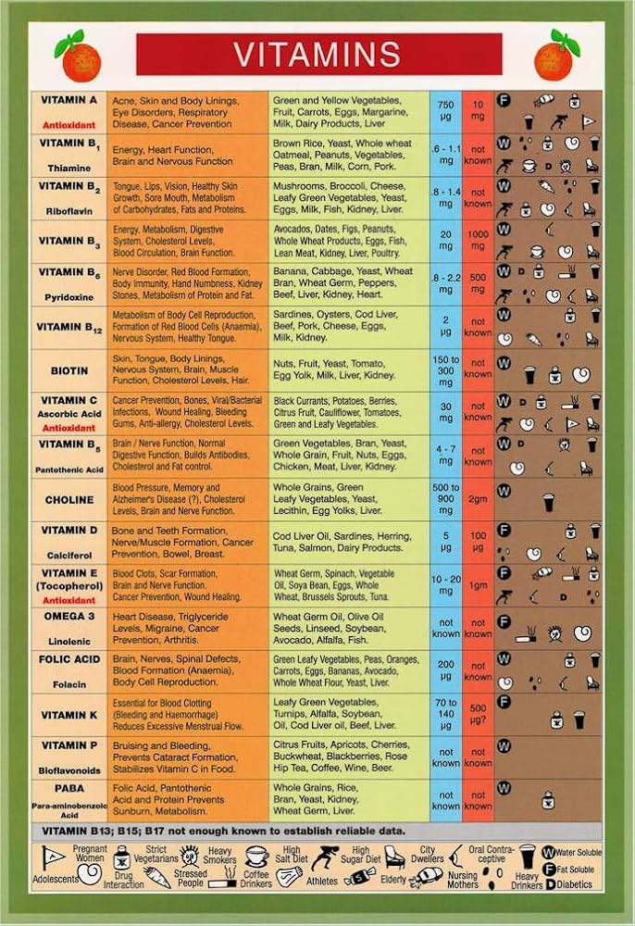
3
Micronutrients: Tiny but Mighty
Vitamins and Minerals Your Body Needs to Thrive
Essential for various bodily functions, from immune support to energy production. Get your vitamins from a colorful array of fruits and vegetables.
Play a crucial role in bone health, nerve function, and more. Key minerals include calcium, iron, and potassium. Minerals keep you going!
Lack of essential micronutrients can lead to various health problems. Ensure a diverse diet or consider supplements as needed.
Prioritize obtaining micronutrients from whole foods whenever possible. Supplements should complement, not replace, a healthy diet.
Photo by Google

Slide 6
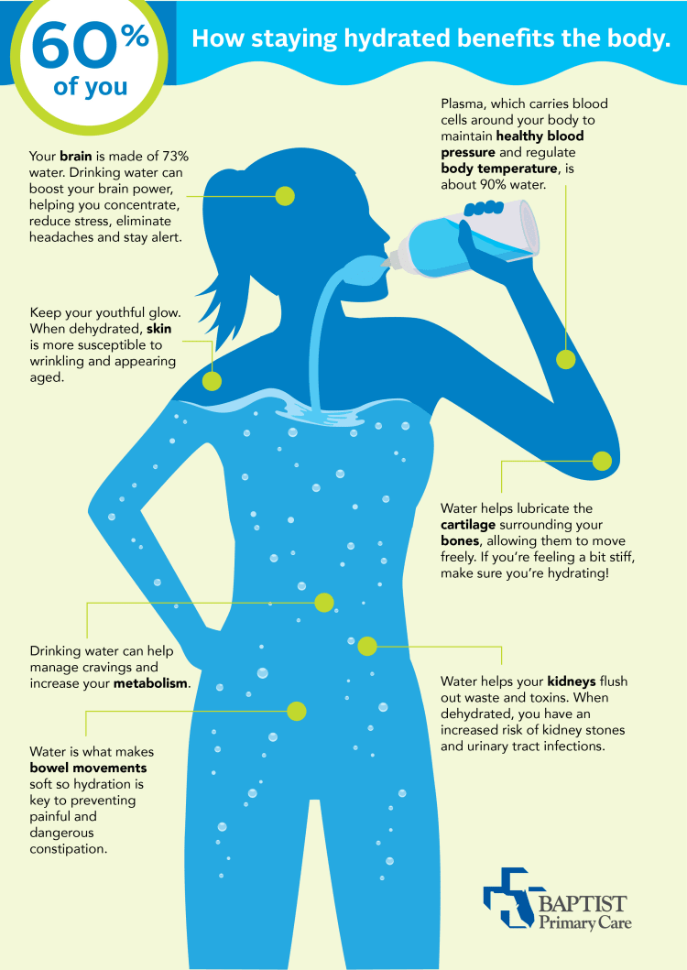
4
Hydration: The Elixir of Life
Why Water is Essential for Optimal Function
Water is crucial for all cellular processes, from nutrient transport to waste removal. Hydration keeps your cells happy!
Water helps regulate body temperature through sweat, preventing overheating. Stay cool and hydrated, especially during exercise.
Water aids in digestion and helps the body absorb nutrients from food. Drink water before, during, and after meals.
Aim for at least eight glasses of water per day, and adjust based on activity level and climate. Listen to your body's thirst cues.
Photo by Google

Slide 7
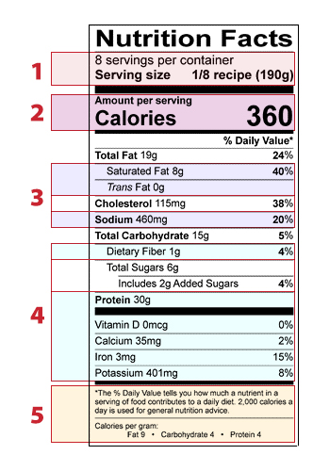
5
Decoding Food Labels
Understanding Nutrition Facts for Informed Choices
Pay attention to serving sizes, as all nutrient information is based on this amount. Don't be fooled by small packages!
Understand the number of calories per serving and how it fits into your daily calorie needs. Calories provide energy!
Focus on key nutrients like fiber, protein, vitamins, and minerals. Limit saturated fat, sodium, and added sugars.
Read the ingredient list to identify added sugars, unhealthy fats, and artificial additives. The shorter the list, the better!
Photo by Google

Slide 8
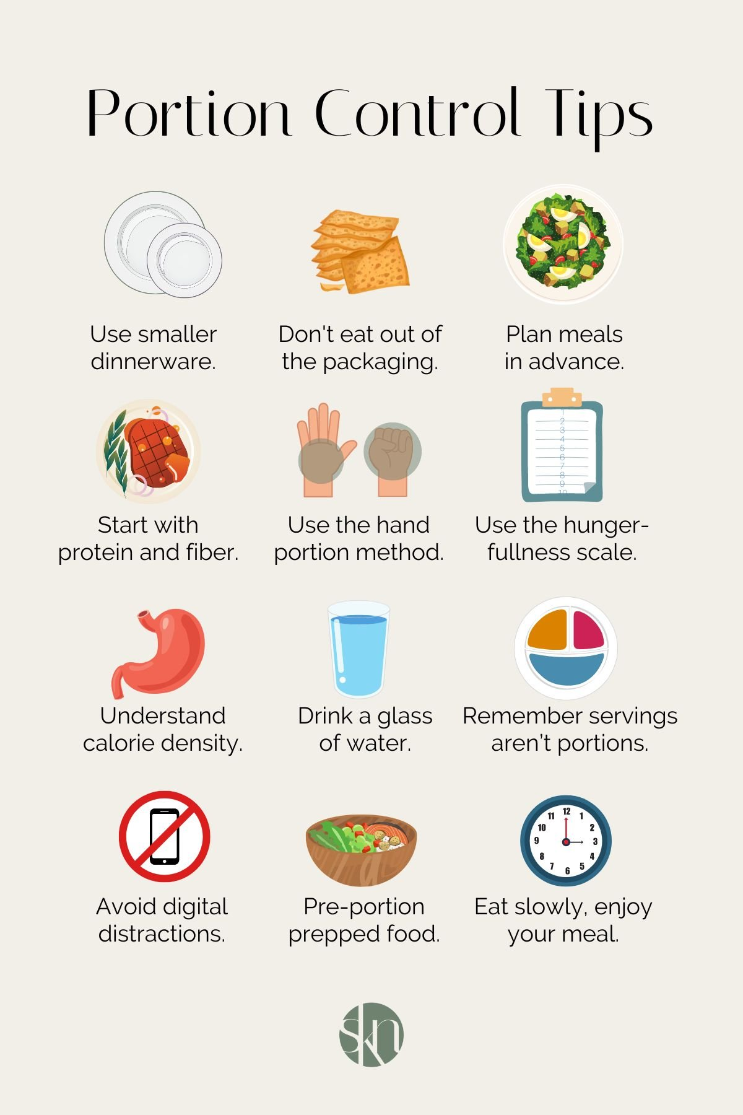
6
The Power of Portion Control
Managing Serving Sizes for Weight Management and Health
Use smaller plates to visually reduce portion sizes. A full plate feels more satisfying, even if it's less food.
Pay attention to your hunger and fullness cues. Eat slowly and savor each bite. Mindful eating can work wonders!
Choose healthy snacks like fruits, vegetables, or nuts to curb hunger between meals. Avoid processed snacks high in sugar and fat.
Be mindful of portion sizes when eating out. Share entrees or take half home for later. Control your portions!
Photo by Google

Slide 9

7
Healthy Eating on a Budget
Tips and Tricks for Nutritious Meals Without Breaking the Bank
Plan your meals for the week and create a grocery list to avoid impulse purchases. Planning saves money!
Buy staples like rice, beans, and oats in bulk to save money. These are nutritious and versatile ingredients.
Purchase fruits and vegetables that are in season for the best prices and flavors. Seasonal produce is budget-friendly!
Cooking at home is generally cheaper and healthier than eating out. Embrace your inner chef!
Photo by Google

Slide 10
8
The Importance of Fiber
Why Fiber is a Key Component of a Healthy Diet
Fiber promotes healthy digestion and prevents constipation. It keeps your gut moving smoothly.
Fiber helps regulate blood sugar levels and can reduce the risk of type 2 diabetes. Fiber stabilizes your energy.
Fiber can lower cholesterol levels and reduce the risk of heart disease. It supports a healthy heart.
Fiber helps you feel full and satisfied, which can aid in weight management. Fiber makes you feel fuller for longer.
Photo by Google

Slide 11

9
Building Healthy Habits
Small Changes for a Sustainable and Nutritious Lifestyle
Make gradual changes to your diet rather than trying to overhaul everything at once. Small steps lead to big results!
Set achievable goals and celebrate your successes along the way. Focus on progress, not perfection.
Surround yourself with supportive friends, family, or a nutritionist to help you stay on track. Support helps you succeed!
Building healthy habits takes time and effort. Don't get discouraged by setbacks, just keep moving forward. Patience is key!
Photo by Google

Slide 12

10
Thank You
For Investing in Your Health!
We appreciate you taking the time to learn about food and nutrition. Your health journey starts now!
We hope this presentation has empowered you with the knowledge to make healthier choices.
Share this information with your friends and family to help them improve their health too.
We wish you all the best on your path to a healthier and happier life. Thank you for your attention!
Photo by Google

