Slide 1
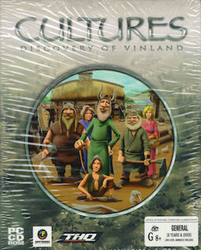
Gaming Galore: Unlocking the Secrets of the Virtual World Explore the multifaceted world of gaming, from its cultural impact to career opportunities and skill development.
Photo by Google

Slide 2
01
Beyond Pixels: The Gaming Revolution
Table of Contents
02
Cultural Phenomenon: More Than Just Fun
03
Skills Unlocked: The Cognitive Benefits
04
Level Up Your Career: Gaming Industry Roles
05
Beyond Entertainment: Games for Good
06
The Future is Play: Emerging Trends
07
Level Design: Crafting Immersive Worlds
08
Game Development: The Creation Process
09
Esports Ecosystem: Competition and Community
10
Thank You!

Slide 3

1
Beyond Pixels: The Gaming Revolution
From arcades to esports, tracing the evolution and impact of video games on modern society.
The golden age of gaming, where pixelated graphics and simple gameplay captivated a generation in dimly lit arcades. The rise of home consoles like Atari and Nintendo ignited a fierce competition, shaping the future of interactive entertainment. Personal computers emerged as powerful gaming platforms, pushing graphical boundaries and introducing complex strategy games. The internet revolutionized gaming, connecting players worldwide in immersive multiplayer experiences and virtual communities.
Photo by Google

Slide 4

2
Cultural Phenomenon: More Than Just Fun
Gaming's influence extends far beyond entertainment, shaping art, music, and social interactions.
Video games are recognized as a form of art, blending visuals, storytelling, and interactive design to create compelling experiences. Immersive soundtracks and sound effects elevate gaming experiences, creating atmosphere and enhancing emotional engagement. Online games foster communities, connecting players through shared interests and experiences, leading to lasting friendships. Competitive gaming has evolved into a global spectator sport, with professional players and lucrative tournaments.
Photo by Google

Slide 5
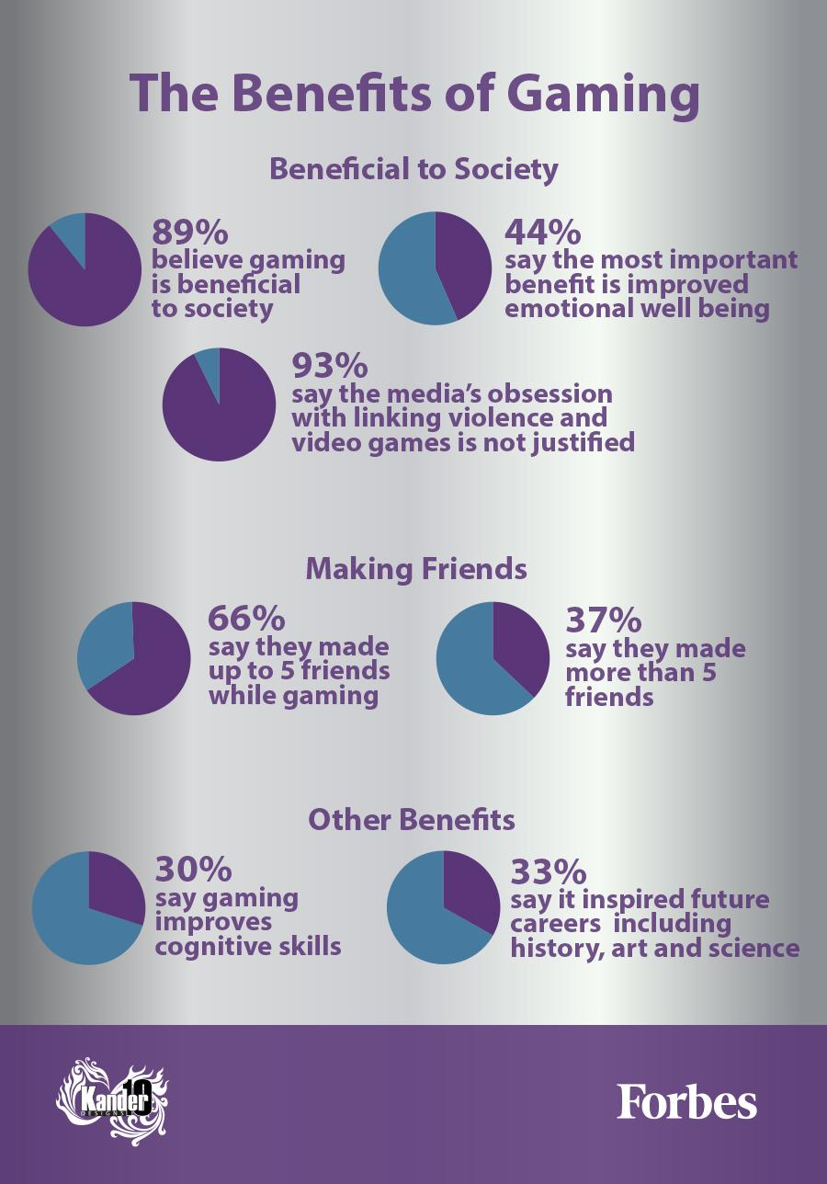
3
Skills Unlocked: The Cognitive Benefits
Gaming enhances problem-solving, strategic thinking, and reaction time, valuable assets in various fields.
Games often present complex challenges that require players to think critically, analyze situations, and find creative solutions. Strategy games demand planning, resource management, and adaptability, honing strategic thinking skills applicable in real-world scenarios. Fast-paced games improve reaction time and hand-eye coordination, skills valuable in sports, medicine, and other professions. Navigating virtual environments strengthens spatial reasoning, aiding in fields like architecture and engineering.
Photo by Google

Slide 6
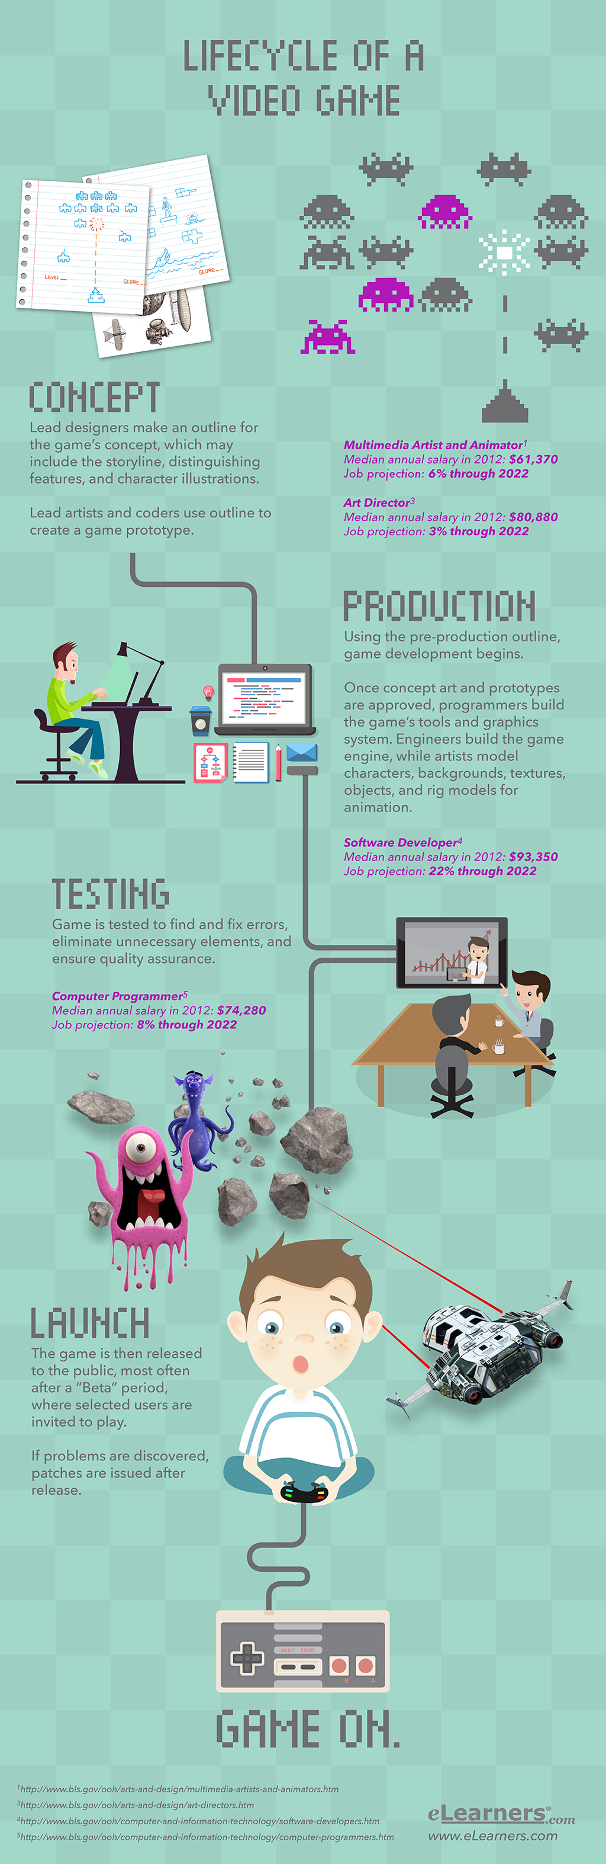
4
Level Up Your Career: Gaming Industry Roles
Explore diverse career paths in game development, esports, and related fields.
Design and create video games, from concept to implementation, utilizing programming, art, and storytelling skills. Compete professionally in video game tournaments, requiring skill, dedication, and teamwork. Craft the rules, systems, and narratives that define a game's experience, shaping player engagement and enjoyment. Identify and report bugs and issues in video games, ensuring a polished and enjoyable user experience.
Photo by Google

Slide 7

5
Beyond Entertainment: Games for Good
Exploring the use of games for education, therapy, and social change.
Gamified learning environments make education engaging and effective, teaching subjects through interactive experiences. Games are used in therapy to address mental health issues, rehabilitation, and pain management, offering personalized support. Games raise awareness about social issues, promote empathy, and inspire positive change through interactive storytelling. Developers are creating more accessible games, ensuring that individuals with disabilities can enjoy and participate in the gaming world.
Photo by Google

Slide 8
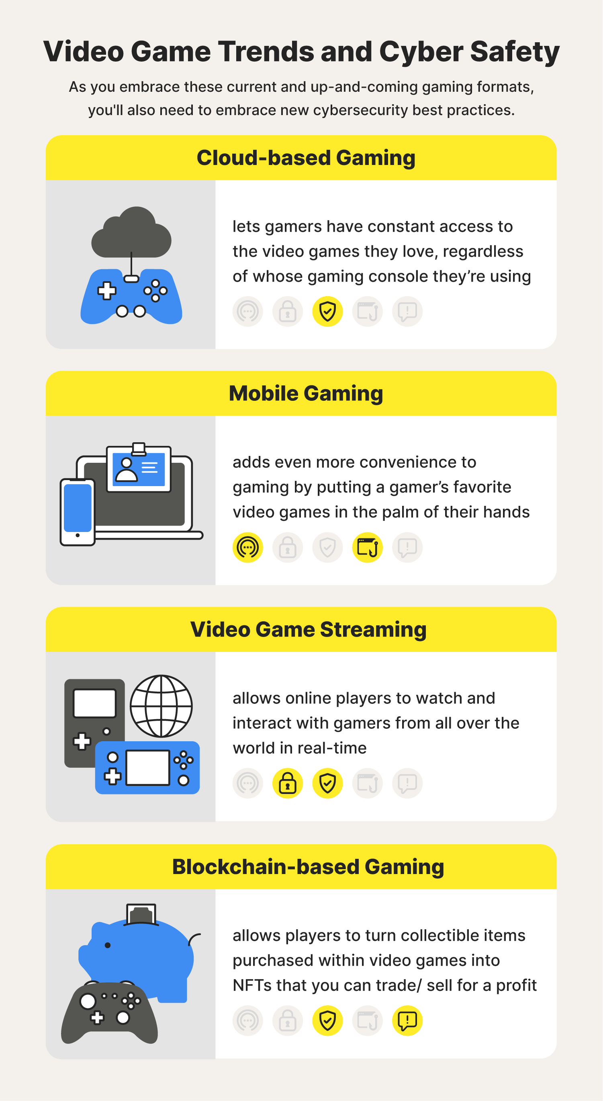
6
The Future is Play: Emerging Trends
Virtual reality, augmented reality, and cloud gaming are reshaping the landscape of interactive entertainment.
VR technology transports players into fully immersive virtual worlds, blurring the lines between reality and simulation. AR games blend virtual elements with the real world, creating interactive experiences that overlay digital content onto physical environments. Cloud gaming allows players to stream games to any device, eliminating the need for expensive hardware and expanding accessibility. The metaverse is integrating gaming elements, creating persistent virtual worlds where users can interact, create, and socialize.
Photo by Google

Slide 9

7
Level Design: Crafting Immersive Worlds
The art and science of creating engaging and functional game environments.
Level designers create believable and engaging environments by considering layout, narrative, and player progression. Level design influences gameplay, creating challenges, opportunities, and interactive elements that define the player experience. Environments communicate narrative details, creating atmosphere and revealing information about the game's story and world. Good level design prioritizes user experience, ensuring intuitive navigation, clear objectives, and enjoyable exploration.
Photo by Google

Slide 10
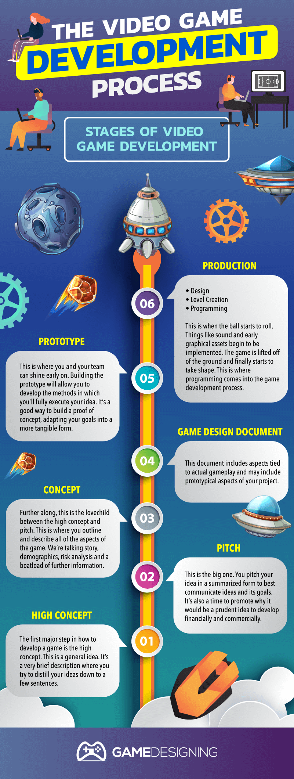
8
Game Development: The Creation Process
From concept to release, understanding the stages of game creation.
The initial stage involves brainstorming ideas, defining the game's mechanics, and creating a design document. Programmers write code to bring the game to life, implementing gameplay mechanics, artificial intelligence, and user interfaces. Artists create the visual assets, including characters, environments, and animations, enhancing the game's aesthetic appeal. The game undergoes rigorous testing to identify and fix bugs, ensuring a polished and enjoyable final product.
Photo by Google

Slide 11
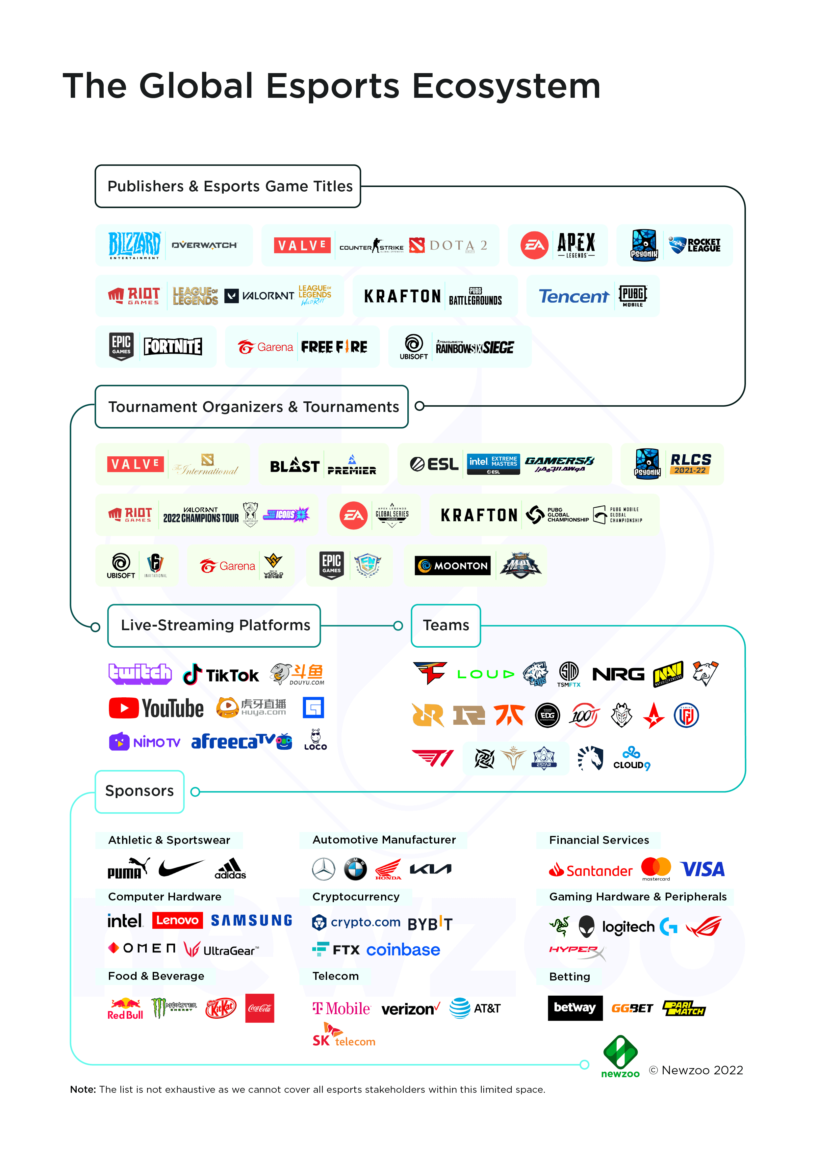
9
Esports Ecosystem: Competition and Community
Exploring the structure, dynamics, and impact of competitive gaming.
Esports teams consist of skilled players who compete in tournaments, representing organizations and sponsors. Esports tournaments and leagues provide platforms for competitive gaming, offering prize pools and opportunities for recognition. Streamers and content creators share gameplay footage, commentary, and insights, engaging with viewers and building communities. Esports attracts sponsorships and advertising from brands, supporting the industry and providing revenue streams for teams and players.
Photo by Google

Slide 12

10
Thank You!
Acknowledging your time and interest in the world of gaming.
Thank you for joining us on this exploration of the gaming world. We appreciate your time and attention. We encourage you to continue exploring the diverse and exciting world of video games and its many facets. Keep learning about the industry, its innovations, and its impact on society. We hope this presentation has inspired you to engage further with gaming, whether as a player, creator, or enthusiast.
Photo by Google

