Slide 1
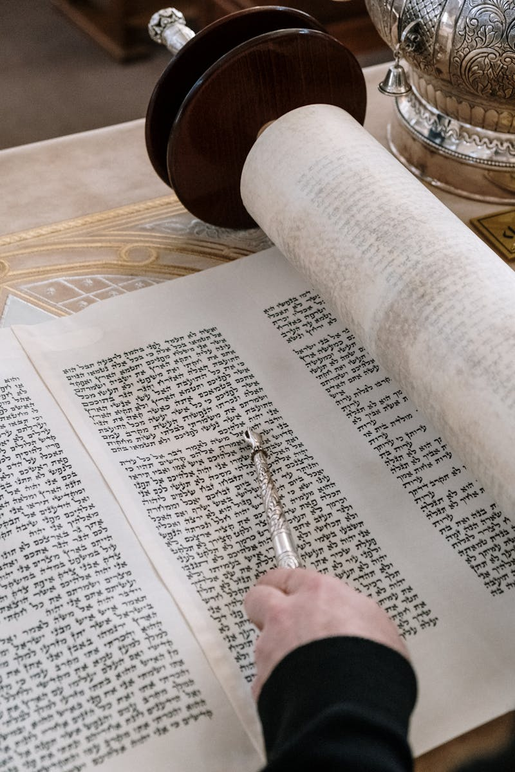
Gurukul Wisdom Ancient Education for Modern Times
Photo by Pexels

Slide 2
01
The Gurukul Legacy
Table of Contents
02
Core Principles
03
Modern Relevance
04
Contemporary Applications
05
Future Possibilities

Slide 3

1
The Gurukul Legacy
Understanding Ancient Indian Education
Gurukuls represent the oldest form of education system where students lived with teachers to gain knowledge. The system focused on overall growth including academics, spirituality, and practical life skills. Close relationships between gurus and disciples created a foundation for lifelong learning and guidance. Students resided in ashrams, learning through daily routines and immersive experiences.

Slide 4

2
Core Principles
Foundation of Gurukul Education
The sacred tradition of knowledge transfer from teacher to student through direct guidance. Education emphasized moral values, ethics, and character development alongside academic subjects. Students learned through strict routines, meditation, and personal responsibility. Knowledge was applied to real-life situations, making learning meaningful and purposeful.

Slide 5

3
Modern Relevance
Why Gurukul System Matters Today
Individual attention in gurukuls addresses the need for customized learning experiences. In today's world, the emphasis on values provides essential guidance for ethical living. The meditative and disciplined approach helps combat modern educational pressures. Ancient wisdom and traditions continue to enrich contemporary educational practices.

Slide 6

4
Contemporary Applications
Implementing Gurukul Wisdom Today
Modern schools are integrating gurukul principles with conventional education systems. Techniques from gurukuls are being used to improve focus and mental well-being. The concept of shared learning spaces creates collaborative educational environments. Educational institutions are incorporating moral and ethical components into curricula.

Slide 7

5
Future Possibilities
Evolution of Gurukul Philosophy
Technology is enabling the spread of gurukul principles to wider audiences online. Ancient Indian educational wisdom is gaining recognition worldwide for its effectiveness. Combining traditional values with modern innovations creates balanced education. The gurukul approach to continuous self-improvement remains relevant throughout life.

