Slide 1
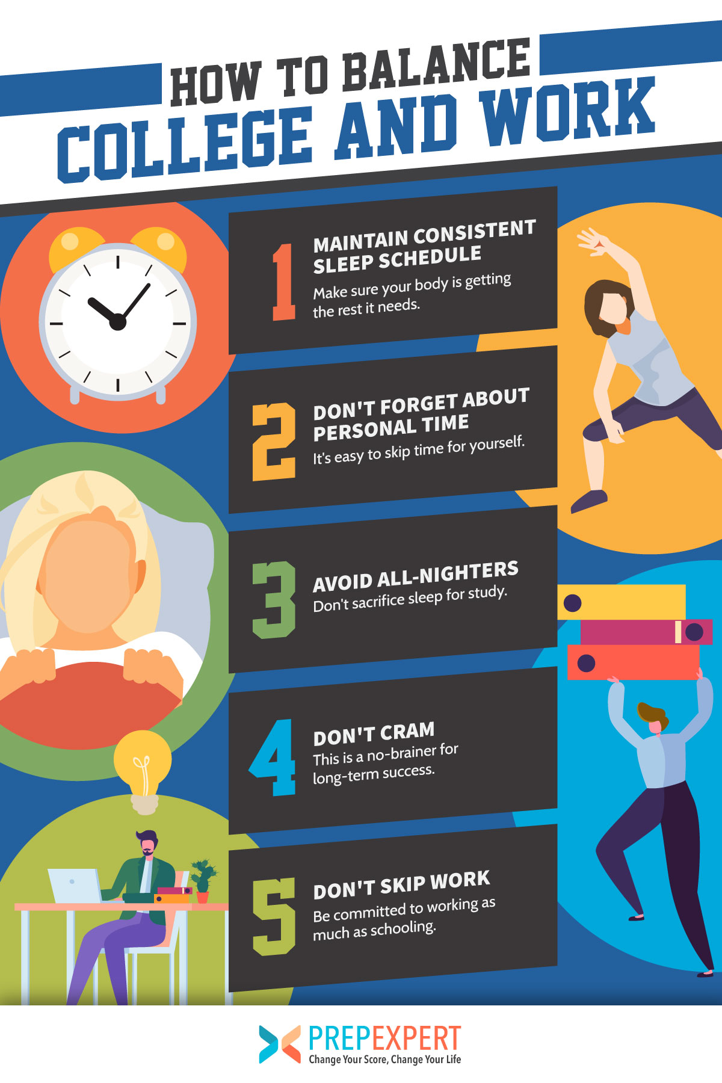
Harmony at Work and Play
Balancing Your Career and Personal Life for College Students
Photo by Google

Slide 2
01
The Illusion of Balance
Table of Contents
02
Harmony: A New Perspective
03
BLEND Framework
04
Practical Implications
05
Merits of Both Approaches
06
Mindfulness
07
Flexibility & Growth
08
Practical Strategies
09
Time & Compassion
10
Thank You!

Slide 3
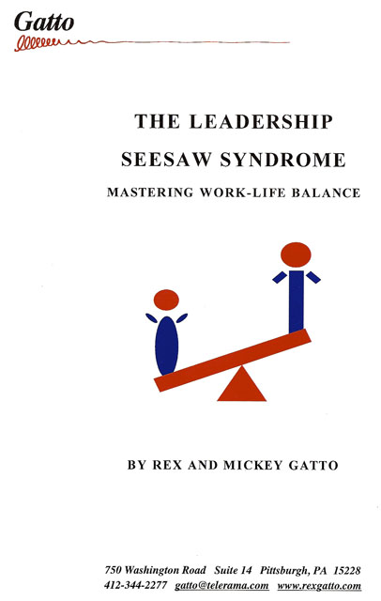
1
The Illusion of Balance
Why the 50/50 Split Doesn't Always Work
Work-life balance implies a clear division between work and personal life, aiming for an equal split of time and energy. However, this can be stressful.
Imagine balancing high above, with work on one foot and personal life on the other. A slight distraction risks losing balance and falling into chaos.
For ambitious individuals, the quest for perfect equilibrium can lead to stress, guilt, and a sense of constant failure when work encroaches on personal time.
Clear segregation between professional and personal lives can stifle creativity and personal growth, which often thrive in the overlap.
Photo by Google

Slide 4
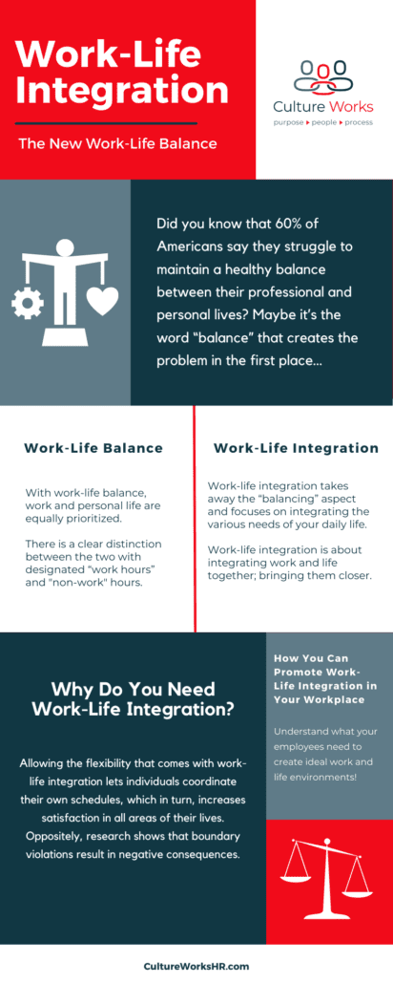
2
Harmony: A New Perspective
Integrating Work and Life Seamlessly
Work-life harmony recognizes that our lives are a complex dance, where work and personal life intertwine and influence one another. Embrace their interconnectedness.
This shift offers a fresh lens through which we view our responsibilities. This harmony-based approach involves integrating work and personal life seamlessly.
Consider incorporating moments of mindfulness throughout your workday and between meetings to maintain focus and calm, creating a blend.
Skills used in professional life, like time management or problem-solving, can help manage personal commitments, from family events to home projects.
Photo by Google

Slide 5
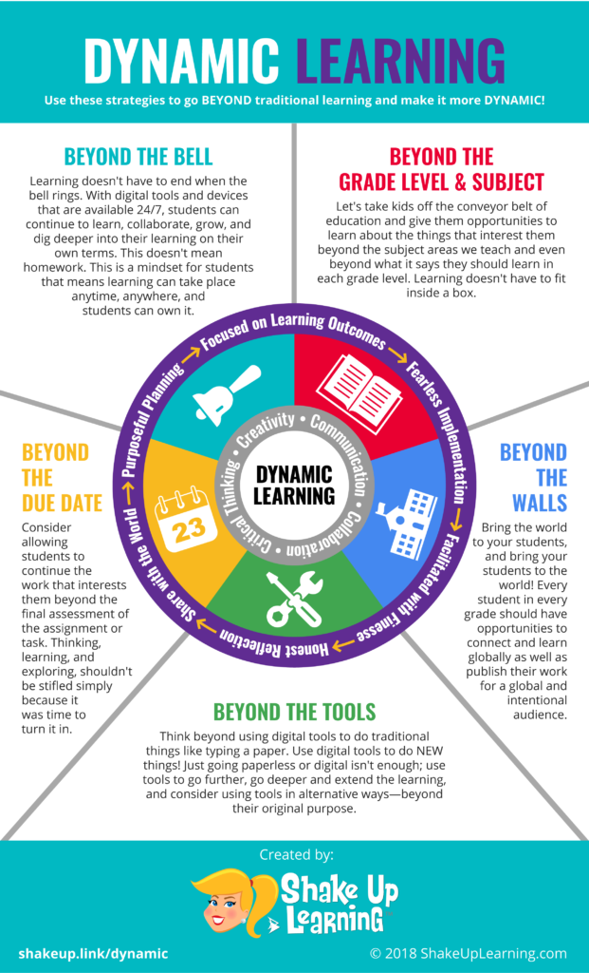
3
BLEND Framework
Understanding the Differences
Work-life balance establishes clear boundaries, while work-life harmony encourages integration, recognizing the interconnectedness.
Balance can feel limiting, while harmony supports flexibility, acknowledging the intertwining nature of work and personal commitments.
Balance suggests equal attention, while harmony is more fluid, adapting to individual circumstances and priorities as needed.
Work-life balance denotes a rigid approach, while harmony advocates for adaptation to personal and professional needs.
Photo by Google

Slide 6
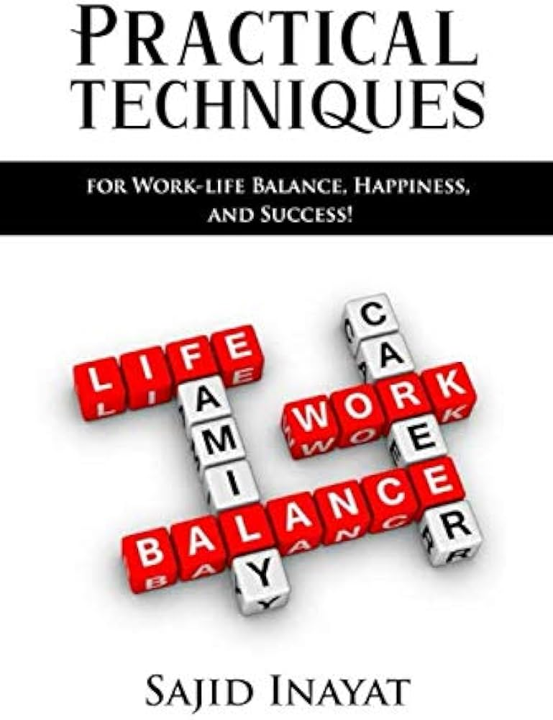
4
Practical Implications
How Harmony and Balance Look in Real Life
Harmony uses an adaptable system, prioritizing tasks based on urgency and alignment with individual energy cycles, not strict time blocks.
Someone pursuing work-life harmony is likely to handle life stages more gracefully as they have adapted to integrating work and life.
Harmony embraces the convenience of technology, using it to seamlessly integrate work and personal life, like personal calls during work hours.
Harmony sees no issue with blending work and leisure, provided it contributes to overall satisfaction and fulfillment. It's about what works best.
Photo by Google

Slide 7
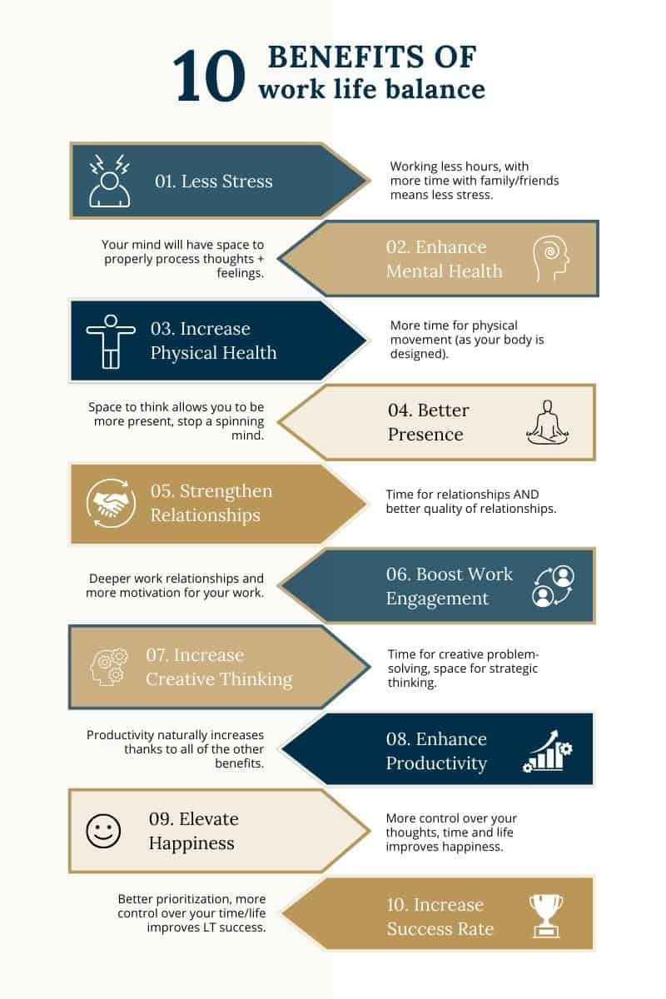
5
Merits of Both Approaches
When to Use Balance and Harmony
Work-life balance provides clear boundaries, preventing work-related stress from infringing on recovery. It's a solid starting point for rehabilitation.
For those whose careers are integral to their identities, work-life harmony can lead to higher job satisfaction, productivity, and overall well-being.
What's important is finding what works best for you. Consider your preferences to understand whether you lean towards balance, harmony, or a mix of both.
By accepting the intersection of work and personal life, work-life harmony can lead to higher job satisfaction, productivity, and overall well-being.
Photo by Google

Slide 8
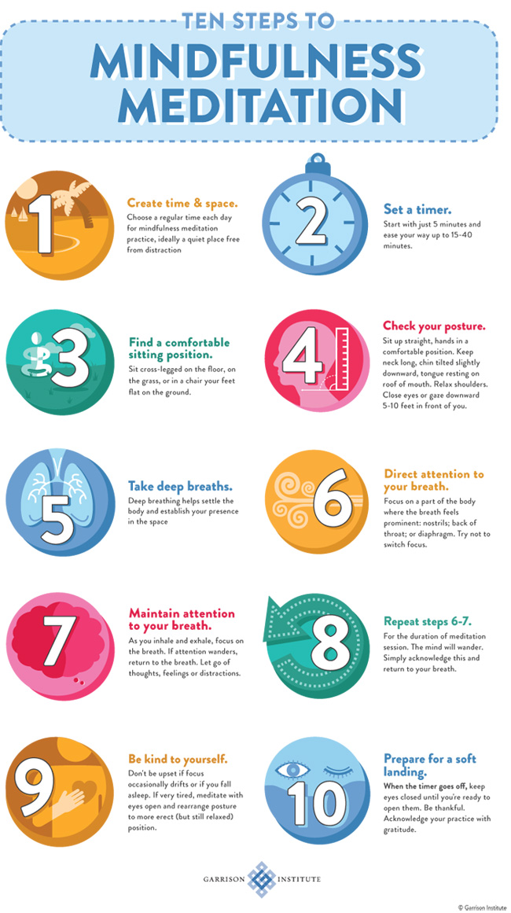
6
Mindfulness
Increasing Self-Awareness
Start by building a robust mindfulness practice to increase your self-awareness. Understand your stress triggers and emotional responses.
You can better manage your work-life harmony by understanding your stress triggers and emotional responses. Enhancing your ability to notice rising stress.
This sense of awareness is a cornerstone in making work-life harmony a reality. Consider your triggers to minimize work-related stress.
The practice could involve mindfulness meditation, which enhances your ability to notice rising stress and respond appropriately.
Photo by Google

Slide 9
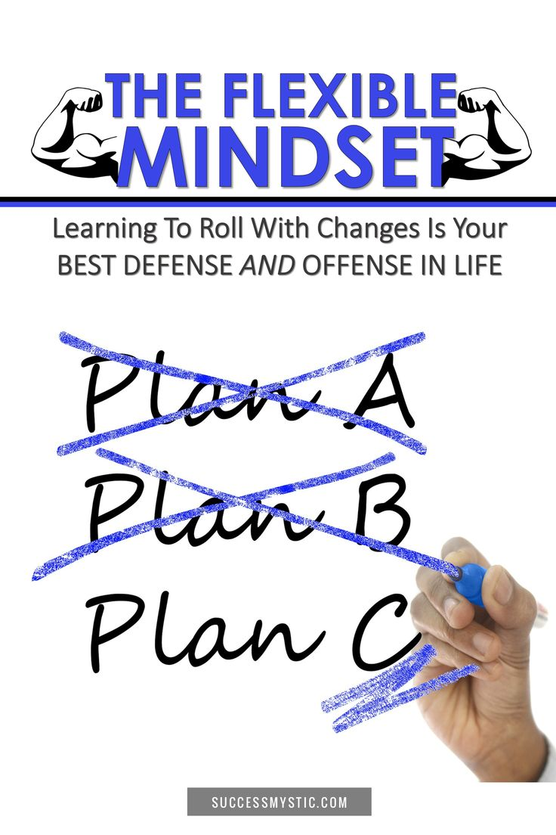
7
Flexibility & Growth
Essential Strategies for Harmony
Let go of rigid routines and expectations. Challenge your beliefs about work and life in general. Embrace a fluid approach that accommodates fluctuating demands.
Embrace a fluid approach that accommodates fluctuating demands of work and personal life. It helps one adopt a growth mindset.
Cultivate a mindset that welcomes challenges and views failure as a growth opportunity. This mindset can help maintain harmony during demanding periods.
It helps you stay calm even when one area of your life demands more attention than the other, leading to an overall healthy work perspective.
Photo by Google

Slide 10

8
Practical Strategies
Integrating Personal and Professional Activities
Promote open communication with family members and colleagues about your work-life harmony approach. This helps manage expectations and allows for better mutual understanding.
Find ways to blend personal and professional activities. This could be as simple as answering personal emails during lunch breaks or conducting meetings.
Recognise that personal well-being is crucial for professional success. Incorporate regular self-care activities into your routine daily for peace of mind.
Establish healthy routines, such as regular physical activity, mindful eating, and adequate sleep. These routines can help reduce stress.
Photo by Google

Slide 11
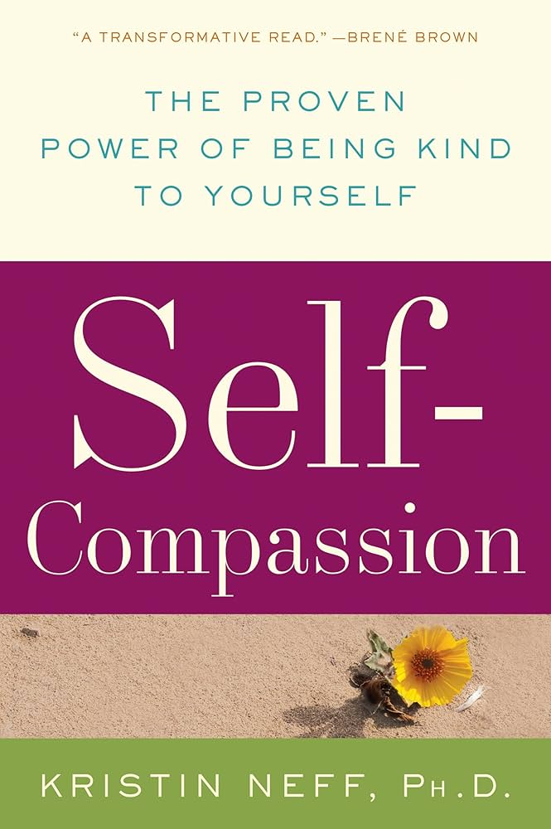
9
Time & Compassion
Audits, Delegation, and Self-Kindness
Remind yourself that you don't have to do everything. Outsourcing tasks at work or hiring help for household chores can create more time for important tasks.
Tracking how time is spent over a week can identify patterns and drains on time. Track how you work and how you relax to help strike balance.
Practice self-compassion, and don't be too hard on yourself when work overruns your personal life or vice versa. After all, the goal is harmony.
Practice self-compassion, and don't be too hard on yourself when work overruns your personal life or vice versa. The goal is harmony.
Photo by Google

Slide 12
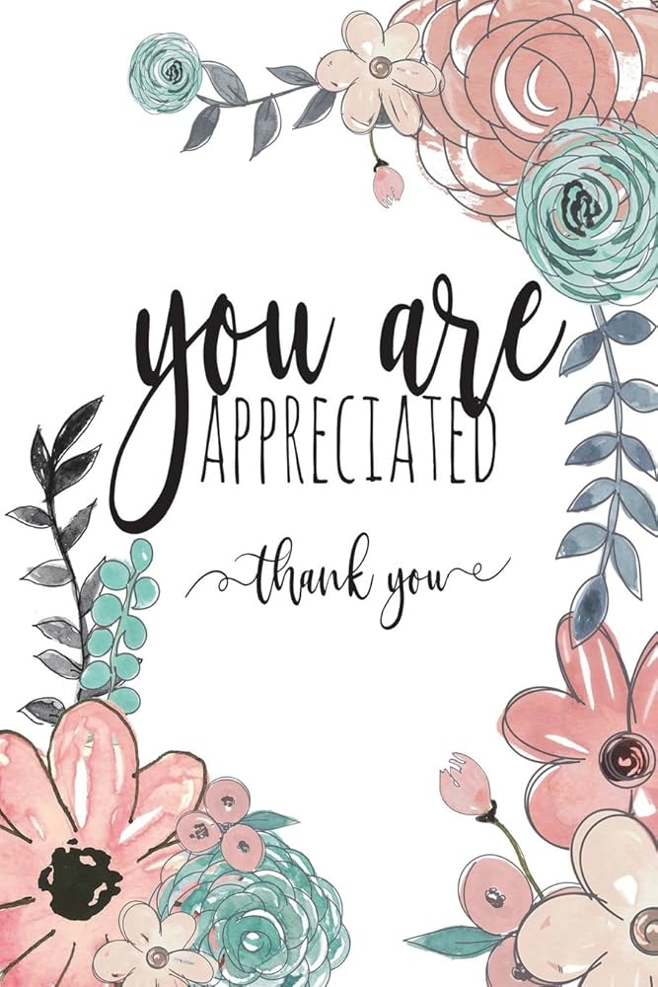
10
Thank You!
Embrace the Dance of Work-Life Harmony
Transform your high-stress act into a fulfilling path where personal joy and professional success coexist harmoniously. Strive for perfection.
It's about finding what suits you best on the spectrum between balance and harmony. It's not about achieving perfection but embracing a satisfying approach.
The journey towards work-life harmony may be challenging, but the rewards promise a richer, deeply satisfying life in both personal and professional realms.
Thank you for your time and attention! May you find the perfect harmony in your work and personal life.
Photo by Google

