Slide 1

Heritage: Our Shared Identity
Exploring Cultural Heritage and its Impact on Identity Formation for Class 10 SST Students.
Photo by Pexels

Slide 2
01
What is Heritage?
Table of Contents
02
Cultural Heritage in India
03
Identity Formation
04
Preserving Our Heritage
05
Thank You!

Slide 3
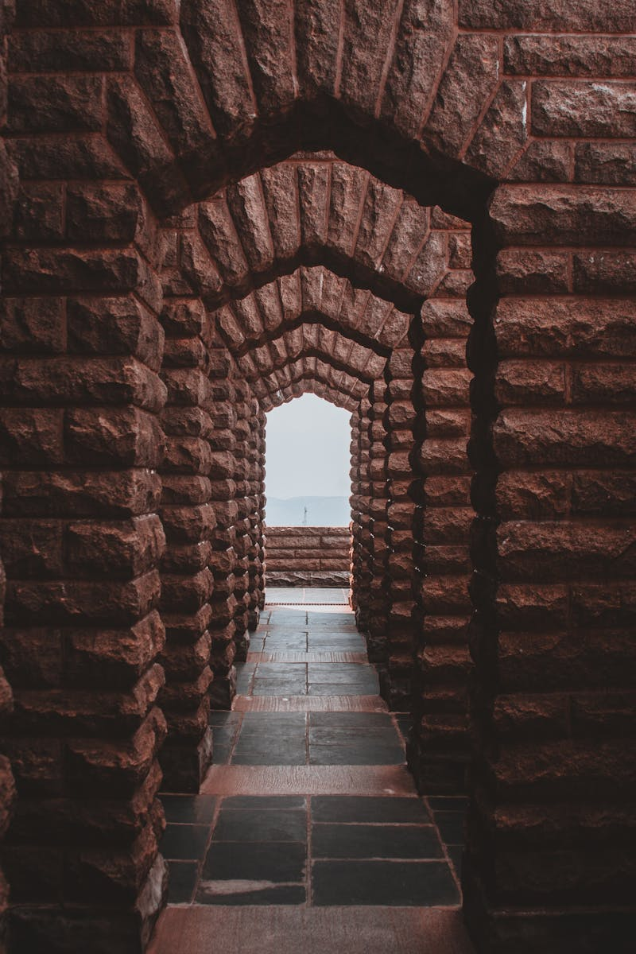
1
What is Heritage?
Unveiling the Layers of Our Past
Includes physical artifacts like monuments, buildings, and historical sites. They offer a glimpse into the lives and achievements of past generations.
Encompasses traditions, oral histories, performing arts, and rituals. It is the living expression of a community’s identity.
Consists of natural sites of biological and geological value. It includes landscapes, biodiversity, and ecosystems crucial for human life.
Preserving heritage connects us to our history and helps us understand our identity. It also promotes cultural diversity and sustainable development.

Slide 4
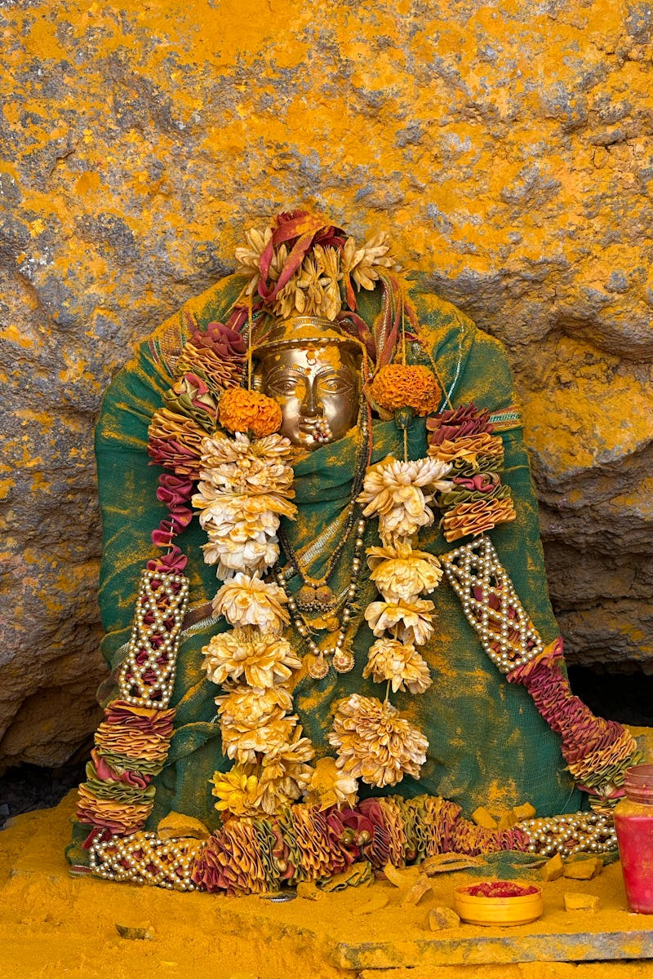
2
Cultural Heritage in India
A Tapestry of Traditions and Treasures
The Indus Valley Civilization left behind planned cities and advanced technologies. The Mughal era gifted architectural marvels like the Taj Mahal.
India is home to various religions, each contributing unique customs and festivals. Temples, mosques, churches, and monasteries dot the landscape.
Classical dance forms like Bharatanatyam and Kathak tell stories through movement. Folk music and theatre reflect local traditions and values.
India boasts hundreds of languages and dialects. Each region has its own literary traditions and oral narratives passed down through generations.

Slide 5
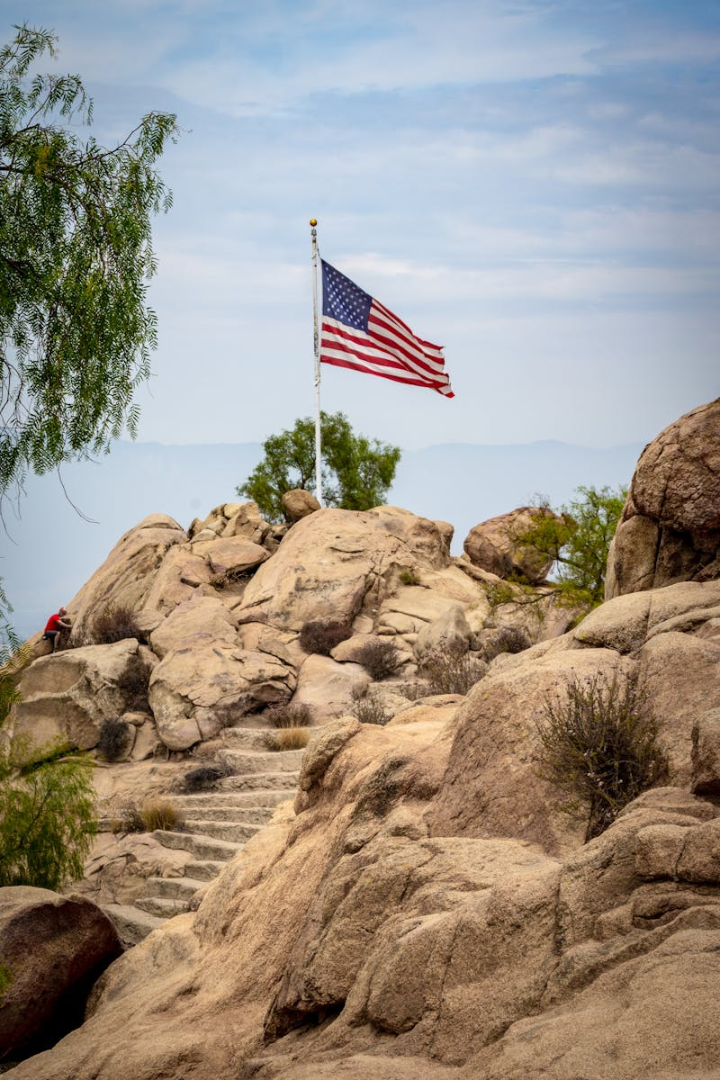
3
Identity Formation
How Heritage Shapes Who We Are
Shared cultural heritage creates a sense of belonging to a community. Common traditions and values foster social cohesion and unity.
Heritage transmits cultural values and beliefs from one generation to the next. These values guide our behavior and shape our worldview.
Understanding our heritage helps us develop a historical consciousness. It enables us to critically analyze the past and learn from its lessons.
Our cultural heritage influences our personal identity and self-esteem. It gives us a sense of pride in our roots and traditions.

Slide 6
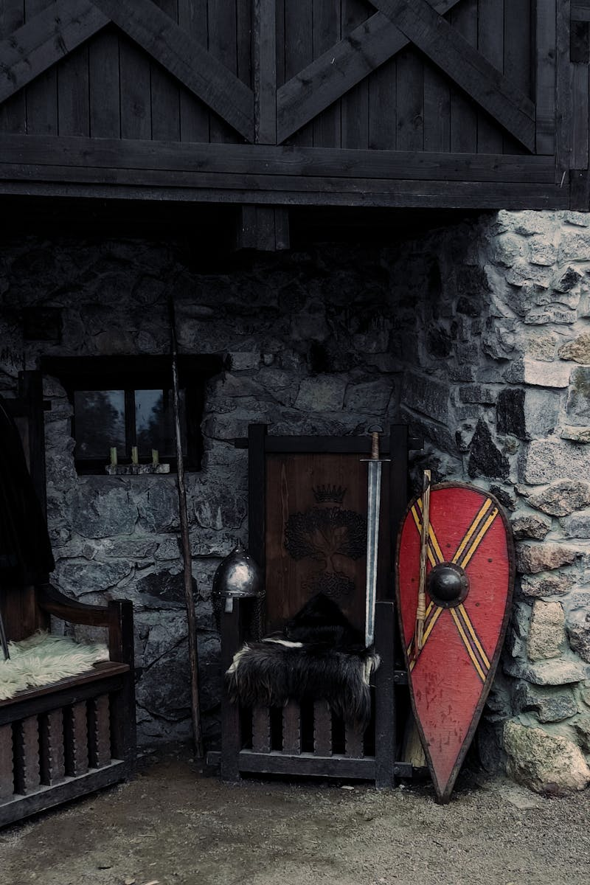
4
Preserving Our Heritage
Safeguarding the Past for the Future
Educating people about the importance of cultural heritage is crucial. Promoting awareness encourages responsible behavior and respect for cultural sites.
Conserving historical sites and artifacts requires expertise and resources. Governments and organizations work to protect and restore cultural heritage.
Engaging local communities in preservation efforts is essential. Their knowledge and participation ensure sustainable management of cultural heritage.
Promoting responsible tourism can generate revenue for heritage preservation. Balancing economic benefits with environmental protection is necessary.

Slide 7

5
Thank You!
Celebrating Our Shared Legacy
Thank you for your kind attention! We hope this presentation has shed light on the importance of cultural heritage and identity.
Continue exploring the rich tapestry of cultures around the world. Every culture has a unique story to tell and important lessons to share.
Let's work together to preserve our cultural heritage for future generations. Every action, no matter how small, contributes to this vital effort.
We're happy to answer any questions you might have. Let's continue the conversation about our shared cultural identity!

