Slide 1


Hinduism: An Overview
Understanding the World's Oldest Religion

Slide 2


Table of Contents
1
Hinduism: An Overview
2
Core Beliefs of Hinduism - Part 1
3
Core Beliefs of Hinduism - Part 2
4
Hindu Sacred Texts

Slide 3


Hinduism: An Overview
Hinduism is practiced by over a billion people and is the world’s oldest active religion.
Often considered more a way of life than a formal religion, Hindus refer to it as Sanātana Dharma, meaning 'the eternal tradition' or 'eternal order'.
It originates from the ancient Indus Valley civilization and nomadic tribes arriving around 1500 BCE, with roots possibly thousands of years older.
The term 'Hindu' derives from the Sanskrit name for the Indus River (Sindhu), as used by ancient Persians and Greeks.

Slide 4

Core Beliefs of Hinduism - Part 1
Brahman is the formless, ultimate reality and source of all existence, like an ocean from which all things emerge as drops, temporarily separate but inherently one.
Each person has an immortal soul (Atman) that undergoes cycles of rebirth, influenced by karma accumulated during life.
Karma represents actions and their consequences, affecting current and future lives, with good and bad deeds shaping one’s spiritual journey.
The ultimate goal is liberation (moksha) from the cycle of birth and death by realizing unity with Brahman, freeing the soul from worldly illusions.

Slide 5

Core Beliefs of Hinduism - Part 2
The Vedas are the four ancient sacred texts revealed to sages, providing spiritual knowledge and guidance.
Time is eternal and cyclical, divided into four ages (yugas)—Krita, Treta, Dvapara, and Kali—with the current era being Kali Yuga, characterized by moral decline.
Dharma signifies righteous conduct or cosmic order, maintaining balance in the universe, with every being having its own dharma based on nature, age, and social position.
Hinduism is diverse, encompassing strict practitioners and philosophical followers without deity worship, best understood through these seven foundational beliefs.

Slide 6
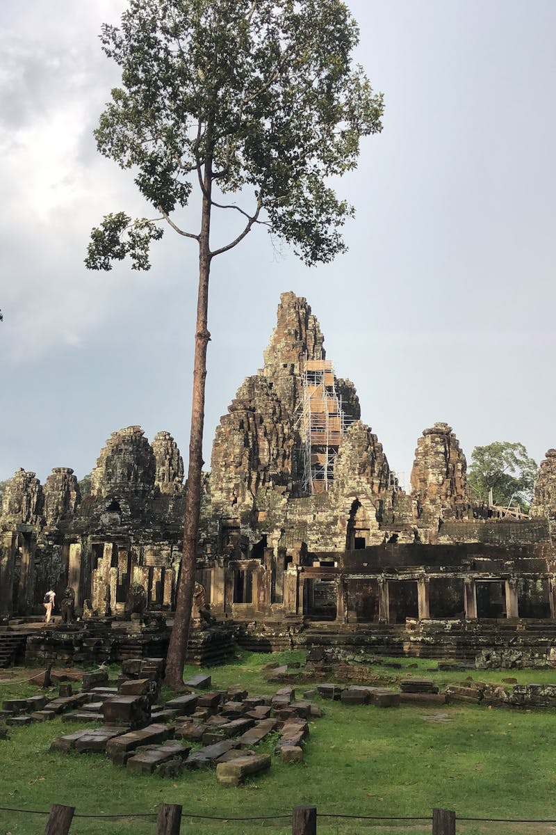
Hindu Sacred Texts
Hymns praising gods and exploring cosmic truths.
Rituals and sacrificial formulas.
Musical chants for worship.
Spells, healing, and practical knowledge including magic.

