Slide 1
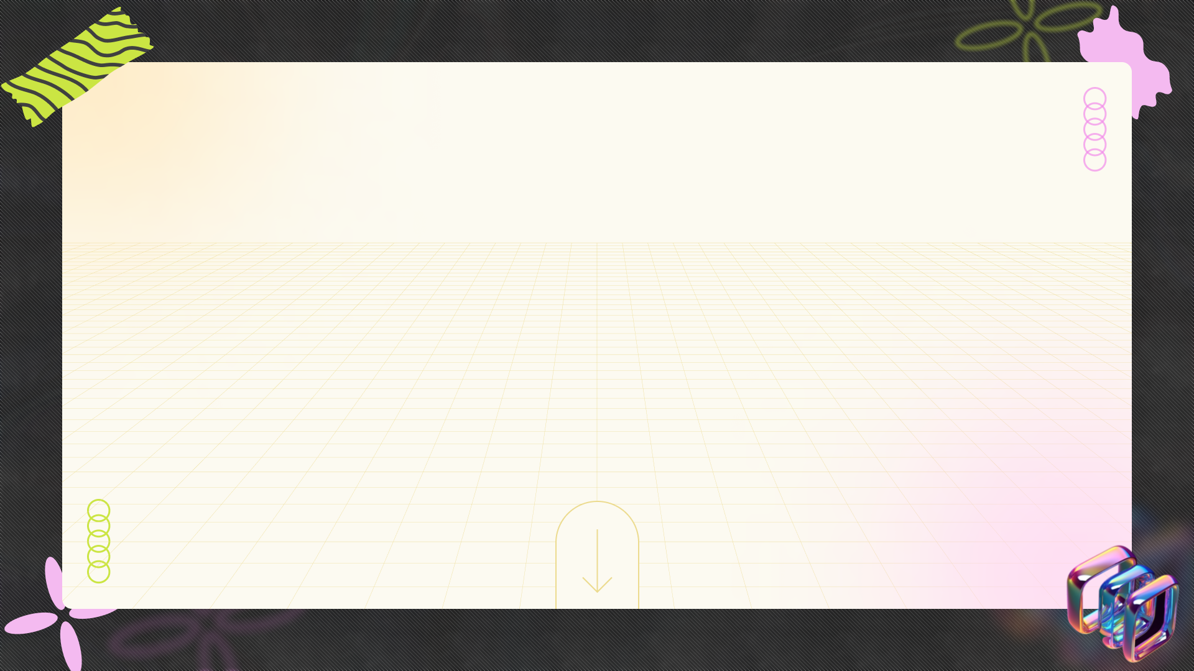
Illuminating the Path: A Journey into Electricity
+
+
+
Unlocking the Secrets of Electric Current, Potential, and Circuits
+
+
+

Slide 2



Table of Contents
01
The Spark of Discovery: Introduction to Electricity
02
Current Affairs: Defining Electric Current
03
Potential Power: Electric Potential and Potential Difference
04
Resistance is Futile... or is it? Ohm's Law
05
Wiring Wonders: Series and Parallel Circuits
06
Power Up: Electric Power and Energy
07
Heating Up: Heating Effect of Electric Current
08
Power to the People: Domestic Electric Circuits
09
Safety First: Electrical Safety Precautions

Slide 3
Table of Contents
10
Thank You

Slide 4

The Spark of Discovery: Introduction to Electricity
Electric charge is a fundamental property of matter that causes it to experience a force when placed in an electromagnetic field. It can be positive or negative.
There are two types of electric charges: positive and negative. Like charges repel each other, while opposite charges attract each other.
Electric charge is quantized, meaning it exists in discrete units. The smallest unit of charge is the elementary charge, carried by a single proton or electron.
Conductors allow electric charge to flow freely through them, while insulators resist the flow of electric charge. Metals are good conductors, and rubber is a good insulator.

Slide 5
The Spark of Discovery: Introduction to Electricity
Electric potential, often called voltage, is the electric potential energy per unit charge. It's measured in volts and drives the flow of current.

Slide 6
Current Affairs: Defining Electric Current
Electric current is the rate of flow of electric charge through a conductor. It is measured in amperes (A), where 1 ampere is equal to 1 coulomb per second.
Conventional current is defined as the flow of positive charge, which is opposite to the direction of electron flow in most conductors.
Electrons in a conductor move with a slow drift velocity due to collisions with atoms. This drift velocity is proportional to the electric field.
Current density is the amount of current flowing per unit area of a conductor. It is a vector quantity and indicates the direction of current flow.

Slide 7
Current Affairs: Defining Electric Current
Ammeters are used to measure electric current in a circuit. They are connected in series with the component whose current is being measured.

Slide 8
Potential Power: Electric Potential and Potential Difference
Electric potential at a point is the amount of work done to bring a unit positive charge from infinity to that point. It is a scalar quantity measured in volts.
Potential difference, or voltage, is the difference in electric potential between two points. It drives the flow of current in a circuit.
Voltage is related to the energy required to move a charge between two points. A higher voltage means more energy is required to move the same charge.
Batteries maintain a potential difference by converting chemical energy into electrical energy. This potential difference is called electromotive force (EMF).

Slide 9
Potential Power: Electric Potential and Potential Difference
Voltmeters are used to measure potential difference in a circuit. They are connected in parallel with the component whose voltage is being measured.

Slide 10
Resistance is Futile... or is it? Ohm's Law
Resistance is the opposition to the flow of electric current in a conductor. It is measured in ohms (Ω).
Ohm's Law states that the voltage across a conductor is directly proportional to the current flowing through it, provided the temperature remains constant. V = IR.
Resistors are components designed to provide a specific amount of resistance in a circuit. They are used to control current flow and voltage levels.
Resistance depends on the material, length, area, and temperature of the conductor. Longer and thinner conductors have higher resistance.

Slide 11
Resistance is Futile... or is it? Ohm's Law
Resistivity is a material property that measures how strongly a material opposes the flow of electric current. It is independent of the conductor's dimensions.

Slide 12
Wiring Wonders: Series and Parallel Circuits
In a series circuit, components are connected end-to-end, so the same current flows through each component. The total resistance is the sum of individual resistances.
In a parallel circuit, components are connected across each other, so the voltage is the same across each component. The total resistance is lower than the smallest individual resistance.
The current is the same at every point in a series circuit. If one component fails, the entire circuit is broken, and no current flows.
The voltage is the same across each branch in a parallel circuit. If one component fails, the other branches continue to operate normally.

Slide 13
Wiring Wonders: Series and Parallel Circuits
Many real-world circuits are combinations of series and parallel connections. Analyzing these circuits requires breaking them down into simpler components.

Slide 14
Power Up: Electric Power and Energy
Electric power is the rate at which electrical energy is consumed or transferred in a circuit. It is measured in watts (W).
Electric power can be calculated using the formula P = VI, where P is power, V is voltage, and I is current. It can also be expressed as P = I²R or P = V²/R.
Electric energy is the amount of electrical energy consumed over a period. It is measured in kilowatt-hours (kWh).
Electrical appliances are rated by their power consumption. Higher power appliances consume more electrical energy in the same amount of time.

Slide 15
Power Up: Electric Power and Energy
The cost of electrical energy is calculated by multiplying the energy consumption (in kWh) by the cost per kWh charged by the utility company.

Slide 16
Heating Up: Heating Effect of Electric Current
When electric current flows through a conductor, it generates heat due to the resistance of the conductor. This is known as the heating effect of electric current.
Joule's Law states that the heat produced in a conductor is directly proportional to the square of the current, the resistance, and the time for which the current flows. H = I²Rt.
The heating effect is used in various applications, such as electric heaters, electric irons, toasters, and electric bulbs.
In filament lamps, the current heats a thin tungsten filament to a high temperature, causing it to emit light. These lamps are inefficient, converting only a small fraction of energy into light.

Slide 17
Heating Up: Heating Effect of Electric Current
Fuses are safety devices that protect circuits from overcurrent by melting and breaking the circuit when the current exceeds a certain limit.

Slide 18
Power to the People: Domestic Electric Circuits
Domestic electric circuits consist of live, neutral, and earth wires. The live wire carries the current, the neutral wire provides a return path, and the earth wire provides a safety ground.
Circuit overloading occurs when the total current drawn by all appliances in a circuit exceeds the circuit's capacity, potentially causing overheating and fire.
A short circuit occurs when the live and neutral wires come into direct contact, creating a path of very low resistance and causing a large current to flow.
Earthing connects the metal body of an appliance to the earth wire, providing a safe path for current to flow in case of a fault, preventing electric shock.

Slide 19
Power to the People: Domestic Electric Circuits
Miniature Circuit Breakers (MCBs) are automatic switches that interrupt the circuit when the current exceeds a certain limit, protecting against overcurrent and short circuits.

Slide 20
Safety First: Electrical Safety Precautions
Never use electrical appliances or handle electrical wires with wet hands, as water is a good conductor of electricity and can cause electric shock.
Regularly inspect electrical cords and plugs for damage. Replace damaged cords immediately to prevent short circuits and electric shock.
Ensure that electrical wiring in your home is properly installed and maintained by a qualified electrician to prevent overloading and short circuits.
Unplug appliances when not in use, especially during thunderstorms, to protect them from power surges. This also conserves energy.

Slide 21
Safety First: Electrical Safety Precautions
Ensure that all appliances are properly grounded to provide a safe path for current in case of a fault, preventing electric shock. Use three-prong plugs whenever possible.

Slide 22
Thank You
Thank you for your attention and participation in this presentation on electricity. We hope you found it informative and insightful.
We encourage you to continue exploring the fascinating world of electricity and its applications in various fields.
We are now open to answering any questions you may have about the topics covered in this presentation.
We would like to acknowledge the various sources of information and resources that were used in the preparation of this presentation.

Slide 23
Thank You
We wish you continued success in your studies and future endeavors related to electricity and electrical engineering.

