Slide 1
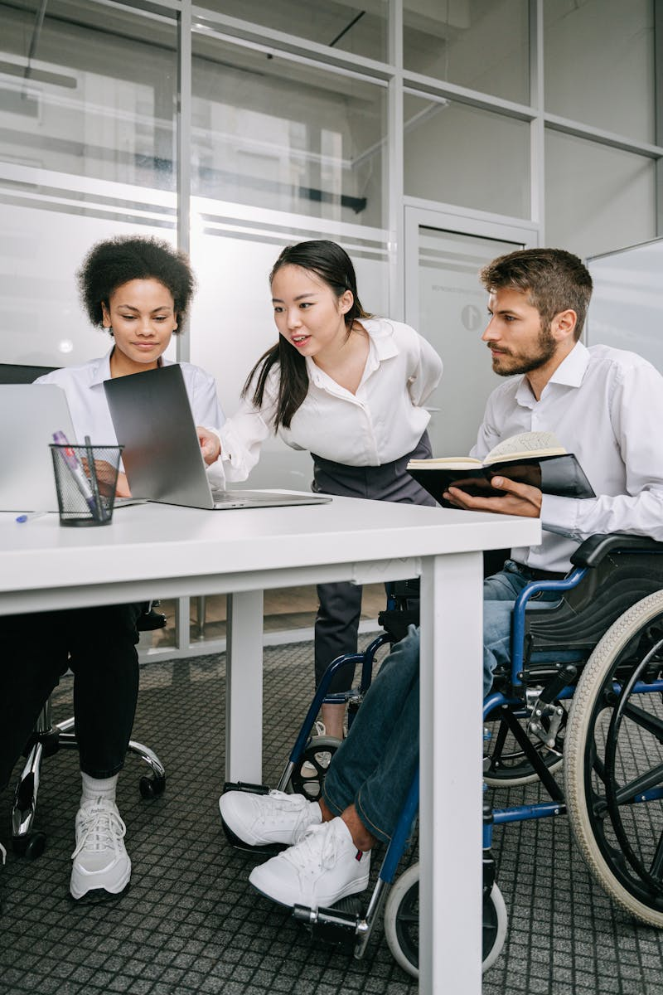
Inclusive Technology
Creating Accessible and Equitable Solutions
Photo by Google

Slide 2
01
What is Inclusive Technology?
Table of Contents
02
Benefits of Inclusive Technology
03
Examples of Inclusive Technology
04
Implementing Inclusive Design
05
Decoration and Visuals

Slide 3

1
What is Inclusive Technology?
Designing for Everyone
Focus on creating technology accessible to all, regardless of ability.
Employ design principles that cater to a wide range of users from the outset.
Ensure everyone has equal opportunities to use and benefit from technology.
Strive for true inclusion, exceeding minimum accessibility requirements.
Photo by Google

Slide 4

2
Benefits of Inclusive Technology
Why Inclusion Matters
Reach a larger audience by accommodating diverse needs and preferences.
Enhance usability for everyone, leading to greater satisfaction.
Inclusion fosters creativity and the development of innovative solutions.
Promote equity and create a more inclusive society through technology.
Photo by Google

Slide 5
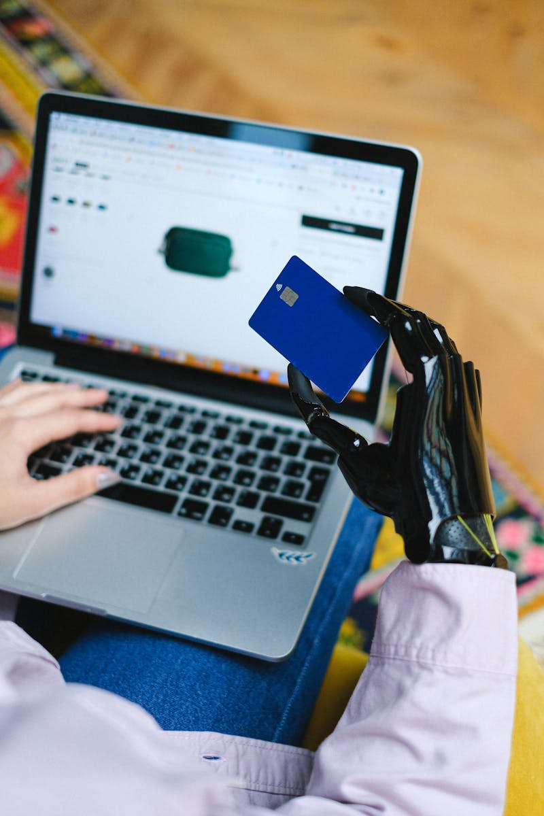
3
Examples of Inclusive Technology
Real-World Applications
Software that converts text to speech for visually impaired users.
Technology that allows users to control devices with their voice.
Options to increase or decrease font size for improved readability.
Text alternatives for audio content, benefiting hearing-impaired individuals.
Photo by Google

Slide 6

4
Implementing Inclusive Design
Practical Strategies
Involve people with diverse abilities in the design process.
Regularly test technology with assistive technologies.
Create content that is easily accessible and understandable.
Educate developers and designers on inclusive design principles.
Photo by Google

Slide 7

5
Decoration and Visuals
Enhancing Your Presentation
Use sufficient contrast between text and background for readability.
Choose fonts that are easy to read and have a large x-height.
Use headings, subheadings, and bullet points to organize information.
Include relevant images that support and enhance the content.
Photo by Google

