Slide 1
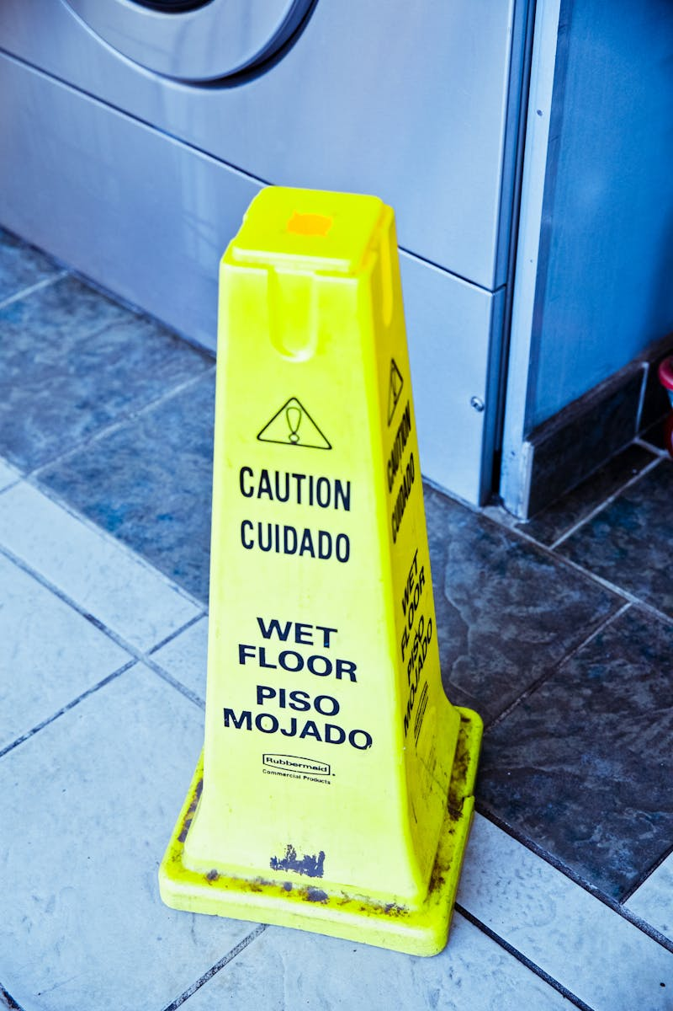
Industrial Accident: Root Cause Analysis Understanding and Preventing Workplace Incidents
Photo by Pexels

Slide 2
01
Introduction: The Importance of Understanding ...
Table of Contents
02
Common Causes of Industrial Accidents
03
Root Cause Analysis (RCA): Digging Deeper
04
Implementing Corrective Actions
05
The Role of Prevention
06
Conclusion: Creating a Safer Workplace

Slide 3
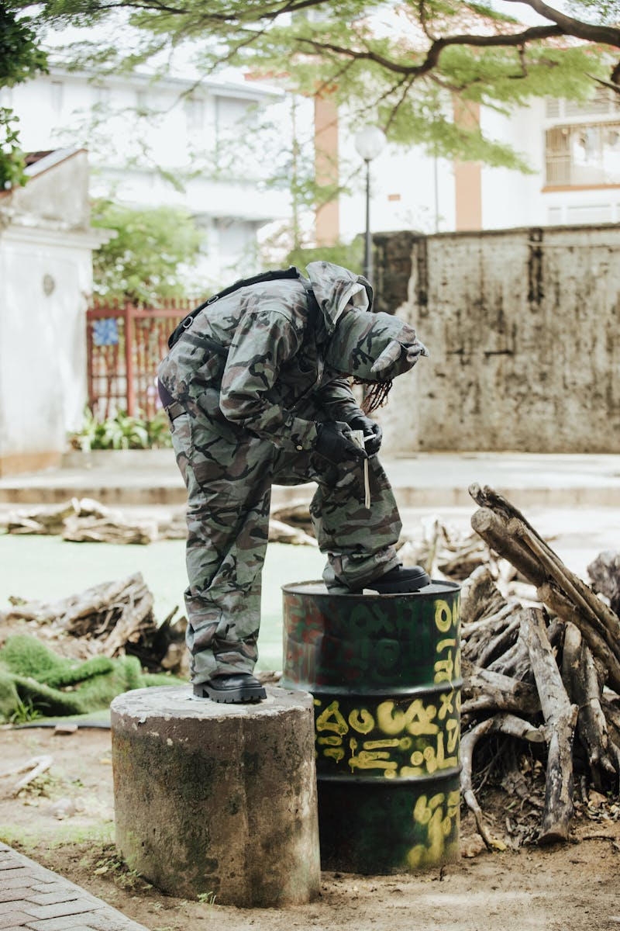
1
Introduction: The Importance of Understanding Industrial Accidents
Why Analyze Accidents?
Any unplanned event occurring in a workplace that results in injury, illness, or damage. Accidents lead to physical and psychological trauma for workers and their families. Direct costs (medical, compensation) and indirect costs (downtime, legal fees, damage). Organizations have a legal and moral obligation to ensure worker safety.

Slide 4
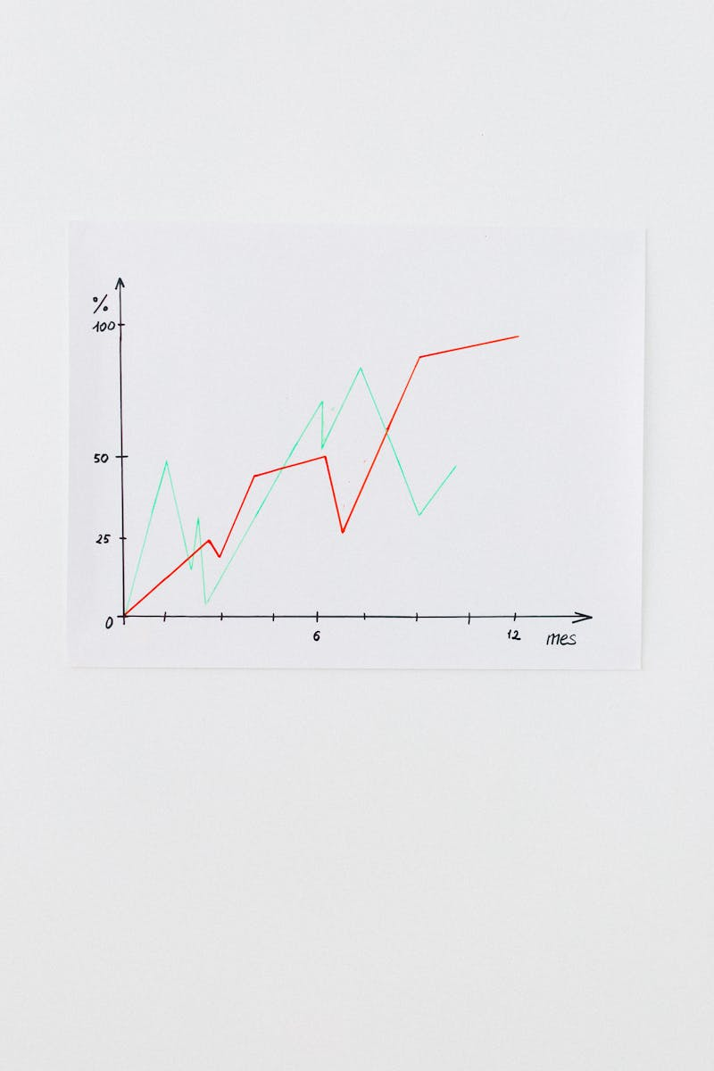
2
Common Causes of Industrial Accidents
Identifying Contributing Factors
Actions taken by individuals that increase the risk of an accident (e.g., ignoring safety procedures). Hazards present in the workplace environment (e.g., faulty equipment, poor housekeeping). Insufficient training on equipment operation, safety protocols, and hazard recognition. Failure to properly oversee work activities and enforce safety regulations.

Slide 5

3
Root Cause Analysis (RCA): Digging Deeper
Finding the Underlying Problems
A systematic process to identify the fundamental causes of an accident, not just the symptoms. Repeatedly asking "why" to drill down to the core issue. A visual tool to categorize potential causes (Man, Machine, Method, Material, Measurement, Environment). A top-down, deductive failure analysis used to determine the causes of system failures.

Slide 6

4
Implementing Corrective Actions
Preventing Recurrence
Outlining specific steps to address the identified root causes. Modifying the workplace to eliminate or reduce hazards (e.g., machine guarding). Implementing procedures and policies to minimize risk (e.g., safety training, job rotation). Providing workers with equipment to protect them from hazards (e.g., gloves, safety glasses).

Slide 7

5
The Role of Prevention
Proactive Safety Measures
Regularly identifying potential hazards and evaluating the associated risks. Providing comprehensive training on safe work practices and hazard awareness. Conducting periodic inspections to identify and correct safety deficiencies. Creating a workplace environment where safety is valued and prioritized by all employees.

Slide 8

6
Conclusion: Creating a Safer Workplace
Continuous Improvement
A strong organizational commitment to safety is essential for preventing accidents. Engaging employees in the safety process improves hazard identification and promotes ownership. Regularly evaluating safety performance and making adjustments as needed. Thoroughly investigating accidents and sharing lessons learned to prevent future incidents.

