Slide 1

Industrial Training PPT Sugar Factory Operations
Photo by Pexels

Slide 2
01
Industrial Training Overview
Table of Contents
02
Factory Equipment & Machinery
03
Production Processes
04
Engineering Applications
05
Career Development

Slide 3

1
Industrial Training Overview
Understanding Sugar Factory Operations
Industrial training provides hands-on experience in sugar factory operations and engineering processes. Working in a sugar factory involves understanding machinery, equipment, and production systems. Following safety protocols is essential when working with industrial equipment and machinery. Gaining practical knowledge about sugar production methods and factory operations.

Slide 4
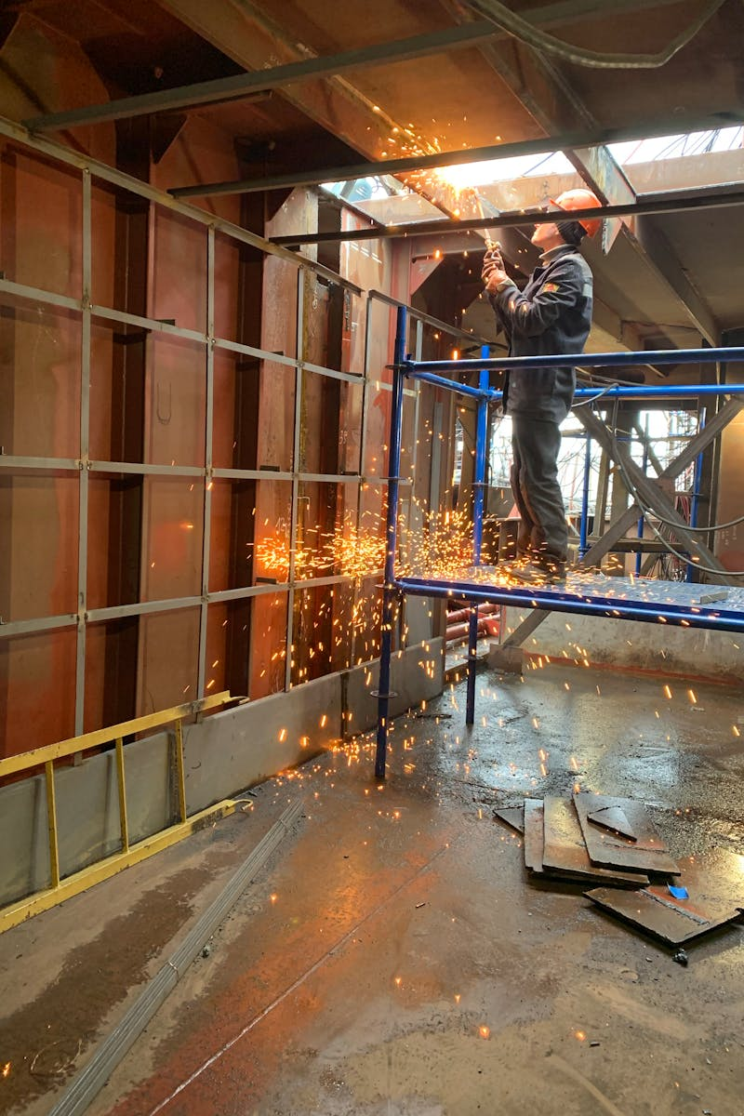
2
Factory Equipment & Machinery
Technical Components in Sugar Production
Understanding the various types of machinery used in sugar processing and production. Learning to operate and maintain industrial equipment efficiently and safely. Familiarizing with engineering systems that support sugar factory operations. Proper maintenance procedures to ensure optimal performance and longevity of equipment.

Slide 5
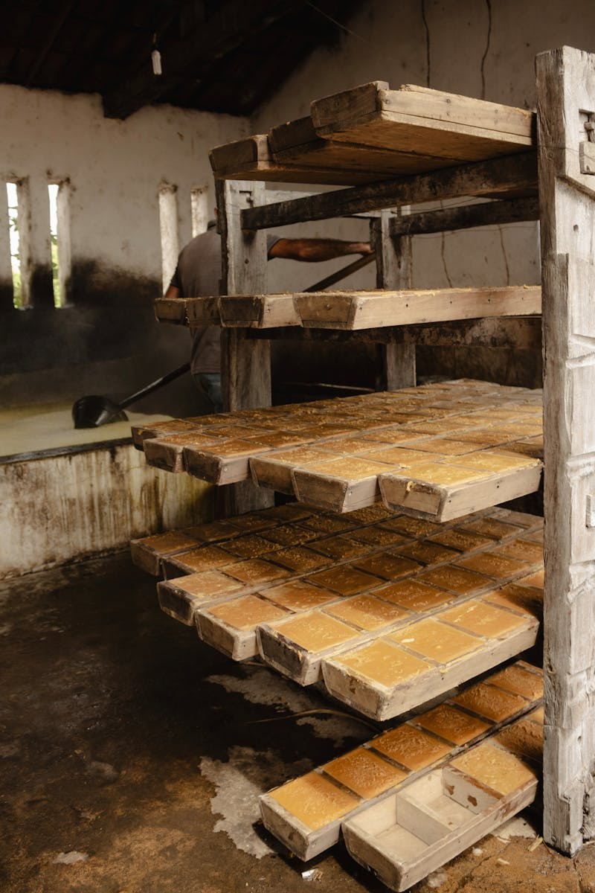
3
Production Processes
Sugar Manufacturing Workflow
Understanding the sourcing and preparation of raw materials for sugar production. Following the complete workflow from raw material to finished sugar product. Implementing quality assurance measures throughout the production process. Meeting industry standards for sugar quality and production efficiency.

Slide 6
4
Engineering Applications
Technical Skills Development
Applying engineering concepts to solve real-world factory problems and challenges. Analyzing factory operations and identifying areas for improvement. Learning to optimize industrial systems for better performance and efficiency. Developing critical thinking skills to address operational issues in sugar production.

Slide 7

5
Career Development
Professional Growth Opportunities
Gaining valuable industry experience through hands-on training in sugar manufacturing. Developing technical and professional skills applicable to various industrial sectors. Exploring career opportunities in industrial engineering and manufacturing sectors. Building connections with industry professionals and mentors in the field.

