Slide 1



Innovation and Design Thinking
Exploring the Concepts and Applications
July 2025

Slide 2

Table of Contents
1
Introduction to Design Thinking
5
Tools of Design Thinking
2
Features and Principles
6
Design Thinking for Strategic Innovation
3
Theories of Design Thinking
7
Features and Scope of Strategic Innovation
4
Practices of Design Thinking
8
Design Thinking in Information Technology

Slide 3
9
Scenario Based Prototyping
10
Design Thinking Workshop

Slide 4

Introduction to Design Thinking
Design Thinking is a versatile approach used by inventors across various fields to solve problems creatively.
Design Thinking involves strategic, conceptual, and practical processes to develop innovative solutions.
The roots of Design Thinking can be traced back to the practices of great inventors in engineering and art.
Organizations use Design Thinking to enhance creativity and problem-solving in projects and processes.
Photo by PDF
01

Slide 5

Features and Principles
Design Thinking emphasizes empathy, experimentation, and collaboration to drive innovation.
Key principles include user-centricity, iterative learning, and embracing ambiguity.
The process involves stages like empathy, define, ideate, prototype, and test.
It fosters creativity, improves problem-solving, and enhances user experience.
Photo by PDF
02

Slide 6

Theories of Design Thinking
Explores different modes of thinking that influence creative processes.
Focuses on strategies to overcome challenges and find effective solutions.
Identifies barriers to creativity and methods to overcome them.
Describes the stages involved in generating innovative ideas.
Photo by PDF
03

Slide 7
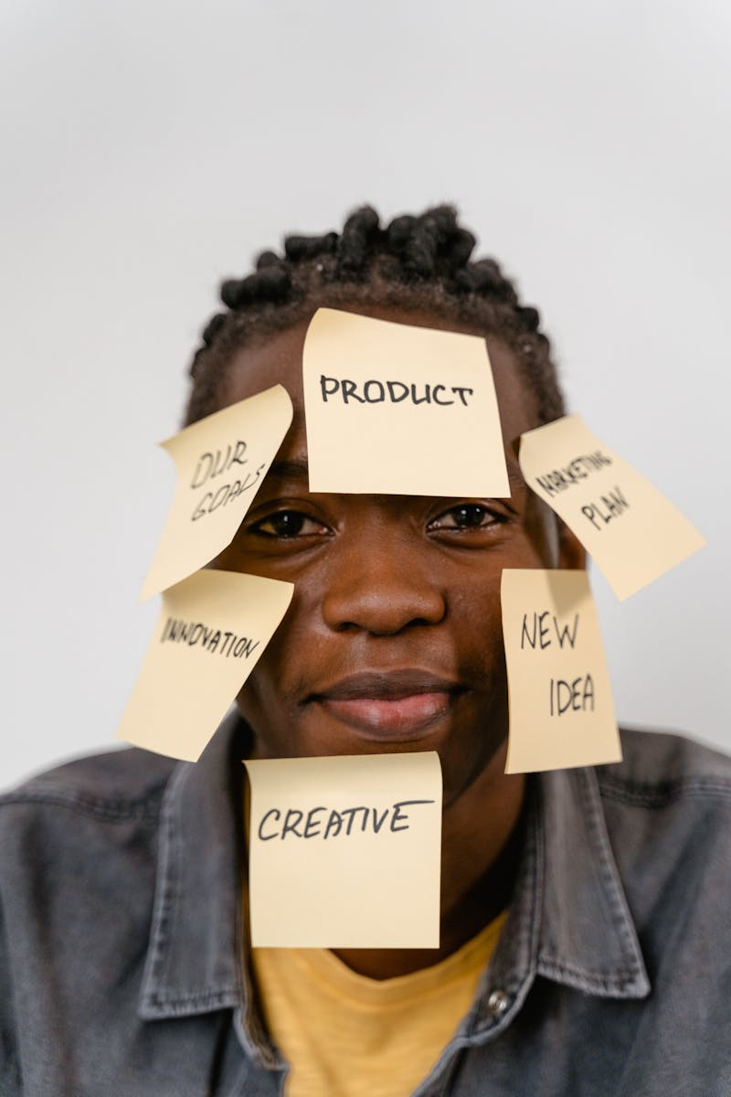
Practices of Design Thinking
Collaborative approach to solving problems using Design Thinking principles.
Using visual tools to represent ideas and concepts effectively.
A method to visualize the user's experience and identify improvement areas.
Analyzing the steps involved in delivering a product or service to enhance efficiency.
Photo by PDF
04

Slide 8
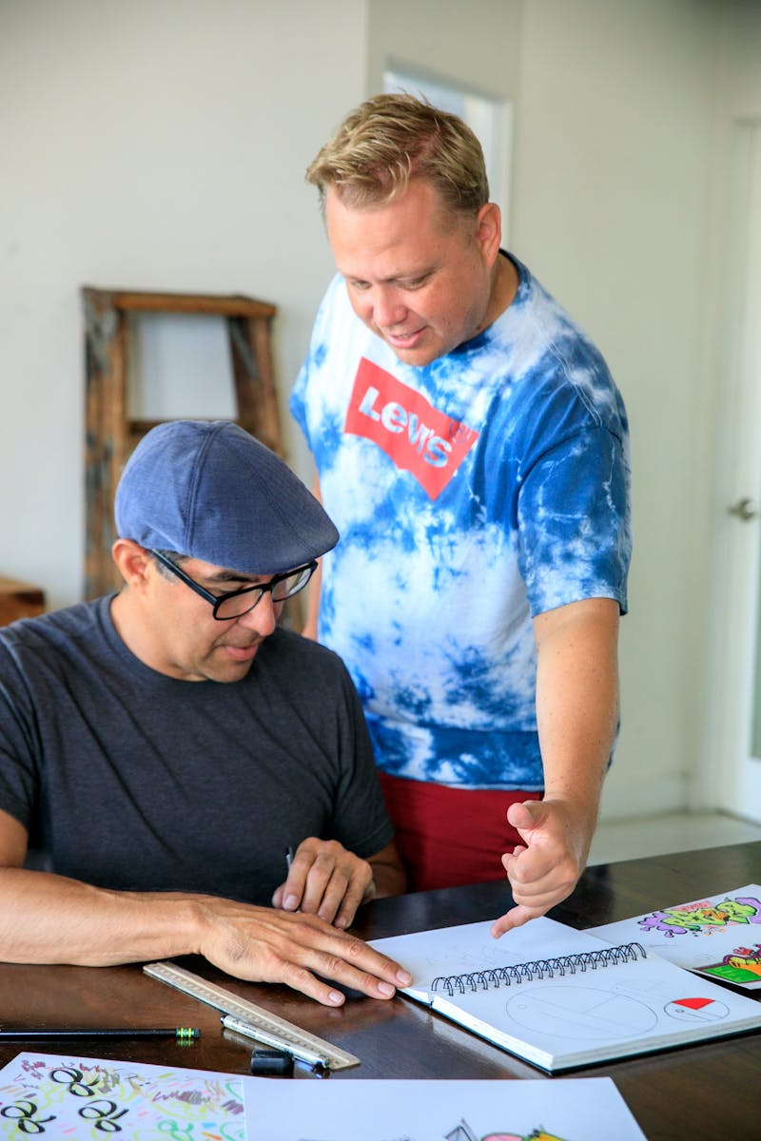
Tools of Design Thinking
A technique to organize thoughts and ideas visually.
Quickly developing and testing ideas to refine them.
Challenging assumptions to validate ideas and concepts.
Creating models to test and refine ideas before full-scale production.
Photo by PDF
05

Slide 9

Design Thinking for Strategic Innovation
Strategic management involves planning and executing strategies to achieve organizational goals.
Innovation management focuses on managing processes to foster new ideas and innovations.
Includes disruptive, sustaining, radical, incremental, architectural, and modular innovations.
Combines strategic management with innovation to drive growth and competitiveness.
Photo by PDF
06

Slide 10

Features and Scope of Strategic Innovation
Involves integrating innovation into strategic planning for long-term success.
Covers various areas including product development, market expansion, and process improvement.
Design Thinking enhances strategic innovation by fostering creativity and user-centric approaches.
Methods to incorporate Design Thinking into strategic innovation processes.
Photo by PDF
07

Slide 11

Design Thinking in Information Technology
Involves analyzing and improving business processes for efficiency and effectiveness.
Helps in visualizing processes to identify areas for improvement and innovation.
Applying Design Thinking to enhance business process modelling and outcomes.
Using agile methodologies to improve collaboration in virtual environments.
Photo by PDF
08

Slide 12

Scenario Based Prototyping
Involves creating prototypes based on real-world scenarios to test and refine ideas.
Testing new ideas in a controlled environment to gather feedback and improve.
Collaborating with stakeholders to develop innovative solutions.
Using narratives to convey ideas and engage audiences effectively.
Photo by PDF
09

Slide 13

Design Thinking Workshop
Workshops aim to teach and apply Design Thinking principles in a hands-on environment.
Workshops are essential for learning and practicing Design Thinking skills.
Includes stages like introduction, ideation, prototyping, and feedback.
Enhances learning, collaboration, and practical application of Design Thinking.
Photo by PDF
10

