Slide 1
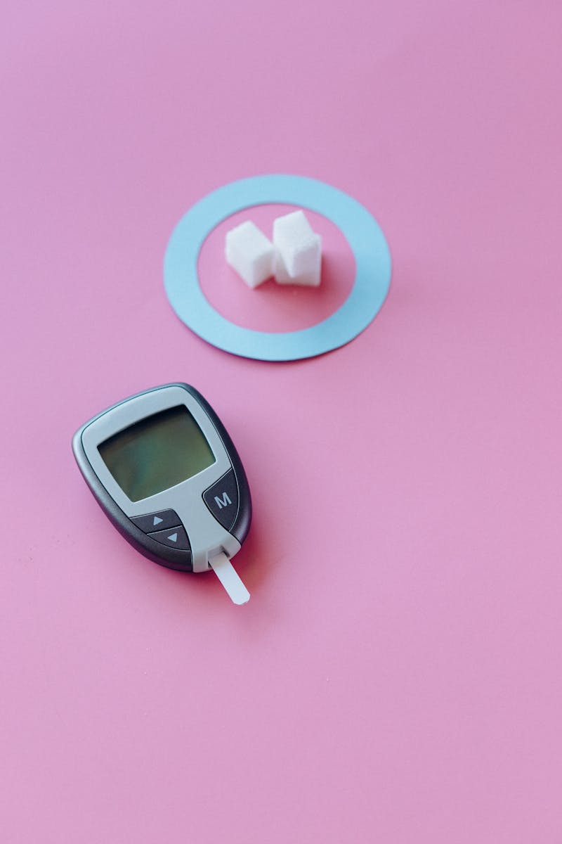
Insulin: A Deep Dive Exploring Biosynthesis, Action, and Therapeutic Applications of Insulin
Photo by Pexels

Slide 2
01
Unlocking Insulin's Secrets
Table of Contents
02
Insulin Biosynthesis: The Cellular Journey
03
Pharmacological Actions: Insulin's Impact
04
Mechanism of Action: Cellular Signaling
05
Therapeutic Uses: Insulin's Role
06
Adverse Effects: Potential Risks
07
Synthetic Human Insulin: A Breakthrough
08
Semisynthetic Human Insulin: An Alternative
09
Insulin Analogues: Tailored Action
10
Thank You

Slide 3
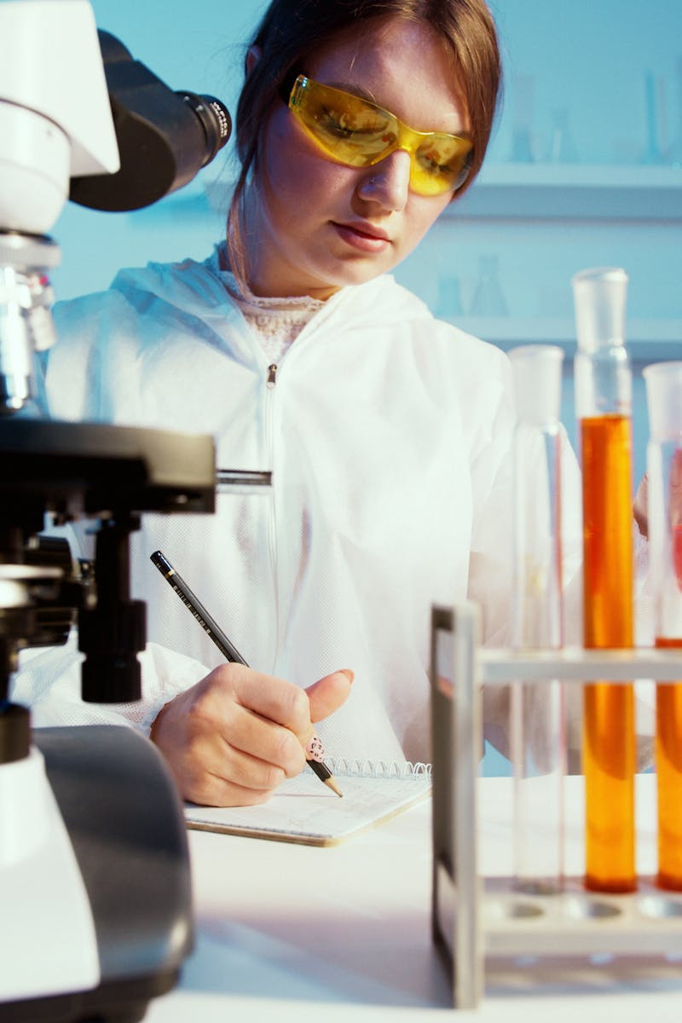
1
Unlocking Insulin's Secrets
An Introduction to the Vital Hormone
Insulin, a peptide hormone, is crucial for regulating glucose metabolism. Its discovery revolutionized diabetes treatment, impacting millions worldwide. We will explore insulin's biosynthesis, pharmacological actions, mechanisms, uses, adverse effects, and synthetic preparation. The discussion emphasizes human insulin, including synthetic and semisynthetic preparations, for clinical application. The primary clinical usage of insulin is in the management of diabetes mellitus, a condition characterized by elevated blood glucose levels.

Slide 4

2
Insulin Biosynthesis: The Cellular Journey
From Preproinsulin to Active Hormone
Ribosomes synthesize preproinsulin, a precursor containing a signal peptide. This initial step occurs in the endoplasmic reticulum. Signal peptide cleavage converts preproinsulin to proinsulin. Disulfide bonds form, stabilizing the proinsulin structure in ER. Proinsulin moves to Golgi apparatus. Enzymes cleave C-peptide, creating active insulin composed of A and B chains linked by disulfide bridges. Insulin and C-peptide are stored in secretory granules. Glucose stimulates insulin secretion, vital for blood sugar regulation.

Slide 5
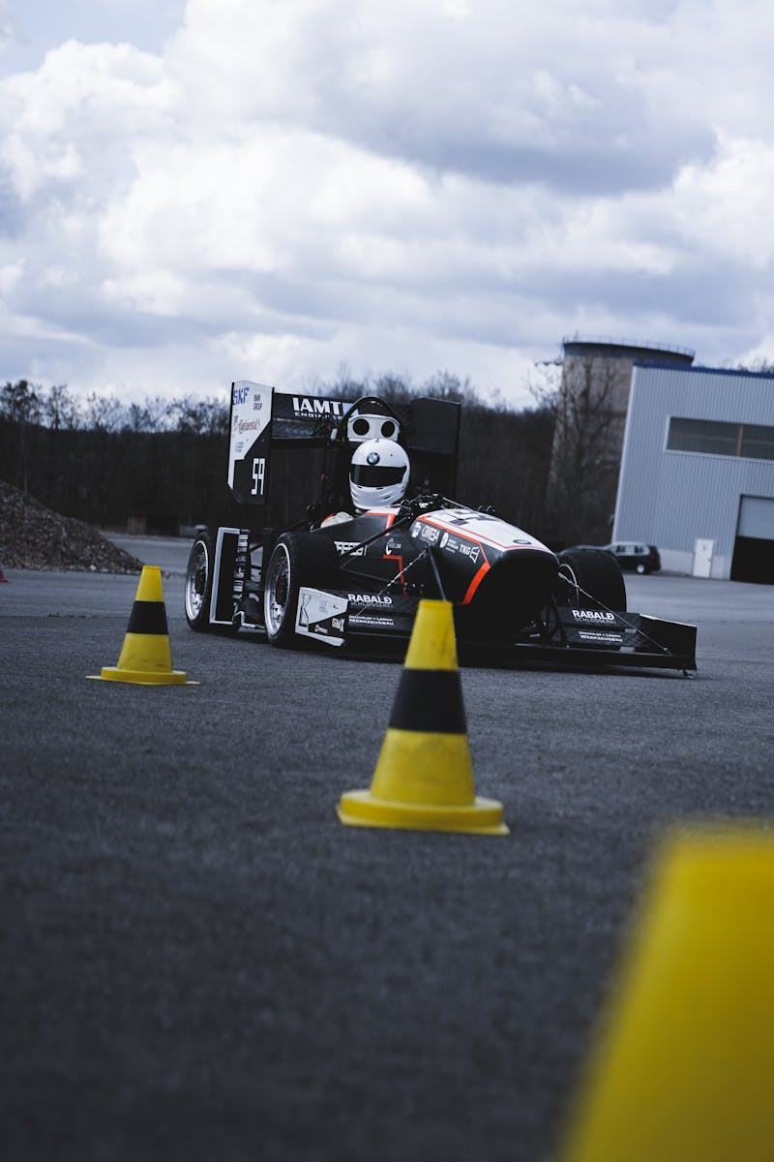
3
Pharmacological Actions: Insulin's Impact
Regulating Metabolism and Beyond
Insulin stimulates glucose uptake in muscle and adipose tissue via GLUT4 translocation. It is critical for energy production and storage. Insulin promotes glycogen synthesis in liver and muscle. It converts glucose to glycogen for energy storage. It reduces blood sugar. Insulin enhances lipid synthesis and inhibits lipolysis. This action leads to energy storage. It is crucial in lipid metabolism. Insulin stimulates protein synthesis. Amino acid uptake in muscle and other tissues enhances protein production. It is essential.

Slide 6
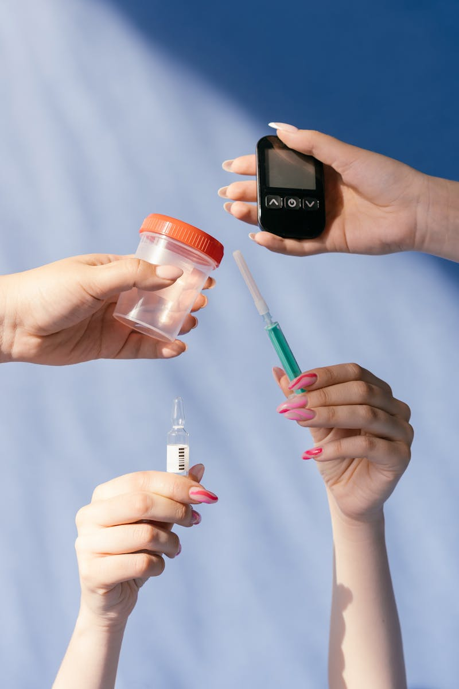
4
Mechanism of Action: Cellular Signaling
Insulin's Receptor and Downstream Effects
Insulin binds to the insulin receptor, a tyrosine kinase receptor, on cell surfaces. This triggers receptor activation. Receptor autophosphorylation activates tyrosine kinase activity. Downstream signaling pathways are initiated by phosphorylation events. Insulin Receptor Substrate (IRS) proteins are phosphorylated. This leads to activation of PI3K and other signaling cascades. Signaling cascades lead to increased glucose uptake, protein synthesis, and altered gene expression. Ultimately it contributes to homeostasis.

Slide 7
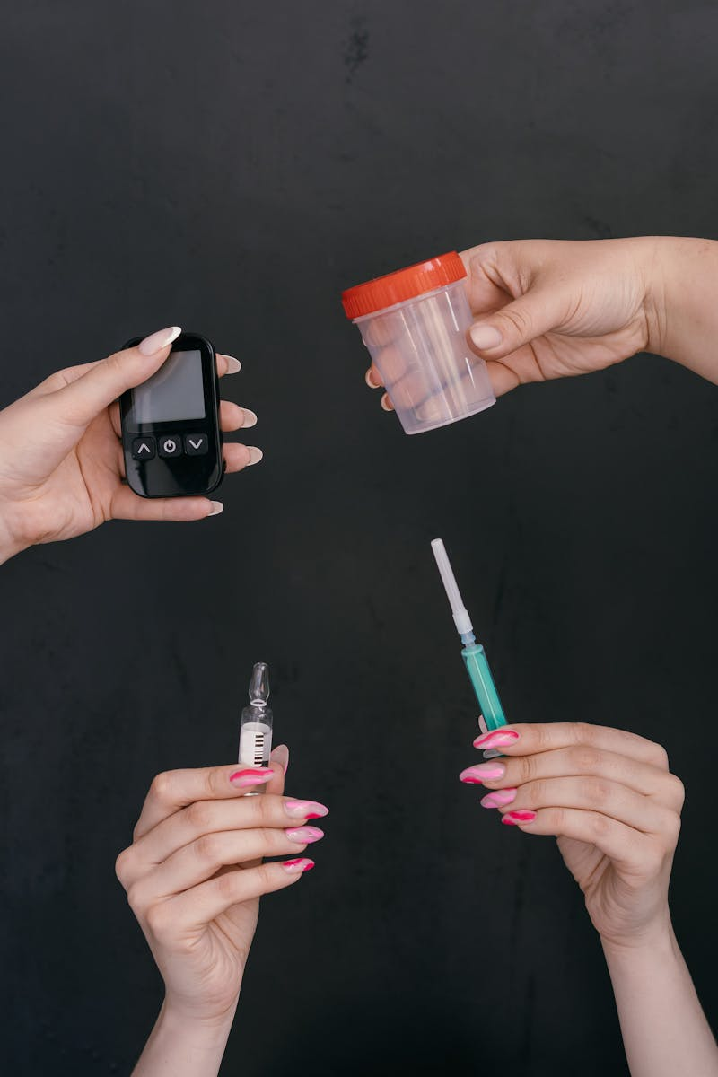
5
Therapeutic Uses: Insulin's Role
Treating Diabetes and Beyond
Insulin is essential for survival in type 1 diabetes. Pancreatic beta cells are destroyed, requiring exogenous insulin. Insulin is used when oral agents are insufficient to control blood glucose. Insulin resistance and beta-cell dysfunction is addressed. Insulin is frequently required to manage gestational diabetes. Maternal and fetal health depends on controlled glucose levels. Insulin is occasionally used in hyperkalemia to shift potassium into cells. It is used for critical care settings and research.

Slide 8

6
Adverse Effects: Potential Risks
Understanding Insulin's Drawbacks
Hypoglycemia is the most common adverse effect. Excessive insulin dosing, skipped meals, or exercise causes this medical problem. Insulin can promote weight gain by increasing glucose uptake and storage. Monitor for calorie intake and weight maintenance. Lipodystrophy (at injection sites) occurs with repeated injections at the same location. Proper rotation is essential for treatment. Allergic reactions to insulin are rare, but can happen. Local or systemic reactions require immediate medical attention. Be careful.

Slide 9

7
Synthetic Human Insulin: A Breakthrough
Revolutionizing Diabetes Treatment
Synthetic human insulin is produced using recombinant DNA. Genes encoding insulin A and B chains are inserted into microorganisms. Microorganisms (E. coli or yeast) express the insulin chains separately. The chains are then purified and combined to form insulin. The insulin is rigorously purified to remove microbial contaminants. The final product is formulated for subcutaneous injection. Consistent supply and reduced immunogenicity are the advantages. It is widely available with fewer allergic reactions than animal insulin.

Slide 10
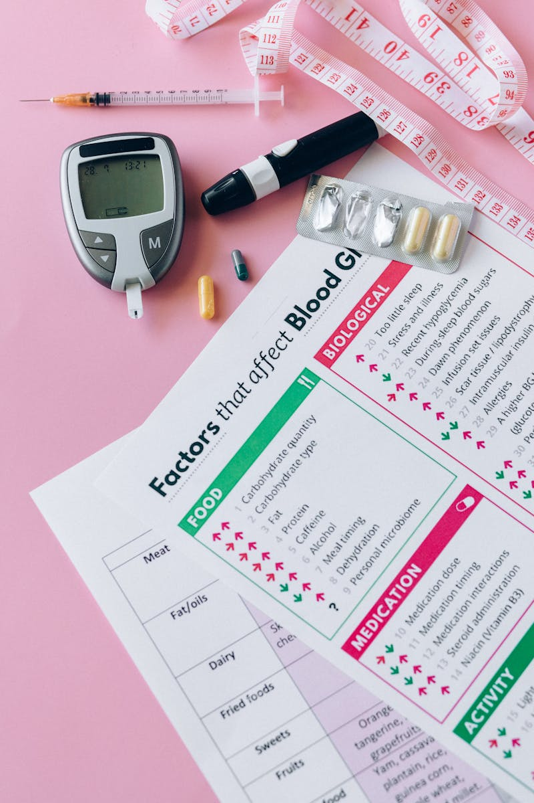
8
Semisynthetic Human Insulin: An Alternative
Modifying Animal Insulin for Human Use
Semisynthetic insulin starts with purified animal insulin (usually porcine). Animal insulin differs slightly from human insulin. Enzymatic reactions replace specific amino acids. Porcine insulin is converted to human insulin by replacing alanine with threonine. The modified insulin is purified. The product is then formulated for subcutaneous injection, it is effective. Semisynthetic insulin is now less common due to the availability of synthetic insulin. Yet, it serves as an alternative approach and solution.

Slide 11
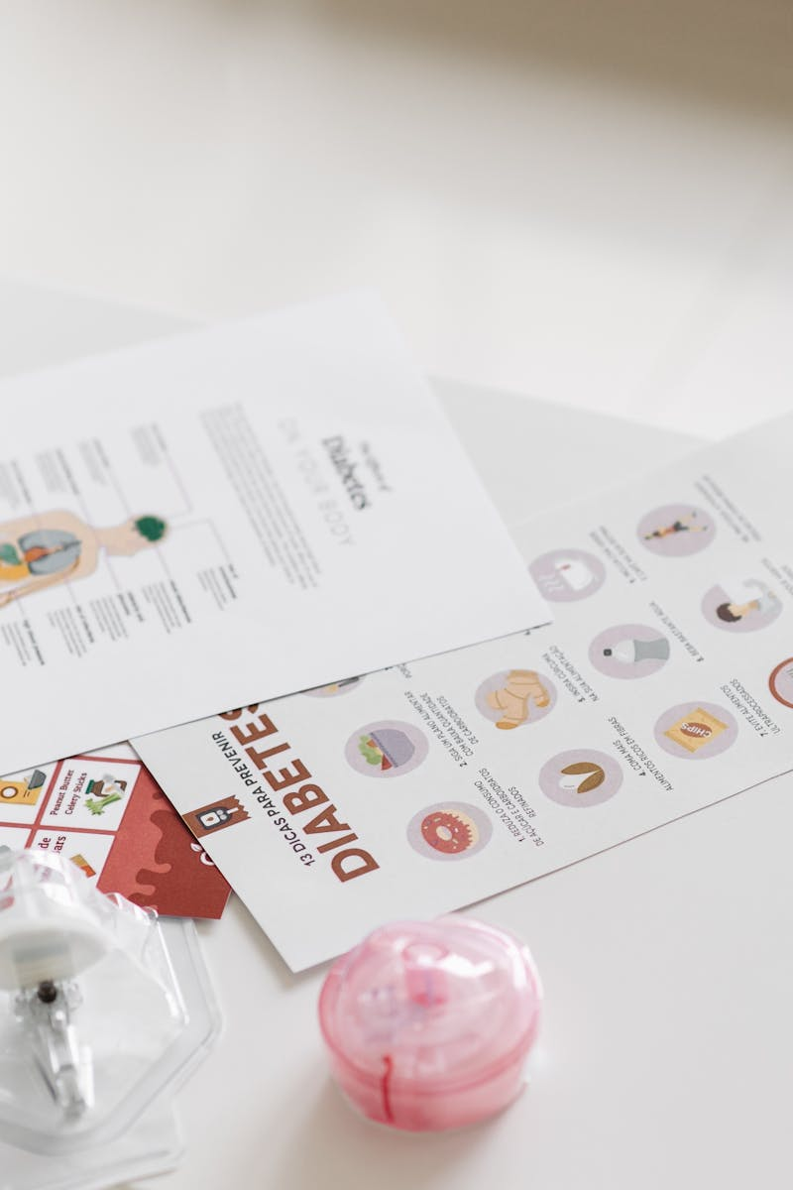
9
Insulin Analogues: Tailored Action
Designing Insulin for Specific Needs
Lispro, aspart, and glulisine are rapid-acting insulin analogues. Amino acid modifications facilitate faster absorption and onset. Glargine, detemir, and degludec are long-acting insulin analogues. Modifications prolong duration for basal coverage with less peak. Analogues offer improved glycemic control and reduced risk of hypoglycemia. Specific insulin action is tailored for patient needs. Insulin analogues have become the treatment standard. They are a vital component of comprehensive diabetes management plans.

Slide 12

10
Thank You
Gratitude and Acknowledgements
Thank you for your time and attention. I am grateful for the opportunity to present this information. I acknowledge and appreciate all researchers and contributors in insulin research. Feel free to ask questions or seek further clarification on any topic that needs explaining. This concludes the presentation on insulin biosynthesis, action, uses and synthetic preparation.

