Slide 1
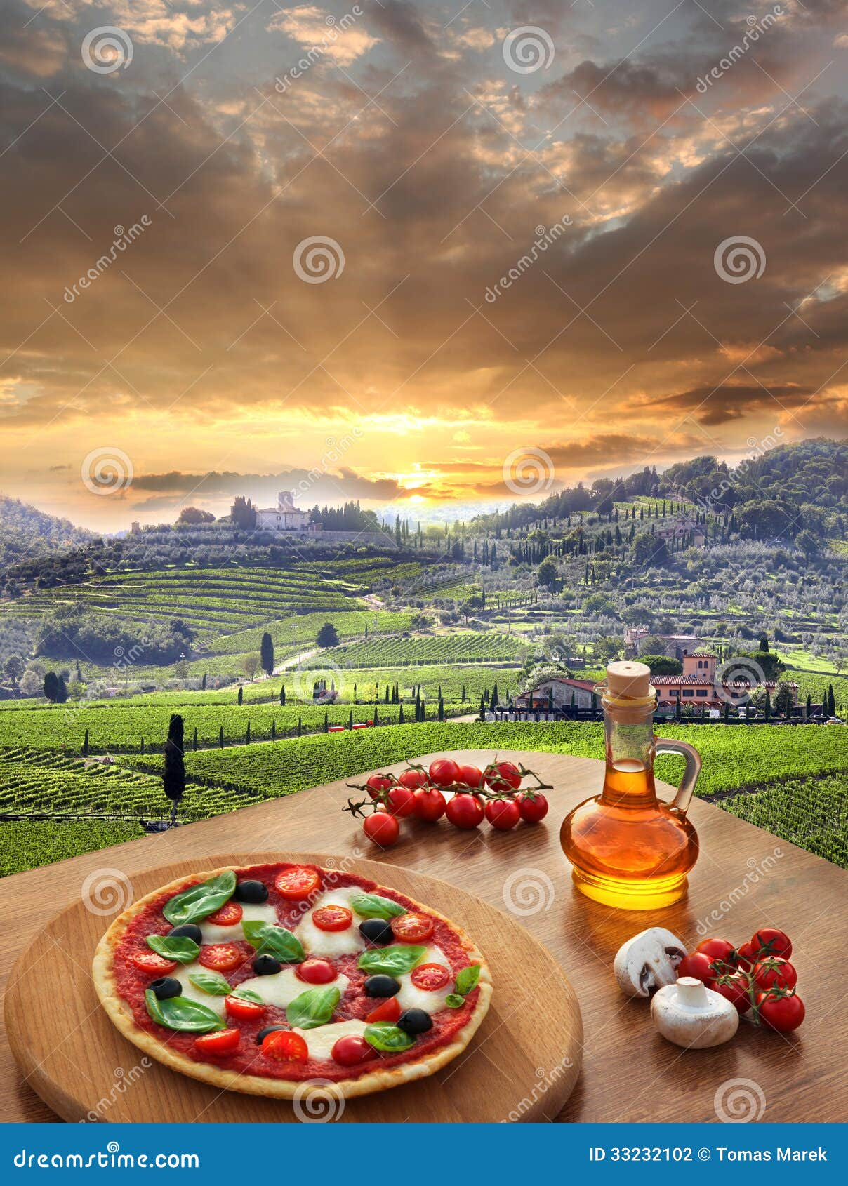
Italian Cuisine: A Culinary Voyage
Exploring the rich history and diverse regional specialties of Italy.
Photo by Google

Slide 2
01
A Taste of Italy's Heritage
Table of Contents
02
Pasta: More Than Just Noodles
03
Pizza: A Global Icon
04
Risotto: Creamy Rice Perfection
05
Regional Cheeses: A Dairy Delight
06
Tuscan Cuisine: Simple Elegance
07
Sicilian Flavors: A Cultural Melting Pot
08
Italian Wine: A Perfect Pairing
09
Dolci: Sweet Endings
10
Thank You

Slide 3
1
A Taste of Italy's Heritage
Unveiling the historical roots of Italian gastronomy.
Discover how ancient Roman agriculture and culinary practices laid the foundation for Italian cuisine, emphasizing grains, olives, and wine.
Explore the impact of the spice trade during the medieval period, introducing new flavors and ingredients to Italian kitchens.
Witness the refinement of Italian cuisine during the Renaissance, marked by elaborate banquets and the development of regional specialties.
Trace the standardization and evolution of Italian dishes after the unification, adapting to modern times while preserving tradition.
Photo by Google

Slide 4
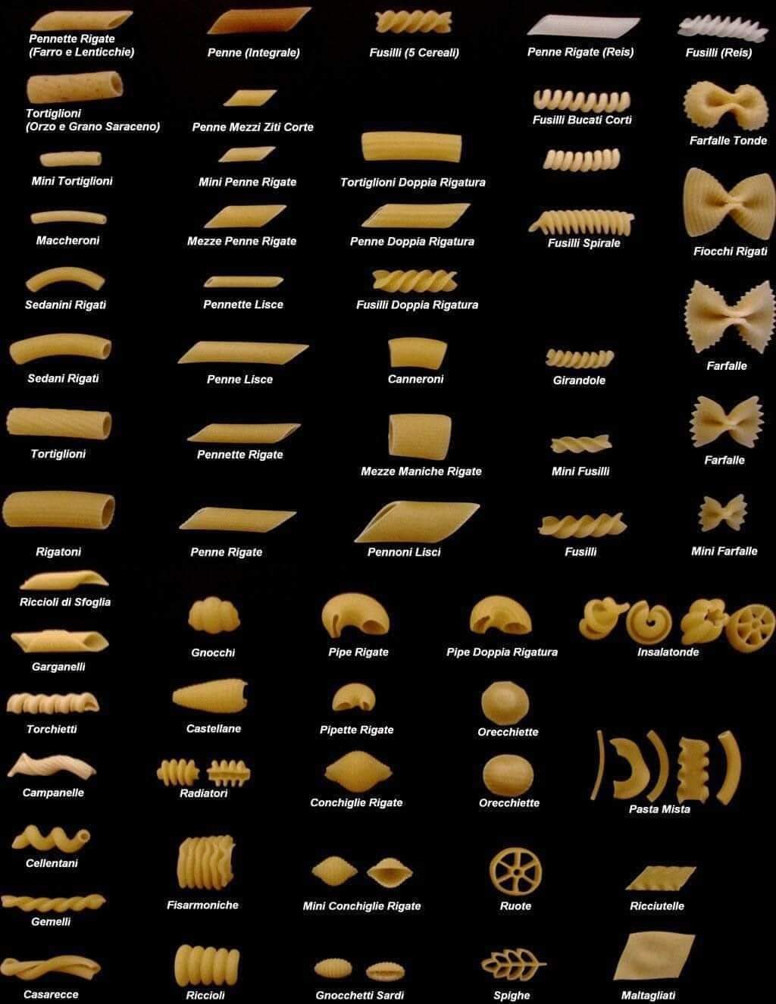
2
Pasta: More Than Just Noodles
Delving into the world of pasta shapes, sauces, and regional variations.
Learn about the different types of pasta flour, the traditional techniques of pasta making, and the regional variations in pasta shapes.
Explore classic pasta sauce pairings, from creamy Alfredo to hearty Bolognese, and discover regional sauce specialties.
Discover iconic pasta dishes from different regions of Italy, such as Cacio e Pepe in Rome and Pesto Genovese in Liguria.
Understand how pasta has evolved, from a simple staple to a gourmet delight, and its place in modern Italian cuisine.
Photo by Google

Slide 5
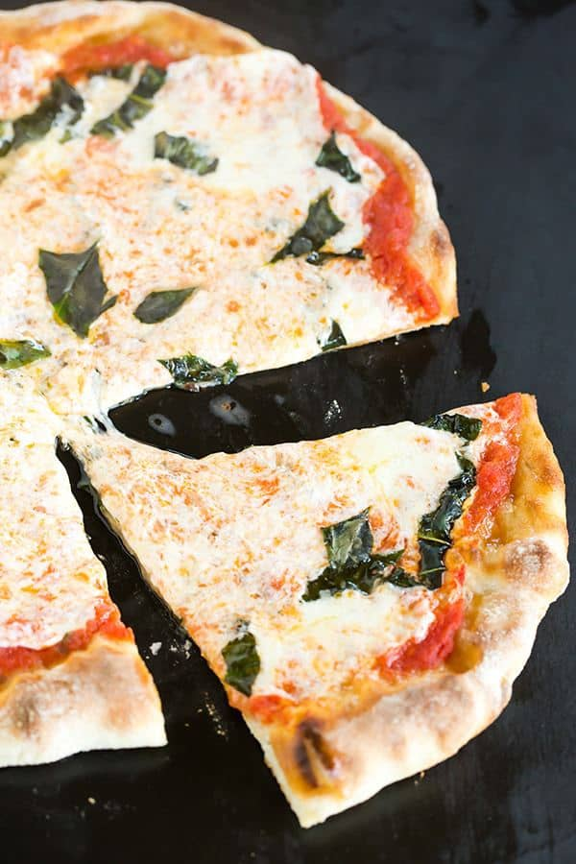
3
Pizza: A Global Icon
Tracing the origins and evolution of Italy's most famous export.
Discover the humble beginnings of pizza in Naples as a simple flatbread topped with tomatoes, cheese, and herbs.
Explore the different regional styles of pizza, including Roman-style thin crust and Sicilian-style thick crust.
Learn about the spread of pizza worldwide and its adaptation to local tastes and ingredients, becoming a global phenomenon.
Appreciate the techniques and ingredients used in traditional pizza making, including the importance of high-quality dough and toppings.
Photo by Google

Slide 6
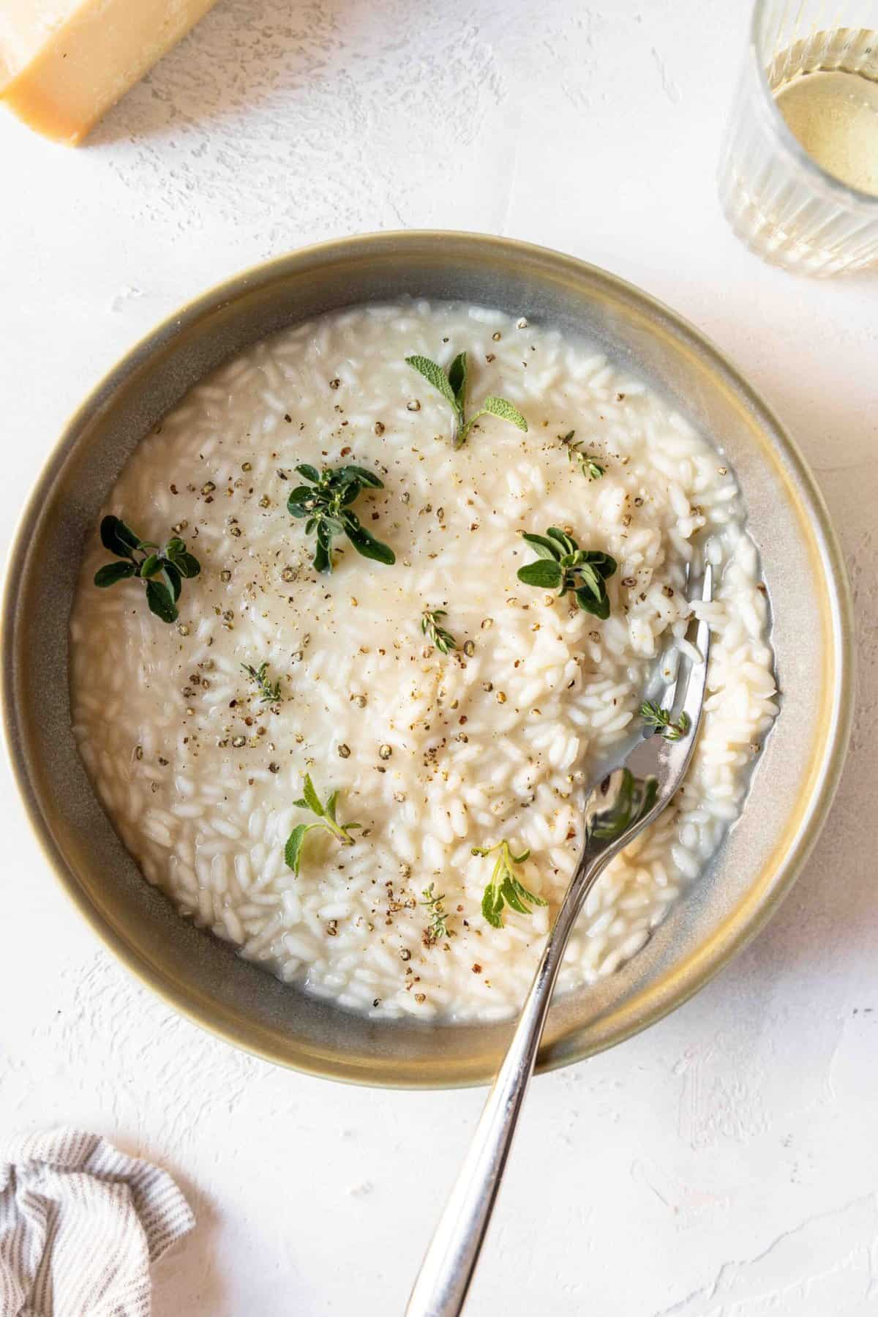
4
Risotto: Creamy Rice Perfection
Unveiling the secrets of making authentic Italian risotto.
Understand the importance of using the correct type of rice, like Arborio or Carnaroli, for authentic risotto texture and flavor.
Explore the significance of using a flavorful broth, often homemade, to create the creamy consistency and rich taste of risotto.
Master the art of slow stirring, which releases the starch from the rice, creating the signature creamy texture of perfect risotto.
Discover different regional variations of risotto, like saffron risotto in Milan and seafood risotto on the coast.
Photo by Google

Slide 7
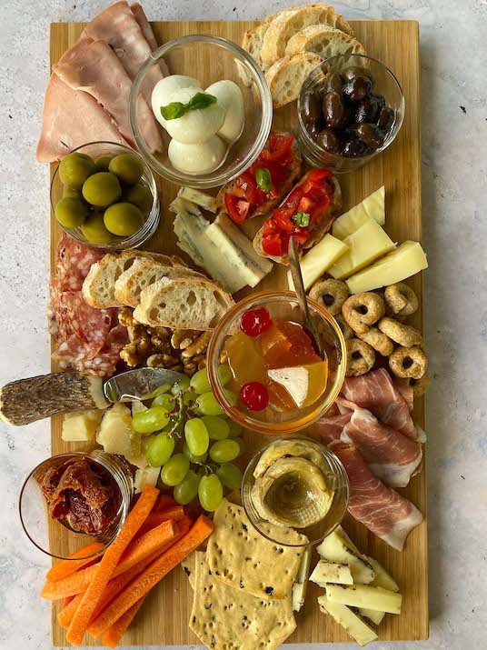
5
Regional Cheeses: A Dairy Delight
Exploring Italy's diverse landscape of cheeses, from creamy to sharp.
Learn about the origins of Parmigiano-Reggiano and its aging process and production, as well as its cultural significance to Italian cuisine.
Discover the different varieties of mozzarella, including fresh buffalo mozzarella and fior di latte, and their uses in Italian dishes.
Explore the range of Pecorino cheeses, made from sheep's milk, and their unique flavors, from salty to tangy, across different regions.
Taste the pungent flavor of Gorgonzola and other blue cheeses of Italy, understanding their fermentation and impact on Italian culinary tradition.
Photo by Google

Slide 8
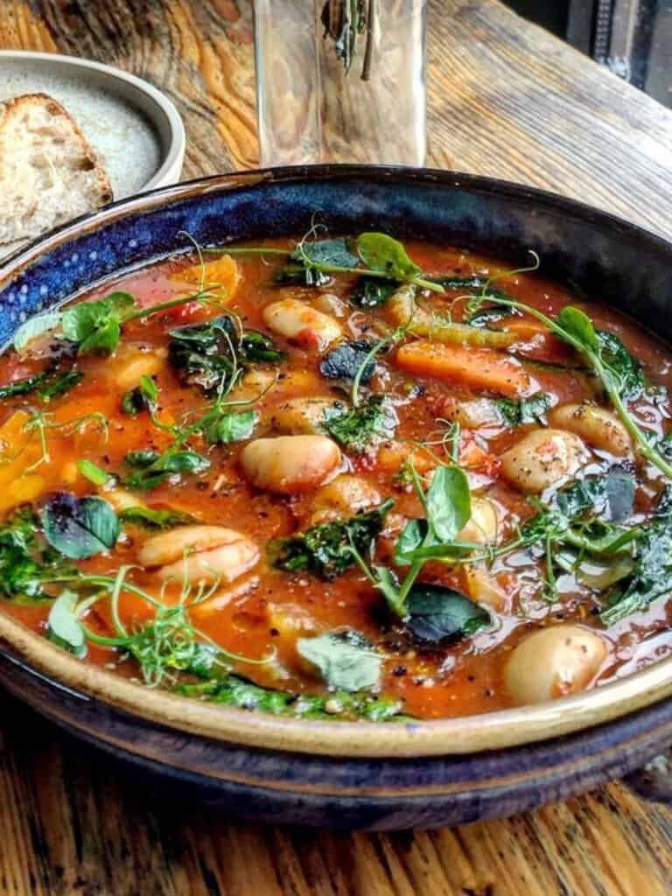
6
Tuscan Cuisine: Simple Elegance
Embracing the rustic flavors of Tuscany with fresh, local ingredients.
The significance of olive oil in Tuscan dishes, enhancing flavors and emphasizing the region's agricultural traditions.
Ribollita showcases Tuscan cuisine with seasonal vegetables and bread, highlighting the region's resourceful and flavorful cooking.
Florentine Steak, features high-quality beef cooked simply, symbolizing Tuscan simplicity and dedication to local and natural ingredients.
Cantucci, paired with Vin Santo, showcase Tuscan culinary traditions, offering a delightful end to a meal with simple ingredients.
Photo by Google

Slide 9

7
Sicilian Flavors: A Cultural Melting Pot
Exploring the vibrant and diverse culinary traditions of Sicily.
Arancini exemplifies Sicilian street food culture, blending rice, fillings, and frying techniques to celebrate the region's culinary creativity.
Seafood abundance on Sicily reflects the island's connection to the sea, offering diverse catches incorporated into flavorful traditional recipes.
Cannoli showcases Sicily's rich pastry traditions, combining creamy ricotta and crispy shells for a delightful and authentic taste of the island.
Caponata illustrates Sicily's culinary diversity, blending eggplant, tomatoes, and capers for a sweet-sour flavor profile and a unique culinary tradition.
Photo by Google

Slide 10
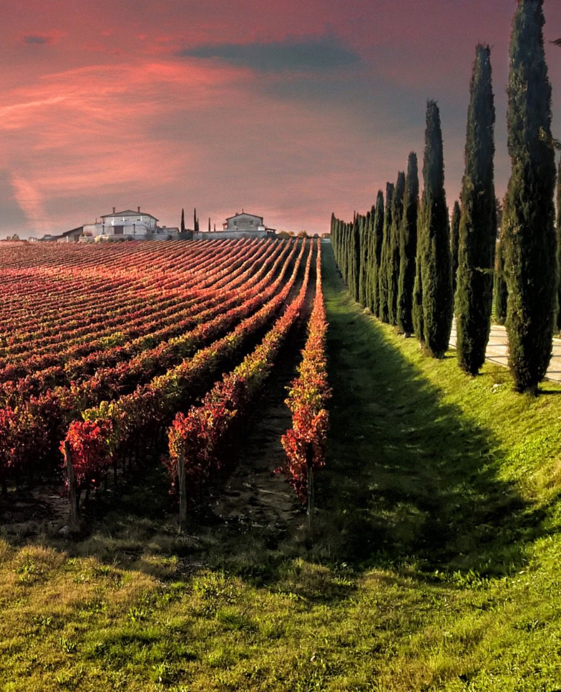
8
Italian Wine: A Perfect Pairing
Discovering the world of Italian wines and their regional expressions.
Explore Chianti's winemaking heritage, highlighting Sangiovese grapes and Tuscan traditions, showcasing the region's dedication to quality and flavor.
Discover Barolo's prestigious status, crafted from Nebbiolo grapes in Piedmont, representing the region's commitment to excellence and unique wines.
Prosecco wines, originating from Veneto, offer a refreshing sparkle, embodying Italian celebration and joy, crafted with Glera grapes.
Exploring regional wine varietals showcases Italy's diverse terroir, each bottle telling a story of tradition, craftsmanship, and distinct regional identity.
Photo by Google

Slide 11

9
Dolci: Sweet Endings
Indulging in Italy's delectable desserts and pastries.
Tiramisu showcases Italian dessert mastery, blending espresso-soaked ladyfingers, mascarpone, and cocoa, creating a timeless, indulgent treat.
Gelato tradition highlights Italy's passion for flavors and textures, offering a creamy, artisanal alternative to ice cream for delighting generations.
Panna Cotta exemplifies Italian dessert elegance, with creamy simplicity, vanilla essence, and a delicate wobble, representing dessert perfection.
Biscotti tradition highlights Italian baking excellence, offering crunchy almond cookies, double-baked for biscotti, capturing the essence of Italian flavors.
Photo by Google

Slide 12
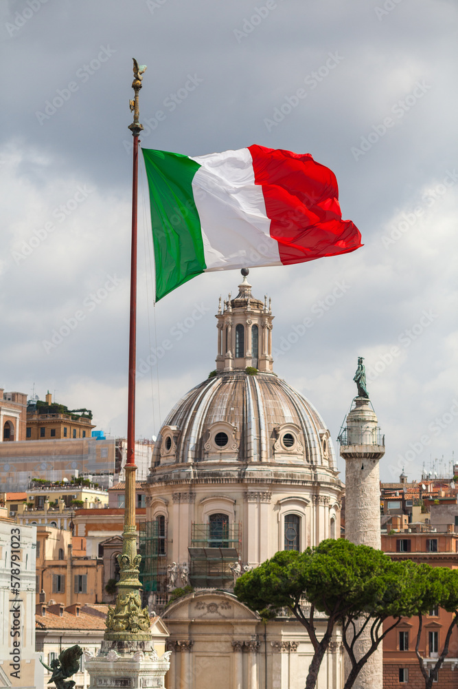
10
Thank You
Grazie!
Thank you for joining us on this culinary journey through Italy! We hope you enjoyed the exploration of its history and regional specialties.
May your future meals be filled with the delicious flavors and warm hospitality that define Italian cuisine. Buon Appetito!
We hope this presentation has inspired you to explore the rich and diverse world of Italian food further. Arrivederci and until next time.
Thank you again for your time and attention. We hope you have a newfound appreciation for Italian culinary heritage. Ciao!
Photo by Google

