Slide 1
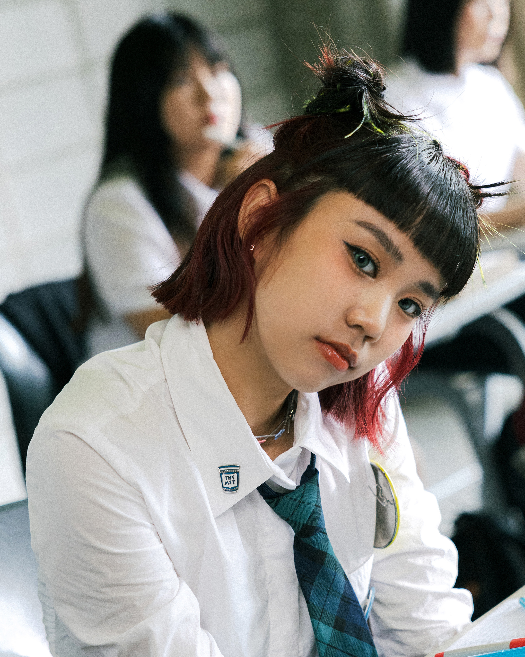
K-Pop Dreams: Launching a Next-Gen Girl Group in Taiwan A 3-Year Plan for Self-Media Domination, IP Merchandising, E-Commerce Success, and DIY Cosmetics, All Fueled by Trendsetting Music.
Photo by Google

Slide 2
01
Igniting the Stage: Our Vision
Table of Contents
02
Self-Media Blitz: Viral Domination
03
IP Merch Mania: Beyond the Music
04
E-Commerce Empire: Direct-to-Fan Power
05
DIY Cosmetics Craze: Beauty Reimagined
06
Funding Breakdown: NT$5,000,000
07
Year 1: Launch & Growth
08
Year 2: Expansion & Engagement
09
Year 3: Monetization & Sustainability
10
Thank You

Slide 3
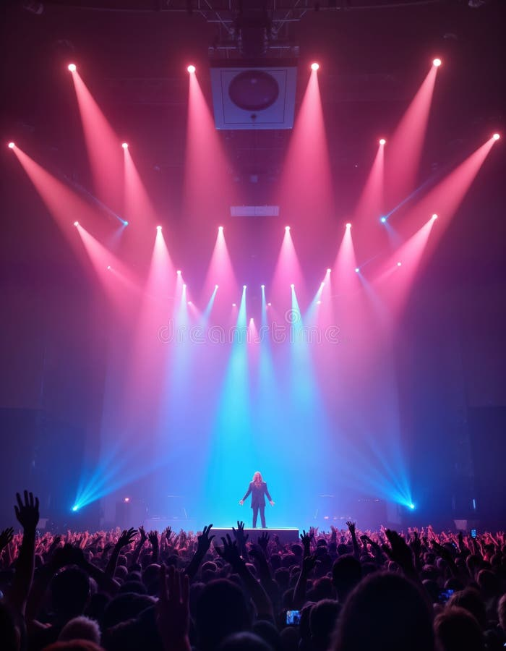
1
Igniting the Stage: Our Vision
Introducing a fresh, vibrant 5-member girl group poised to redefine Taiwanese pop culture within three years.
We will carefully select five talented and versatile young women with exceptional singing, dancing, and performance abilities. Original music production blends K-Pop energy with unique Taiwanese influences, setting new trends in the Mandopop scene. A cutting-edge aesthetic, with vibrant visuals, daring fashion, and captivating music videos that resonate with Gen Z and beyond. A clear, actionable plan to recoup the initial investment of NT$5,000,000 within three years through diverse revenue streams.
Photo by Google

Slide 4
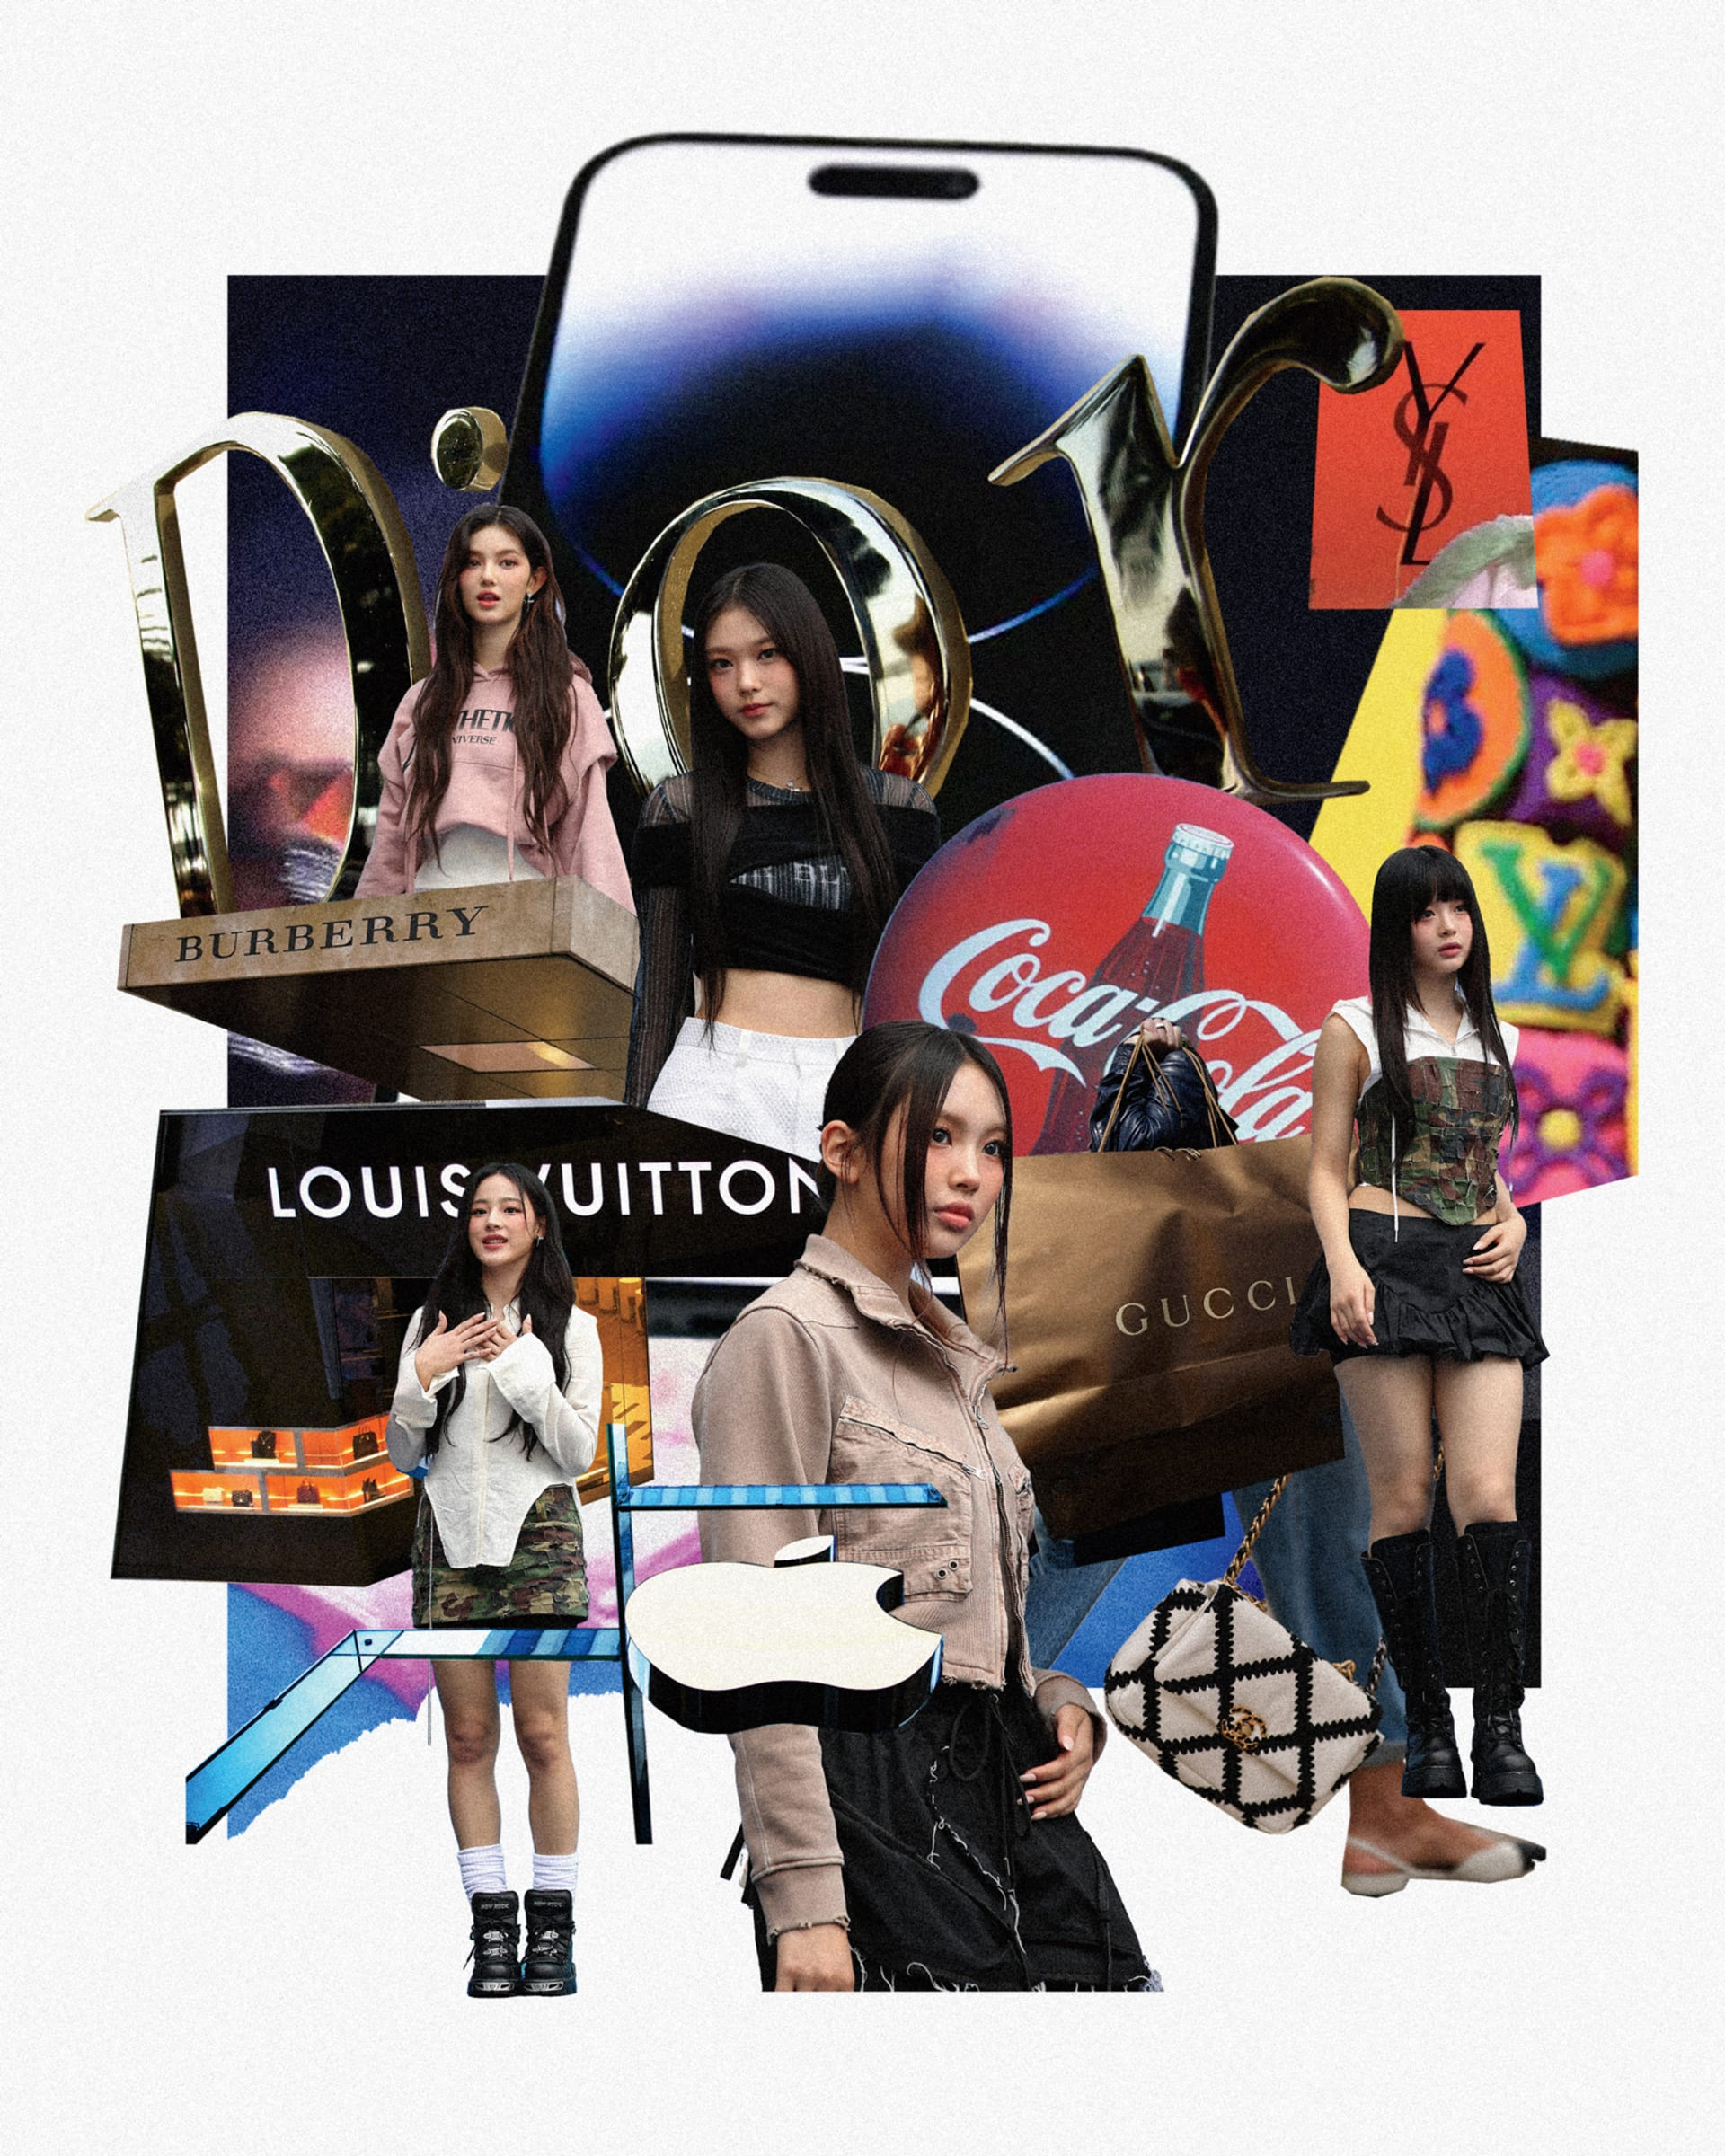
2
Self-Media Blitz: Viral Domination
Harnessing the power of social media to build a dedicated fanbase and drive engagement.
Short, engaging dance challenges, behind-the-scenes content, and interactive Q&As to maximize reach and virality on TikTok. High-quality photoshoots, stylish visuals, and intimate glimpses into the members' lives to foster a personal connection with fans on Instagram. Music video premieres, dance practice videos, vlogs, and variety show content to cultivate a loyal subscriber base on YouTube. Collaborate with influencers and key opinion leaders (KOLs) to broaden reach and enhance credibility within target demographics.
Photo by Google

Slide 5
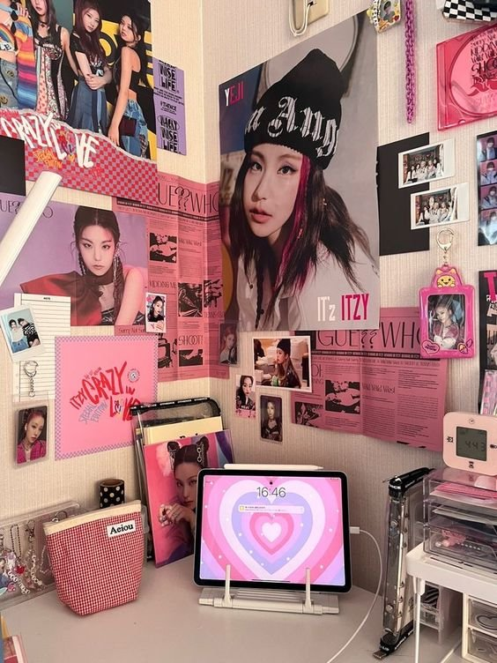
3
IP Merch Mania: Beyond the Music
Creating desirable merchandise that embodies the group's brand and resonates with fans.
Exclusive apparel, accessories, and collectibles released in limited quantities to create hype and drive sales. Involve fans in the design process through contests and polls to ensure merchandise reflects their preferences and strengthens their bond with the group. Partner with established brands on co-branded merchandise that expands the group's reach and introduces them to new audiences. Explore NFTs of digital art, exclusive content, and virtual experiences to engage fans in a new and exciting way.
Photo by Google

Slide 6
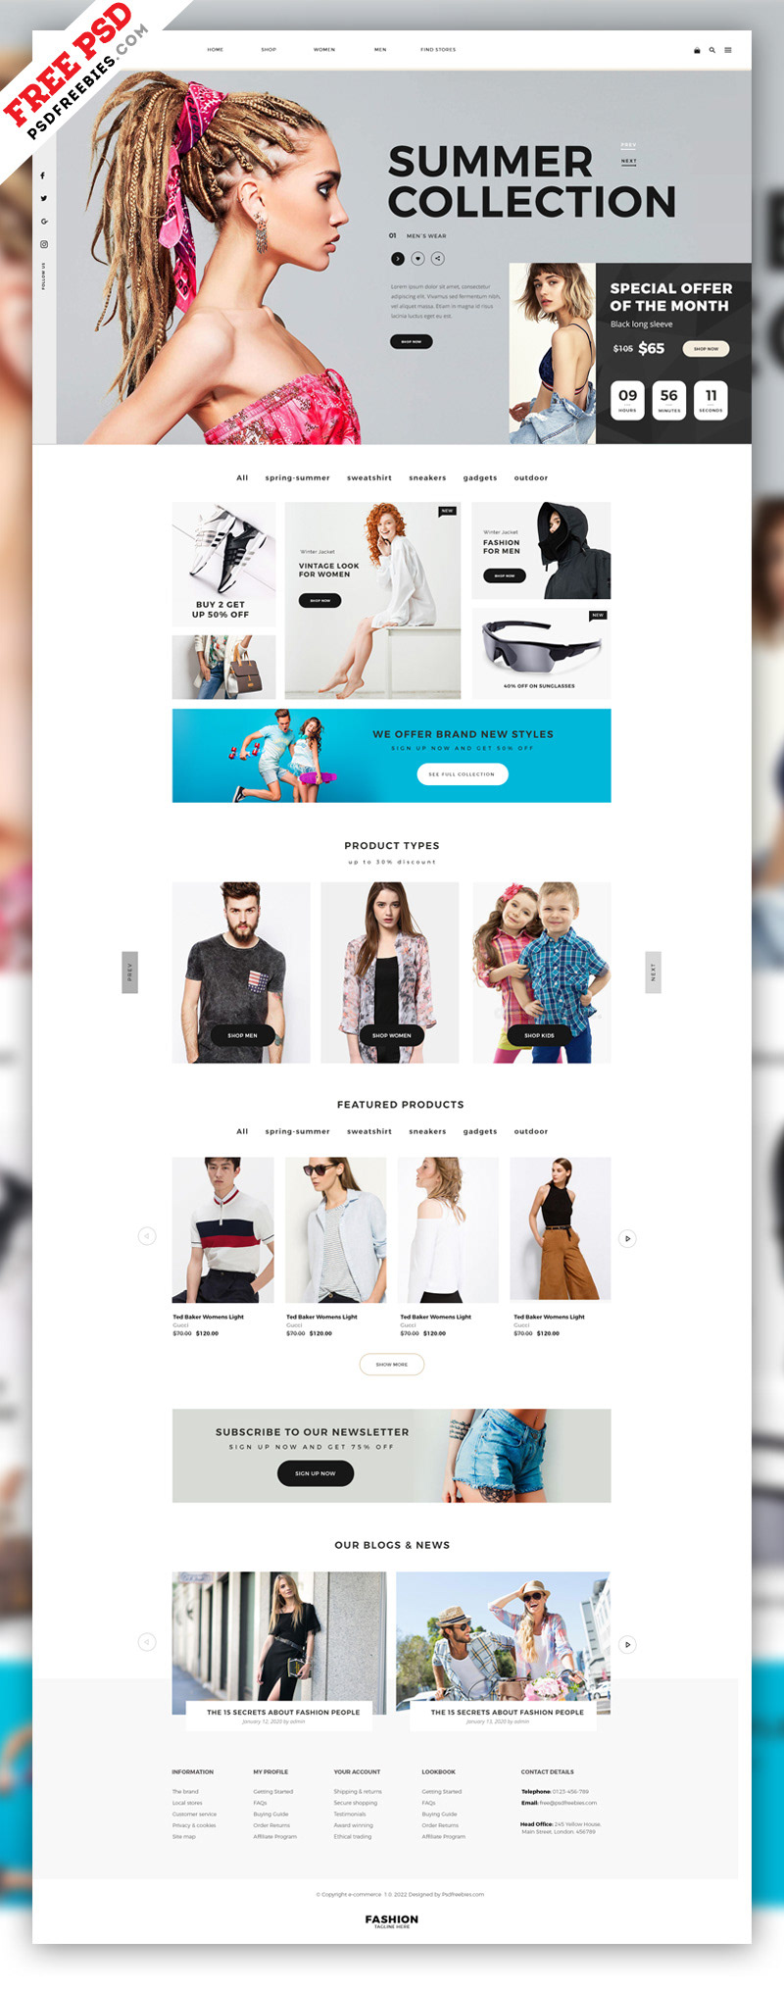
4
E-Commerce Empire: Direct-to-Fan Power
Building a robust online store to sell merchandise, music, and exclusive content directly to fans.
A seamless and intuitive online store experience optimized for mobile devices to facilitate easy browsing and purchasing. Reward repeat customers with exclusive discounts, early access to merchandise, and other perks to foster brand loyalty. Offer worldwide shipping to cater to international fans and expand the group's global reach. Track key metrics such as website traffic, conversion rates, and customer behavior to continuously improve the e-commerce platform and maximize sales.
Photo by Google

Slide 7
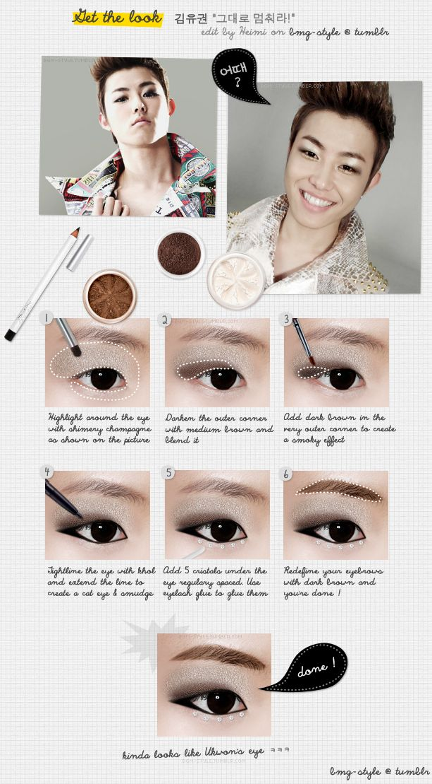
5
DIY Cosmetics Craze: Beauty Reimagined
Leveraging the group's influence to launch a line of self-made cosmetics marketed through authentic self-media campaigns.
Members showcase their favorite makeup looks and demonstrate how to use the products in engaging tutorials on social media. Highlight the natural and ethically sourced ingredients used in the cosmetics line to appeal to conscious consumers. Create a platform for fans to share their makeup looks, ask questions, and connect with each other, fostering a sense of community around the brand. Partner with other beauty influencers or brands on limited edition collections to create buzz and drive sales.
Photo by Google

Slide 8
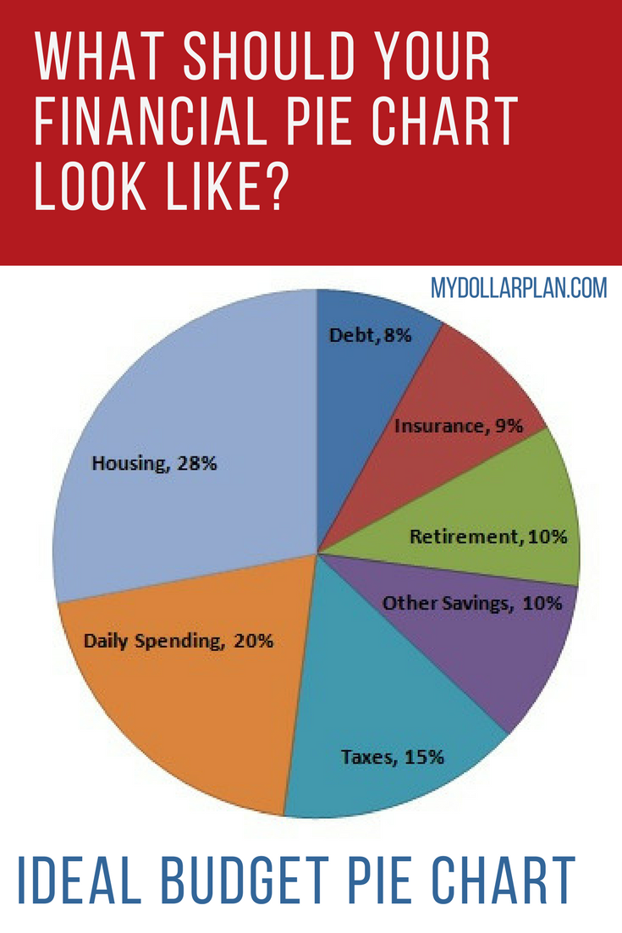
6
Funding Breakdown: NT$5,000,000
Detailed allocation of initial capital to ensure strategic investment and maximize ROI.
NT$1,500,000 allocated for composing, recording, mixing, and mastering high-quality original music tracks. NT$1,500,000 for social media advertising, influencer collaborations, public relations, and content creation. NT$1,000,000 dedicated to designing, producing, and sourcing high-quality merchandise and packaging. NT$1,000,000 allocated to e-commerce platform development, shipping, warehousing, and administrative costs.
Photo by Google

Slide 9
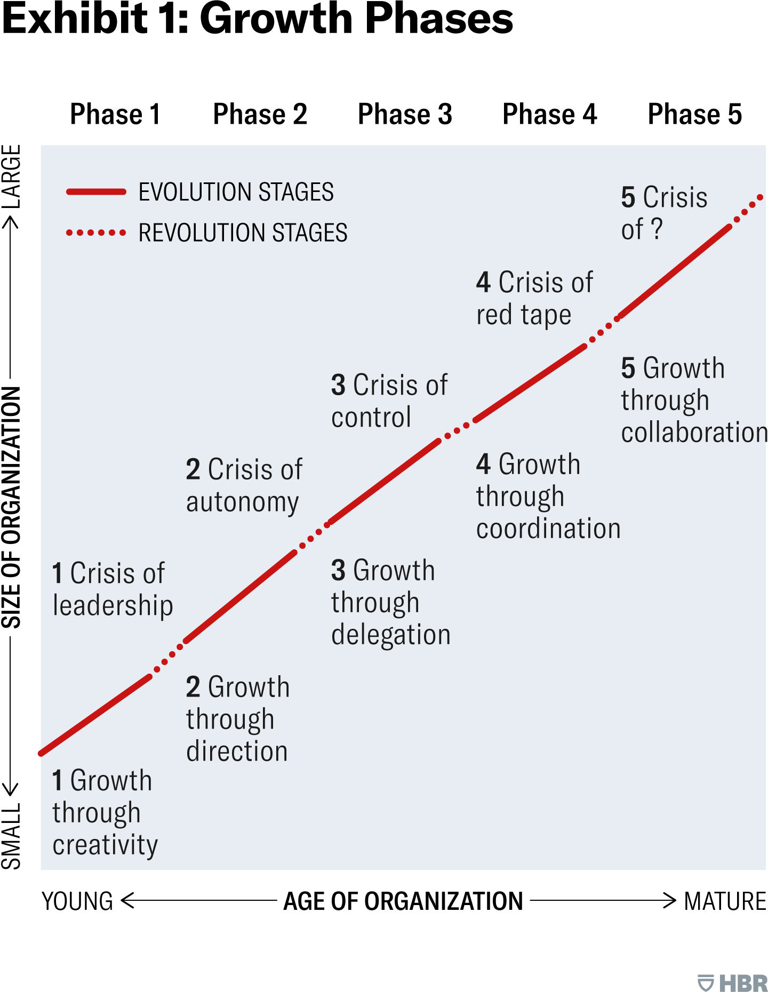
7
Year 1: Launch & Growth
Focus on building brand awareness, acquiring initial fans, and establishing a strong online presence.
Launch with a catchy and visually stunning debut single supported by a high-impact music video. Aggressive social media marketing campaigns to drive traffic to online platforms and build a fan base. Release a limited edition collection of core merchandise items to gauge demand and generate early revenue. Secure performances at local events and festivals to connect with fans in person and build momentum.
Photo by Google

Slide 10
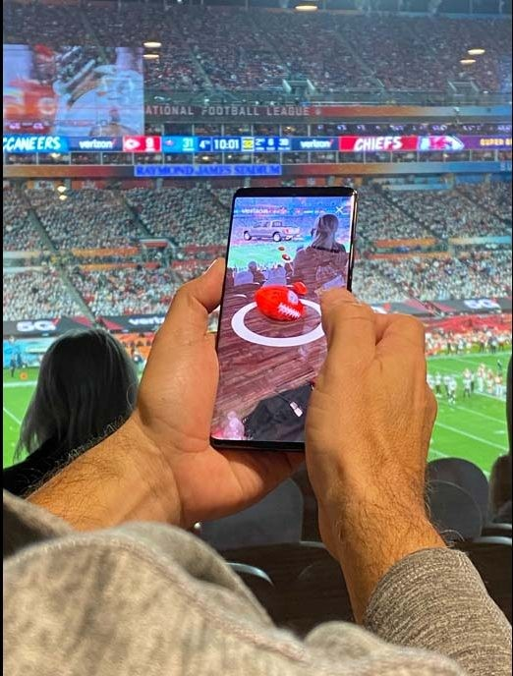
8
Year 2: Expansion & Engagement
Expanding reach, deepening fan engagement, and diversifying revenue streams.
Capitalize on initial momentum with a follow-up single that showcases the group's versatility and reinforces their brand. Introduce the self-made cosmetics line and leverage the group's influence to drive sales. Organize exclusive fan events and meet-and-greets to foster deeper connections and build loyalty. Expand reach beyond Taiwan with regional performances and collaborations in neighboring markets.
Photo by Google

Slide 11

9
Year 3: Monetization & Sustainability
Maximizing revenue, solidifying the brand, and achieving long-term sustainability.
Culminate the first three years with a full-length album that showcases the group's artistic growth and solidifies their position in the Mandopop scene. Pursue collaborations with international artists to broaden reach and appeal to a global audience. Secure long-term partnerships with brands that align with the group's values and target audience. Explore new revenue streams and innovative marketing strategies to stay ahead of the curve and maintain long-term sustainability.
Photo by Google

Slide 12

10
Thank You
We appreciate your time and consideration.
Thank you for considering our proposal. We are confident that this girl group will redefine Taiwanese pop culture. We envision a future where our group becomes a leading force in the global music scene. Your investment will empower us to create unforgettable music and experiences for fans worldwide. We are excited to discuss this opportunity further and answer any questions you may have.
Photo by Google

