Slide 1
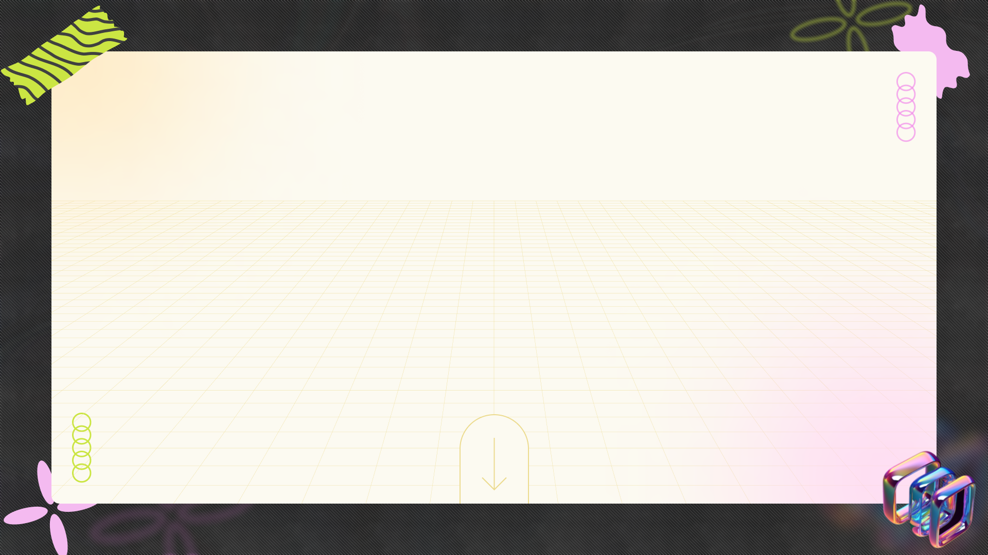
Kaustav Das: A Journey in Full-Stack Web Development
+
+
+
Showcasing Skills, Projects, and Experiences in Building Modern Web Applications
+
+
+

Slide 2
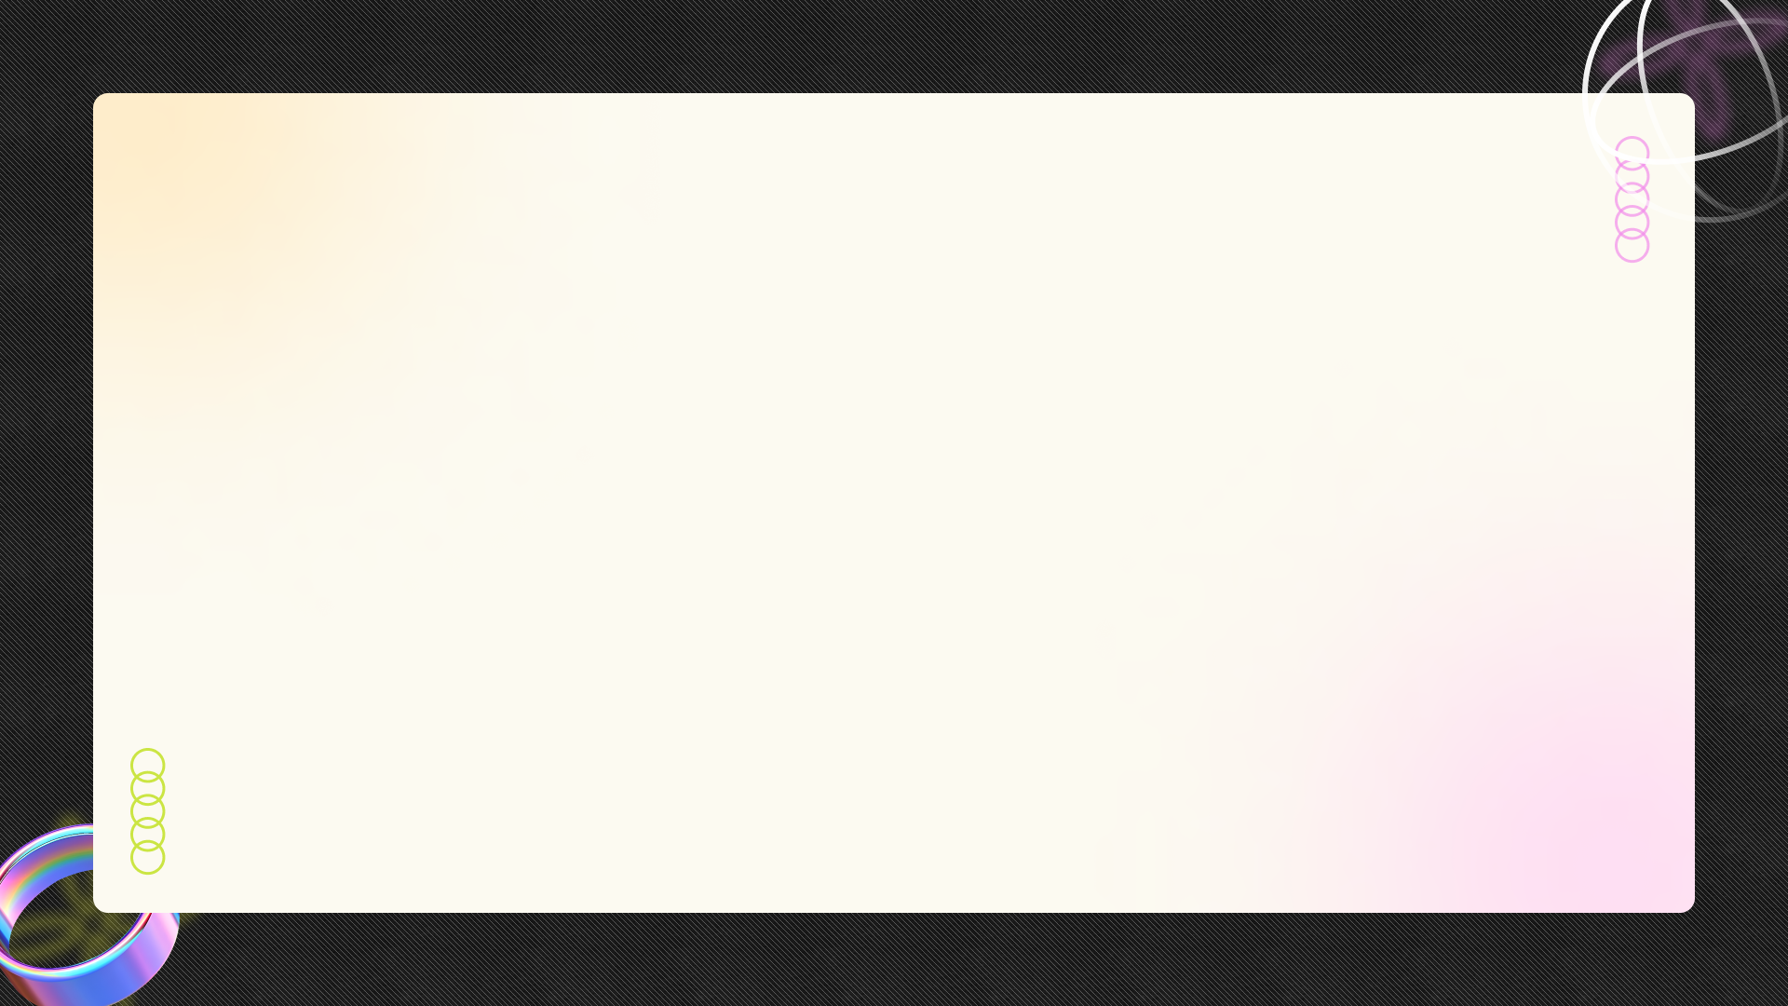


Table of Contents
01
Igniting Innovation
02
MERN Stack Mastery
03
Design and User Experience
04
Backend Brilliance
05
Real-Time Magic
06
Project Showcase: Chat App
07
Project Showcase: Online Code Editor
08
Instibuzz Internship
09
Toolbox of Tech

Slide 3
Table of Contents
10
Thank You

Slide 4
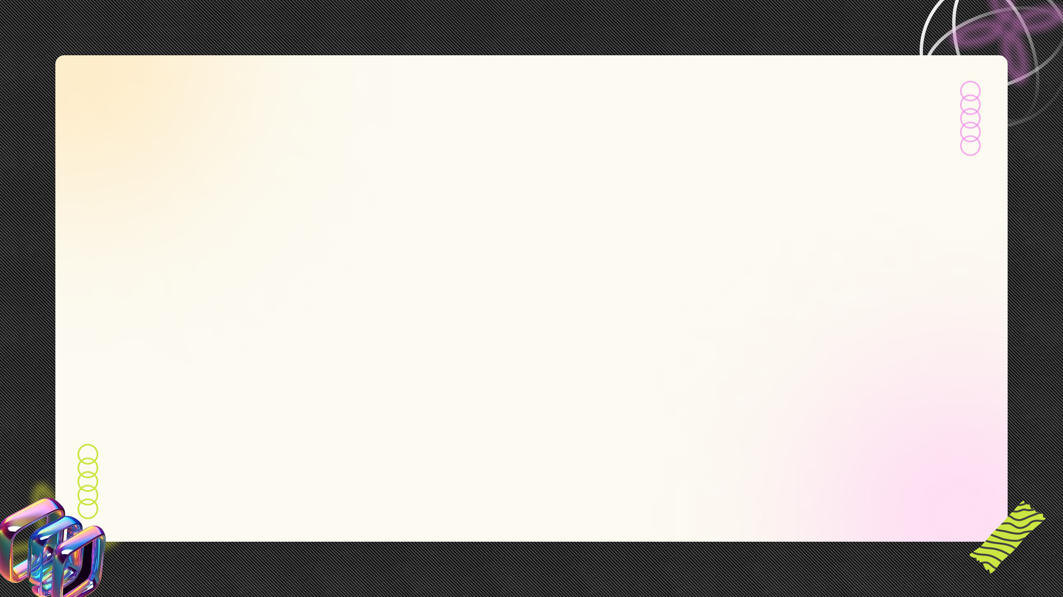
Igniting Innovation
A Computer Science & Engineering student at Jalpaiguri Government Engineering College, driven by a passion for creating innovative web solutions.
Maintaining a GPA of 9.2/10, demonstrating a strong commitment to learning and mastering key concepts in computer science.
Proficient in MERN stack, TypeScript, SQL, and experienced in developing responsive and user-friendly web applications.
Gaining practical experience through internships, contributing to projects, and collaborating with cross-functional teams.

Slide 5
Igniting Innovation
Aspiring to create impactful solutions that enhance user experiences and solve real-world problems through technology.

Slide 6
MERN Stack Mastery
Utilizing MongoDB for efficient and scalable NoSQL database management in various web applications.
Developing RESTful APIs and handling backend logic using Express.js to ensure seamless data flow.
Creating dynamic and responsive user interfaces with React.js, focusing on enhancing user engagement.
Leveraging Node.js for server-side scripting, enabling the creation of real-time and scalable web applications.

Slide 7
MERN Stack Mastery
Ensuring seamless integration of the MERN stack components for creating high-performance web applications.

Slide 8
Design and User Experience
Designing web applications that adapt seamlessly to different screen sizes, ensuring optimal user experience on all devices.
Using Tailwind CSS to create visually appealing and consistent user interfaces with minimal custom styling.
Focusing on intuitive design principles to ensure that web applications are easy to navigate and use.
Implementing dynamic toggling features to enhance user interaction and optimize the presentation of information.

Slide 9
Design and User Experience
Ensuring that every design element contributes to a seamless and enjoyable user journey, improving overall satisfaction.

Slide 10
Backend Brilliance
Building RESTful APIs to facilitate communication between the frontend and backend, ensuring data integrity and security.
Handling database operations with SQL and PostgreSQL to efficiently manage and retrieve data for web applications.
Implementing secure authentication mechanisms to protect user data and ensure authorized access to web applications.
Using TypeScript to enhance code reliability and maintainability in backend development.

Slide 11
Backend Brilliance
Designing and optimizing database schemas to handle complex business data and relationships effectively.

Slide 12
Real-Time Magic
Integrating Socket.io for real-time communication features, enabling seamless one-to-one messaging in chat applications.
Implementing backend logic to ensure real-time message delivery, enhancing the responsiveness of chat applications.
Enabling scalable WebSocket connections to support concurrent live chats efficiently, ensuring smooth performance.

Slide 13
Real-Time Magic
Elevating user engagement through real-time features, creating a dynamic and interactive web application experience.

Slide 14
Project Showcase: Chat App
Built a real-time chat app using MERN stack and Socket.io for seamless one-to-one communication.
Designed a responsive UI with dynamic toggling for optimized user experience on all screen sizes.
Integrated backend logic for unique user identification and real-time message delivery.
Enabled scalable WebSocket connections to support concurrent live chats efficiently.

Slide 15
Project Showcase: Chat App
Utilizing React JS, Tailwind CSS, Express JS, Socket.io, and MongoDB to create a robust and engaging chat application.

Slide 16
Project Showcase: Online Code Editor
Developed a fully responsive online code editor for HTML, CSS, and JavaScript using React.js and Tailwind CSS.
Enhanced coding experience by integrating Code Mirror, providing features like syntax highlighting and auto-completion.
Offering syntax highlighting to improve code readability and reduce errors.
Providing auto-completion features to accelerate the coding process and improve efficiency.

Slide 17
Project Showcase: Online Code Editor
Built with React JS and Tailwind CSS, providing a seamless and efficient coding environment.

Slide 18
Instibuzz Internship
Developing a B2B web application using React JS, Express JS and PostgreSQL.
Implementing TypeScript for type safety and code maintainability across both frontend and backend.
Designed and optimized database schemas in PostgreSQL to handle complex business data and relationships.
Ensuring seamless integration across the entire tech stack, enhancing overall application performance.

Slide 19
Instibuzz Internship
Gained practical experience in building and deploying a real-world web application in a professional environment.

Slide 20
Toolbox of Tech
Proficient in MongoDB, Express.js, React.js, and Node.js, enabling full-stack web development capabilities.
Skilled in TypeScript, enhancing code reliability and maintainability for both frontend and backend.
Knowledgeable in SQL and PostgreSQL for relational database management, ensuring efficient data storage.
Familiar with Vite, Hot Toast, and CodeMirror for an optimized developer experience.

Slide 21
Toolbox of Tech
Adept at collaborating with cross-functional teams and adhering to Agile methodologies.

Slide 22
Thank You
I extend my sincere gratitude for your time and consideration of my work.
I am excited about the opportunity to contribute my skills and passion to future projects.
I am committed to continuous learning and staying updated with the latest technologies.
I am eager to collaborate with innovative teams to create meaningful web solutions.

Slide 23
Thank You
Feel free to reach out to me via email or connect with me on LinkedIn. Thank you again!

