Slide 1

Khaki Pant Marketing Analysis
Comparing Alibaba, Myntra & Amazon
Photo by Pexels

Slide 2
01
Marketing Landscape Overview
Table of Contents
02
Alibaba Marketing Strategy
03
Myntra Fashion Marketing
04
Amazon Marketing Dominance
05
Marketing Comparison & Insights

Slide 3

1
Marketing Landscape Overview
Understanding the e-commerce giants
Alibaba, Myntra, and Amazon dominate the online retail space with distinct marketing strategies and consumer approaches.
The casual wear segment presents significant marketing potential across all three platforms with varying consumer demographics.
Each platform employs unique marketing tactics from B2B bulk purchasing to fashion-forward retail experiences.
Understanding how customers discover, evaluate, and purchase khaki pants reveals key marketing insights.

Slide 4
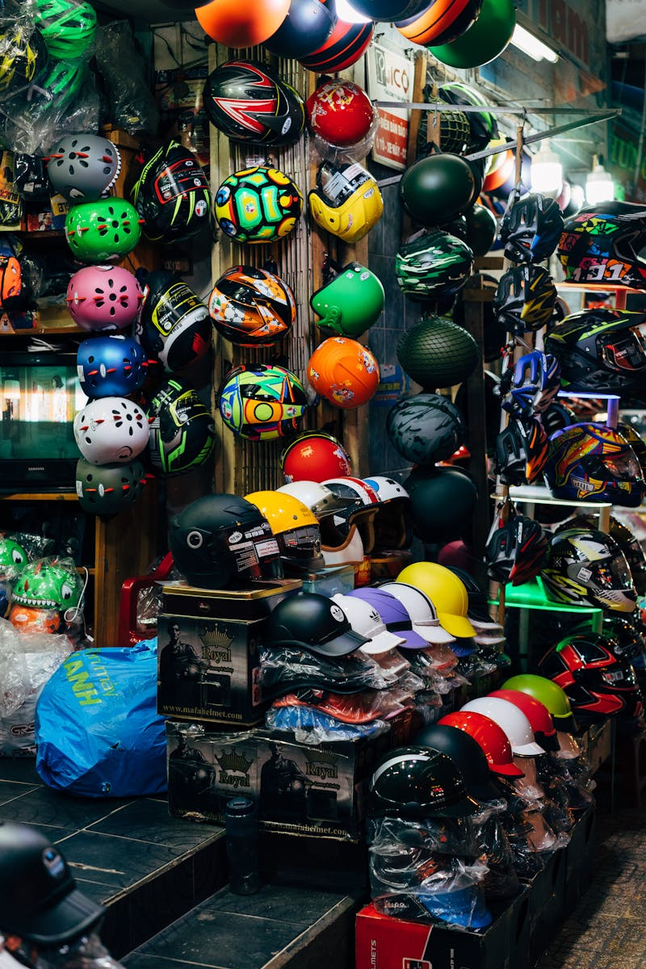
2
Alibaba Marketing Strategy
B2B and B2C powerhouse approach
Alibaba excels in bulk ordering opportunities for khaki pants, appealing to business buyers and resellers with competitive pricing.
Direct manufacturer connections enable Alibaba to offer diverse khaki pant options with customizable features for bulk buyers.
Focus on wholesale relationships and bulk order processing makes Alibaba ideal for institutional and business khaki pant requirements.
Cost-effective khaki pant solutions through direct supply chain management and volume-based pricing strategies.

Slide 5

3
Myntra Fashion Marketing
Fashion-forward retail experience
Myntra positions khaki pants as fashion statements with trendy designs and style-focused marketing campaigns.
Strategic collaborations with fashion brands elevate khaki pant offerings with premium positioning and exclusive collections.
High-quality imagery and styling content showcase khaki pants in various fashion contexts, appealing to style-conscious consumers.
Khaki pants are marketed as versatile fashion pieces that adapt to current trends and seasonal fashion movements.

Slide 6

4
Amazon Marketing Dominance
Customer-centric retail ecosystem
Amazon emphasizes ease of purchase with fast delivery and hassle-free returns for khaki pant shoppers.
Customer reviews and ratings system creates trust and social proof for khaki pant purchasing decisions.
Data-driven marketing tailors khaki pant recommendations based on browsing history and purchase patterns.
Exclusive khaki pant deals and Prime membership benefits drive customer loyalty and repeat purchases.

Slide 7

5
Marketing Comparison & Insights
Strategic recommendations for khaki pant marketing
Alibaba suits bulk buyers, Myntra attracts fashion enthusiasts, and Amazon serves convenience-focused shoppers for khaki pants.
Multi-platform approach leverages Alibaba's sourcing, Myntra's fashion expertise, and Amazon's customer reach for khaki pants.
Each platform offers unique value propositions that can be strategically combined for comprehensive khaki pant marketing coverage.
Cross-platform marketing strategies and integrated customer experiences present growth potential for khaki pant sales across all three platforms.

