Slide 1
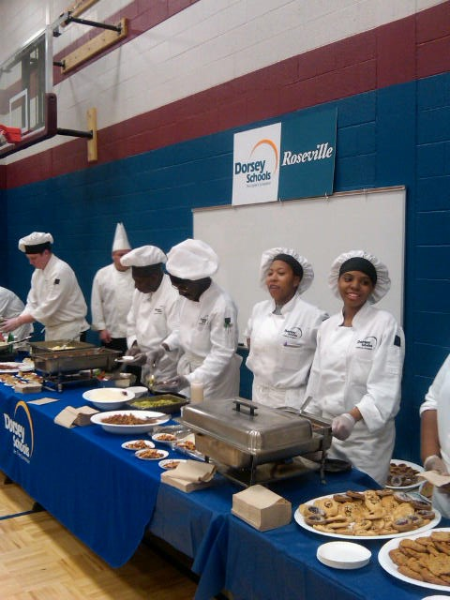
Kitchen Creations: Cooking Up Confidence
Unleashing Your Culinary Potential with Knowledge and AI-Powered Support
Photo by Google

Slide 2
01
Ignite Your Culinary Journey
Table of Contents
02
Mastering the Basics: Foundations First
03
Exploring Global Flavors
04
Budget-Friendly Feasts
05
Healthy Eating, Happy Living
06
Stress-Free Meal Planning
07
Baking Bliss: Sweet Endings
08
Troubleshooting in the Kitchen
09
Shadowing AI: Your Culinary Ally
10
Thank You

Slide 3

1
Ignite Your Culinary Journey
Welcome to a world where cooking becomes an empowering adventure!
Step into the kitchen not with trepidation, but with the self-assurance to create delicious and nourishing meals. Unlock your potential.
Cooking is more than just following recipes; it's a vital life skill that empowers you to make healthier choices and impress everyone.
Gain a deeper understanding of ingredients, techniques, and flavor profiles, allowing you to adapt and innovate in the kitchen.
Discover how Shadowing AI can be your personal culinary assistant, providing guidance and support every step of the way.
Photo by Google

Slide 4
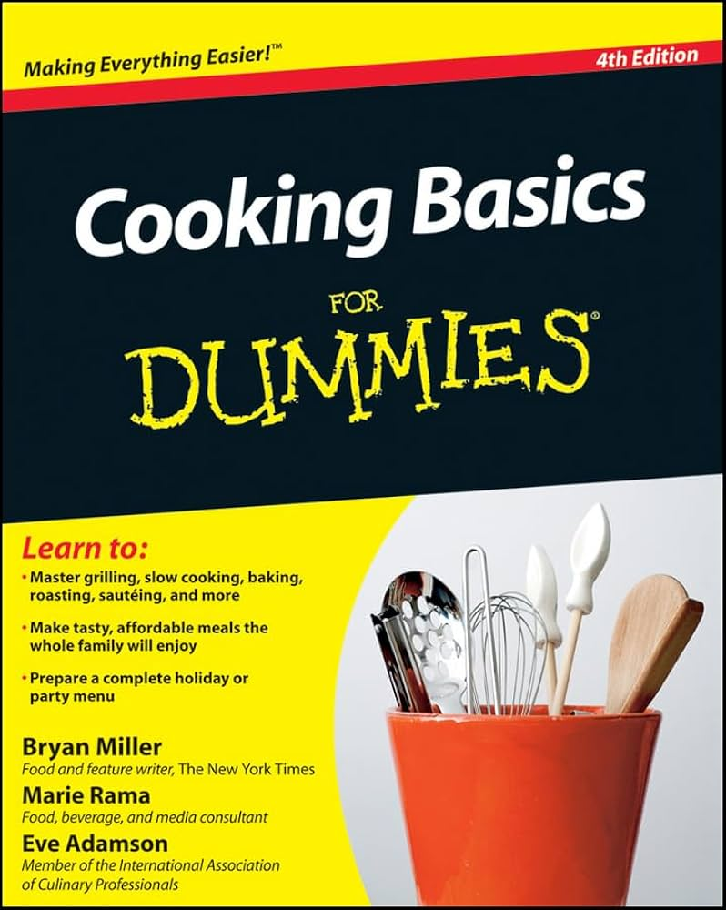
2
Mastering the Basics: Foundations First
Building a solid culinary base for delicious success.
Learn essential knife techniques, from dicing and mincing to slicing and julienning, for efficient and safe food preparation, like a professional.
Explore different cooking methods – sautéing, roasting, boiling, steaming – and understand when to use each one to achieve the best results.
Understand the importance of seasoning and learn how to layer flavors using herbs, spices, and other aromatics to create depth.
Prioritize safety in the kitchen with essential knowledge about preventing accidents, proper food handling, and hygiene practices.
Photo by Google

Slide 5
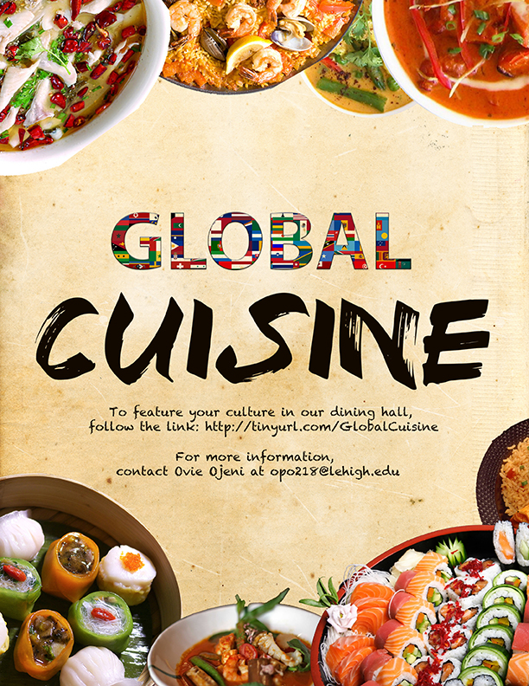
3
Exploring Global Flavors
Embark on a culinary tour around the world.
Discover the secrets of authentic pasta dishes, flavorful sauces, and classic Italian desserts that bring joy to the table and create lasting memories.
Explore the vibrant and diverse flavors of Asia, from stir-fries and curries to sushi and noodles, using authentic ingredients.
Spice up your life with delicious Mexican dishes, learning to make tacos, enchiladas, and guacamole with fresh, flavorful ingredients.
Experiment with fusion cuisine, blending culinary traditions from different cultures to create unique and exciting dishes that tantalize the taste buds.
Photo by Google

Slide 6
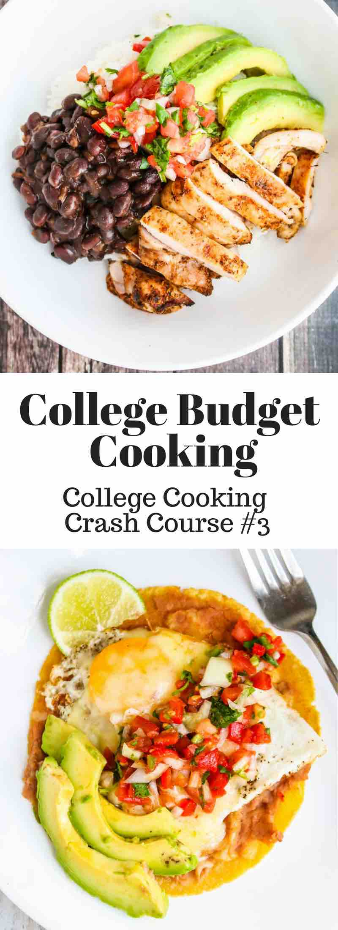
4
Budget-Friendly Feasts
Delicious meals don't have to break the bank.
Learn how to shop smart, choosing seasonal ingredients, utilizing leftovers, and avoiding food waste to save money and reduce your environmental impact.
Discover the convenience and simplicity of one-pot meals, creating delicious and satisfying dishes that require minimal cleanup and effort.
Save time and money by batch cooking meals in advance, portioning them out for quick and easy lunches and dinners throughout the week, planning meals.
Learn how to substitute ingredients creatively, adapting recipes to fit your budget and dietary needs without compromising flavor or quality of taste.
Photo by Google

Slide 7

5
Healthy Eating, Happy Living
Nourishing your body and mind with wholesome food.
Understand the importance of creating balanced plates with lean protein, whole grains, and plenty of fruits and vegetables for optimal health, promoting long living.
Practice mindful eating techniques, savoring each bite, paying attention to your body's hunger cues, and avoiding distractions to improve digestion.
Discover nutrient-rich foods that boost energy, support immunity, and promote overall well-being, enhancing quality of life and building strength.
Make simple and healthy swaps in your favorite recipes, replacing unhealthy fats, sugars, and processed ingredients with whole, nutritious alternatives.
Photo by Google

Slide 8
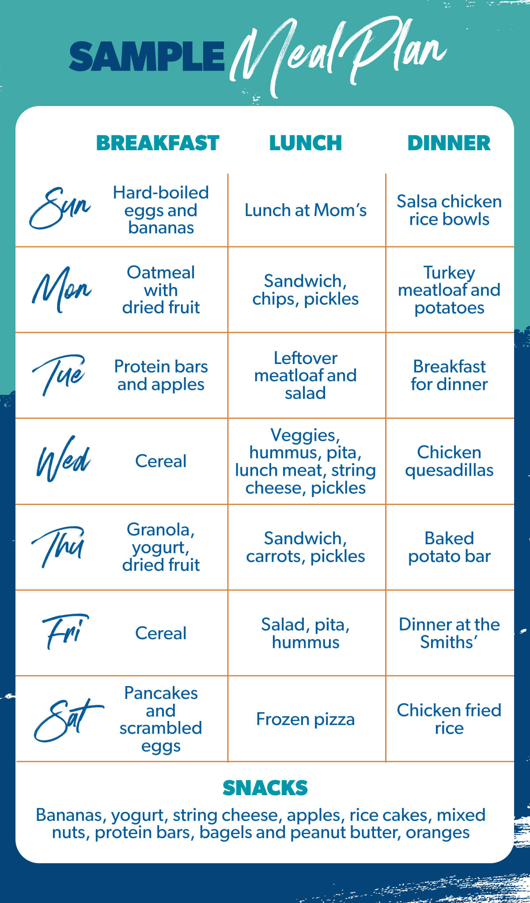
6
Stress-Free Meal Planning
Organize your meals for a smoother week.
Develop a meal planning template to guide your weekly grocery shopping and meal preparation, streamlining the process and reducing decision fatigue.
Introduce theme nights to add excitement and variety to your weekly meals, such as Taco Tuesday, Pasta Night, or Curry Night, spicing the food life.
Dedicate a day to prepping ingredients and assembling components of your meals, saving time and effort during the busy weekdays, increasing convenience.
Explore digital tools and apps that simplify meal planning, helping you create grocery lists, track your nutrition, and discover new recipes, enhancing convenience.
Photo by Google

Slide 9

7
Baking Bliss: Sweet Endings
Indulge your sweet tooth with homemade treats.
Master the basics of cake baking, from measuring ingredients accurately to understanding the science behind leavening agents, to make fluffy desserts.
Experiment with different cookie recipes, from classic chocolate chip to unique flavor combinations, mastering the art of achieving the perfect texture.
Learn the fundamentals of bread making, from kneading dough to proofing and baking, creating homemade bread and rolls. Explore baking arts.
Discover dessert hacks and shortcuts, using simple ingredients and techniques to create impressive desserts without spending hours in the kitchen, baking.
Photo by Google

Slide 10
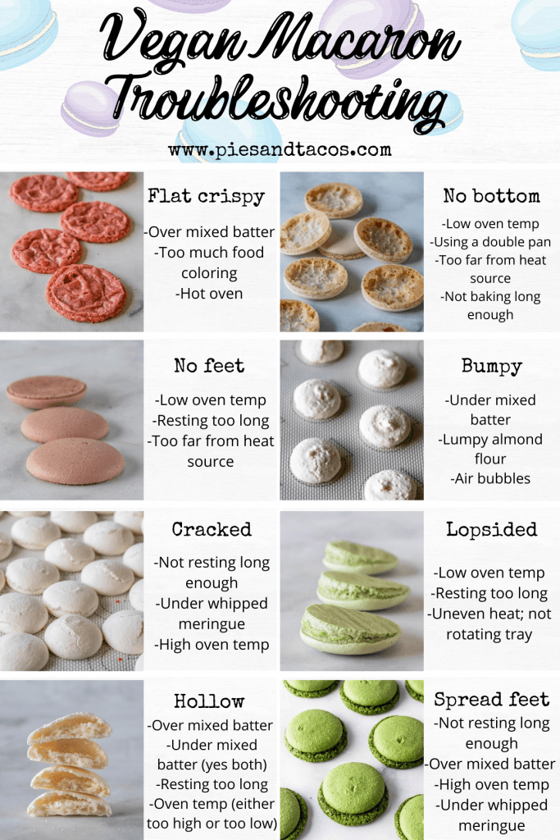
8
Troubleshooting in the Kitchen
Turning kitchen mishaps into learning opportunities.
Learn how to fix overly salty dishes by adding acidity, sweetness, or starches to balance the flavors and rescue your meal and manage salt proportion.
Discover techniques for salvaging burned food, such as removing the scorched parts, masking the flavor, or repurposing the dish into something new, improving it.
Explore different methods for thickening sauces and soups, using cornstarch, flour, or other thickening agents to achieve the desired consistency and tastes.
Understand how to identify and correct common flavor imbalances in dishes, adding acidity, sweetness, or heat to create a harmonious taste profile, rescue dishes.
Photo by Google

Slide 11

9
Shadowing AI: Your Culinary Ally
Elevating your cooking with AI-powered support.
Shadowing AI offers personalized guidance, career paths, and role discovery to support your career aspirations and culinary explorations.
Use Shadowing AI's resume scorecard and recruiter chat to refine your skills and showcase your culinary talents effectively, boosting your ability.
Prepare for culinary job interviews with Shadowing AI's practice tools, question bank, and interview analytics, ensuring success in your career endeavors.
Shadowing AI provides an affordable and accessible platform for continuous learning and professional development in the culinary arts, increase the skills.
Photo by Google

Slide 12

10
Thank You
Embark on your culinary adventure with confidence!
Thank you for joining this presentation, wishing you delicious culinary journey in the world of cooking and flavor exploration.
We encourage you to continue exploring culinary arts and develop your skills. Keep learning, keep experimenting, and most importantly, keep cooking.
Shadowing AI is here to support you every step of the way, offering personalized guidance and resources to help you reach your culinary goals.
Wishing you many delicious and successful kitchen creations. May your culinary adventure be filled with joy, discovery, and countless tasty memories.
Photo by Google

