Slide 1
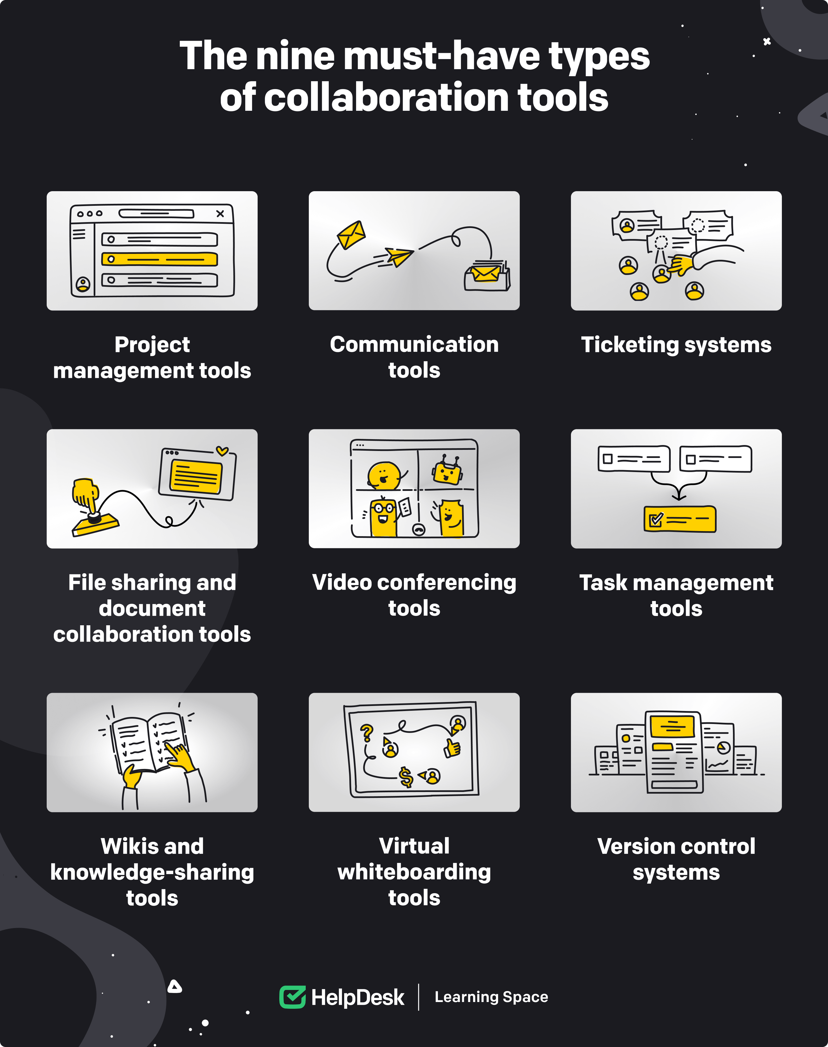
Knowmax & Globivion: Synergistic Knowledge Solutions
Unifying Knowledge Management for Enhanced Efficiency and Performance
Photo by Google

Slide 2
01
Bridging the Knowledge Gap
Table of Contents
02
Enhanced Knowledge Accessibility
03
Data-Driven Insights
04
Streamlined Content Management
05
G-Assist Enhancement
06
User-Friendly Script Access
07
Enhanced Collaboration & Communication
08
Empowering Agents: A Holistic Approach
09
Measurable Business Outcomes
10
Thank You

Slide 3
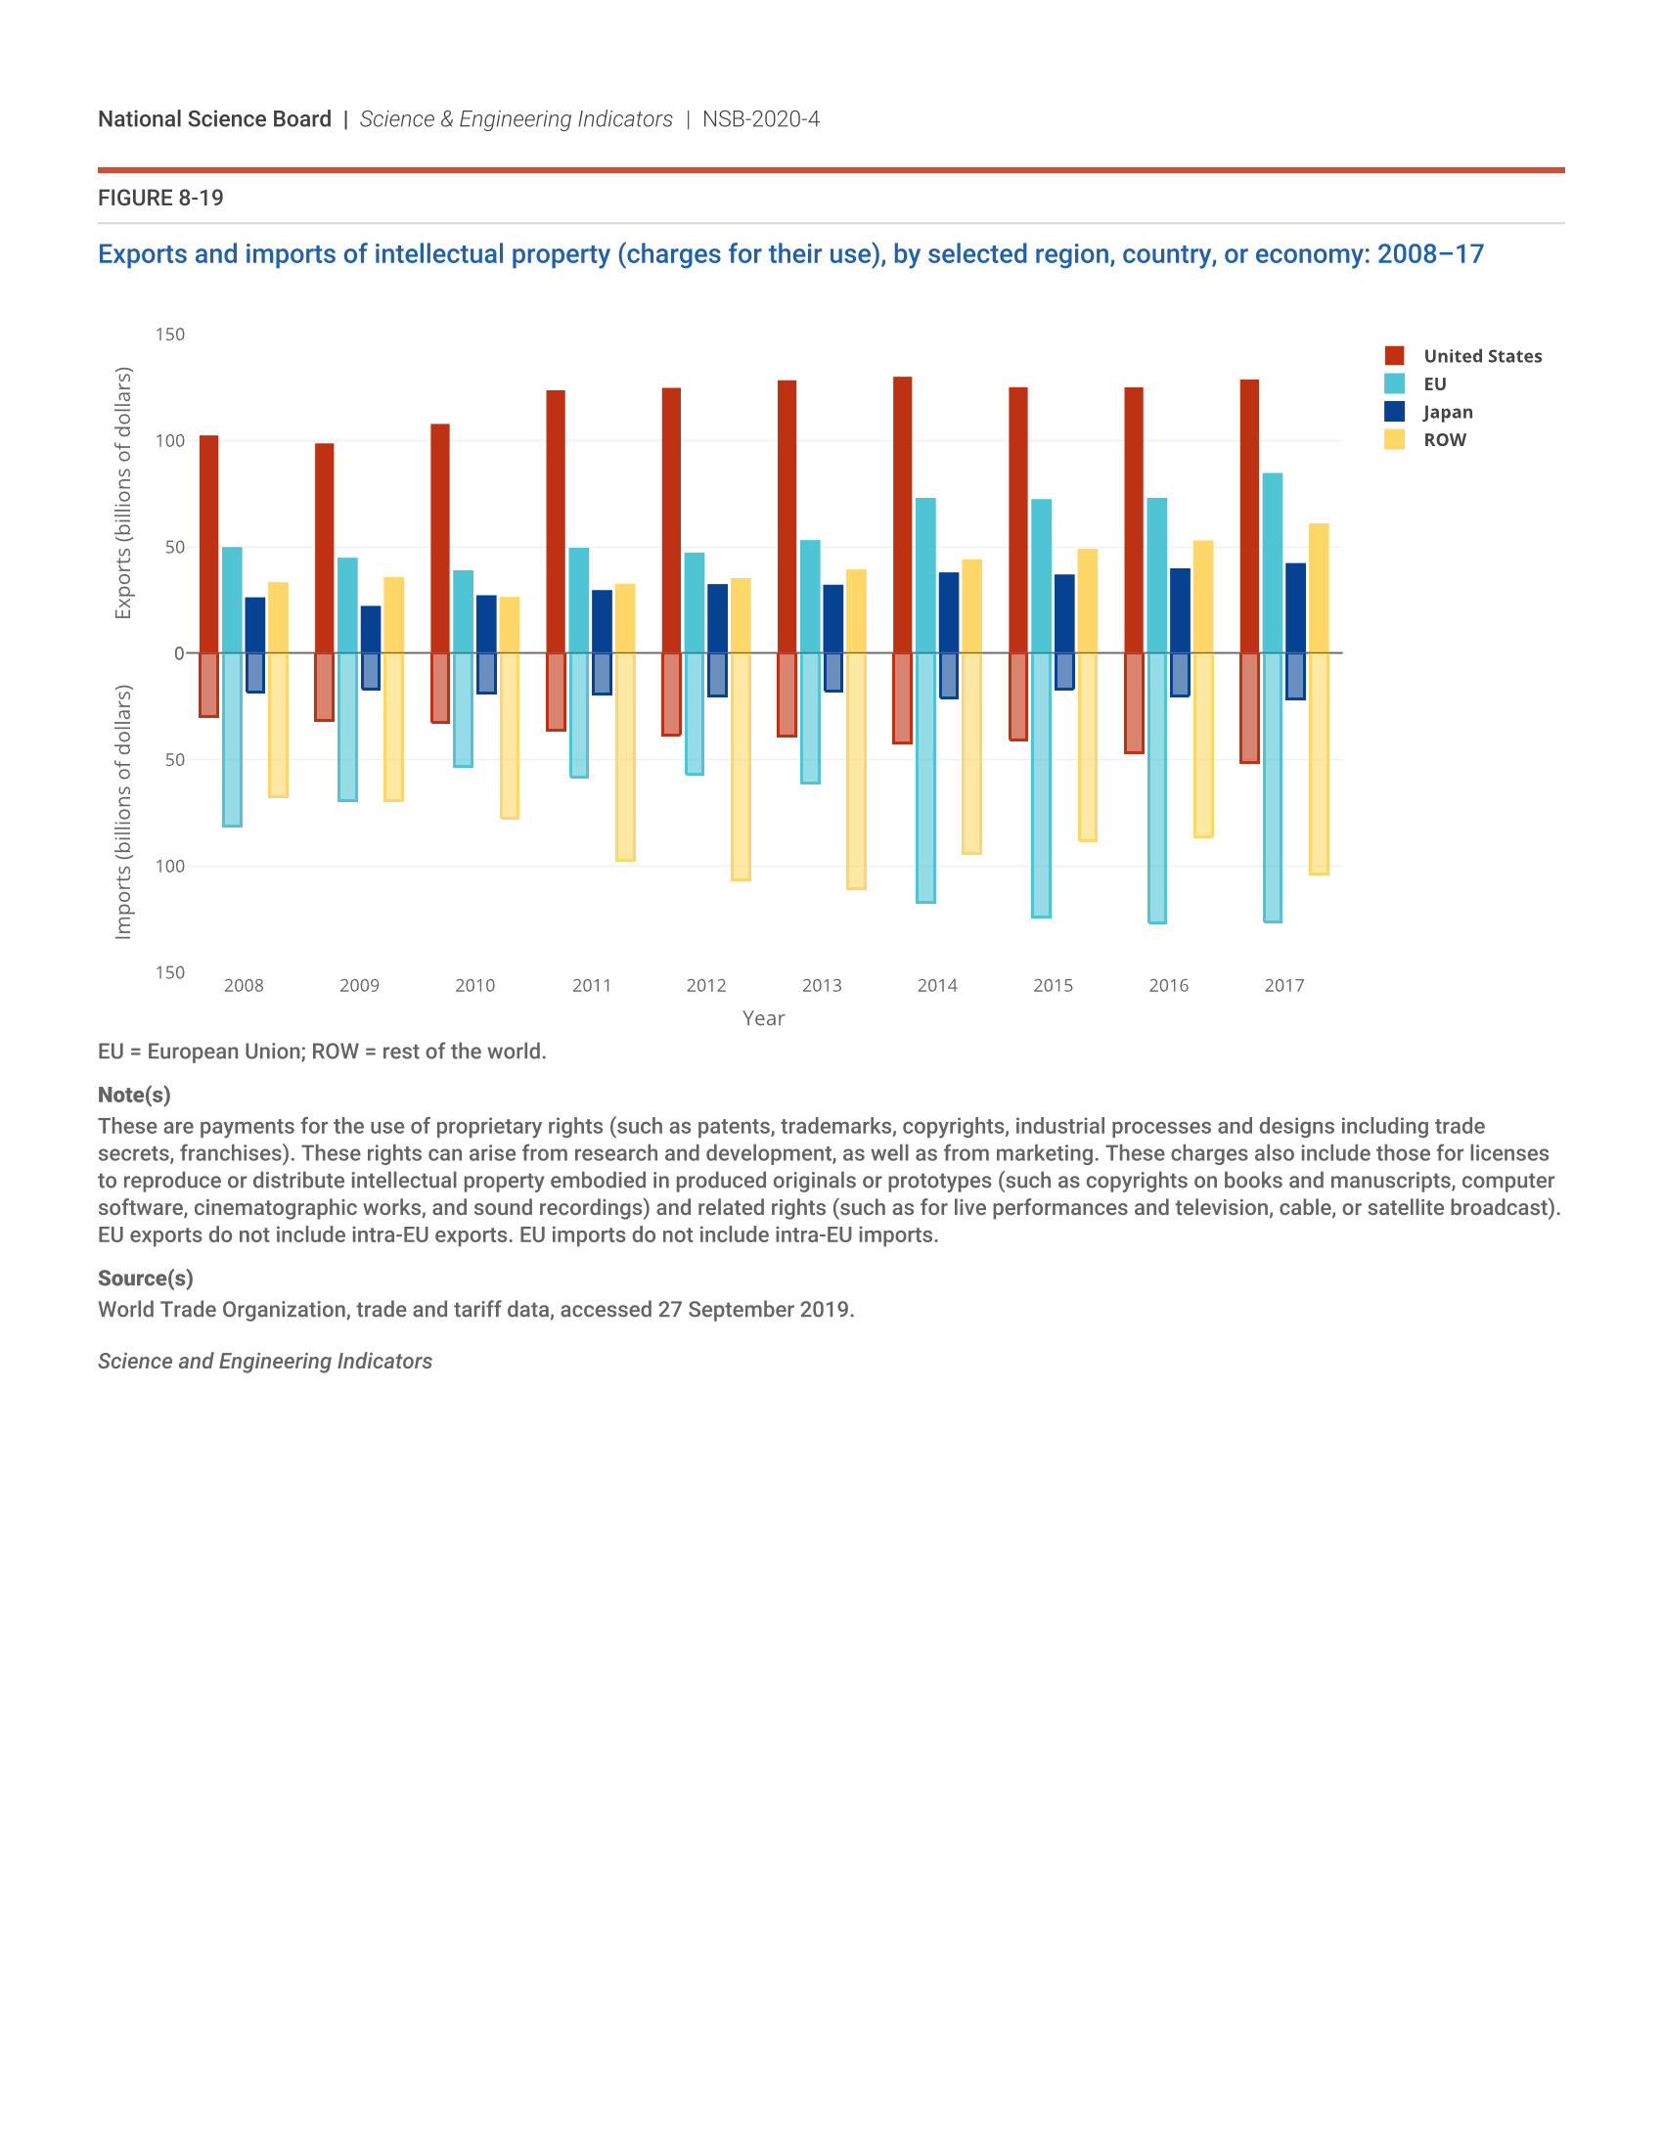
1
Bridging the Knowledge Gap
Seamless integration for comprehensive information access.
Transitioning from bulk uploads to a streamlined, singular knowledge repository enhances manageability and reduces redundancy in content storage.
Knowmax articles now seamlessly integrated into Globivion, ensuring agents have access to necessary knowledge for effective troubleshooting.
Enhanced search capabilities allow users to quickly find relevant articles and information, improving agent response times and accuracy.
Uploading for knowledge tests ensures agents' understanding of the material and their readiness to handle customer inquiries confidently.
Photo by Google

Slide 4
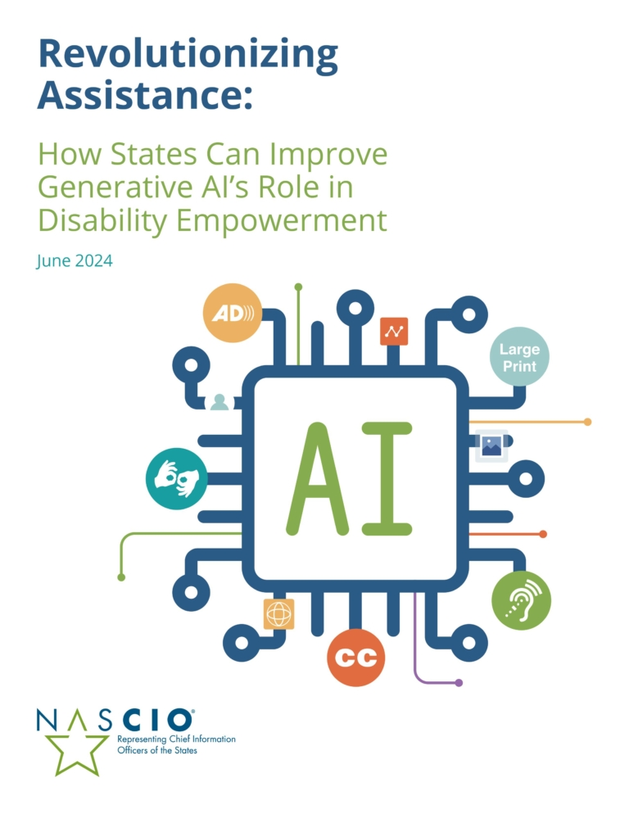
2
Enhanced Knowledge Accessibility
Empowering agents with readily available self-help resources.
Providing offline access to video tutorials prepares agents to assist customers anytime, anywhere, optimizing learning and knowledge retention.
Decision trees from Knowmax now integrated into Globivion, assisting agents in resolving issues using step-by-step guidance.
Quick quizzes and self-learning modules allow agents to reinforce their understanding of key concepts and identify knowledge gaps.
User-friendly search functionality ensures agents can quickly locate necessary information, improving efficiency during customer interactions.
Photo by Google

Slide 5
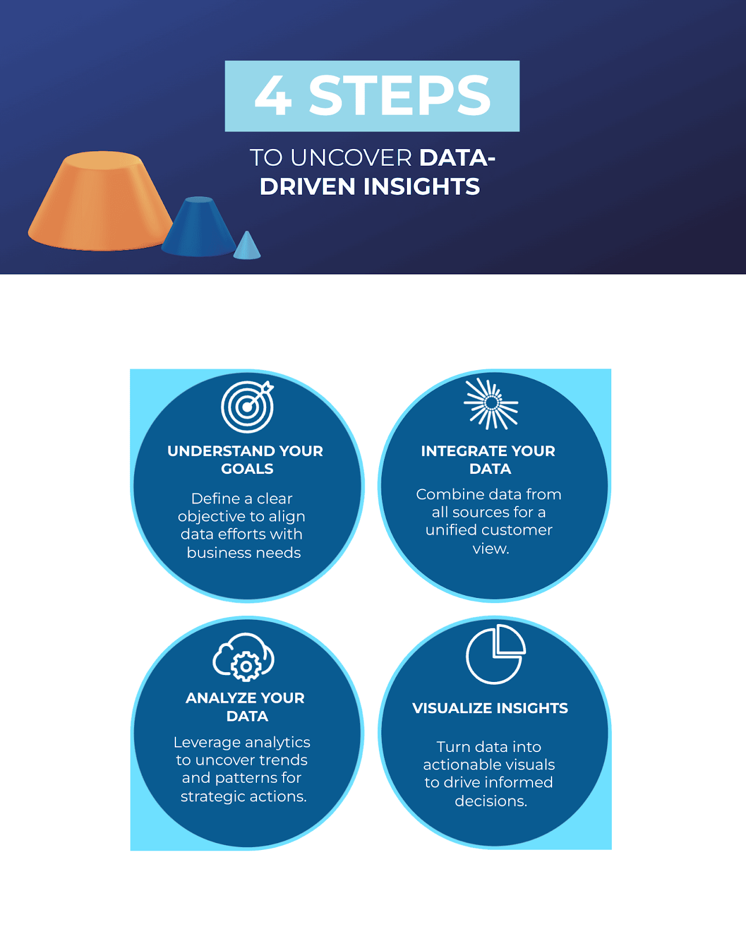
3
Data-Driven Insights
Leveraging usage data for continuous improvement and optimization.
Monitoring usage data helps identify areas where agents need additional support or training, improving overall performance metrics.
Simplified creation and deletion of access links ensures that only authorized personnel can access sensitive information, enhancing security.
Incorporating video tutorials directly within the knowledge base provides agents with dynamic and engaging learning resources to boost knowledge.
Identifying content present in Knowmax but absent in Globivion ensures consistency and completeness of information across platforms.
Photo by Google

Slide 6
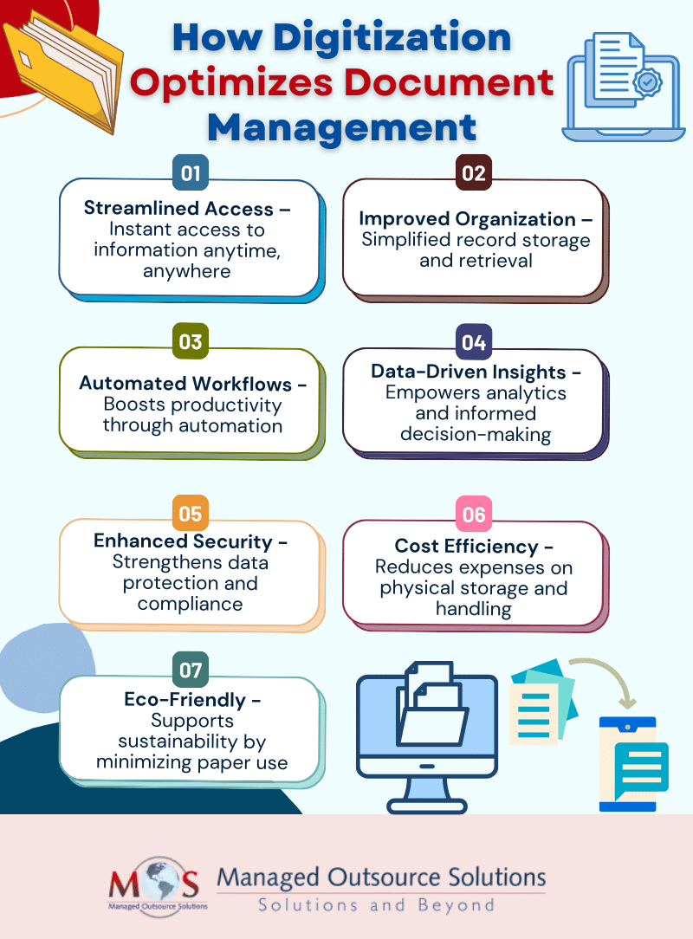
4
Streamlined Content Management
Simplifying uploads and navigation for enhanced user experience.
Ability to upload various material as attachments streamlines content management, providing agents with comprehensive resources.
Easy navigation through the sitemap enhances user experience, ensuring agents can quickly find relevant topics and subtopics.
Mapping scenario-wise dispositions improves data analysis, enabling businesses to understand customer interactions and optimize strategies.
Uploading training material in PPT format ensures agents have access to structured learning resources, enhancing knowledge retention.
Photo by Google

Slide 7
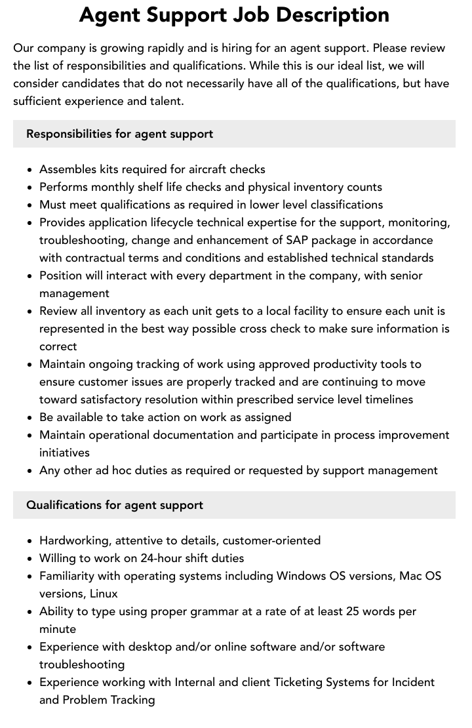
5
G-Assist Enhancement
Improving agent support with dedicated tools and feedback mechanisms.
A dedicated tab for dispositions in G-Assist enhances agent efficiency, enabling quick categorization of customer interactions.
Tracking incorrect answers in assessments provides insights into agent knowledge gaps, facilitating targeted training and development.
Collecting feedback post-assessments allows for continuous improvement of training programs, ensuring they meet agent needs.
A calendar view for updates keeps agents informed about recent changes, promoting knowledge retention and awareness of new initiatives.
Photo by Google

Slide 8
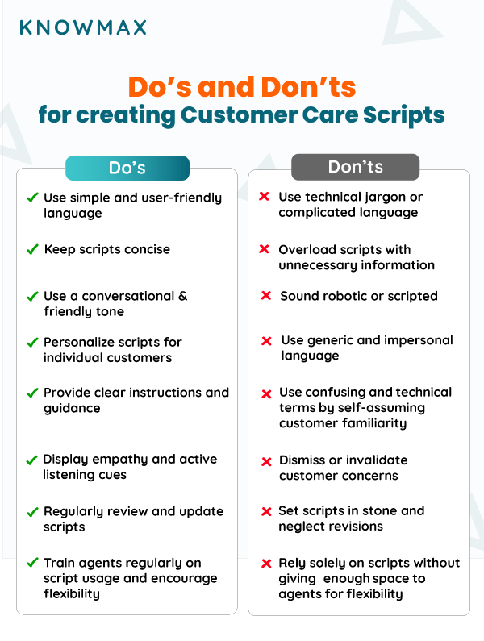
6
User-Friendly Script Access
Facilitating quick access to scripts for enhanced agent performance.
User-friendly interface helps agents quickly find required scripts, improving response times and accuracy during customer interactions.
Providing separate tabs for LOB and sub-campaign scripts ensures agents have easy access to specific guidelines, improving consistency.
Consolidating all scripts in a centralized repository streamlines access and management, reducing search time and improving efficiency.
Facilitating alignment of scripts with ongoing campaigns ensures agents are equipped with the most up-to-date information, boosting performance.
Photo by Google

Slide 9

7
Enhanced Collaboration & Communication
Improving the flow of information between teams.
Improved integration reduces bottlenecks, allowing for quicker response times, resulting in customer satisfaction and agent productivity.
Enhances communication by ensuring all teams have access to the same information, creating a unified and informed support structure.
Offers instant updates, allowing immediate action. This responsiveness is crucial for handling escalations and customer support.
Feedback loops between departments improve the accuracy and relevance of knowledge, which in turn improves training and agent competence.
Photo by Google

Slide 10
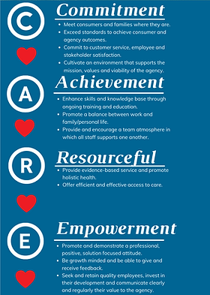
8
Empowering Agents: A Holistic Approach
Providing resources and information for overall effectiveness.
Integrating Knowmax articles within Globivion makes it a one-stop-shop, enhancing support effectiveness through unified information access.
Real-time access to decision trees boosts agent capabilities, which is vital for resolving support issues effectively and ensuring high-quality service.
Optimizing available resources enables the delivery of superior support, creating opportunities to address a wide array of customer issues.
Improvement in efficiency increases agent output and translates directly into better customer experiences, which results in increased customer retention.
Photo by Google

Slide 11
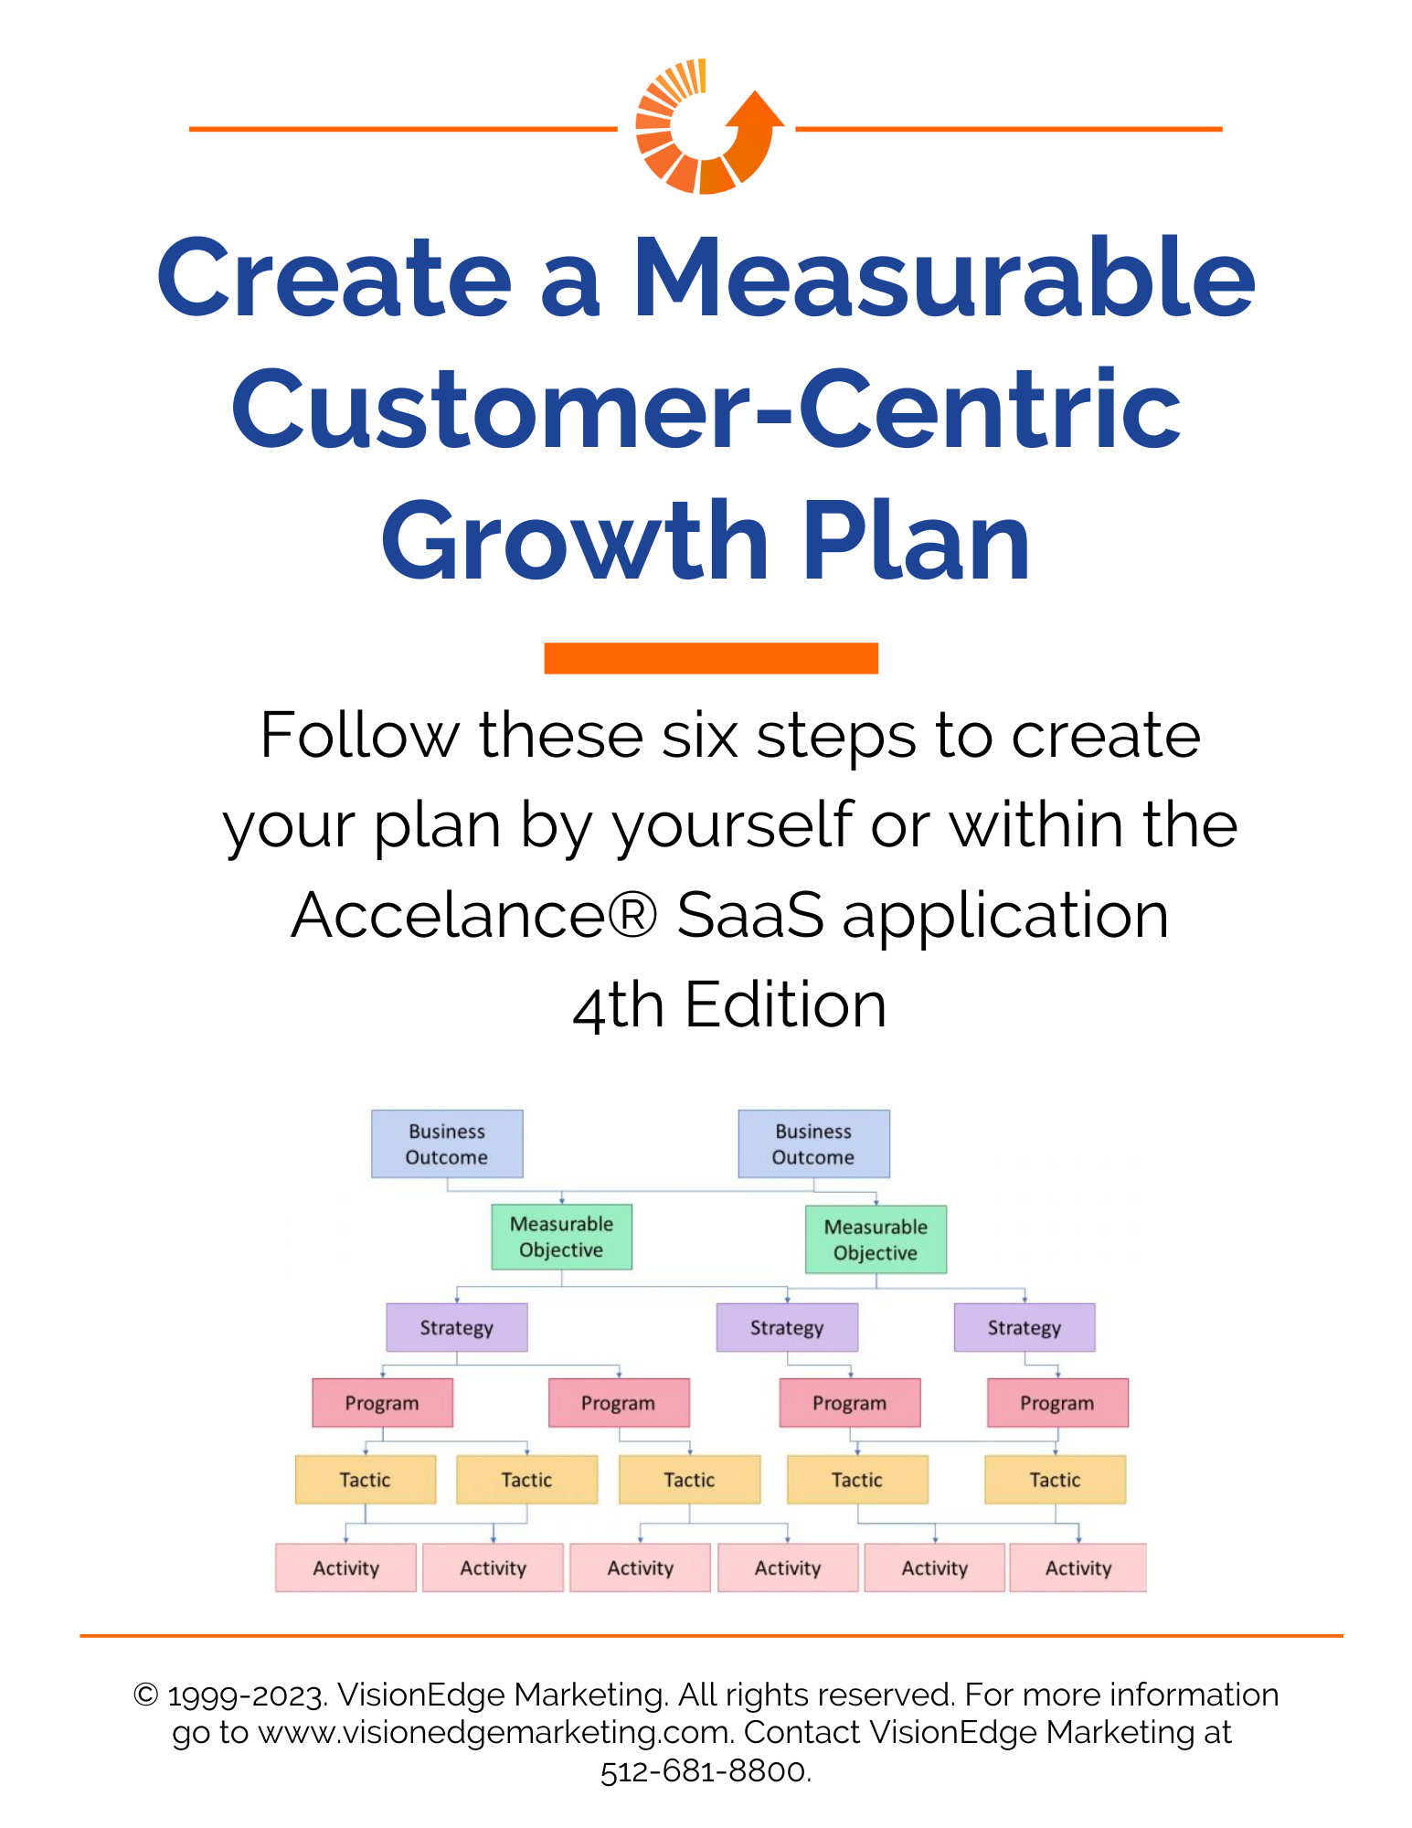
9
Measurable Business Outcomes
Driving tangible results through effective knowledge management.
Enhanced knowledge access reduces agent onboarding time and ensures swift resolution of queries, leading to increased productivity and faster turnaround.
Improved SOP/knowledge management results in enhanced first-call resolution rates, reducing escalations and enhancing customer satisfaction.
Data-driven insights enhance training and resource allocation, resulting in optimized performance metrics across all support functions.
Improved access to materials is central to optimizing support, ensuring a positive customer journey, and increasing loyalty.
Photo by Google

Slide 12
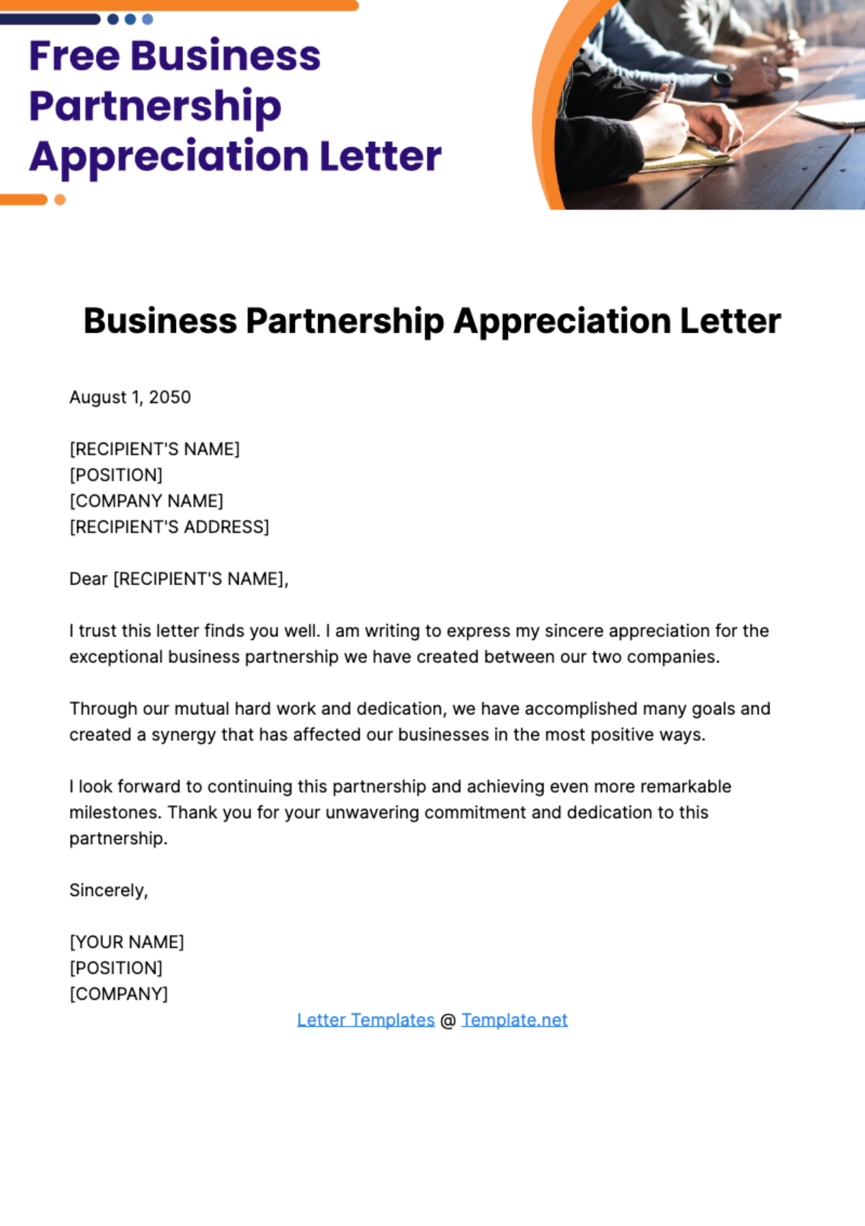
10
Thank You
We look forward to a successful partnership.
We appreciate you taking the time to learn about how Knowmax and Globivion can transform your knowledge management strategy.
We are excited about the potential of working together and driving significant improvements in your organization.
We welcome any questions you may have and are ready to discuss your specific needs and requirements.
Please feel free to reach out to us with any inquiries. We're here to help you achieve your goals.
Photo by Google

