Slide 1

Long Walk to Freedom
The Journey of Nelson Mandela
Photo by Pexels

Slide 2
01
The Beginning of the Journey
Table of Contents
02
The Path of Resistance
03
The Road to Freedom
04
The Long Walk Continues
05
Freedom Achieved

Slide 3

1
The Beginning of the Journey
Understanding the Path to Freedom
Nelson Mandela embarked on a remarkable journey dedicated to justice and equality for all people in South Africa.
The long walk to freedom started with a commitment to challenge oppression and fight for human rights.
Mandela faced numerous obstacles and hardships that tested his resolve and strengthened his determination.
Each step forward in the journey brought hope and inspired others to join the cause for freedom.

Slide 4

2
The Path of Resistance
Standing Against Injustice
Mandela demonstrated extraordinary courage by standing firm against systemic injustice and discrimination.
The journey brought people together with shared purpose, creating a powerful movement for change.
Personal sacrifices were made along the way, showing deep commitment to the cause of liberation.
The resistance movement grew stronger with each passing year, gaining international support and recognition.

Slide 5

3
The Road to Freedom
Persistence Through Adversity
Through countless challenges, Mandela's resolve never wavered, keeping the dream of freedom alive.
The journey required immense inner strength to maintain hope and continue fighting against overwhelming odds.
International solidarity grew, showing that the struggle for freedom resonated with people worldwide.
Critical moments in the journey marked significant progress toward the ultimate goal of freedom.

Slide 6
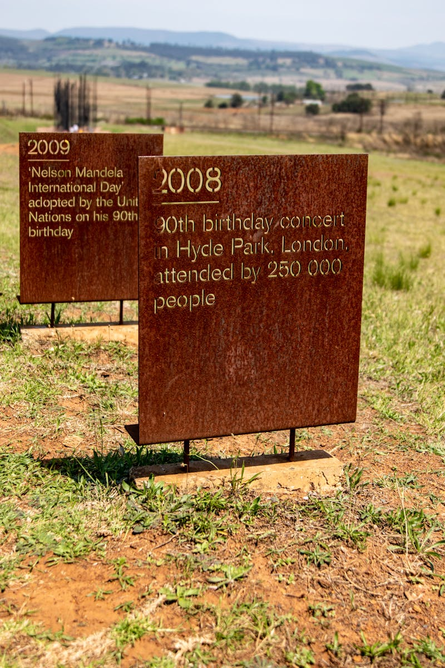
4
The Long Walk Continues
Building a New Future
The journey evolved toward healing and reconciliation, building bridges between divided communities.
A new democratic society emerged from the long struggle, founded on equality and justice for all.
The journey left a lasting legacy of hope, inspiring future generations to continue the work for freedom.
The path to true freedom remains ongoing, requiring continued commitment to justice and human rights.

Slide 7
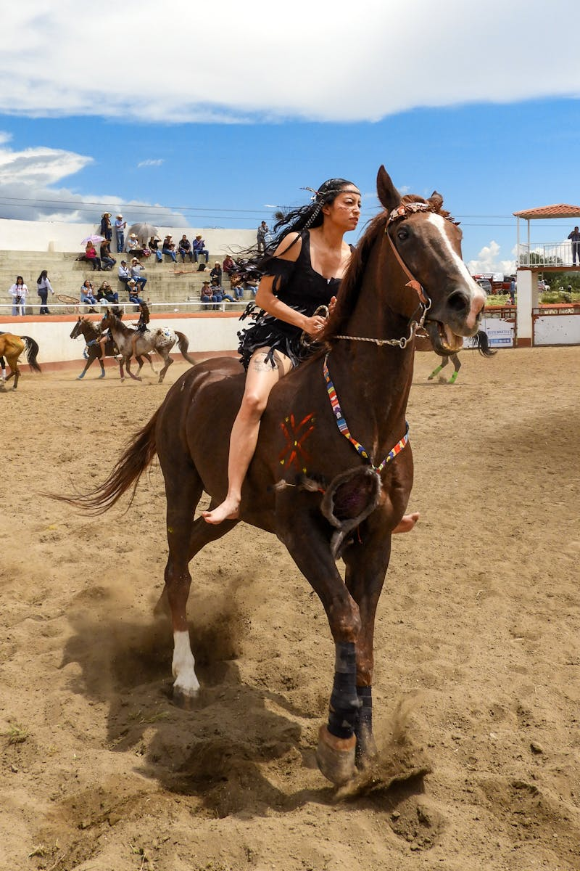
5
Freedom Achieved
The Triumph of the Human Spirit
The long walk finally reached its destination, achieving the ultimate victory of justice over oppression.
Nelson Mandela became a global symbol of hope, demonstrating that freedom is possible through perseverance.
The journey taught valuable lessons about courage, forgiveness, and the power of collective action.
The story continues to inspire people everywhere to stand up for freedom and human dignity.

