Slide 1
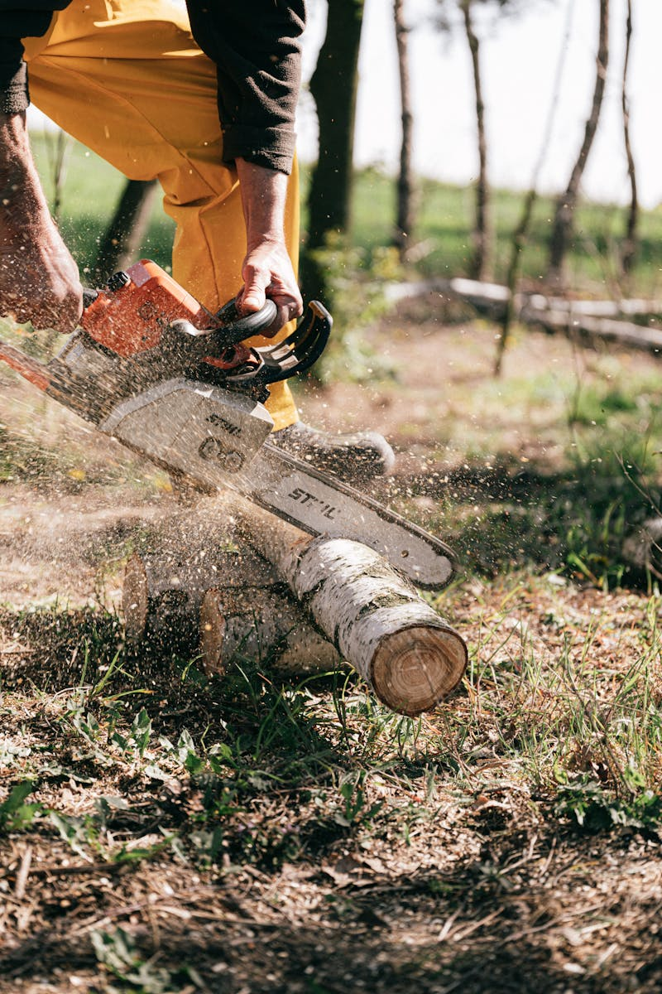
Lumbering in Canada The Forest Industry's Legacy and Future
Photo by Pexels

Slide 2
01
The Canadian Timber Empire
Table of Contents
02
Sustainable Forestry Practices
03
Regional Lumbering Hubs
04
Modern Lumbering Technologies
05
Future of Lumbering in Canada

Slide 3
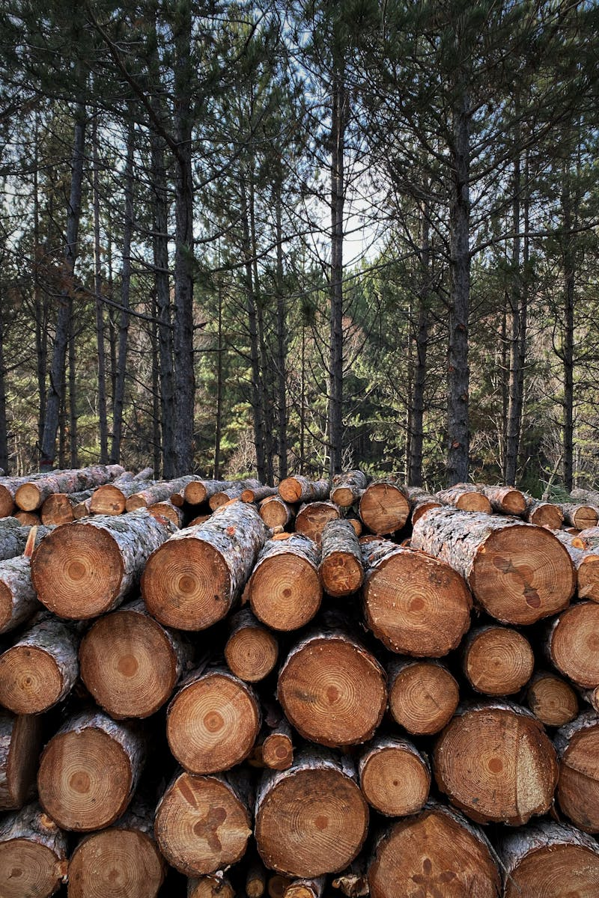
1
The Canadian Timber Empire
A National Economic Pillar
Lumbering in Canada dates back to the 17th century, forming the foundation of early settlements and economic development across the nation's vast wilderness regions. The lumber industry contributes billions annually to Canada's economy, supporting hundreds of communities and providing employment for thousands of workers nationwide. Canada possesses over 30% of the world's boreal forests, making it a global leader in sustainable lumber production and forest management practices. Canadian lumber exports reach markets worldwide, with the United States being the primary destination, demonstrating the industry's international economic importance.

Slide 4

2
Sustainable Forestry Practices
Balancing Ecology and Economy
Modern lumbering employs selective harvesting techniques that preserve forest ecosystems while meeting production needs, ensuring long-term sustainability. Canada's lumber industry invests heavily in reforestation programs, planting millions of trees annually to maintain healthy forest cover for future generations. Industry leaders adhere to strict certification standards like FSC and SFI, ensuring environmental responsibility and sustainable forest management practices. Well-managed forests serve as carbon sinks, helping mitigate climate change while providing sustainable lumber resources for construction and manufacturing.

Slide 5
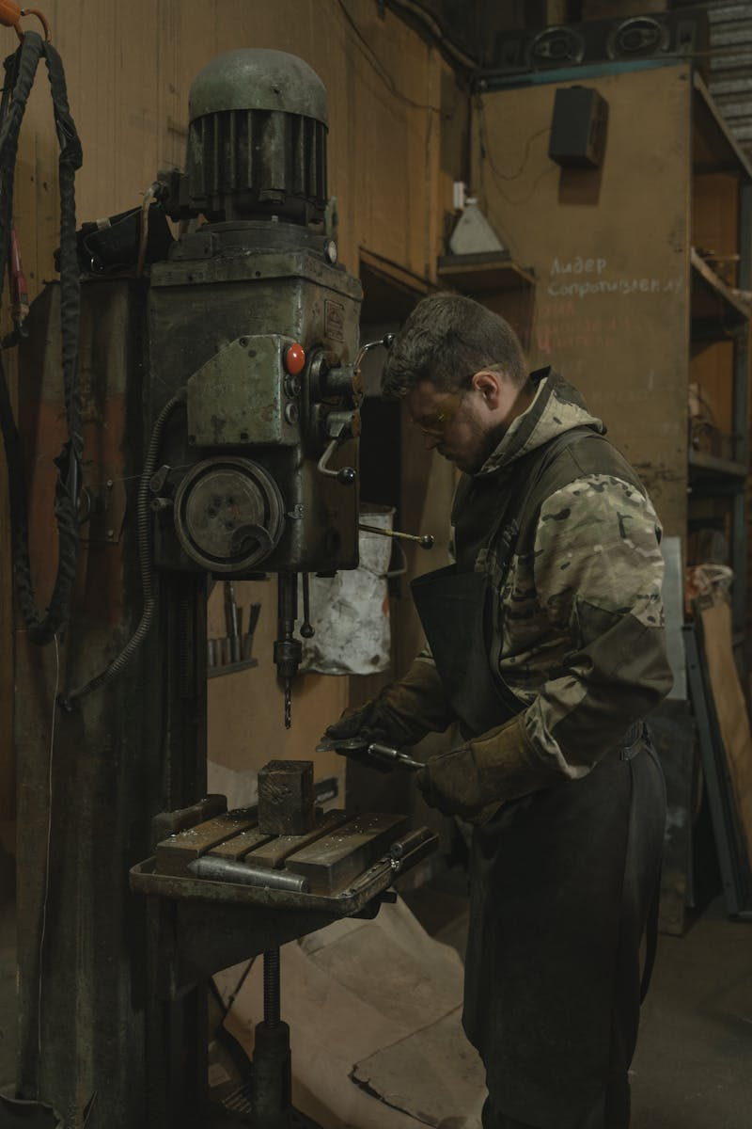
3
Regional Lumbering Hubs
Industry Centers Across the Nation
BC leads Canada's lumber production with its vast coastal and interior forests, producing high-quality softwoods for domestic and international markets. Quebec's boreal forests support a thriving lumber industry, producing both softwood and hardwood products for construction and manufacturing sectors. Ontario's diverse forest regions support lumber operations ranging from small mills to large industrial complexes, serving regional and national markets. Maritime provinces maintain strong lumbering traditions, utilizing both softwood and hardwood resources for specialized woodworking and construction industries.

Slide 6

4
Modern Lumbering Technologies
Innovation in Forest Harvesting
Advanced GPS and computerized systems enable precise tree selection and harvesting, minimizing environmental impact while maximizing resource utilization. Modern lumber mills employ automated sawing and processing equipment, improving efficiency, reducing waste, and enhancing product quality consistency. Satellite imagery and drone technology allow forest managers to monitor forest health, plan harvesting operations, and track reforestation progress effectively. Sophisticated inventory management systems track forest resources in real-time, ensuring sustainable harvesting rates and long-term forest planning accuracy.

Slide 7
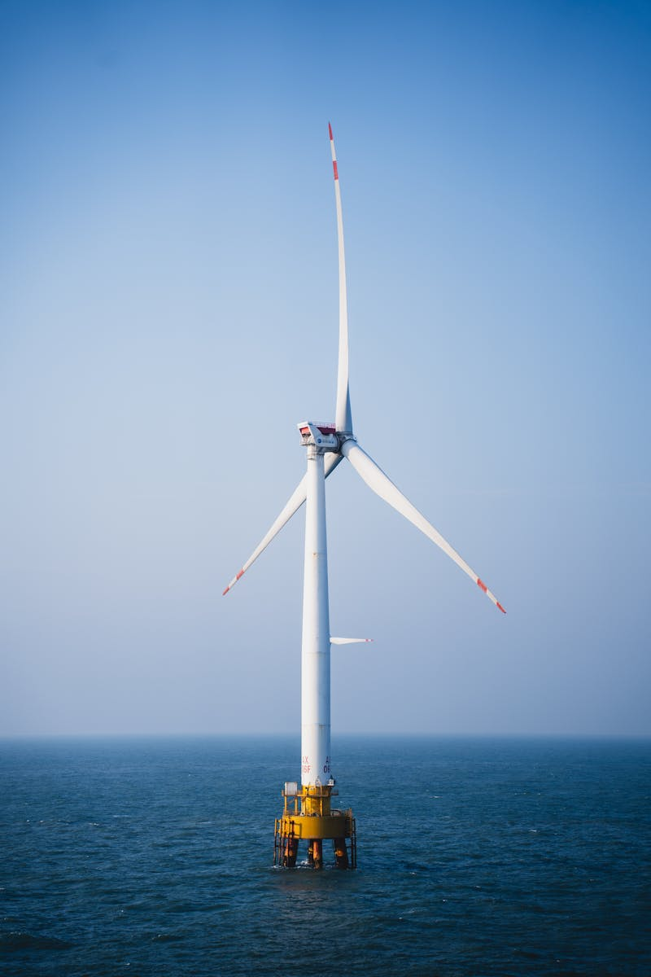
5
Future of Lumbering in Canada
Sustainability and Innovation
The lumber industry is embracing cross-laminated timber and engineered wood products, positioning Canadian lumber as a sustainable alternative to traditional construction materials. Lumber operations increasingly incorporate bioenergy systems, utilizing wood waste to power mills and reduce carbon footprints while maintaining production efficiency. Growing collaboration between lumber companies and Indigenous communities ensures traditional knowledge integration while creating economic opportunities and cultural preservation. The industry is developing climate-resilient forest management strategies, preparing for changing conditions while maintaining sustainable lumber production for future generations.

