Slide 1

Lysosomes: Cellular Powerhouses
Understanding Lysosome Organelles and Human Disease Connections
Photo by Pexels

Slide 2
01
Introduction to Lysosomes
Table of Contents
02
Lysosome Structure and Function
03
Lysosome-Related Diseases Overview
04
Specific Lysosomal Storage Disorders
05
Research and Future Directions

Slide 3
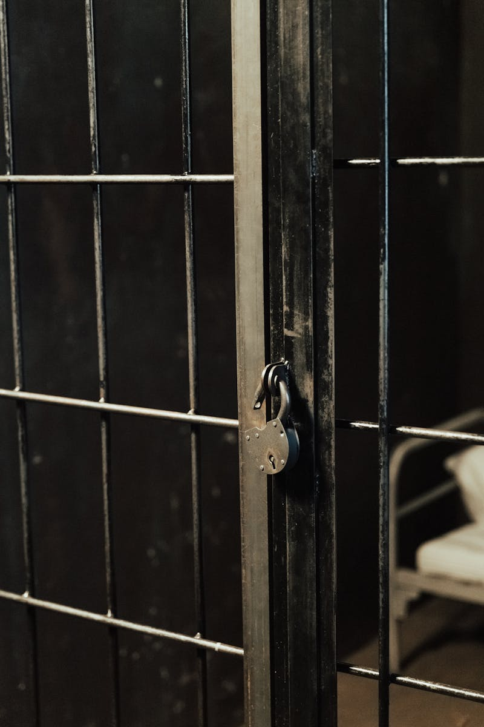
1
Introduction to Lysosomes
The Cellular Recycling Centers
Lysosomes are membrane-bound organelles containing digestive enzymes that break down cellular waste and foreign materials.
First discovered by Christian de Duve in 1955, lysosomes play crucial roles in cellular maintenance and homeostasis.
Found in most animal cells, lysosomes originate from the Golgi apparatus and are distributed throughout the cytoplasm.
Proper lysosome function is essential for cellular health, and dysfunction leads to various human diseases and disorders.

Slide 4

2
Lysosome Structure and Function
Molecular Machinery of Cellular Cleanup
Lysosomal membranes contain specific transport proteins and proton pumps to maintain optimal acidic pH for enzyme activity.
Contain over 60 different hydrolytic enzymes including proteases, nucleases, lipases, and glycosidases for breaking down various biomolecules.
Lysosomes perform autophagy, recycling cellular components and removing damaged organelles to maintain cellular health and energy balance.
Lysosomes receive materials from endocytosis, phagocytosis, and autophagy, serving as the final destination for cellular degradation.

Slide 5
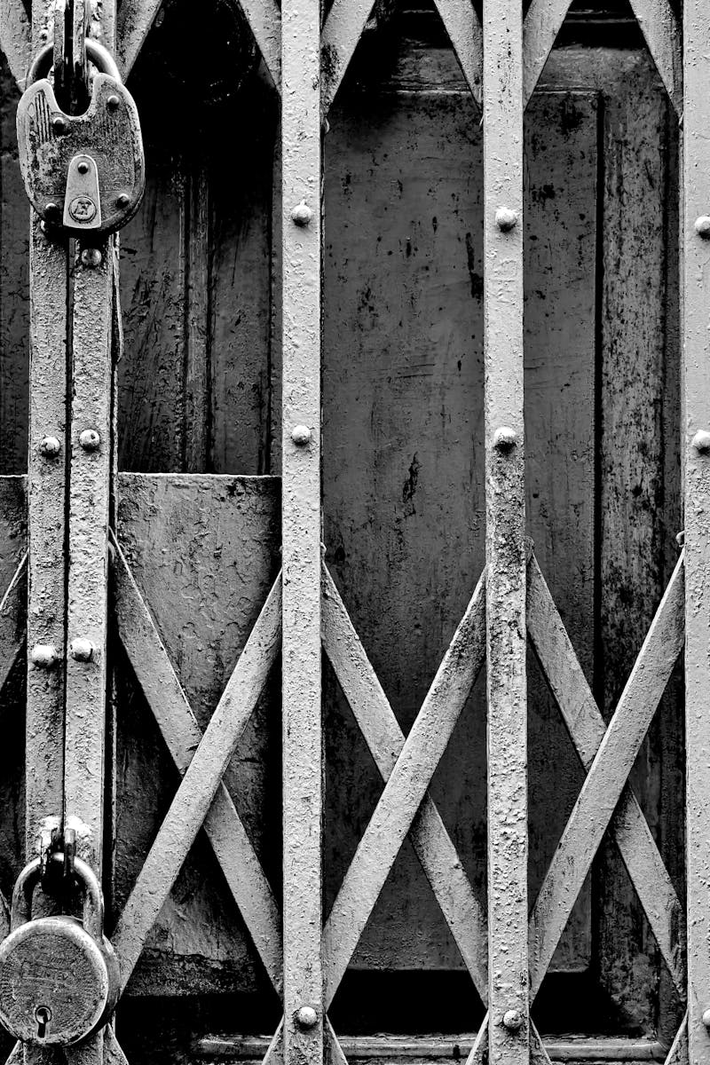
3
Lysosome-Related Diseases Overview
When Cellular Recycling Fails
A group of inherited metabolic disorders caused by enzyme deficiencies leading to substrate accumulation in lysosomes.
Many lysosomal diseases primarily affect the nervous system, causing progressive neurological deterioration and cognitive impairment.
Lysosomal dysfunction can impact multiple organ systems including liver, spleen, bones, and cardiovascular systems throughout the body.
Most lysosomal diseases are autosomal recessive disorders requiring inheritance of defective genes from both parents for disease manifestation.

Slide 6

4
Specific Lysosomal Storage Disorders
Major Disease Categories and Characteristics
Caused by hexosaminidase A deficiency, leading to GM2 ganglioside accumulation and severe neurological deterioration in infants.
Results from glucocerebrosidase deficiency, causing glucocerebroside buildup in macrophages and affecting liver, spleen, and bones.
Alpha-galactosidase A deficiency leads to globotriaosylceramide accumulation, causing pain, kidney failure, and cardiovascular problems.
Acid alpha-glucosidase deficiency results in glycogen accumulation, causing muscle weakness and respiratory insufficiency in various forms.

Slide 7

5
Research and Future Directions
Advances in Lysosome Disease Treatment
Intravenous administration of functional enzymes to compensate for deficient enzymes, showing promise in treating several lysosomal disorders.
Emerging technologies aim to deliver functional genes to restore enzyme production, offering potential cures for genetic lysosomal diseases.
Medications that reduce the production of accumulating substrates, complementing enzyme replacement strategies for comprehensive treatment.
Ongoing studies focus on improving delivery methods, developing combination therapies, and exploring novel treatment approaches for lysosomal disorders.

