Slide 1
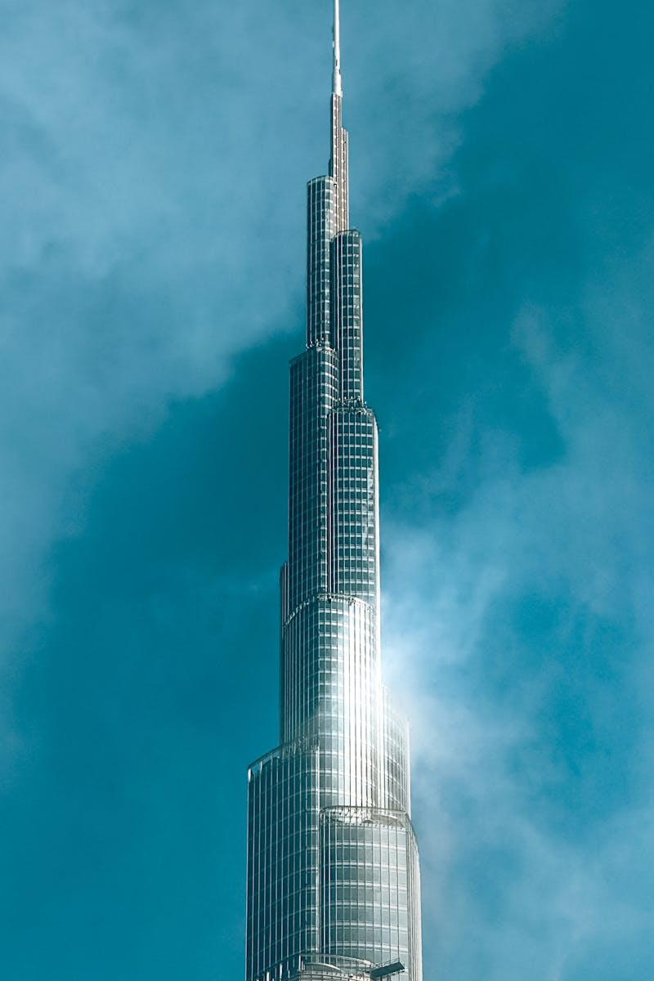
MILLPRO: Building Excellence Globally Two Decades of Innovation and Trusted Construction Solutions
Photo by Pexels

Slide 2
01
Our Foundation: Building Trust
Table of Contents
02
Why Choose MILLPRO?
03
Uncompromising Results
04
What We Offer
05
Thank You

Slide 3
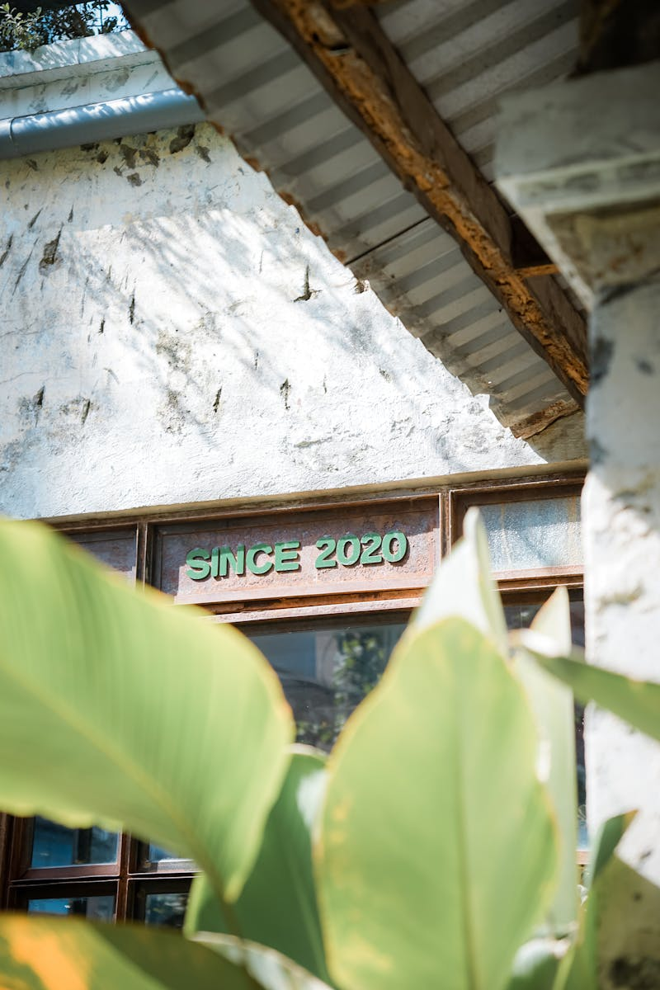
1
Our Foundation: Building Trust
From Local Roots to International Business Networks
Our journey began with MBP, focusing on paint and waterproofing trading. This established a strong foundation in the construction sector. Post-COVID, MILLPRO PAKISTAN emerged, aiming at international clients with top-quality services and worldwide business networks. MILLPRO focuses on introducing innovation to the business world, with a key emphasis on incorporating green building materials. Expanding its network internationally and adding consistent dynamism to its layout. We have put thorough research into getting a better understanding of the complex material needed.

Slide 4

2
Why Choose MILLPRO?
Expertise, Precision, and Unwavering Commitment
MILLPRO brings over two decades of experience and expertise to meet diverse construction needs and demands with state-of-the-art services. Joining hands with MILLPRO means adding our precision and expertise to your business, ensuring optimal results. Establishing healthy relationships with clients, closely associating with project consultants, ensures better systems advice. Our expanded international business network has honed our skills and expertise, ensuring top-notch results for every project we undertake.

Slide 5
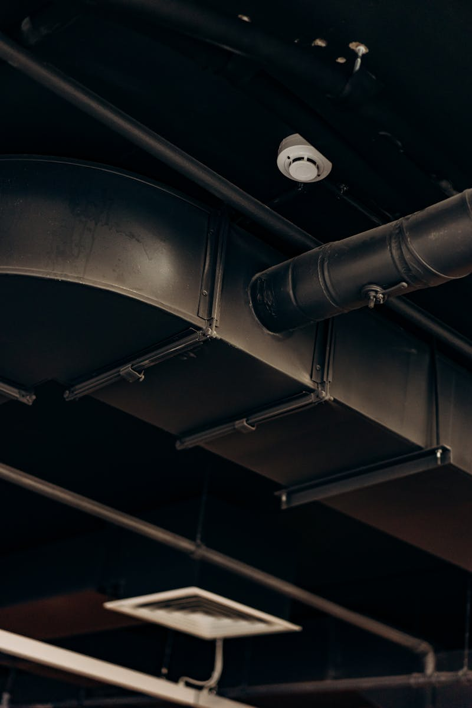
3
Uncompromising Results
Dedication to Quality and Customer Compliance
Consistent engagement during designing and project execution ensures uncompromised results. We are well-versed in our skills Enhancing customer compliance, from responsive interactions to supplying top-quality products, defines our reputable standards. Accomplishing a 3S deal providing specialist service solutions. We, along with our clients have reached the excellence. We approach our business with the vision of expanding its network internationally and adding consistent dynamism to its layout.

Slide 6
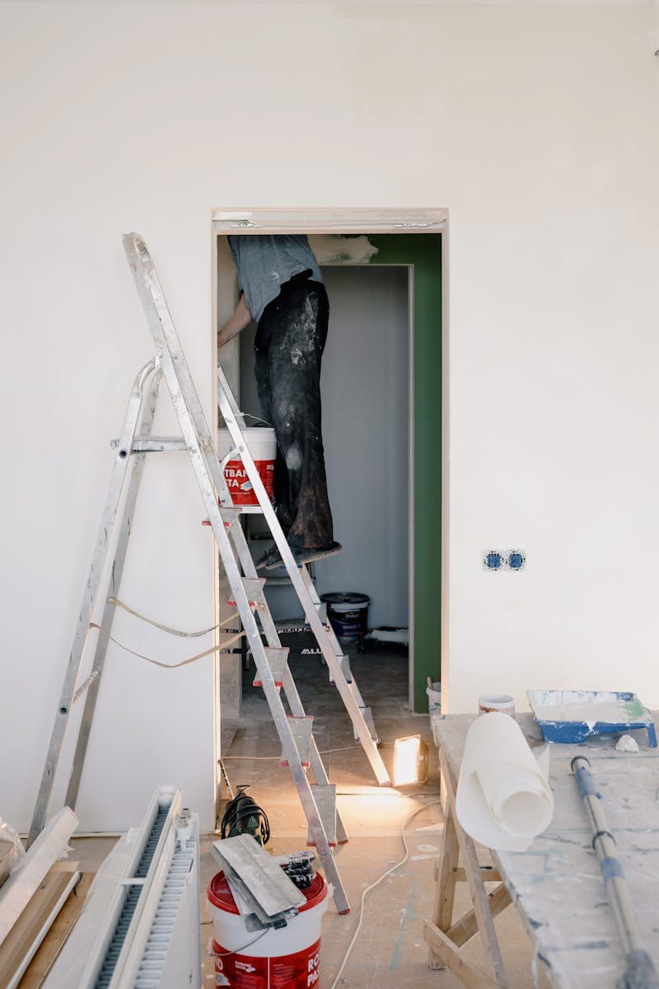
4
What We Offer
Tailored Solutions for Unique Project Needs
MILLPRO PAKISTAN is a trusted name, offering utmost dedication and commitment to innovative business strategies over two decades. We offer a comprehensive range of services meticulously tailored to meet the unique demands of each and every project we undertake. Our mission extends beyond client dealings, incorporating years of experience and case studies with top architects and consultants. We have put thorough research into getting a better understanding of the complex material needed, offering long-lasting performing solutions.

Slide 7

5
Thank You
Appreciating Your Time and Consideration
We extend our sincere gratitude for your time and consideration. We value the opportunity to share our vision and expertise with you. We look forward to potential collaborations and the opportunity to contribute to your future projects with our dedicated services. For any inquiries or further information, please do not hesitate to reach out. We are always ready to assist you with your construction needs. We are well-versed in our skills.

