Slide 1

Major Events in the Indian Freedom Struggle
A Brief Overview by Nahid Begum

Slide 2


Table of Contents
01
Introduction
02
The Revolt of 1857
03
Formation of Indian National Congress
04
Jallianwala Bagh Massacre
05
Quit India Movement
06
Thank You

Slide 3


Introduction
01
I am Nahid Begum.
02
I am a student of Class VIII.
03
I study at Neo Rosary High School.
04
Today, I will discuss major events in the Indian freedom struggle.
Photo by Pexels

Slide 4
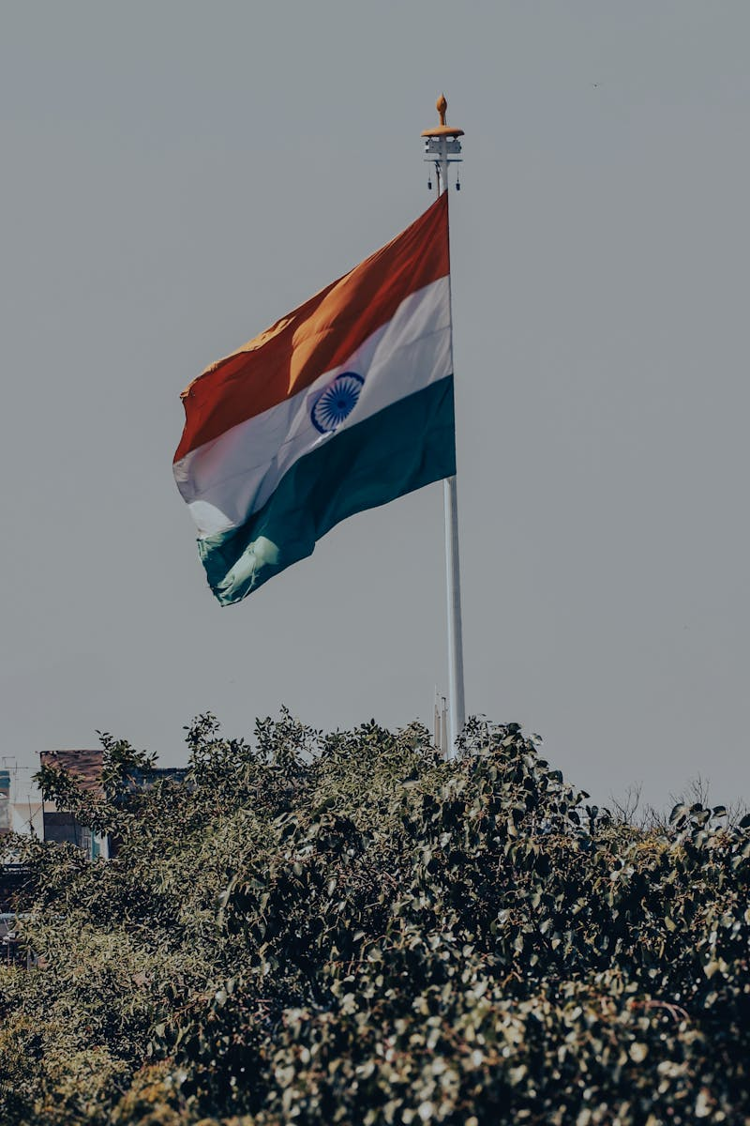
The Revolt of 1857
01
The revolt began as a mutiny by Indian soldiers in the British East India Company's army.
02
Figures like Mangal Pandey, Bahadur Shah II, and Rani Lakshmibai played significant roles.
03
It spread across regions like Delhi, Kanpur, and Lucknow, challenging British rule.
04
The revolt was suppressed, leading to the end of the East India Company's rule and direct British control.
Photo by Pexels

Slide 5

Formation of Indian National Congress
01
The Indian National Congress was founded in 1885 by A.O. Hume and Indian leaders.
02
It aimed to promote Indian interests and demand greater representation in government.
03
The first session was held in Bombay, focusing on constitutional reforms.
04
It became a platform for nationalists, evolving into a major force in the freedom struggle.
Photo by Pexels

Slide 6
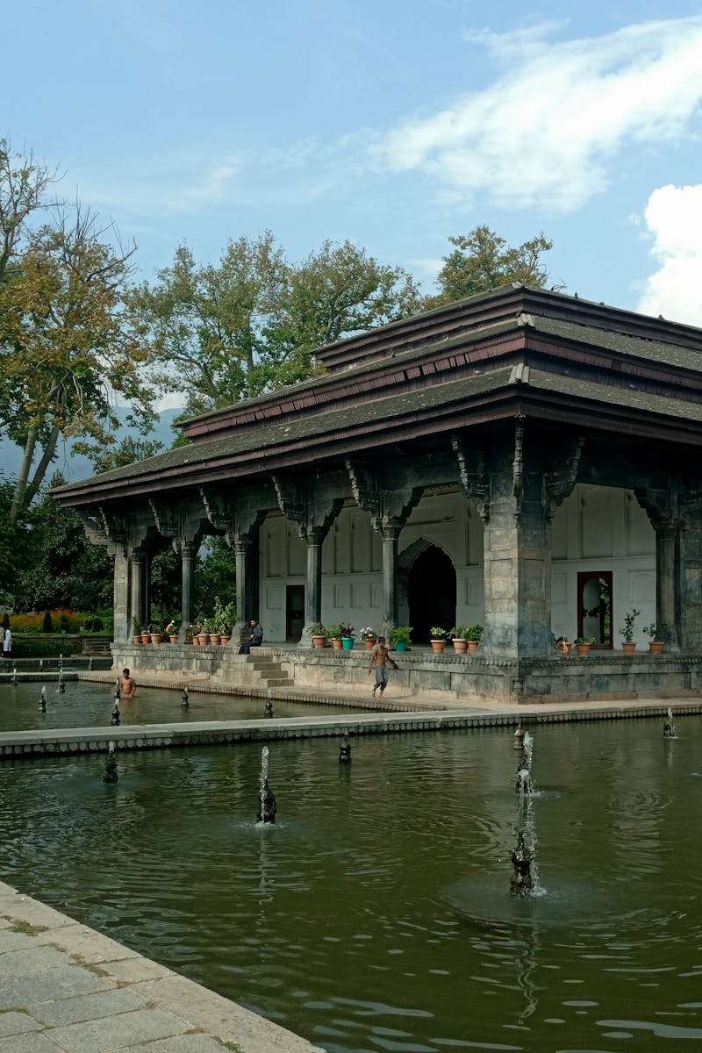
Jallianwala Bagh Massacre
01
Occurred on April 13, 1919, in Amritsar, Punjab.
02
British troops fired on a peaceful crowd protesting the Rowlatt Act.
03
Hundreds of unarmed Indians were killed, sparking widespread outrage.
04
It galvanized the independence movement and increased support for Gandhi's non-violent resistance.
Photo by Pexels

Slide 7

Quit India Movement
01
Launched by Mahatma Gandhi in 1942 with the slogan 'Do or Die'.
02
It called for the British to quit India and transfer power to Indians.
03
Widespread protests, strikes, and arrests occurred across the country.
04
It pressured the British and contributed to India's independence in 1947.
Photo by Pexels

Slide 8

Thank You
01
Thank you for your attention and time.
02
I am open to any questions you may have.
03
Your feedback is valuable to me.
04
Remember the sacrifices made in the Indian freedom struggle.
Photo by Pexels

