Slide 1
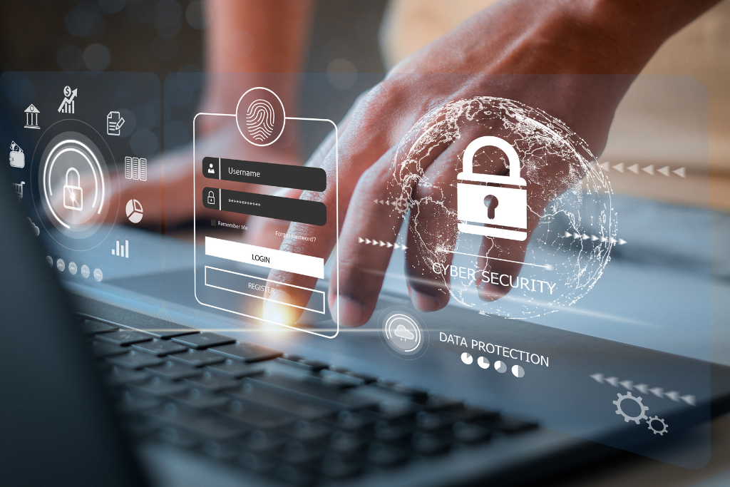
Mastering Password Strength Analysis A professional guide to evaluating and building secure digital credentials for modern cybersecurity.
Photo by Google

Slide 2
01
Securing Your Digital Identity
Table of Contents
02
The Mechanics of Evaluation
03
Why Length Trumps Complexity
04
Common Cyber Attack Vectors
05
The Power of Passphrases
06
Password Management Tools
07
Multi-Factor Authentication
08
Industry Security Statistics
09
Best Practices for Students
10
Securing Your Digital Future

Slide 3
1
Securing Your Digital Identity
The critical role of password strength in modern defense.
Password strength measures how effectively a credential resists unauthorized guessing or automated attacks. It serves as the primary barrier protecting sensitive personal and professional data from global cyber threats. A password strength checker evaluates strings of characters to provide real-time feedback. These tools help users identify vulnerabilities and encourage the creation of complex, high-entropy secrets for online accounts. Weak passwords remain a top entry point for hackers worldwide. Statistics show that nearly eighty-one percent of data breaches are directly linked to poor password hygiene or reused credentials. In an era of sophisticated computing, simple passwords can be cracked in milliseconds. Strengthening your digital gates is no longer optional; it is a fundamental requirement for maintaining online privacy.
Photo by Google

Slide 4
2
The Mechanics of Evaluation
Understanding how strength checkers analyze your data.
Strength checkers use information theory to calculate entropy, which quantifies randomness in bits. Higher entropy scores indicate a more unpredictable password that is significantly harder for automated tools to crack. Advanced checkers compare inputs against massive databases of common words and leaked credentials. This ensures that even complex-looking passwords are not based on easily guessable patterns or previously compromised data. Tools like the zxcvbn library detect predictable sequences such as keyboard patterns or dates. By identifying these non-random structures, the checker can provide a more accurate assessment of true security. Modern interfaces use color-coded meters and progress bars to guide users. This immediate interaction educates individuals on how specific changes, like adding length, impact the overall security of their password.
Photo by Google

Slide 5
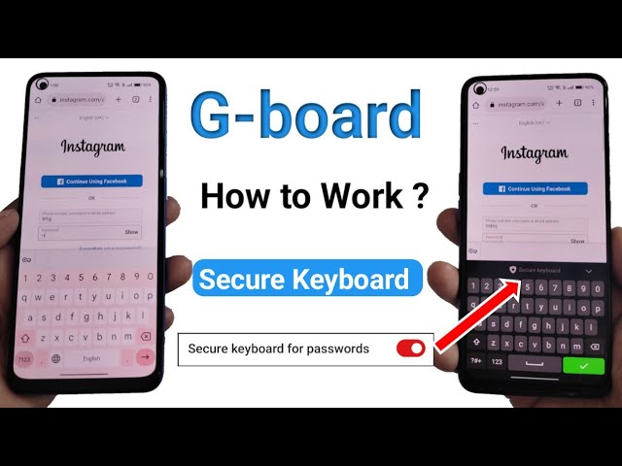
3
Why Length Trumps Complexity
The mathematical advantage of longer credentials.
Every additional character in a password exponentially increases the number of possible combinations. Adding just one letter can double the time required for an attacker to successfully guess the secret. The National Institute of Standards and Technology currently recommends passwords of at least fifteen characters. This standard focuses on length to maximize entropy and protect against modern high-speed cracking hardware. While special characters add security, they often make passwords harder for humans to remember. Increasing length provides a higher security return with less cognitive load than memorizing random symbols and numbers. A short complex password might take days to crack, but a long simple phrase could take centuries. Checkers illustrate this difference to help users prioritize length over frustratingly complex character sets.
Photo by Google

Slide 6
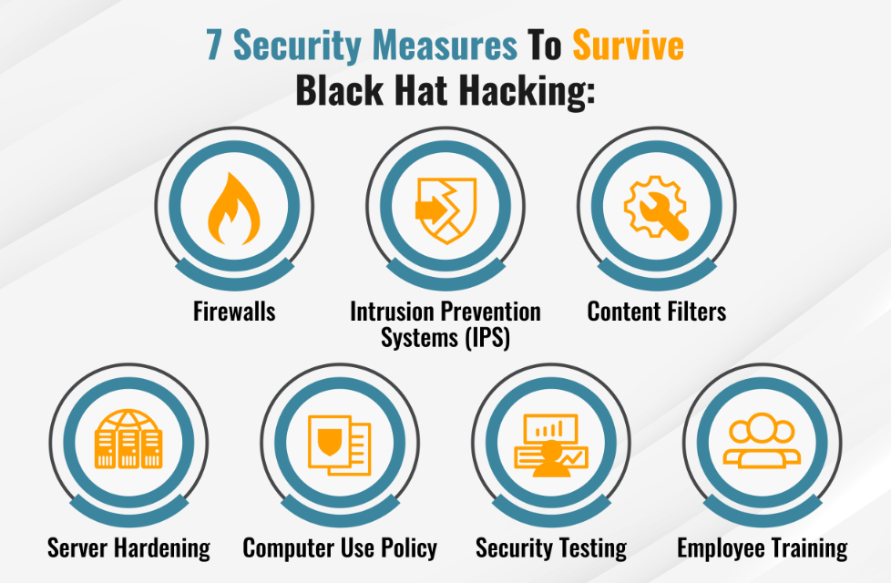
4
Common Cyber Attack Vectors
How hackers bypass weak password protection.
In a brute force attack, automated software systematically tests every possible combination of characters. Strength checkers prevent this by forcing users to create passwords that exceed the capacity of current hardware. Hackers use lists of stolen usernames and passwords from one breach to attack other services. This technique exploits the common habit of password reuse, making even a strong password vulnerable elsewhere. Attackers use pre-compiled lists of common words, names, and phrases to guess credentials. Checkers flag these common terms to ensure users avoid predictable language that is easily targeted by malicious scripts. Sometimes the strongest password is lost through deception rather than cracking. Phishing attacks trick users into revealing credentials, highlighting the need for vigilance alongside strong, unique, and verified password practices.
Photo by Google

Slide 7
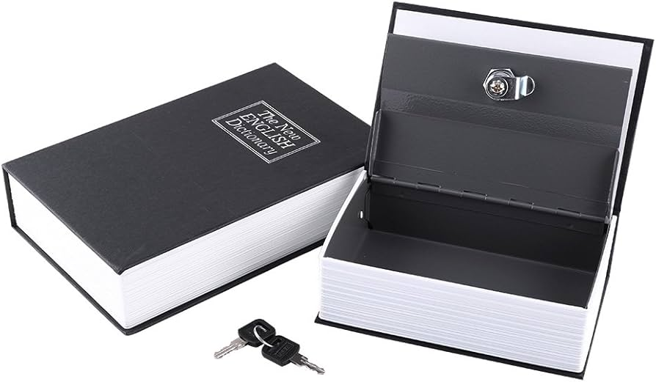
5
The Power of Passphrases
Creating memorable yet unbreakable security keys.
Using four or more random, unrelated words creates a high-entropy passphrase. These are significantly easier for humans to remember while remaining mathematically impossible for computers to guess in a reasonable timeframe. Effective passphrases should never include birthdays, pet names, or campus landmarks. Hackers can easily find this information on social media, so selecting truly random words is essential for maintaining maximum security. Mnemonic sentences can help users create long, secure passwords. By taking the first letter of each word in a unique phrase, you can generate a complex string that is easy to recall. Many modern systems allow spaces within passphrases, which further increases entropy. Combining random words with spaces and a few symbols creates a robust defense that checkers will rate as highly secure.
Photo by Google

Slide 8
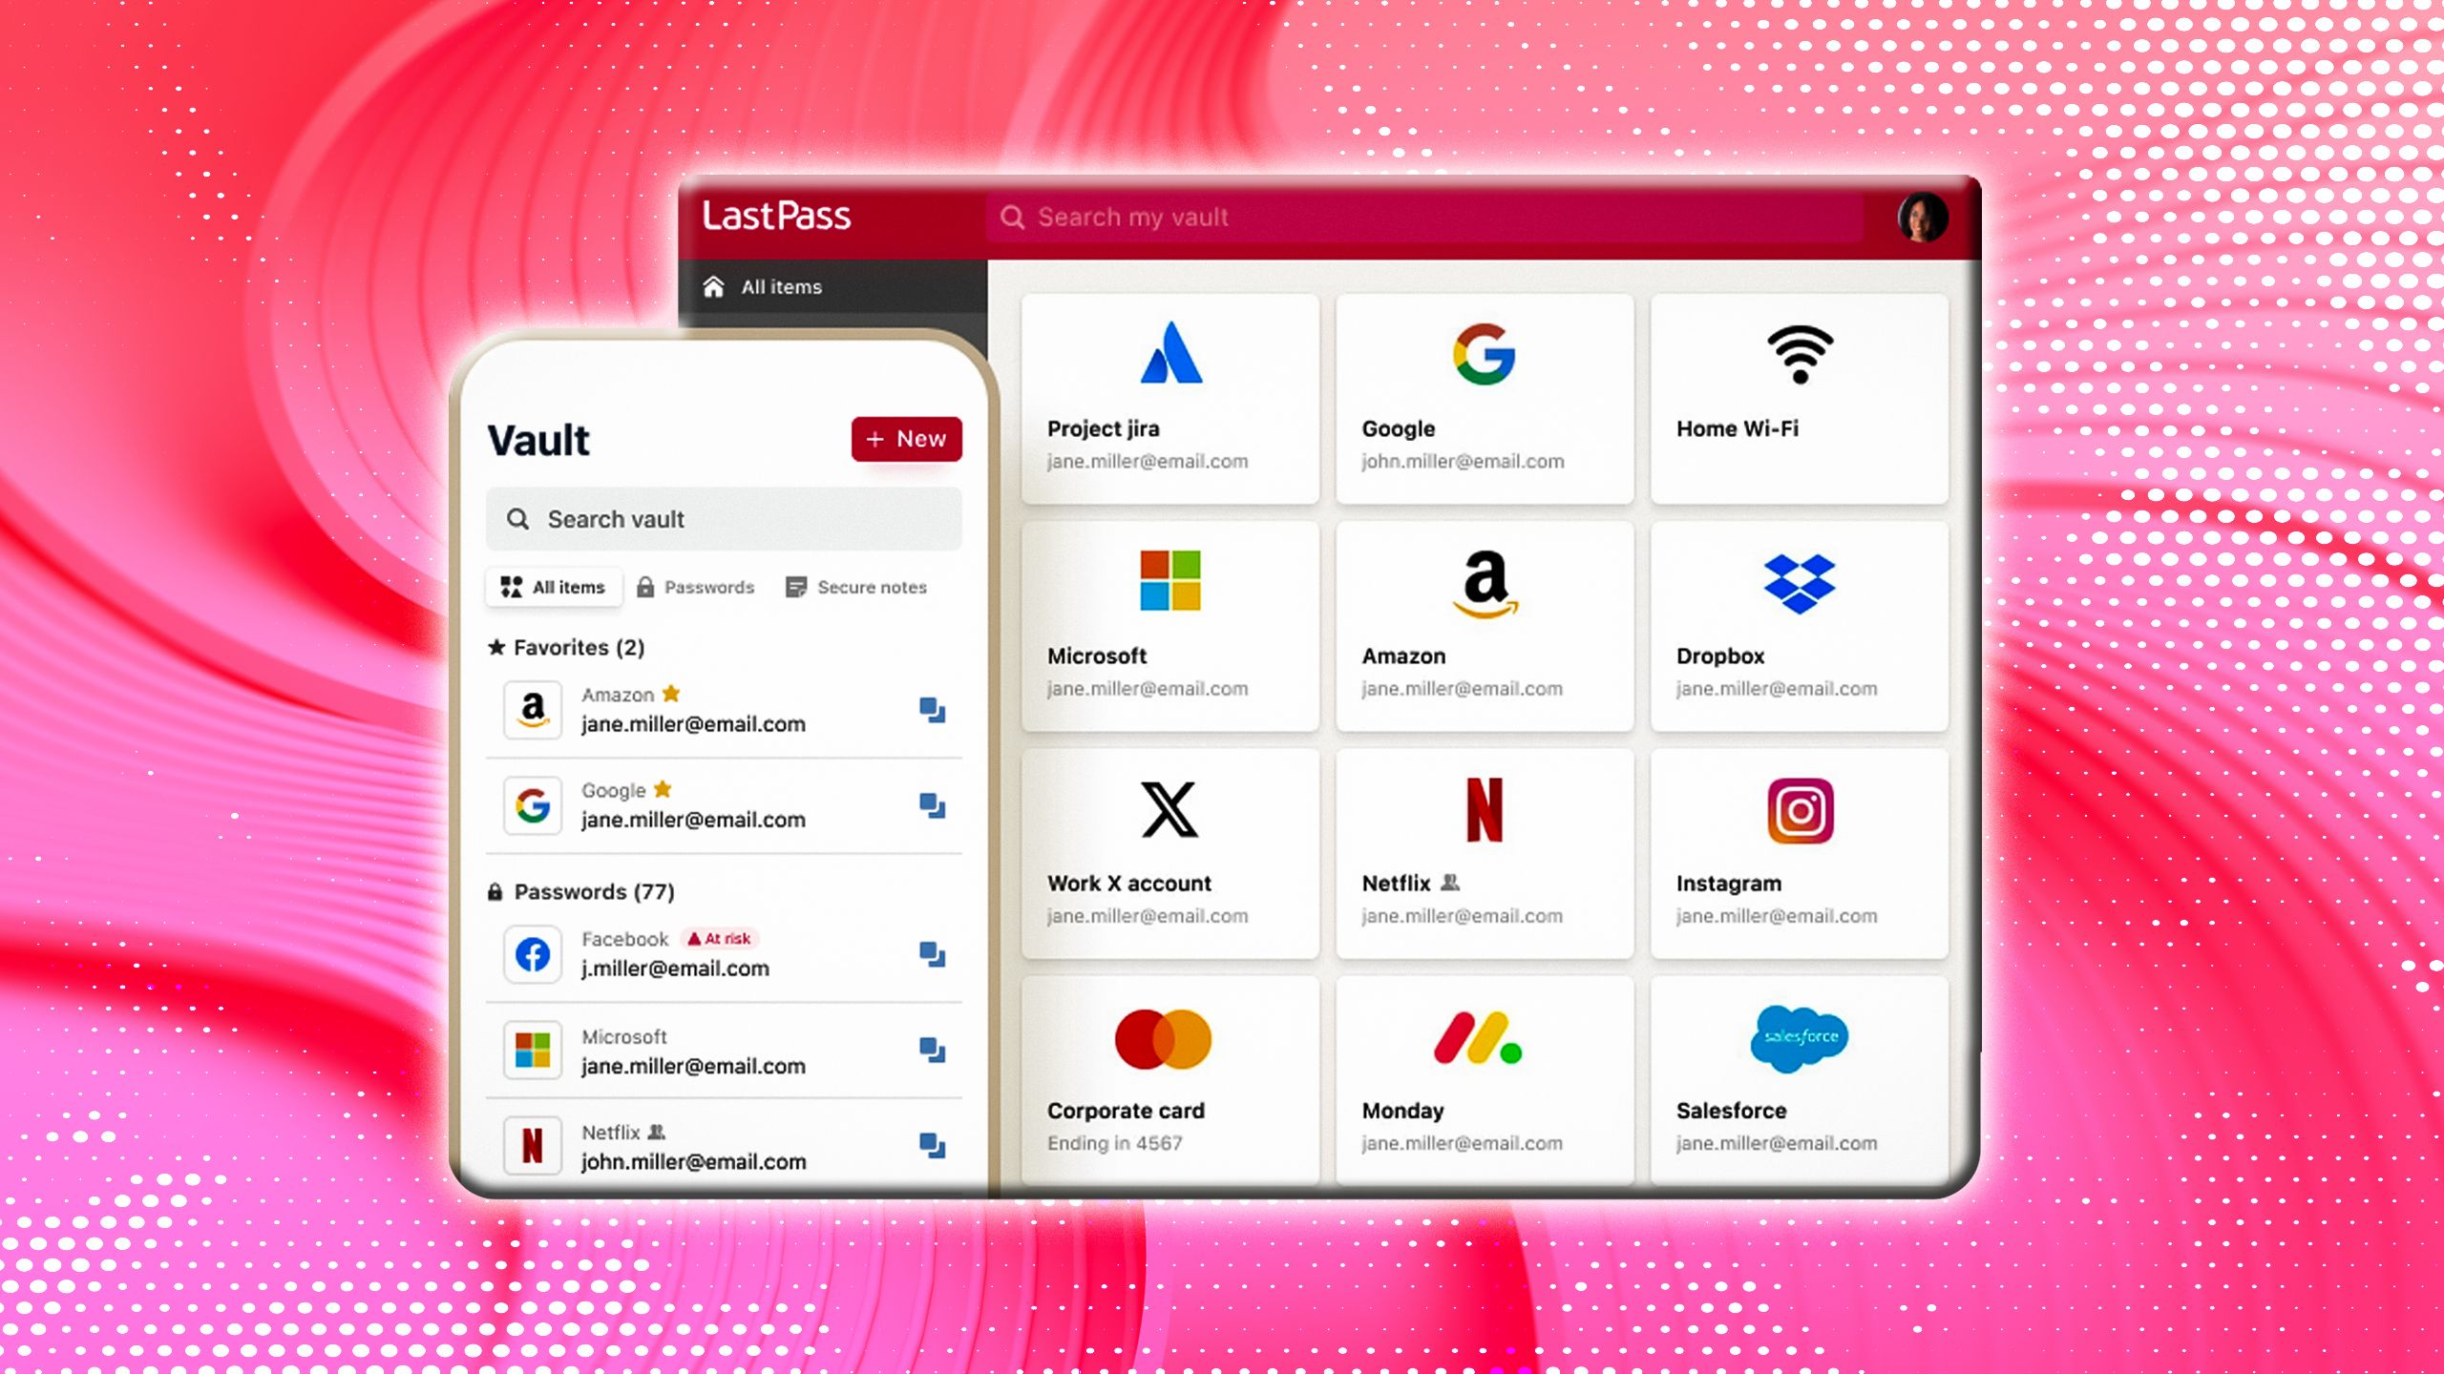
6
Password Management Tools
Leveraging technology for better security habits.
Password managers store unique, complex credentials for every account in an encrypted vault. This eliminates the need for users to remember dozens of different secrets, effectively solving the problem of reuse. Most managers include built-in generators that create high-entropy strings automatically. These tools ensure every new account starts with a maximum-strength password that meets all modern complexity and length requirements. Managers use industry-standard encryption to protect your data locally. By using one strong master passphrase, you can unlock access to all other credentials while keeping them safe from unauthorized external access. Modern password management tools sync across phones, laptops, and tablets. This ensures that your strong, unique credentials are always available, making it easier to maintain high security standards on every device.
Photo by Google

Slide 9
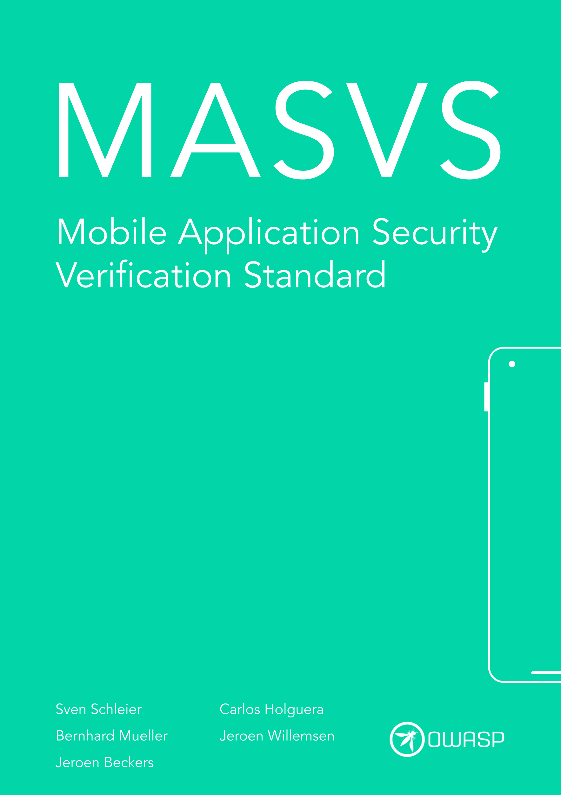
7
Multi-Factor Authentication
The vital second layer of digital protection.
Multi-factor authentication adds a second verification step, such as a mobile app code or biometric scan. This ensures that even if a password is stolen, the account remains protected from hackers. MFA is one of the most effective ways to stop unauthorized access attempts. It acts as a safety net, preventing attackers from gaining entry even when they have acquired valid login credentials. Common factors include something you know, something you have, or something you are. Using a combination of these factors significantly increases the difficulty for any attacker attempting to impersonate a user. College students should enable MFA on all critical accounts, including university portals, email, and banking. This practice provides an essential layer of security that complements the use of strong, unique passwords.
Photo by Google

Slide 10
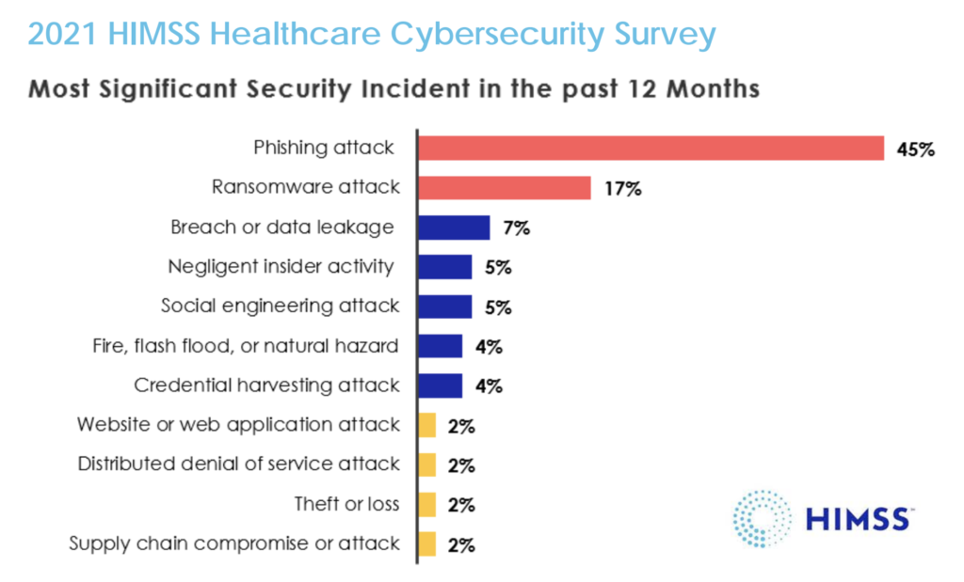
8
Industry Security Statistics
Data-driven insights into credential safety.
Recent reports indicate that over nineteen billion passwords have been leaked in various data breaches. This massive scale of exposure highlights why unique passwords and regular strength checks are absolutely critical. Despite warnings, millions of users still use '123456' or 'password' as their credentials. Strength checkers are designed to flag these dangerous choices and educate users on the risks of predictable sequences. Credential stuffing attacks have a low success rate per attempt but succeed due to the sheer volume of leaked data. Strengthening your passwords reduces the likelihood of falling victim to these automated bots. The average person now manages over one hundred unique accounts. This complexity makes password managers and strength checkers indispensable tools for maintaining a secure and organized digital life in the modern age.
Photo by Google

Slide 11
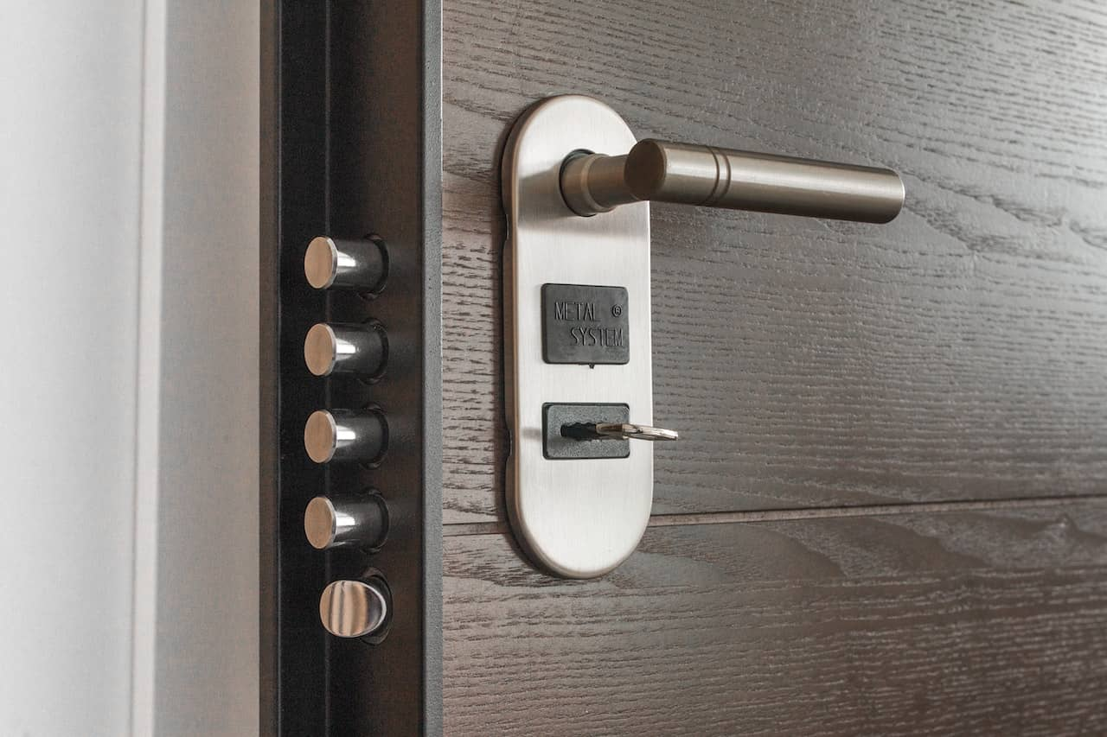
9
Best Practices for Students
Actionable steps for campus digital security.
Your university email is the gateway to all other accounts. Protecting it with a unique, high-strength password and multi-factor authentication is the most important step in securing your entire digital presence. Periodically use a strength checker to review your existing passwords. Updating weak or old credentials ensures that your security remains robust against the latest cracking techniques and newly discovered data breaches. Avoid entering passwords on unsecured public networks without a VPN. Attackers can intercept data on open campus networks, so always ensure your connection is encrypted before accessing sensitive personal or academic information. No legitimate IT department or service provider will ever ask for your password. Keeping your credentials private is a fundamental rule of cybersecurity that prevents social engineering attacks from succeeding against you.
Photo by Google

Slide 12

10
Securing Your Digital Future
Thank you for joining this presentation.
Thank you for your attention and commitment to better cybersecurity. We hope these insights help you build a safer digital environment for your personal, academic, and professional life in the future. Cybersecurity is an evolving field that requires constant learning. Stay updated with the latest recommendations from NIST and your university's IT department to ensure your digital identity remains protected against emerging threats. Start by checking your most important passwords and enabling multi-factor authentication. These small, proactive steps significantly reduce your risk and contribute to a more secure digital community for everyone on campus. If you have any further questions about password strength or digital security tools, please reach out. We are here to support your journey toward becoming a more security-conscious and protected digital citizen.
Photo by Google

