Slide 1
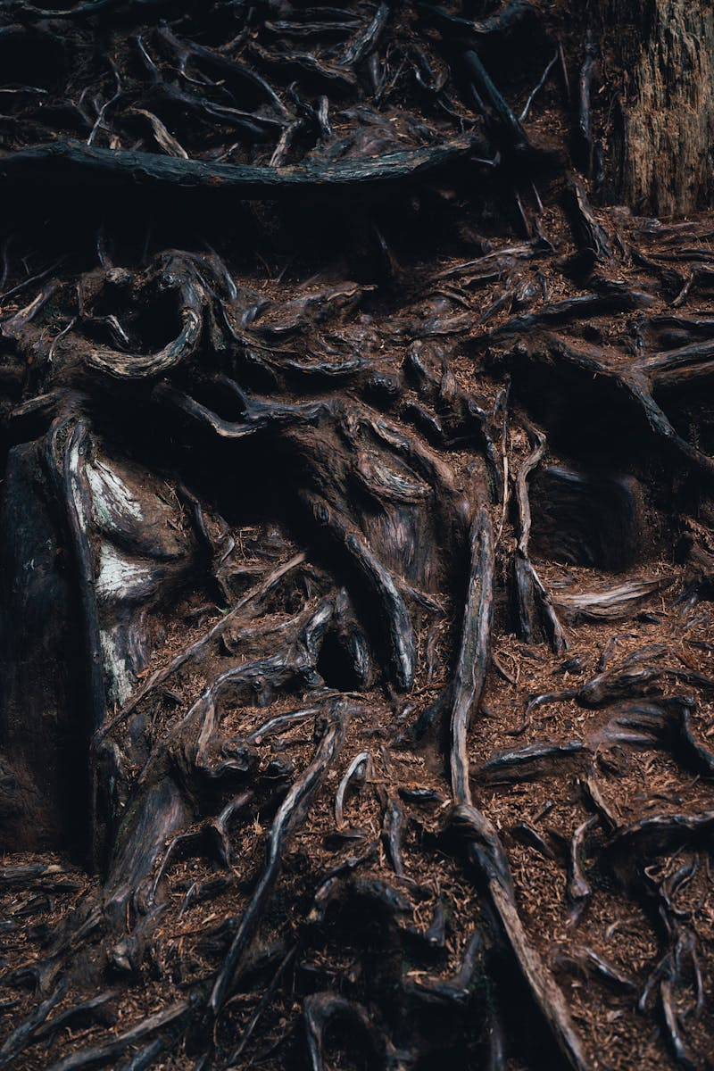
Mathematical Patterns in Nature Exploring the Hidden Mathematics of the Natural World
Photo by Pexels

Slide 2
01
Fibonacci Sequence
Table of Contents
02
Golden Ratio
03
Fractals in Nature
04
Symmetry Patterns
05
Spirals and Curves
06
Tessellations
07
Wave Patterns
08
Crystal Structures
09
Chaos Theory
10
Topology in Nature

Slide 3

1
Fibonacci Sequence
Nature's Favorite Number Pattern
A sequence where each number is the sum of the two preceding ones: 0, 1, 1, 2, 3, 5, 8, 13... Found in the arrangement of leaves on stems, pine cone spirals, and sunflower seed patterns Many flowers have petal counts matching Fibonacci numbers: lilies (3), buttercups (5), delphiniums (8) Tree branches and root systems often follow Fibonacci ratios in their growth patterns

Slide 4
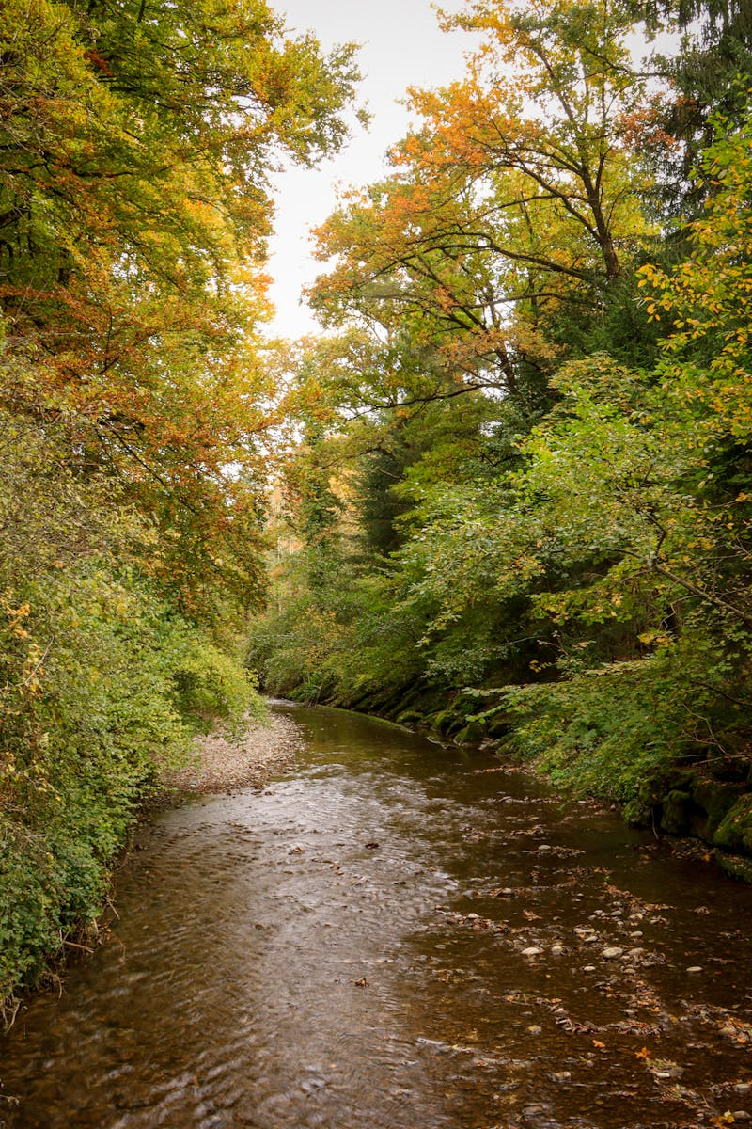
2
Golden Ratio
The Divine Proportion in Nature
The ratio of approximately 1.618, derived from the Fibonacci sequence as numbers approach infinity Found in proportions like the ratio of forearm to hand, face width to length, and body segment ratios The spiral growth of nautilus shells follows the golden ratio in their logarithmic spiral Weather systems like hurricanes and galaxies often display golden ratio proportions in their spiral structures

Slide 5
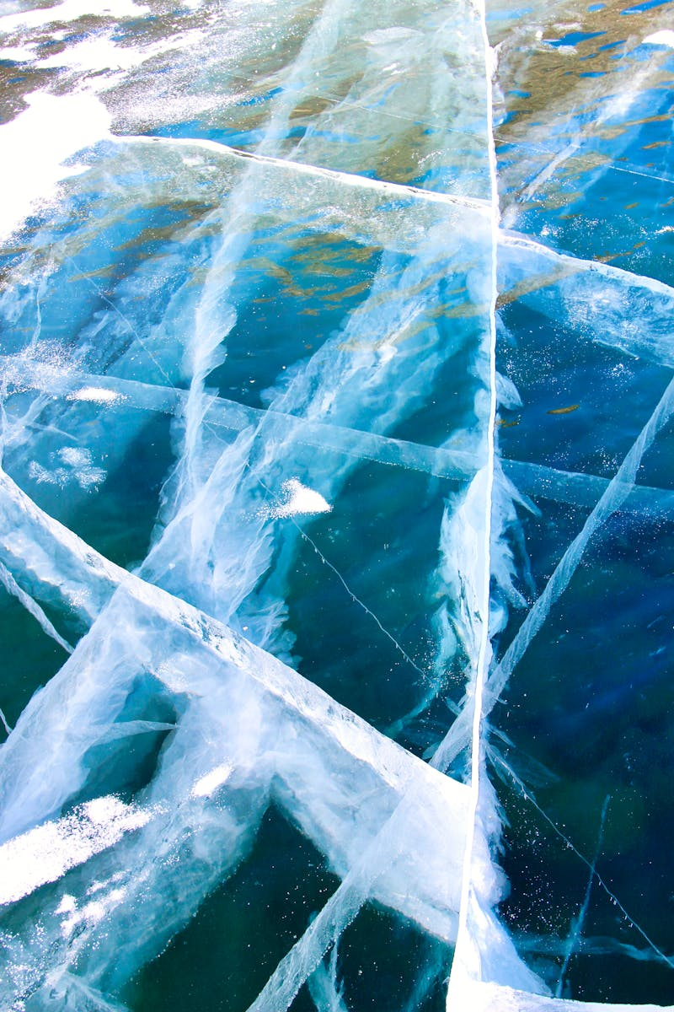
3
Fractals in Nature
Self-Similar Patterns at Every Scale
Patterns that repeat at different scales, where each part resembles the whole structure The irregular boundaries of coastlines exhibit fractal properties when measured at different scales Lightning bolts branch in fractal patterns as they seek the path of least resistance River networks and tributaries form fractal patterns that repeat at multiple scales

Slide 6
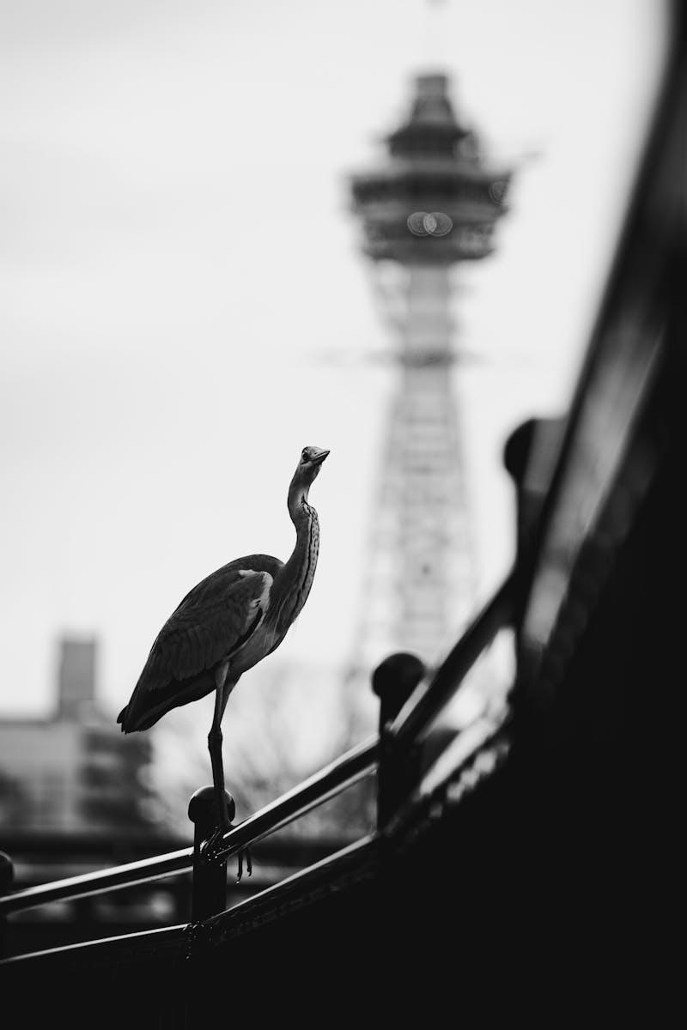
4
Symmetry Patterns
Balance and Order in Natural Forms
Most animals exhibit left-right symmetry, with matching halves on either side of a central axis Found in starfish, jellyfish, and flowers with patterns radiating from a central point Minerals and crystals display perfect geometric symmetry in their molecular arrangements Each snowflake exhibits six-fold symmetry, with intricate patterns repeating in perfect harmony

Slide 7
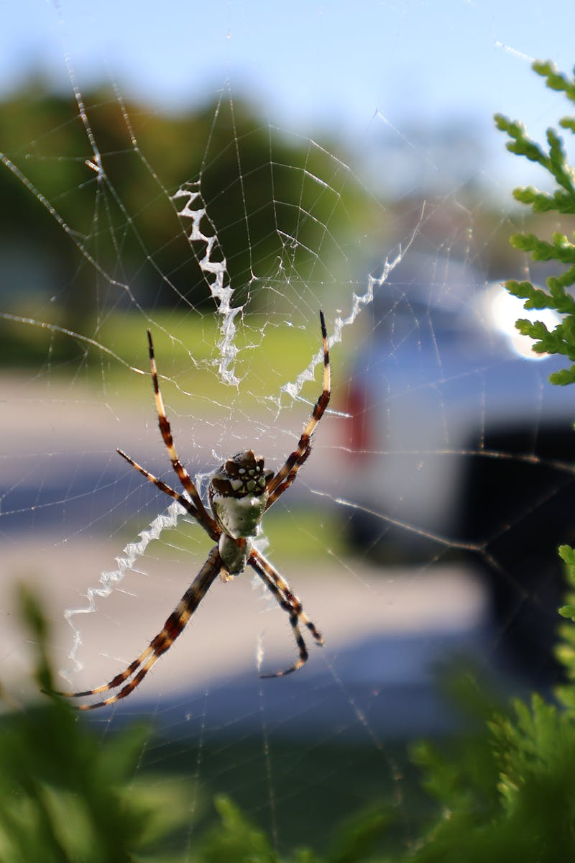
5
Spirals and Curves
Mathematical Curves in Natural Motion
Spirals that maintain constant angles, found in shells, galaxies, and weather systems Spiral galaxies display logarithmic spiral patterns in their arm structures Vining plants curl in mathematical spirals as they seek support structures Water and air flows create spiral patterns in whirlpools and tornadoes

Slide 8

6
Tessellations
Perfect Tiling Patterns in Nature
Patterns that cover a surface with repeating shapes without gaps or overlaps Bees create perfect hexagonal tessellations that maximize space efficiency The scutes on turtle shells form intricate tessellated patterns Biological cells often arrange in tessellated patterns in tissues and organs

Slide 9

7
Wave Patterns
Mathematical Oscillations in Nature
Natural phenomena like sound, light, and water follow sinusoidal patterns Musical harmonies and natural sounds follow mathematical wave patterns Electromagnetic radiation exhibits wave properties with mathematical regularity Water surface waves follow mathematical patterns in their formation and propagation

Slide 10
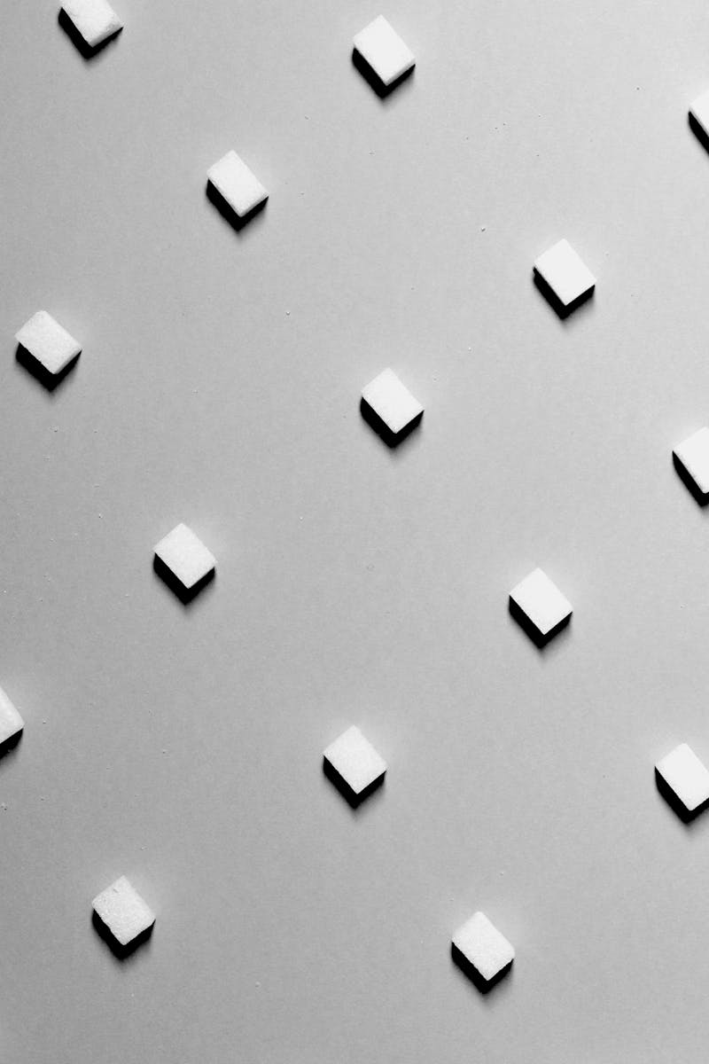
8
Crystal Structures
Geometric Perfection in Minerals
Salt and other minerals form perfect cubic structures with mathematical precision Quartz and similar crystals form six-sided geometric patterns Atoms arrange in mathematically optimal positions for energy minimization Crystal growth follows mathematical laws of symmetry and geometry

Slide 11
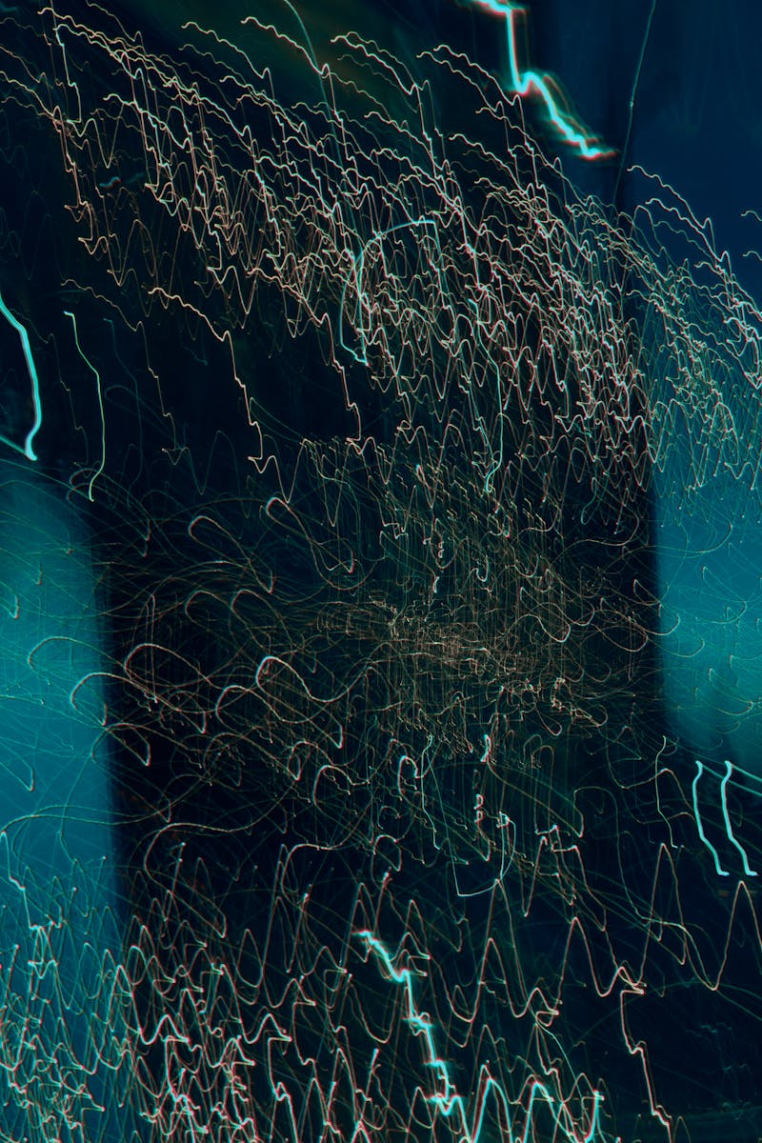
9
Chaos Theory
Order in Apparent Randomness
Small changes in initial conditions lead to vastly different outcomes in complex systems Atmospheric patterns exhibit chaotic behavior with underlying mathematical structure Animal populations follow chaotic patterns with mathematical predictability Mathematical patterns that emerge from chaotic systems, showing order in apparent randomness

Slide 12
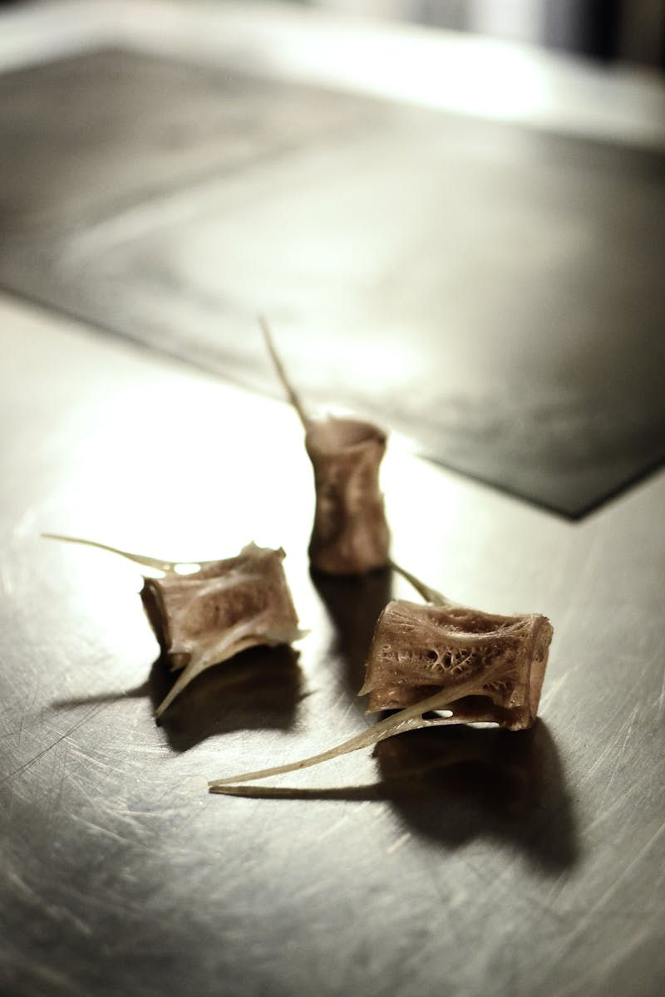
10
Topology in Nature
Shape and Connectivity in Natural Forms
The study of properties preserved under continuous deformations in natural objects Neural networks, food webs, and transportation systems exhibit topological properties DNA molecules and protein structures demonstrate mathematical knotting patterns The arrangement and connectivity of molecules follow topological principles

