Slide 1
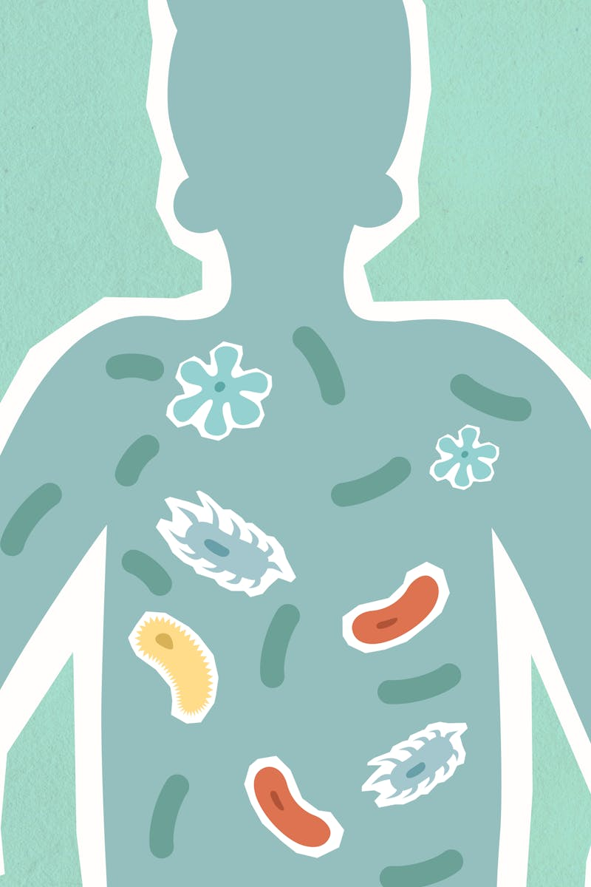
Normal Human Microbiome An Overview of Microbial Communities in the Human Body
Photo by Pexels

Slide 2
01
Normal Human Microbiome
Table of Contents
02
What Is the Microbiome?
03
Major Body Sites
04
Skin Microbiome
05
Oral Microbiome
06
GI Tract Microbiome
07
Genitourinary Microbiome
08
Functions: Protective
09
Functions: Metabolic & Immune
10
Factors Influencing Microbiome

Slide 3
1
Normal Human Microbiome
Introduction to Microbial Communities and Their Importance
The human microbiome refers to the vast array of microorganisms, including bacteria, fungi, viruses, and archaea, that reside in and on the human body, forming intricate communities. These microbial communities are distributed across various body sites, such as the skin, oral cavity, and gastrointestinal tract, each adapting to specific environmental conditions. The microbiome plays critical roles in supporting digestion, bolstering the immune system, and contributing to overall well-being by maintaining balanced ecosystems. A balanced microbiome is essential for preventing diseases, as imbalances can lead to health issues, highlighting the need for ongoing research and understanding.

Slide 4

2
What Is the Microbiome?
Understanding the Composition and Influence of Microorganisms
The microbiome consists of trillions of microorganisms, including bacteria, fungi, viruses, and archaea, that coexist in the human body and form dynamic ecosystems. These organisms are incredibly numerous and diverse, with estimates suggesting they outnumber human cells, creating a complex network that varies between individuals. Microbes in the microbiome aid in digestion by breaking down nutrients and producing essential compounds, which supports efficient nutrient absorption and metabolic processes. The microbiome influences immunity by interacting with the body's defense systems and contributes to overall well-being by regulating inflammation and mental health.

Slide 5

3
Major Body Sites
Exploring the Variation in Microbial Communities Across Body Regions
The human body hosts microbial communities in specific regions, including the skin, oral cavity, respiratory tract, gastrointestinal tract, and genitourinary system. Each site offers unique conditions, such as moisture levels and pH, which shape the diversity and composition of the microbial populations residing there. The skin provides a protective barrier, hosting microbes that adapt to its external exposure, influencing overall body defense mechanisms. The GI tract supports the densest microbial populations due to its nutrient-rich environment, playing a pivotal role in digestive health.

Slide 6

4
Skin Microbiome
The Role and Composition of Microbes on the Skin
The skin microbiome includes species like Staphylococcus epidermidis, Cutibacterium acnes, and Corynebacterium, which form a protective layer on the skin's surface. These microbes compete with harmful pathogens for resources, helping to prevent infections and maintain the skin's integrity. Skin microbes contribute to an acidic pH environment, which acts as a natural barrier against invaders and supports skin health. A balanced skin microbiome is crucial for preventing conditions like acne or eczema, as imbalances can lead to inflammation and disease.

Slide 7

5
Oral Microbiome
Diversity and Functions of Microbes in the Mouth
The oral microbiome features diverse species such as Streptococcus, Actinomyces, and various anaerobes, which thrive in the moist environment of the mouth. These microbes form biofilms on teeth and gums, aiding in the initial stages of digestion and helping to maintain a healthy oral ecosystem. Oral microbes break down food particles and produce enzymes that assist in early digestion, facilitating nutrient processing in the digestive tract. If the oral microbiome becomes imbalanced, it can lead to diseases like cavities or gum infections, underscoring the need for good oral hygiene.

Slide 8

6
GI Tract Microbiome
The Dense and Diverse Microbes in the Gastrointestinal System
The GI tract is dominated by bacteria such as Bacteroides, Firmicutes, and E. coli, which form the most diverse and dense microbial community in the body. These microbes break down complex foods, extract nutrients, and produce beneficial byproducts like short-chain fatty acids to aid in digestion. GI tract microbes synthesize essential vitamins, such as B vitamins and vitamin K, which are vital for human metabolism and overall health. The microbiome regulates metabolic activities, influencing energy harvest from food and helping to maintain a balanced gut environment.

Slide 9

7
Genitourinary Microbiome
Microbial Communities in the Genitourinary System
The vaginal microbiome is primarily dominated by Lactobacillus species, which maintain a low pH to create an inhospitable environment for pathogens. These microbes prevent infections by producing lactic acid and other compounds that inhibit the growth of harmful bacteria and yeast. In the male urethra, species like Staphylococcus, Streptococcus, and Corynebacterium reside, contributing to a balanced microbial environment. The genitourinary microbiome supports urinary tract health by preventing colonization by pathogens, reducing the risk of infections like UTIs.

Slide 10

8
Functions: Protective
How the Microbiome Provides Defense Against Harm
Microbiota protect the body by competing with harmful pathogens for space and nutrients, limiting their ability to establish infections. Certain microbes produce antimicrobial compounds that directly inhibit the growth of invading pathogens, enhancing the body's natural defenses. The microbiome maintains conditions, such as pH and oxygen levels, that discourage the proliferation of harmful microorganisms. By forming a physical barrier, microbiota prevent pathogens from adhering to host tissues, thereby reducing infection risks.

Slide 11

9
Functions: Metabolic & Immune
The Microbiome's Role in Metabolism and Immunity
Microbes produce essential vitamins, such as B12 and folate, which are crucial for human metabolic processes and energy production. The microbiome breaks down complex carbohydrates into short-chain fatty acids, which provide energy and support gut health. Microbes help train the immune system by exposing it to various antigens, enabling it to distinguish between harmful invaders and beneficial organisms. The microbiome modulates immune responses to reduce inflammation and prevent autoimmune conditions, promoting overall immune balance.

Slide 12

10
Factors Influencing Microbiome
Key Elements That Shape Microbiome Composition
Diet plays a significant role in microbiome composition, as different foods provide nutrients that favor certain microbial populations over others. As individuals age, their microbiome changes due to shifts in physiology and lifestyle, potentially altering health outcomes. Antibiotics and other medications can disrupt the microbiome by killing beneficial microbes, leading to imbalances and health issues. Hormones and environmental factors, such as pollution or hygiene practices, can shift microbial balance, affecting overall well-being.

