Slide 1


Offshore Field Training: Vapor Pressure & H2S Management
Simple and Practical Guide for Operators

Slide 2


Table of Contents
1
Introduction
2
What is Reid Vapor Pressure (RVP)?
3
Theory of RVP
4
Field Impact of RVP
5
Introduction to H2S
6
H2S Theory

Slide 3
7
H2S Impact on Safety & Assets
8
What is H2S Scavenging?
9
Triazine Reaction Theory
10
Field Application: Scavenging H2S
11
Measuring H2S in the Field
12
Conclusion & Safety Reminder

Slide 4


Introduction
Designed for offshore field operators with high school education level.
To explain RVP and H2S topics in a clear, simple, and field-relevant way.

Slide 5

What is Reid Vapor Pressure (RVP)?
RVP is a measure of a liquid's tendency to evaporate, especially for petroleum products.
Used to understand volatility and handling safety of fuels.

Slide 6

Theory of RVP
Higher temperature or lighter molecules mean higher vapor pressure.
RVP is measured using a standardized method at 100°F.

Slide 7

Field Impact of RVP
High RVP may cause vapor lock in engines or pumps.
Storage tanks may build dangerous pressure if RVP is too high.

Slide 8

Introduction to H2S
A toxic, flammable gas with a rotten egg smell, commonly found in oilfields.
H2S can cause health issues or death at high concentrations.

Slide 9

H2S Theory
H2S forms naturally from the breakdown of organic materials underground.
Heavier than air, it can collect in low-lying areas.

Slide 10

H2S Impact on Safety & Assets
Even small amounts can affect health; higher levels are fatal.
H2S damages metal, leading to leaks or equipment failure.

Slide 11

What is H2S Scavenging?
Used to reduce H2S content in oil, gas, and water.
Triazine is widely used as a scavenger.

Slide 12

Triazine Reaction Theory
Triazine reacts with H2S to form non-toxic solids or liquids.
Works well but must be dosed properly for effectiveness.

Slide 13
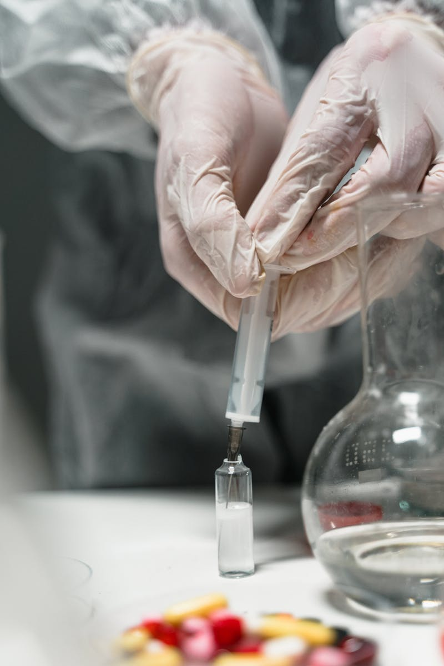
Field Application: Scavenging H2S
Triazine is injected where H2S levels are expected or detected.
Field staff must check H2S levels before and after injection.

Slide 14

Measuring H2S in the Field
Digital devices showing real-time H2S concentration.
Color-changing tubes used with hand pumps for spot checks.

Slide 15

Conclusion & Safety Reminder
Know RVP to handle fuels safely; use scavengers to control H2S.
Always test for gases and follow safety protocols in the field.

