Slide 1

Oncologic Emergencies: An Overview for the Intensivist
The Old, the New, and the Deadly

Slide 2


Table of Contents
01
Title Slide
02
Introduction
03
Febrile Neutropenia
04
Hyperleukocytosis / Leukostasis
05
Tumor Lysis Syndrome (TLS)

Slide 3


Title Slide
01
Oncologic Emergencies: An Overview for the Intensivist
02
The Old, the New, and the Deadly
03
Krishna Thandra, MD, et al.
04
J Intensive Care Med. 2020 Jan; 35(1): 3-13
Photo by Pexels

Slide 4

Introduction
01
Cancer is a leading cause of death globally, but advancements in care have led to a decline in mortality rates.
02
Patients with cancer make up a significant portion of ICU admissions (14-22%).
03
Intensivists must be aware of the unique emergencies associated with cancer and its treatments.
04
Oncologic emergencies can be an initial presentation of the disease or a complication of its treatment.
Photo by Pexels

Slide 5
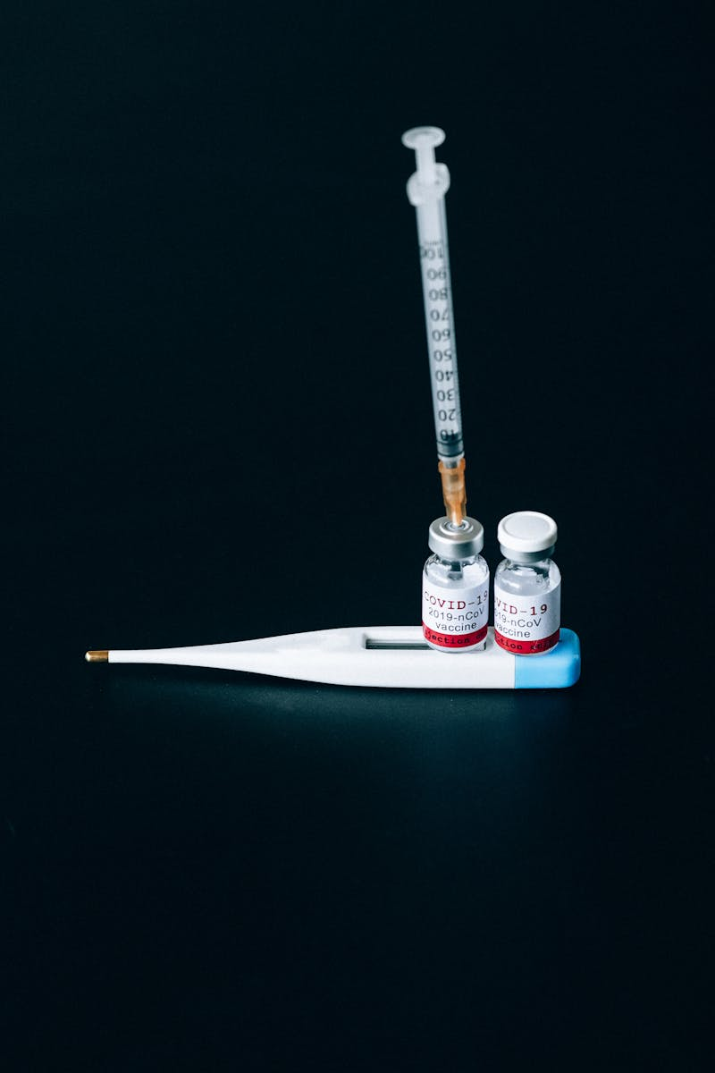
Febrile Neutropenia
01
A single oral temperature of 38.3°C (101°F) in a patient with an absolute neutrophil count (ANC) of less than 1500/µL.
02
Rapid decline of ANC, recent chemotherapy, current immunosuppression, and cardiovascular comorbidities.
03
Often due to a variety of organisms, though a specific causative organism is only identified in a minority of patients. Common organisms are listed in table 2.
04
Empiric antibiotic therapy is the mainstay of treatment, selected based on clinical status and other factors.
Photo by Pexels

Slide 6

Hyperleukocytosis / Leukostasis
01
An extreme form of leukocytosis with a white blood cell (WBC) count >100,000/µL.
02
High quantity of WBCs can clump together, causing impaired microvascular flow, tissue hypoxia, and hemorrhage.
03
Patients with hematologic malignancies especially acute myeloid leukemia (AML) and acute lymphoid leukemia (ALL).
04
Initial management includes aggressive hydration with calcium and potassium-free fluids; definitive treatment involves chemotherapy to decrease tumor load; leukapheresis for symptomatic patients or very high WBC counts; refer to flowchart 2 for detailed strategies.
Photo by Pexels

Slide 7

Tumor Lysis Syndrome (TLS)
01
A group of metabolic abnormalities that occur due to the rapid breakdown of tumor cells and the release of their contents into the bloodstream.
02
Hyperkalemia, hyperphosphatemia, and hyperuricemia, which can lead to hypocalcemia and acute kidney injury (AKI).
03
Based on clinical and laboratory criteria from the Cairo and Bishop classification system (fig 3).
04
Management strategies for TLS, including addressing metabolic imbalances and supportive care (note: content incomplete in source).
Photo by Pexels

