Slide 1
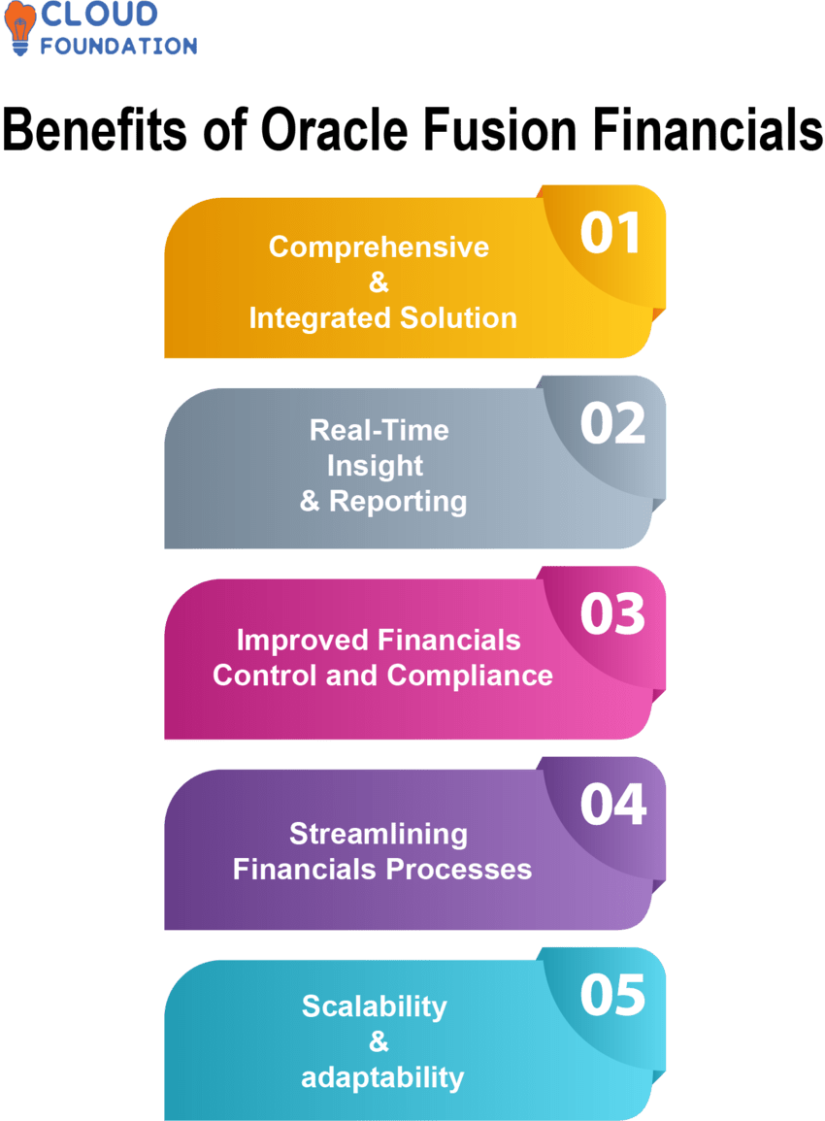
Oracle EBS Financials: A Foundation for Success
Understanding Core Concepts and Configuration of Ledgers in Oracle E-Business Suite
Photo by Google

Slide 2
01
Unlocking Financial Potential with Oracle EBS
Table of Contents
02
The 4 C's: Building Your Ledger
03
Defining Your Accounting Calendar
04
Currency Configuration in Oracle EBS
05
Practical Steps: Creating the 4 C's
06
The Power of Integration
07
Best Practices for Configuration
08
Troubleshooting Common Issues
09
Beyond the Basics: Advanced Features
10
Thank You

Slide 3
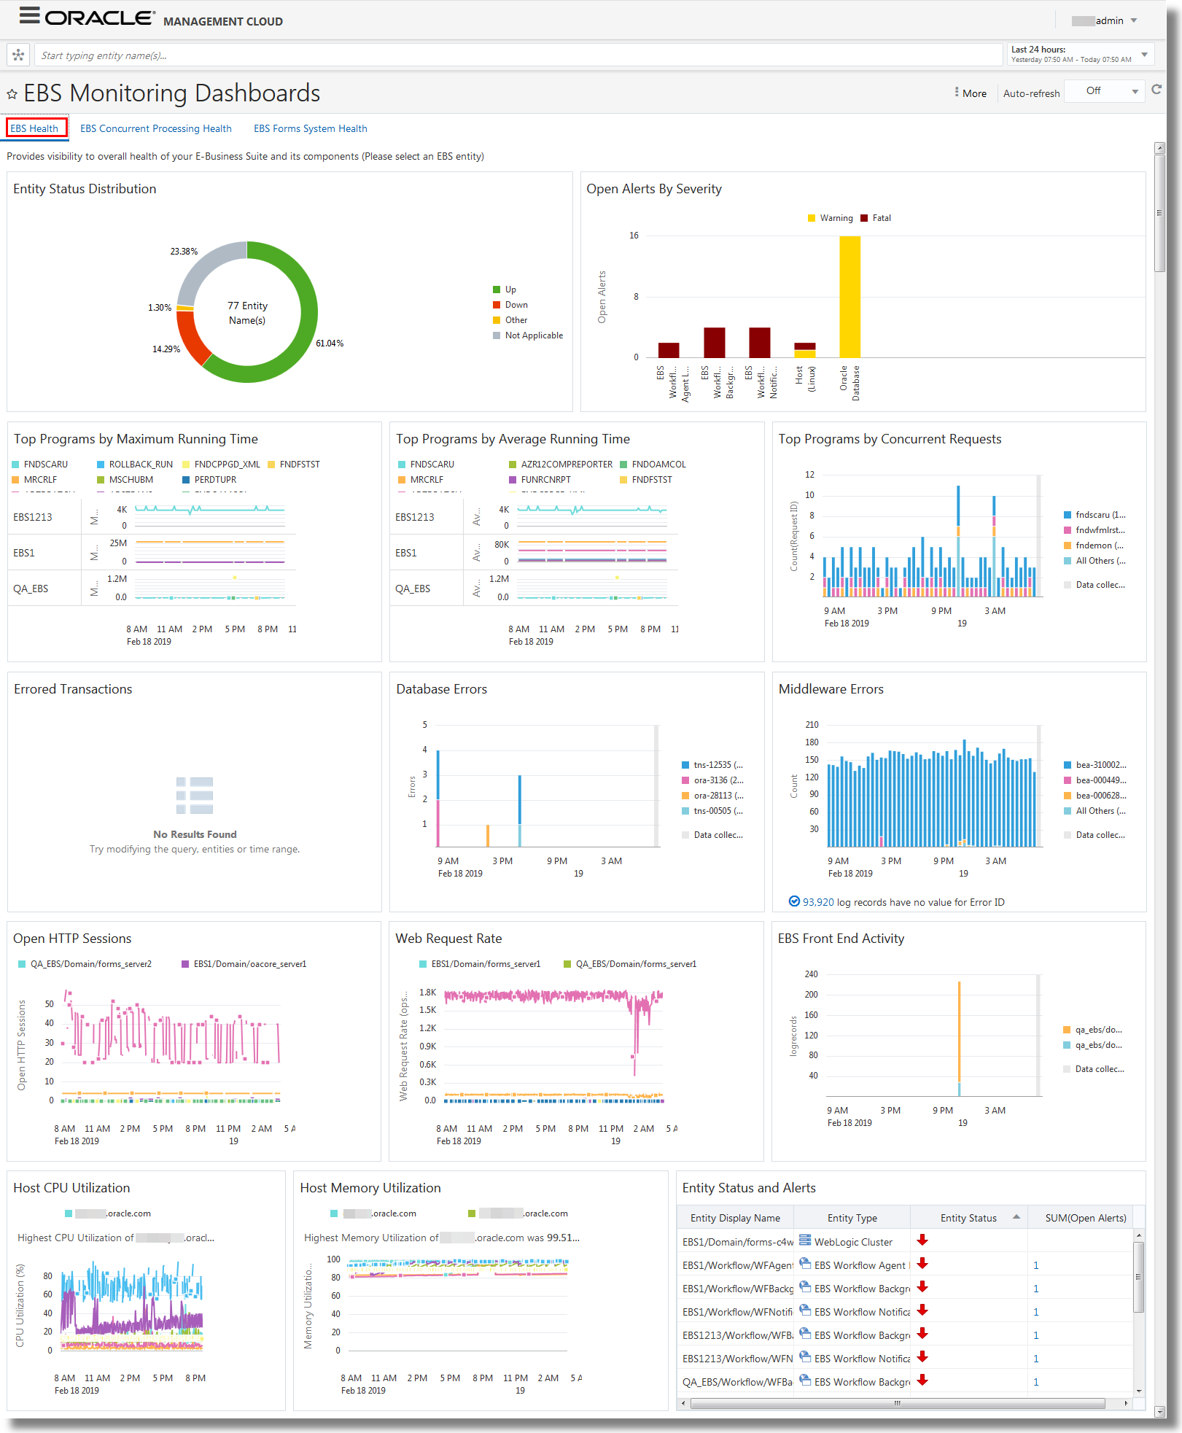
1
Unlocking Financial Potential with Oracle EBS
A Brief Introduction to Oracle E-Business Suite Financials
A comprehensive suite of applications for managing all aspects of an organization's financial operations. Streamlines processes and improves efficiency.
General Ledger, Accounts Payable, Accounts Receivable, Fixed Assets, Cash Management, and more. Integrated for seamless data flow.
Improved financial control, better decision-making, enhanced compliance, and increased operational efficiency. Leading to business growth.
Finance professionals, accountants, system administrators, and anyone involved in financial management within an organization.
Photo by Google

Slide 4
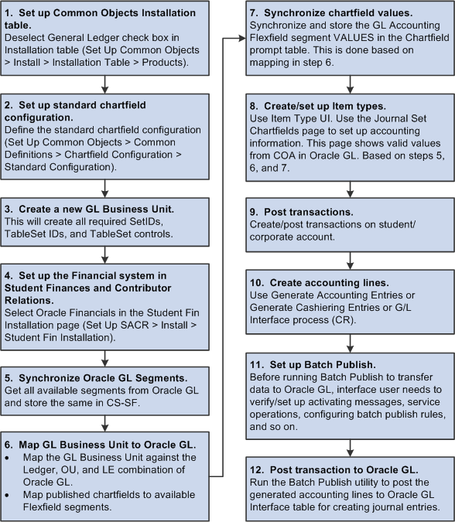
2
The 4 C's: Building Your Ledger
A Deep Dive into the Core Components of an Oracle Ledger
Defines the structure for recording financial transactions. Provides a framework for categorizing and reporting financial data. It is very important.
Defines the accounting periods used for financial reporting. Crucial for tracking financial performance over time. And defining close periods.
Specifies the currency used for recording and reporting financial transactions. Enables global financial management. For better reporting.
Defines the accounting method. It's typically based on organization requirements. And sets the flow for data
Photo by Google

Slide 5
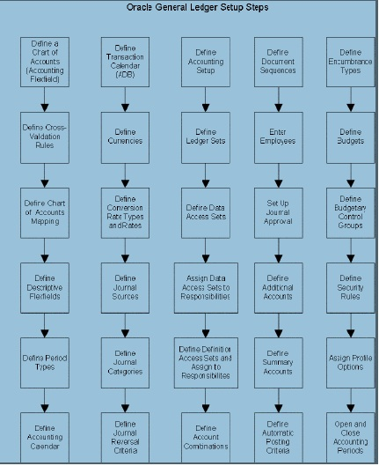
3
Defining Your Accounting Calendar
Setting the Foundation for Accurate Financial Reporting
Choose period frequency: monthly, quarterly, or yearly. Configure the start and end dates for each accounting period.
Align your accounting calendar with your organization's fiscal year. Ensures accurate and consistent financial reporting.
The calendar is crucial for managing the period close process. Facilitates timely and accurate financial statement generation.
Demonstrates how to create and manage accounting calendars in Oracle EBS. Includes setting period types and adjustment periods.
Photo by Google

Slide 6
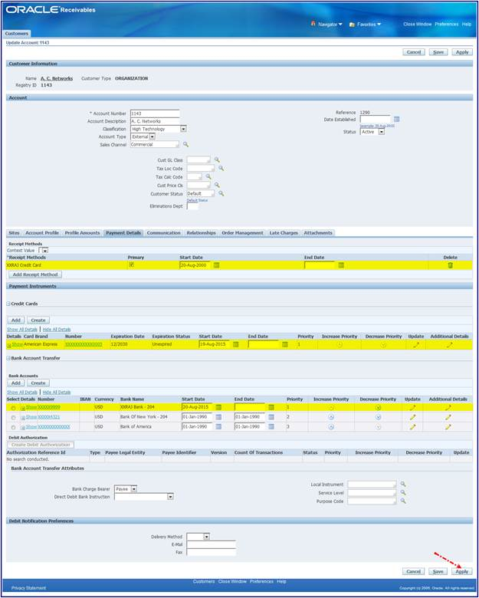
4
Currency Configuration in Oracle EBS
Managing Multiple Currencies for Global Operations
Select your organization's base currency for primary financial reporting. All transactions are ultimately translated.
Configure exchange rates for different currencies. Ensures accurate conversion of foreign currency transactions.
Automates the process of converting foreign currency transactions. Reduces manual effort and minimizes errors.
Accurate currency configuration is vital for reliable financial reporting. Provides a clear view of global financial performance.
Photo by Google

Slide 7
5
Practical Steps: Creating the 4 C's
A Walkthrough of the Configuration Process in Oracle EBS
Navigating to the relevant setup menus within Oracle EBS. Step-by-step guide to finding the configuration screens.
Creating and configuring the COA structure. Including defining segment qualifiers and value sets.
Configuring the accounting calendar. Including defining period types and adjustment periods.
Defining the base currency. Including setting up exchange rates for foreign currencies.
Photo by Google

Slide 8
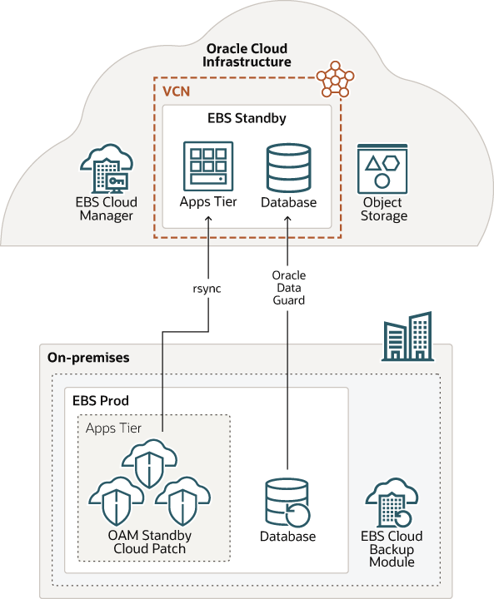
6
The Power of Integration
How the 4 C's Work Together for Seamless Financial Management
Illustrates how data flows between the Chart of Accounts, Calendar, and Currency settings. Shows the interconnectedness.
Highlights automated processes that leverage the 4 C's. Including journal entry creation and financial reporting.
Explains how proper configuration reduces manual errors. Ensures accurate financial data and reporting.
Shows how integration streamlines financial processes. Saves time and resources for finance teams.
Photo by Google

Slide 9

7
Best Practices for Configuration
Tips for Optimizing Your Oracle EBS Financial Setup
Importance of planning and designing your financial setup. Ensures alignment with your organization's needs.
Importance of regular maintenance and updates. Keeps your system running smoothly and efficiently.
Importance of providing adequate user training. Ensures users understand how to use the system effectively.
Importance of implementing proper security measures. Protects your financial data from unauthorized access.
Photo by Google

Slide 10
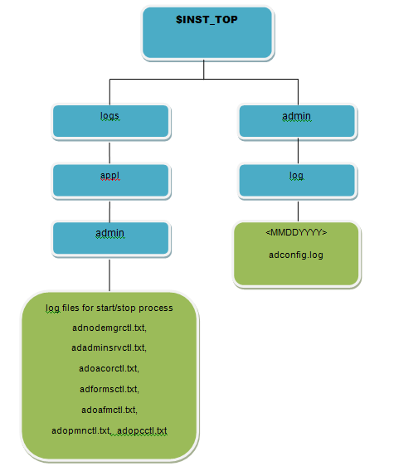
8
Troubleshooting Common Issues
Addressing Potential Challenges and Errors in Oracle EBS
Troubleshooting issues related to invalid account combinations. Explains how to resolve common errors.
Troubleshooting issues related to the period close process. Provides solutions for common challenges.
Troubleshooting issues related to currency conversion. Explains how to correct common errors.
Troubleshooting system performance issues. Provides tips for optimizing system speed and efficiency.
Photo by Google

Slide 11
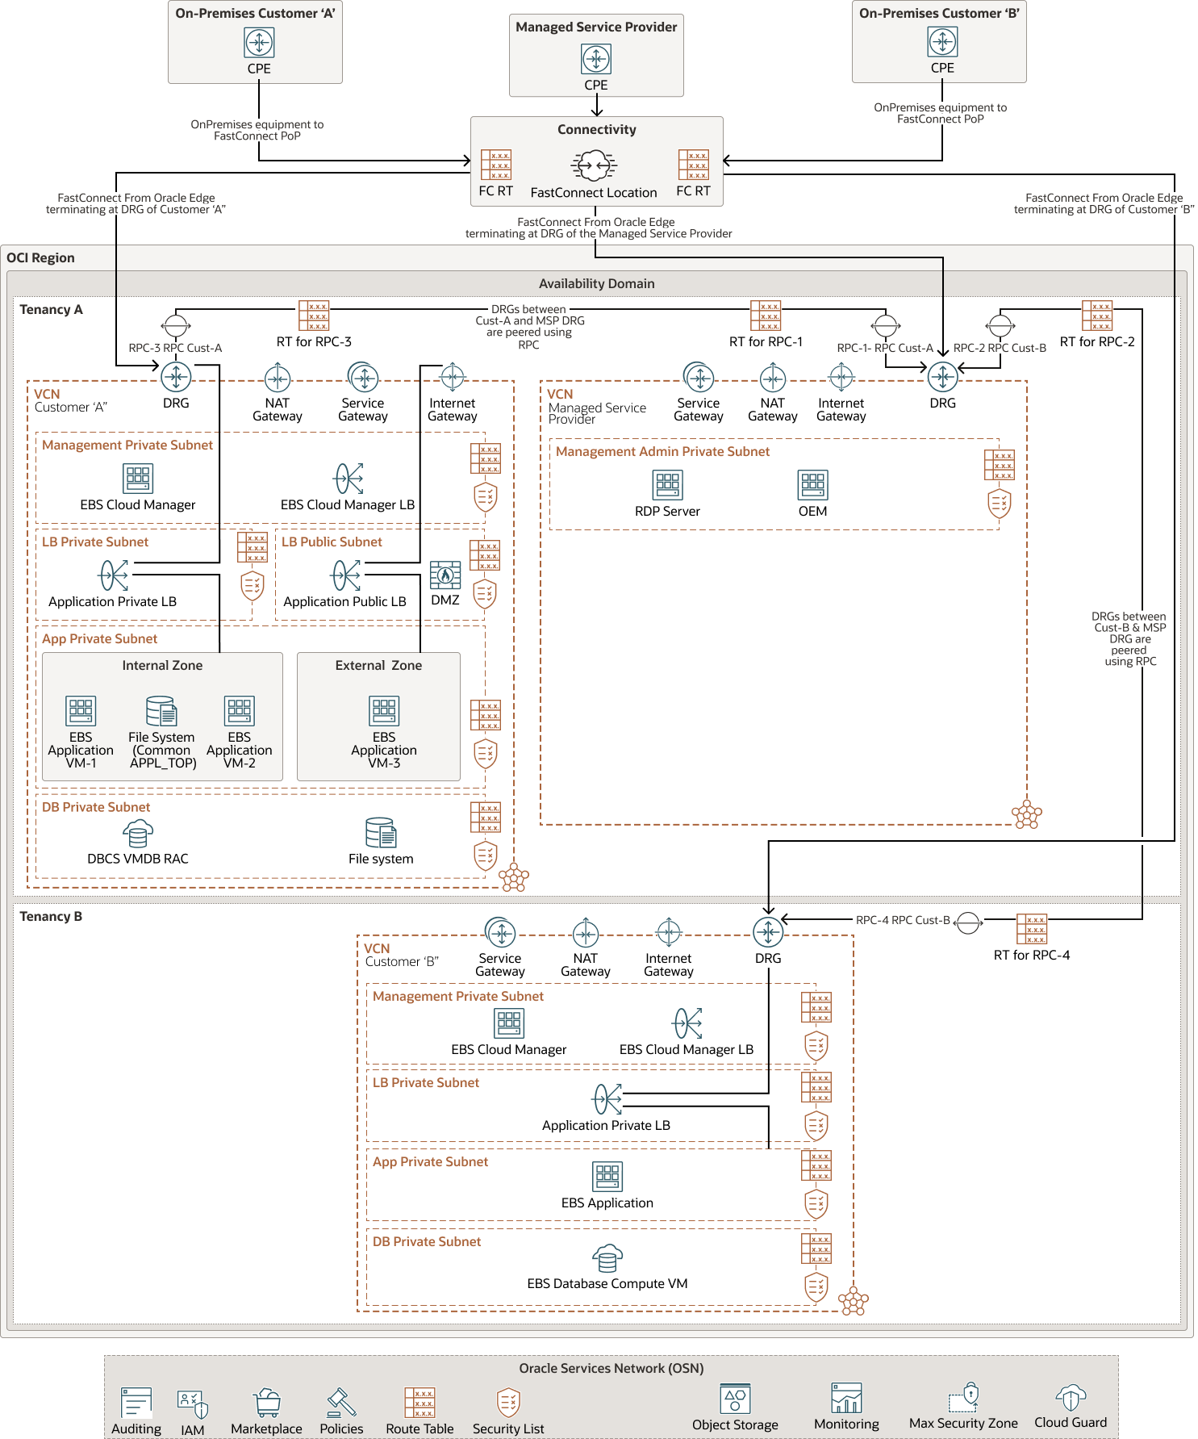
9
Beyond the Basics: Advanced Features
Exploring Advanced Functionality in Oracle EBS Financials
Managing intercompany transactions and eliminations. Streamlines accounting for multinational organizations.
Leveraging advanced reporting tools for deeper insights. Including Oracle Business Intelligence (OBI).
Utilizing budgeting and planning tools for financial forecasting. Enhances financial planning and control.
Integrating with other Oracle EBS modules. Streamlines processes and enhances data visibility.
Photo by Google

Slide 12

10
Thank You
Gratitude and Next Steps
Thank you for your time and attention. We hope this presentation has been informative.
We are happy to answer any questions you may have. Feel free to ask anything.
Explore Oracle's documentation and training resources. Enhance your knowledge.
Reach out to our team for further assistance or support. We will be glad to help you.
Photo by Google

