Slide 1

Partnering with WaruWenJo
Connecting the World to India’s Best Medical Expertise
Photo by Pexels

Slide 2
01
Partnering for Global Healthcare Access
Table of Contents
02
About WaruWenJo
03
The Global Healthcare Gap
04
Why Patients Choose India
05
The WaruWenJo Advantage
06
The WaruWenJo Ecosystem
07
The Patient Journey
08
Our Business Model
09
Benefits for Hospitals
10
Benefits for Doctors
11
Technology & Support Platform
12
Growth & Expansion

Slide 3
13
Partnership Proposal & Next Steps
Table of Contents

Slide 4

1
Partnering for Global Healthcare Access
Connecting the World to India’s Best Medical Expertise
WaruWenJo – Your Bridge to Global Patients
Medical Tourism | Hospital Partnerships | Doctor Collaborations
Empowering global healthcare through collaboration
Photo by Pexels

Slide 5
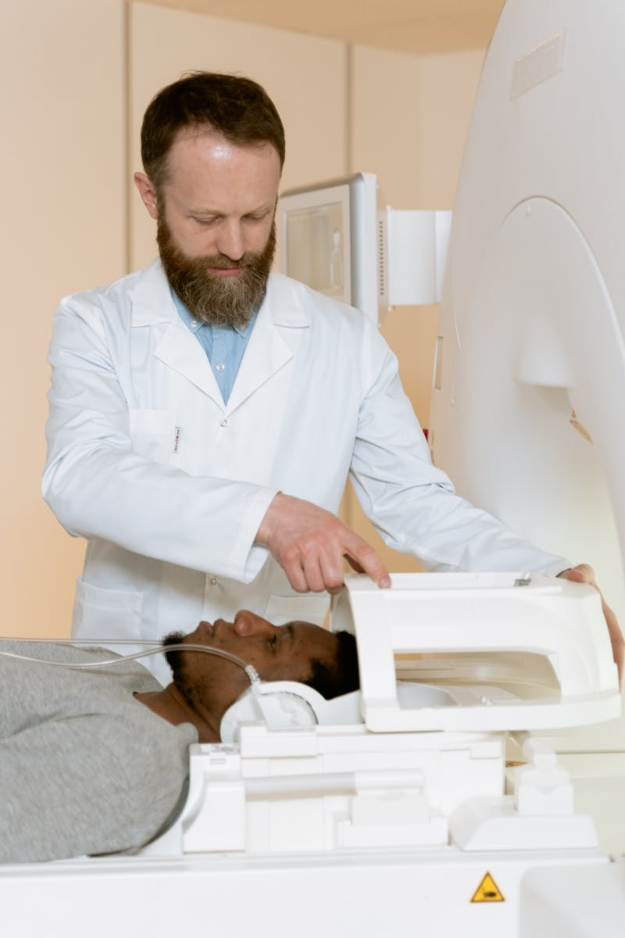
2
About WaruWenJo
Who We Are
A comprehensive medical tourism platform connecting patients worldwide with India’s top hospitals and specialists.
Vision: To make world-class healthcare accessible and affordable for all.
Mission: Simplifying global medical travel through trust, transparency, and technology.
Presence: Strategic partnerships with hospitals, certified doctors, and global patient coordinators.
Photo by Pexels

Slide 6
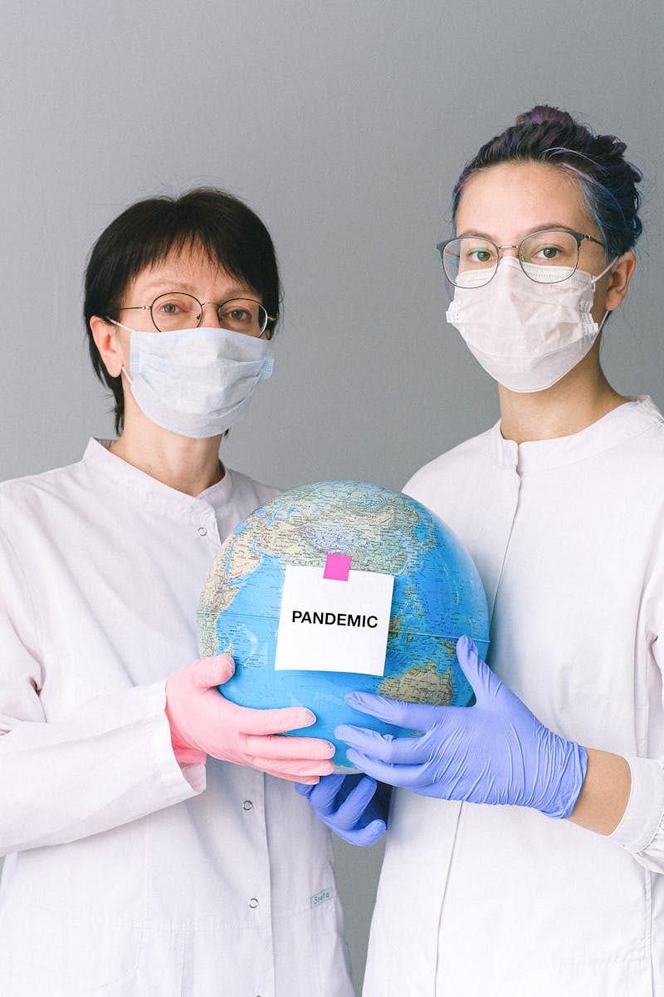
3
The Global Healthcare Gap
Why Patients Travel for Care
Over 20 million people travel annually for medical care.
Key motivations: affordability, accessibility, shorter wait times, and advanced technology.
India ranks among the top 3 global destinations for medical tourism, attracting patients from Africa, GCC, and Southeast Asia.
Photo by Pexels

Slide 7

4
Why Patients Choose India
India’s Global Healthcare Advantage
Up to 70% lower treatment costs than Western countries.
World-class expertise from internationally trained doctors.
Advanced technology and accredited hospitals.
English-speaking medical staff and holistic recovery options, including Ayurveda and wellness.
Photo by Pexels

Slide 8

5
The WaruWenJo Advantage
Our Edge in Global Healthcare Facilitation
Verified network of accredited hospitals and top doctors.
Transparent pricing, digital tracking, and multilingual support.
End-to-end coordination from consultation to post-treatment care.
Dedicated WaruWenJo Buddy for personalized patient assistance.
Photo by Pexels

Slide 9

6
The WaruWenJo Ecosystem
Connecting Patients, Hospitals, and Doctors
Patients: seeking trusted, affordable, and high-quality treatment.
Hospitals: offering specialized procedures and infrastructure.
Doctors: providing expert consultation and case management.
All connected through our centralized digital platform for seamless collaboration.
Photo by Pexels

Slide 10

7
The Patient Journey
How It Works – Step-by-Step
1. Inquiry & Case Submission – patient shares reports securely online.
2. Medical Review – partner doctors assess and recommend treatment plans.
3. Treatment Matching – WaruWenJo presents hospital and cost options; patient chooses confidently.
4. Travel & Arrival – patient greeted by a WaruWenJo Buddy who assists from airport pickup through treatment and follow-up.
Photo by Pexels

Slide 11

8
Our Business Model
Sustainable, Scalable, and Transparent
Revenue Streams: service facilitation, partner commissions, premium concierge services, digital licensing.
Operational Model: central coordination hub in India with international patient reps.
Scalable digital system managing thousands of cases efficiently.
Photo by Pexels

Slide 12
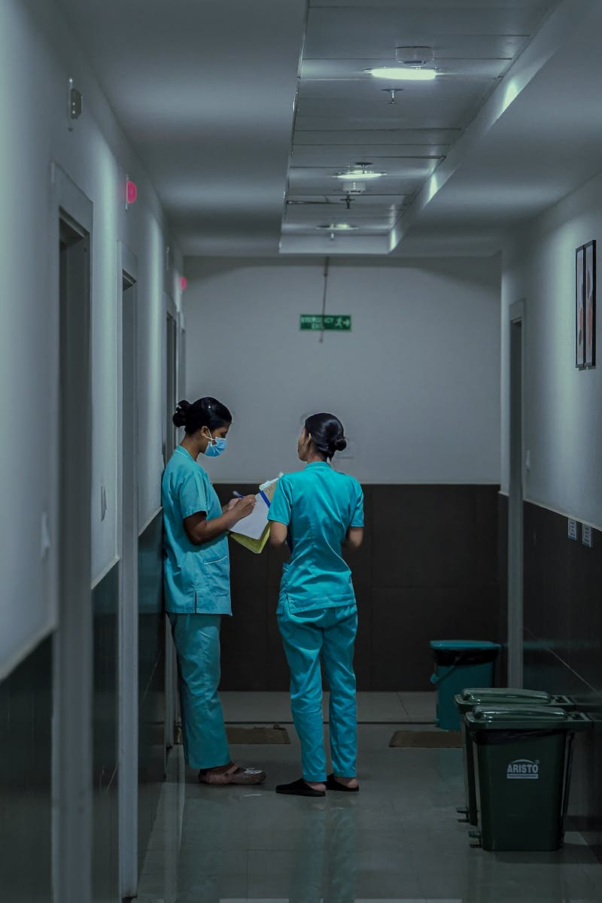
9
Benefits for Hospitals
Expanding Reach & Efficiency
Access to verified, ready-to-travel international patients.
Pre-vetted medical documentation and case briefs.
Increased bed utilization without marketing costs.
Dedicated WaruWenJo liaison for hospital support and reporting.
Photo by Pexels

Slide 13

10
Benefits for Doctors
Professional Growth & Global Exposure
Global patient base expansion through teleconsultations and referrals.
Streamlined case communication and management.
Transparent collaboration and performance recognition.
Integration with WaruWenJo’s patient platform for efficient coordination.
Photo by Pexels

Slide 14

11
Technology & Support Platform
Smart, Secure, and Human-Centered
Digital case management system for patients and hospitals.
Real-time dashboards and multilingual interfaces.
AI-assisted document translation and secure data handling.
24/7 digital and human support combining technology with empathy.
Photo by Pexels

Slide 15

12
Growth & Expansion
Scaling Global Healthcare Access
Expanding reach in Africa, GCC, and Southeast Asia.
Introducing wellness and rehabilitation programs.
Partnerships with insurance and travel providers.
Goal: onboard 50+ hospitals and 200+ doctors by 2026.
Photo by Pexels

Slide 16

13
Partnership Proposal & Next Steps
Collaborate for a Healthier World
Partnership Models: Preferred Hospital Partner, Verified Doctor Partner.
Steps: NDA signing, platform demo, onboarding, and marketing collaboration.
Join us in shaping the future of global healthcare connectivity.
Photo by Pexels

