Slide 1

Partnering with WaruWenJo: Strategic Collaboration for Indian Hospitals
Building a Trusted Bridge in Global Medical Value Travel
Photo by Pexels

Slide 2
01
About WaruWenJo
Table of Contents
02
Why Partner with WaruWenJo
03
Our Operating Model
04
Hospital Partnership Benefits
05
Patient Journey with WaruWenJo
06
Ensuring Quality and Accountability
07
Safeguards for Hospitals
08
Strategic Collaboration Model

Slide 3

1
About WaruWenJo
Crafting Excellence in Medical Value Travel
WaruWenJo is a patient-centric medical tourism company connecting international patients with accredited Indian hospitals.
We focus on ensuring seamless, transparent, and ethical healthcare journeys—built on trust, safety, and accountability.
Our mission: To elevate India’s global medical image while enhancing hospital partnerships through operational excellence.
Photo by Pexels

Slide 4

2
Why Partner with WaruWenJo
A Bridge Between Global Patients and Indian Hospitals
India ranks among the top 5 global destinations for Medical Value Travel (MVT).
WaruWenJo brings pre-qualified, insured, and well-managed international patients to Indian hospitals.
We minimize administrative burdens while maximizing patient satisfaction, post-op outcomes, and hospital revenues.
Our model ensures both patient and hospital protection through structured contracts and transparent processes.
Photo by Pexels

Slide 5
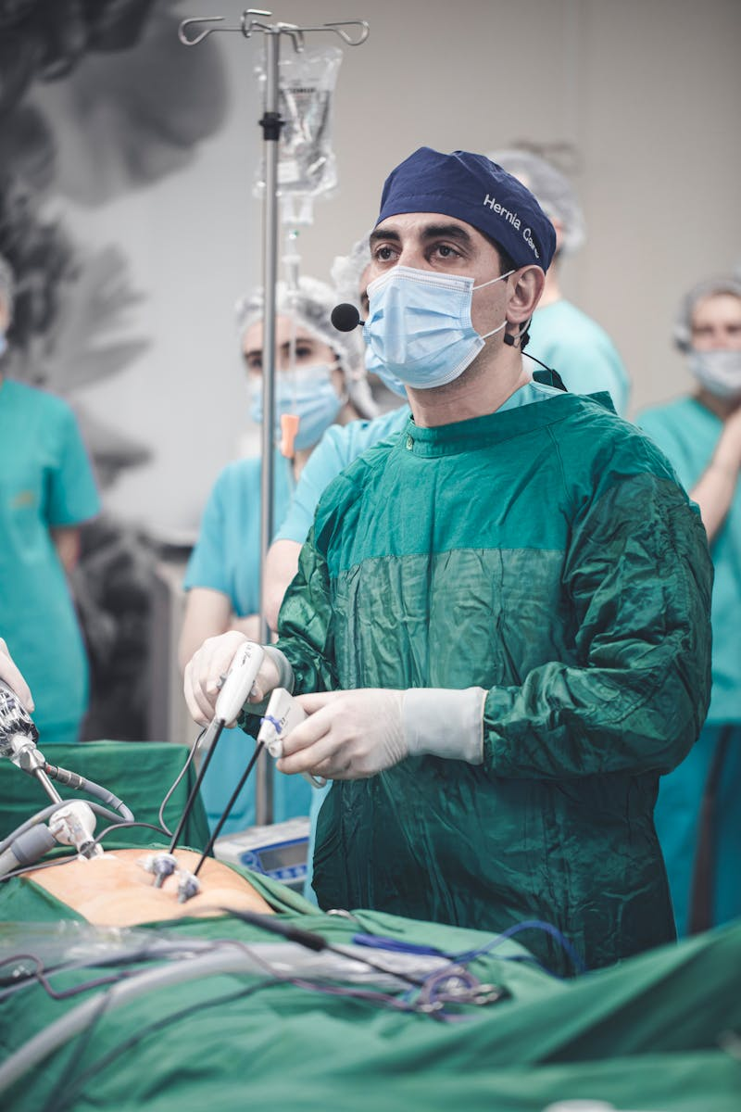
3
Our Operating Model
How We Collaborate with Hospitals
We operate on a structured MOU-based partnership with hospitals ensuring compliance, transparency, and mutual accountability.
Each patient case is managed through a tri-party agreement (Patient – WaruWenJo – Hospital).
Hospitals handle clinical excellence; WaruWenJo handles all non-clinical, legal, and logistic coordination.
We protect both parties via indemnity coverage, digital tracking, and real-time communication tools.
Photo by Pexels

Slide 6
4
Hospital Partnership Benefits
Value Creation for Our Hospital Partners
• Dedicated international patient funnel with verified leads.
• End-to-end logistical support (visa, transport, stay, interpreter).
• Legal indemnity protection and transparent payment systems.
• Enhanced brand visibility in global healthcare markets.
Photo by Pexels

Slide 7

5
Patient Journey with WaruWenJo
Seamless and Safe from Start to Finish
1. Pre-Arrival: Patient selects hospital and treatment plan with our coordination.
2. Arrival & Care: Our dedicated 'WaruBuddy' meets them at the airport, stays connected throughout the treatment journey.
3. Discharge & Recovery: Follow-up care, recovery assistance, and complication insurance coverage.
4. Return Home: Post-op telemedicine follow-up with hospital and continued support.
Photo by Pexels

Slide 8
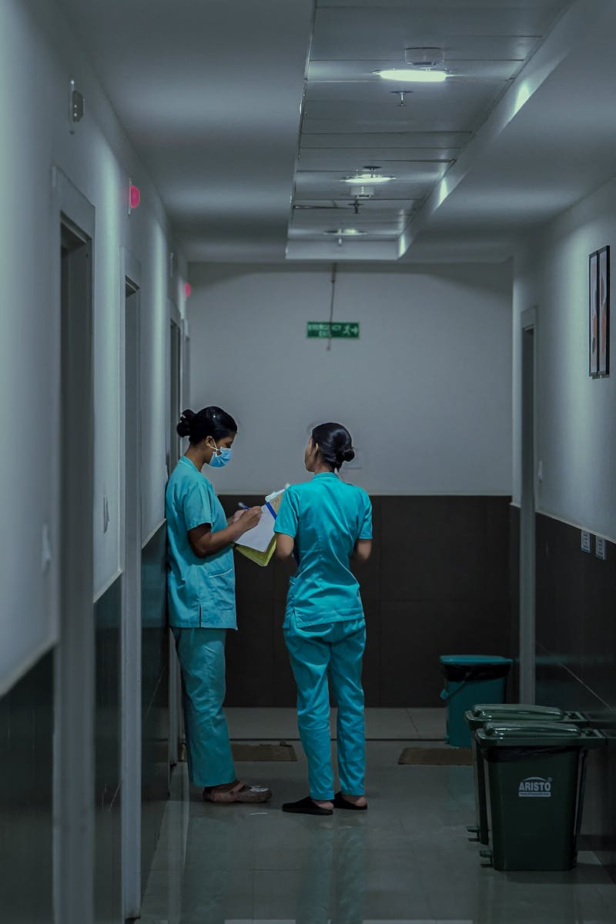
6
Ensuring Quality and Accountability
Building Trust Through Systems and Standards
• Partnerships only with JCI/NABH-accredited hospitals.
• Fixed-price packages eliminate hidden costs and foreign exchange disputes.
• Insurance coverage for medical complications and post-op continuity.
• Real-time tracking via digital CRM and telemedicine follow-ups.
Photo by Pexels

Slide 9

7
Safeguards for Hospitals
Operational and Legal Protection
• Tri-party contracts protecting hospitals from patient legal disputes abroad.
• Lead protection and non-circumvention clauses prevent patient poaching.
• Transparent remittance and milestone-based payment release.
• Comprehensive indemnity and liability coverage under Indian jurisdiction.
Photo by Pexels

Slide 10

8
Strategic Collaboration Model
Long-Term Partnership Vision
WaruWenJo is not just a referral facilitator—it’s a strategic growth partner.
We co-create international patient programs and integrate marketing, telemedicine, and digital systems with hospital teams.
Our aim is to make Indian hospitals global brands through managed medical tourism partnerships.
Join us to expand India's healthcare leadership globally with integrity and excellence.
Photo by Pexels

