Slide 1

Personalized Learning Revolution
Transforming Education Through Adaptive Technology
Photo by Pexels

Slide 2
01
The Future of Learning
Table of Contents
02
Smart Progress Tracking
03
Tailored Educational Content
04
Engaging Interactive Learning
05
Real-Time Support System

Slide 3

1
The Future of Learning
A Platform That Understands Every Student
Imagine a learning platform that understands each student's unique skills and challenges.
It regularly checks in to see where students excel or where they might need a little more help.
Based on this, it creates personalized lessons and extra practice materials just for them.
Making sure every student can learn at their own pace.

Slide 4

2
Smart Progress Tracking
Continuous Assessment and Adaptation
The platform systematically monitors student performance and understanding.
It identifies where students excel and where additional support is needed.
The system adjusts content difficulty based on individual progress.
Tracks improvement over time to ensure continuous development.

Slide 5
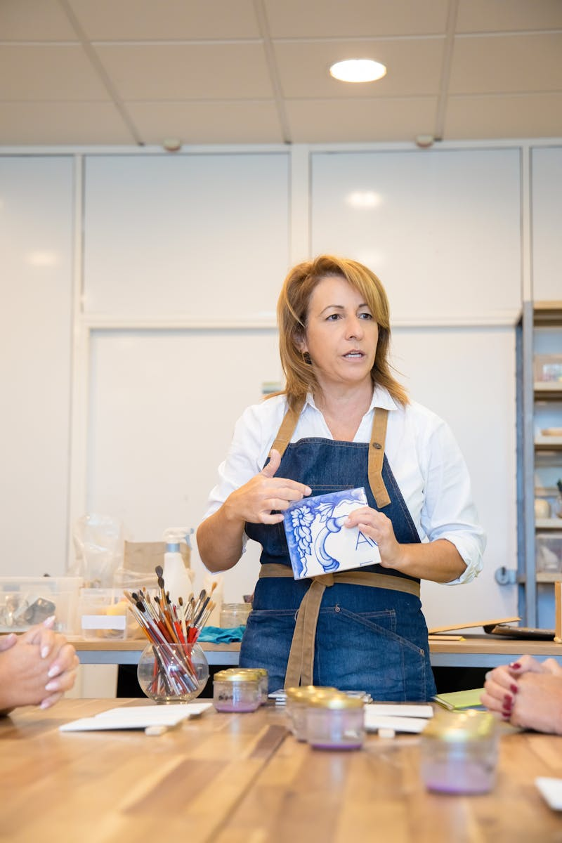
3
Tailored Educational Content
Customized Learning Materials for Success
Creates customized lesson plans based on individual learning needs.
Develops extra practice materials specifically for areas needing improvement.
Materials are designed to address each student's unique challenges.
Ensures content matches current skill level while promoting growth.

Slide 6

4
Engaging Interactive Learning
Making Education Dynamic and Fun
Offers diverse video materials to cater to different learning styles.
Provides engaging quizzes that test understanding while reinforcing concepts.
Incorporates games that make learning enjoyable and memorable.
So learning always feels fresh and engaging with varied activities.

Slide 7

5
Real-Time Support System
Empowering Parents and Teachers
Parents and teachers get real-time insights into student progress.
Analytics help identify patterns and areas needing attention.
Enables parents and teachers to support students more effectively.
Helps them support students at every step of their learning journey.

