Slide 1
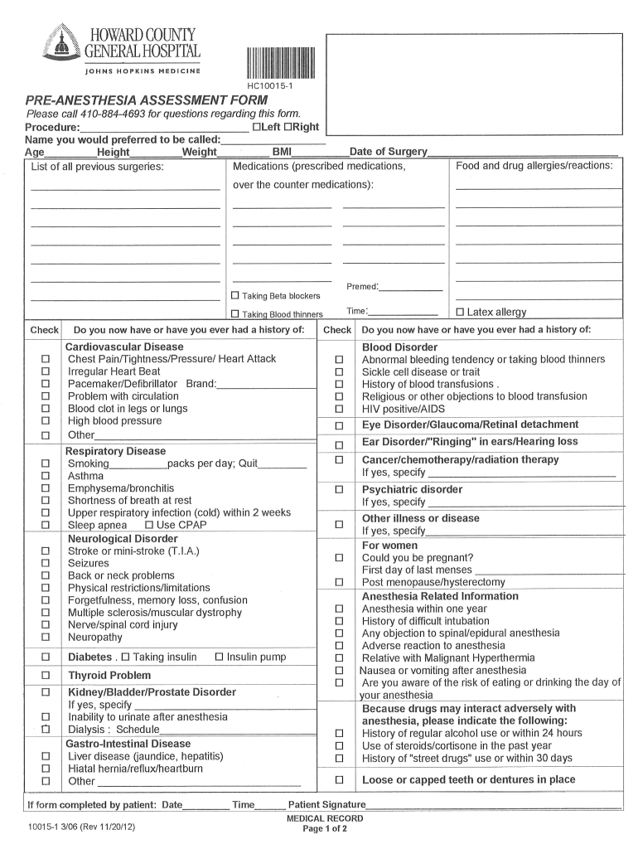
Pre-Anesthesia Check-Up: Your Safety First
Ensuring a Smooth and Safe Anesthesia Experience
Photo by Google

Slide 2
01
Welcome to Your Pre-Anesthesia Journey!
Table of Contents
02
Reviewing Your Medical History
03
Physical Examination: A Closer Look
04
Understanding Anesthesia Options
05
Pre-operative Instructions: Preparing for Success
06
Addressing Your Concerns & Questions
07
Day of Surgery: What to Expect
08
Post-Anesthesia Recovery
09
The Anesthesia Team: Your Dedicated Caregivers
10
Thank You!

Slide 3

1
Welcome to Your Pre-Anesthesia Journey!
Understanding the Importance of Pre-Anesthesia Assessment
Welcome to your pre-anesthesia assessment! This vital step ensures your safety and comfort during anesthesia. We prioritize your well-being.
Pre-anesthesia check-ups help us identify potential risks, optimize your health, and tailor anesthesia to your specific needs. Your safety is paramount.
Each pre-anesthesia assessment is tailored to you. We will consider your medical history, current health, and any specific concerns you may have.
This process is about building trust and open communication. We encourage you to ask questions and share any anxieties you may have about anesthesia.
Photo by Google

Slide 4
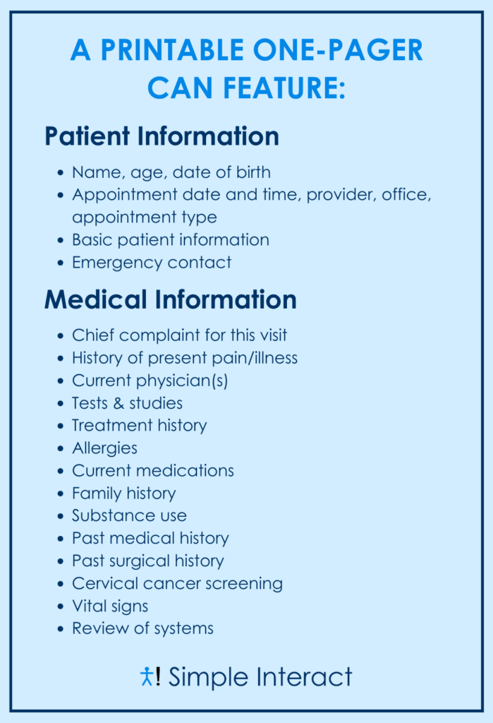
2
Reviewing Your Medical History
Unveiling the Past to Ensure a Safe Future
Your medical history is the foundation of a safe anesthesia plan. It helps us understand your overall health and identify potential risks.
We'll review past illnesses, surgeries, allergies, and medications. Accurate information is crucial for a safe anesthesia experience.
Honesty and openness are key. Please inform us of any medical conditions, even if they seem insignificant. Your input is invaluable.
Provide a complete list of all medications you're taking, including over-the-counter drugs and supplements. Interactions can affect anesthesia.
Photo by Google

Slide 5

3
Physical Examination: A Closer Look
Assessing Your Current Health Status
We'll check your vital signs, including blood pressure, heart rate, and oxygen saturation. This provides a snapshot of your current health.
We'll assess your airway to ensure safe and effective ventilation during anesthesia. This is a critical step for your safety.
Your heart and lung function will be evaluated. We will identify any potential cardiovascular issues that may affect anesthesia.
We'll perform a general physical examination to identify any other health concerns that may need to be addressed before anesthesia.
Photo by Google

Slide 6
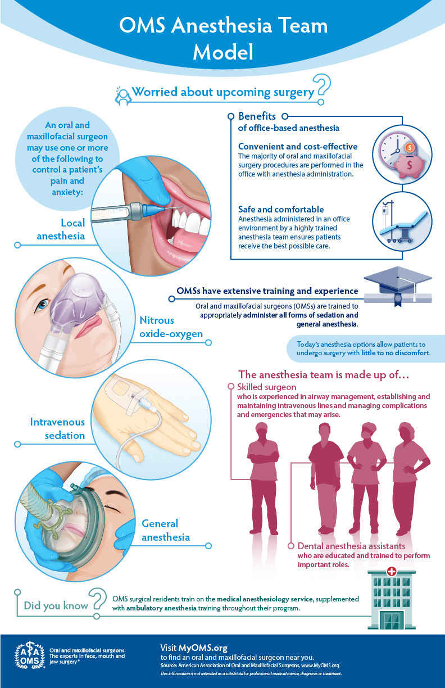
4
Understanding Anesthesia Options
Exploring the Best Anesthesia Plan for You
We'll discuss various anesthesia options, including general anesthesia, regional anesthesia, and sedation. Each has its own benefits and risks.
The best anesthesia plan is tailored to your specific needs, the type of procedure you're undergoing, and your preferences.
We'll explain the benefits and risks of each anesthesia option in detail. Informed consent is essential to the process.
Your preferences matter! We'll work with you to choose an anesthesia plan that aligns with your comfort level and expectations.
Photo by Google

Slide 7
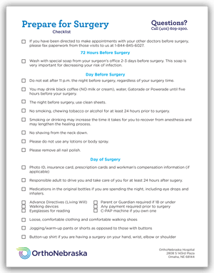
5
Pre-operative Instructions: Preparing for Success
Following Guidelines for a Smooth Experience
We'll provide clear instructions on when to stop eating and drinking before your procedure. Following these guidelines is crucial for your safety.
We'll advise you on which medications to take or avoid before anesthesia. Some medications can interact with anesthesia drugs.
Follow any specific hygiene instructions, such as showering with antibacterial soap. This helps reduce the risk of infection.
We'll let you know what to bring on the day of your procedure, such as identification, insurance information, and comfortable clothing.
Photo by Google

Slide 8
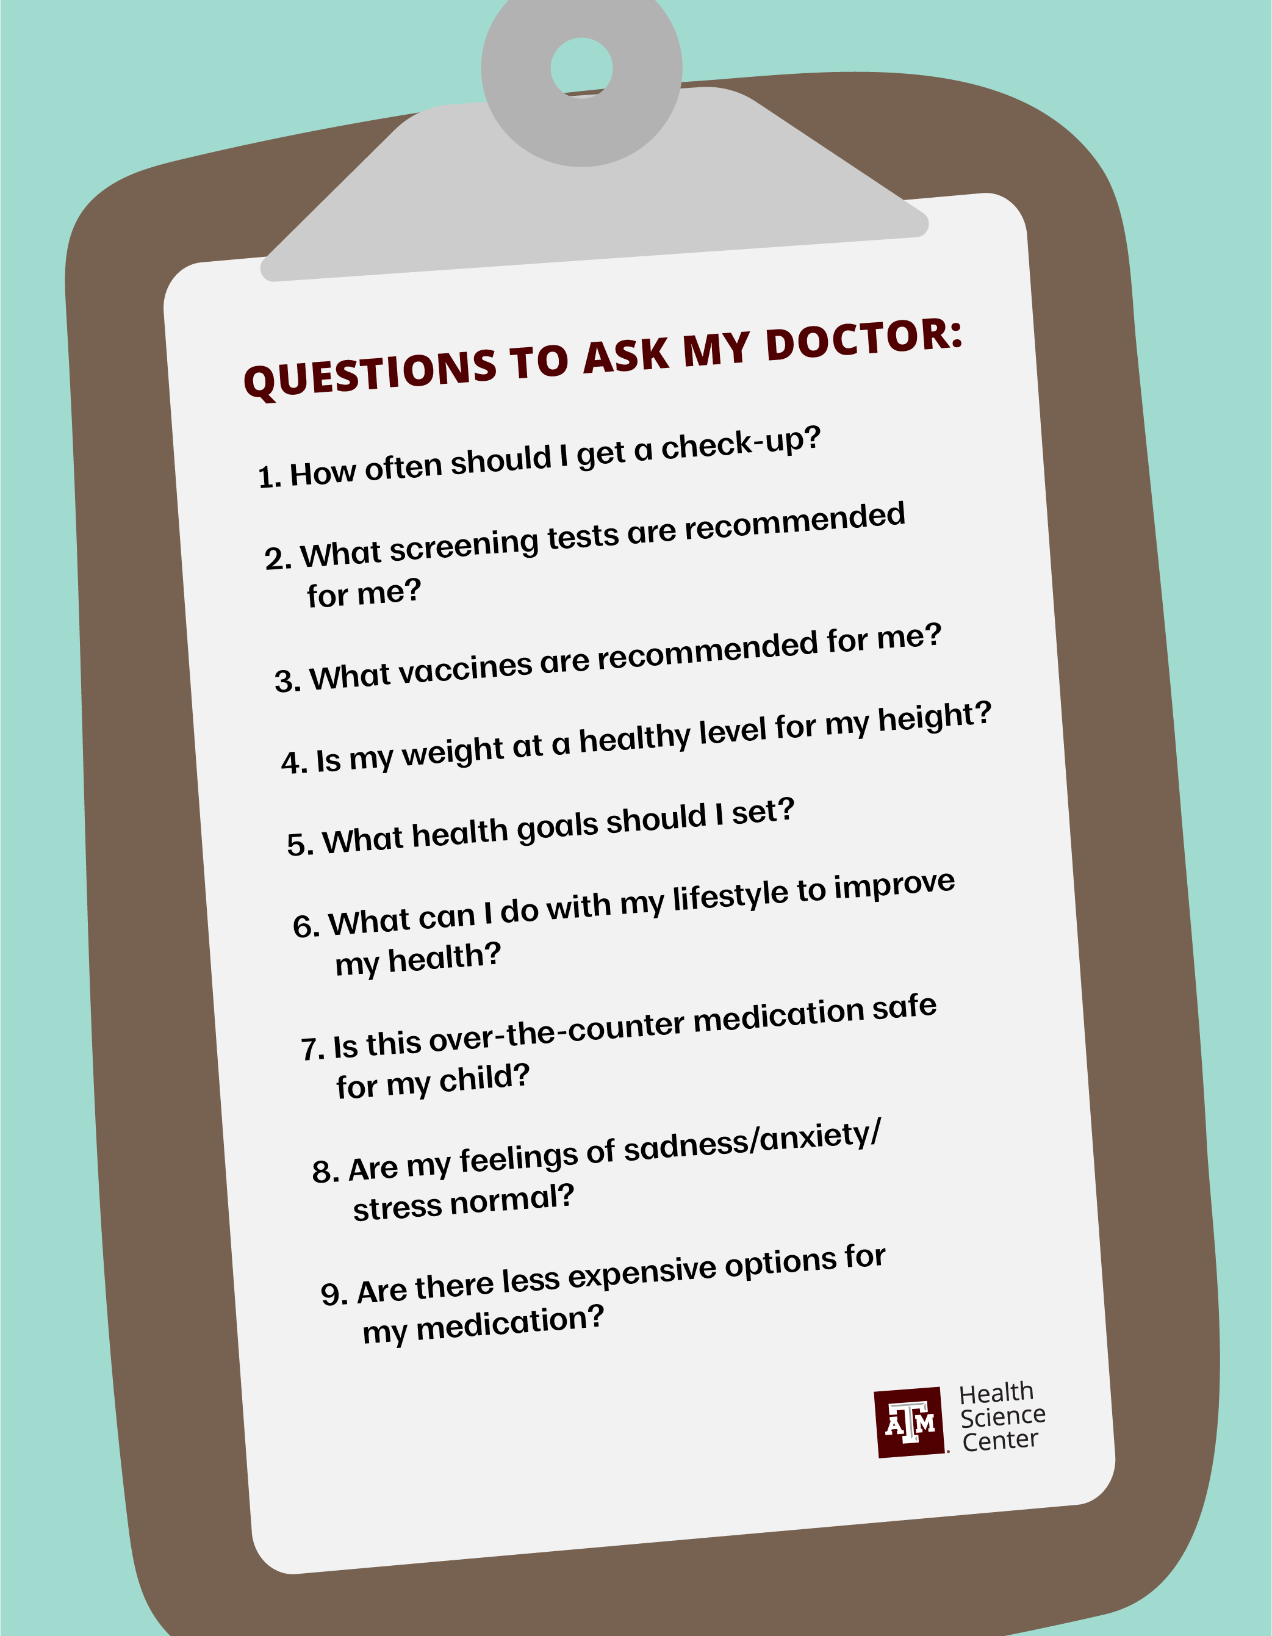
6
Addressing Your Concerns & Questions
Open Communication for Peace of Mind
We encourage you to ask questions and express any concerns you may have about anesthesia. Your voice matters to us.
We'll address common concerns about pain, nausea, and anxiety. We'll provide strategies to minimize these side effects.
We aim to build your confidence and alleviate any fears you may have. We are here to support you throughout the entire process.
Don't hesitate to ask even the smallest questions. We're here to provide you with complete and accurate information.
Photo by Google

Slide 9

7
Day of Surgery: What to Expect
A Step-by-Step Guide to Your Anesthesia Experience
We'll guide you through the arrival and check-in process. We are focused on creating a stress free journey
We'll take you to the pre-anesthesia room, where you'll meet the anesthesia team and have any last-minute questions answered.
We'll carefully administer the anesthesia medication and continuously monitor your vital signs throughout the procedure. Your safety is our priority.
After the procedure, you'll be transferred to the recovery room, where you'll be closely monitored until you are fully awake and stable.
Photo by Google

Slide 10

8
Post-Anesthesia Recovery
Ensuring a Smooth and Comfortable Recovery
We'll closely monitor your vital signs and provide pain relief and anti-nausea medication as needed. We'll ensure you're comfortable.
We'll assess your readiness for discharge based on specific criteria, ensuring you're stable and safe to go home.
We'll provide you with detailed home care instructions, including medication management, wound care, and activity restrictions.
We'll schedule follow-up appointments as needed to monitor your recovery and address any concerns. Your long-term well-being is important to us.
Photo by Google

Slide 11

9
The Anesthesia Team: Your Dedicated Caregivers
Meet the Professionals Dedicated to Your Safety
Our board-certified anesthesiologists are highly trained experts in anesthesia care. They are dedicated to your safety and comfort.
CRNAs are advanced practice nurses who provide anesthesia care under the supervision of an anesthesiologist. They play a vital role in your care.
Anesthesia technicians assist the anesthesia team by preparing equipment and providing support during procedures. They are essential to a safe environment.
The anesthesia team works collaboratively to provide the best possible care. We are dedicated to ensuring your safety and comfort throughout the process.
Photo by Google

Slide 12

10
Thank You!
We Appreciate Your Trust
Thank you for entrusting us with your care. We appreciate your confidence in our anesthesia team.
Your well-being is our top priority. We are committed to providing you with the safest and most comfortable anesthesia experience possible.
Please don't hesitate to contact us if you have any further questions or concerns. We are here to support you.
We wish you a successful procedure and a smooth recovery. Thank you for allowing us to be a part of your healthcare journey.
Photo by Google

