Slide 1
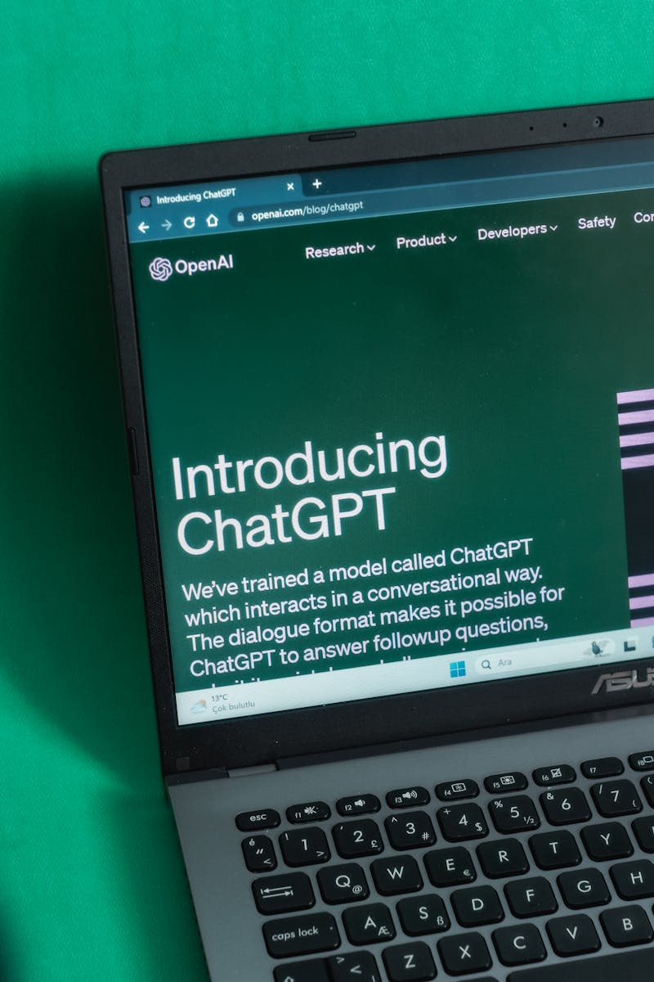
RAG AI Agent – Internship Project
By Fenil Nasriwala | 21012021052 | U.V. Patel College of Engineering | BEE Robokids Pvt Ltd
Photo by Pexels

Slide 2
01
Introduction & Background
Table of Contents
02
Project Objectives
03
System Design Overview
04
Key Features
05
Implementation
06
Testing & Validation
07
Screenshots & UI Flow
08
Conclusion
09
Future Scope
10
Acknowledgements
11
Title Slide

Slide 3

1
Introduction & Background
What is RAG AI Agent?
RAG AI Agent is a smart assistant that combines document retrieval with AI response generation for developer support.
Addresses inefficiencies in navigating technical documentation and reduces cognitive load for developers.undefinedundefined

Slide 4

2
Project Objectives
Goals and Outcomes
Automatically indexes and retrieves relevant technical documents.
Provides context-aware answers using conversational AI.undefinedundefined

Slide 5

3
System Design Overview
Architecture and Tech Stack
Modular design separating core functionalities like document retrieval and response generation.
Built using Next.js, ElizaOS, OpenAI, Groq, and React.js.undefinedundefined

Slide 6
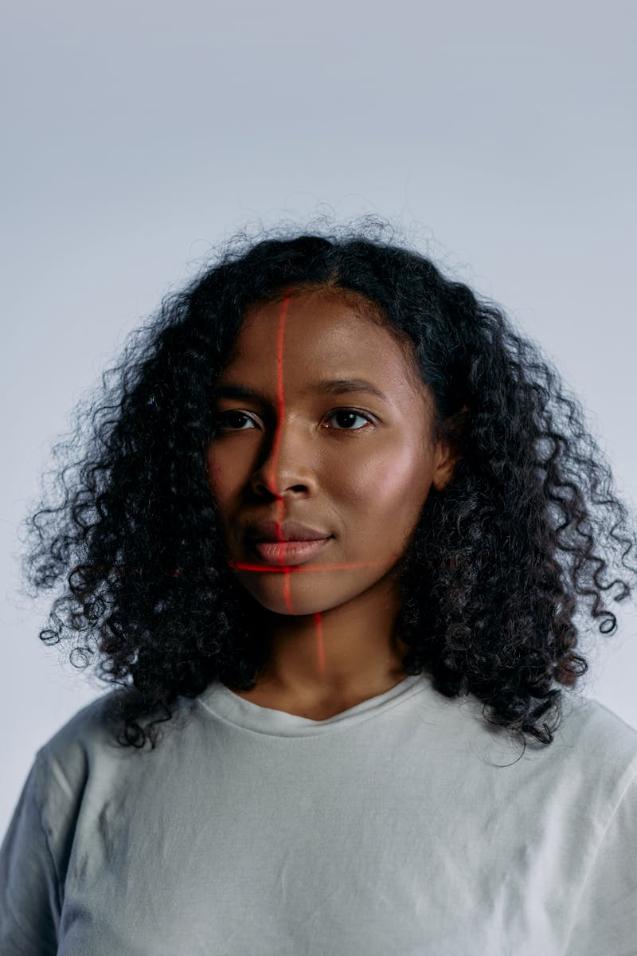
4
Key Features
Functional Highlights
Interprets natural language queries and matches them with relevant documents.
Responsive interface for developer queries with multi-turn memory support.undefinedundefined

Slide 7

5
Implementation
Development Details
Built with ElizaOS and Node.js, featuring plugin-based architecture.
Created using React.js and Next.js for a dynamic user experience.undefinedundefined

Slide 8
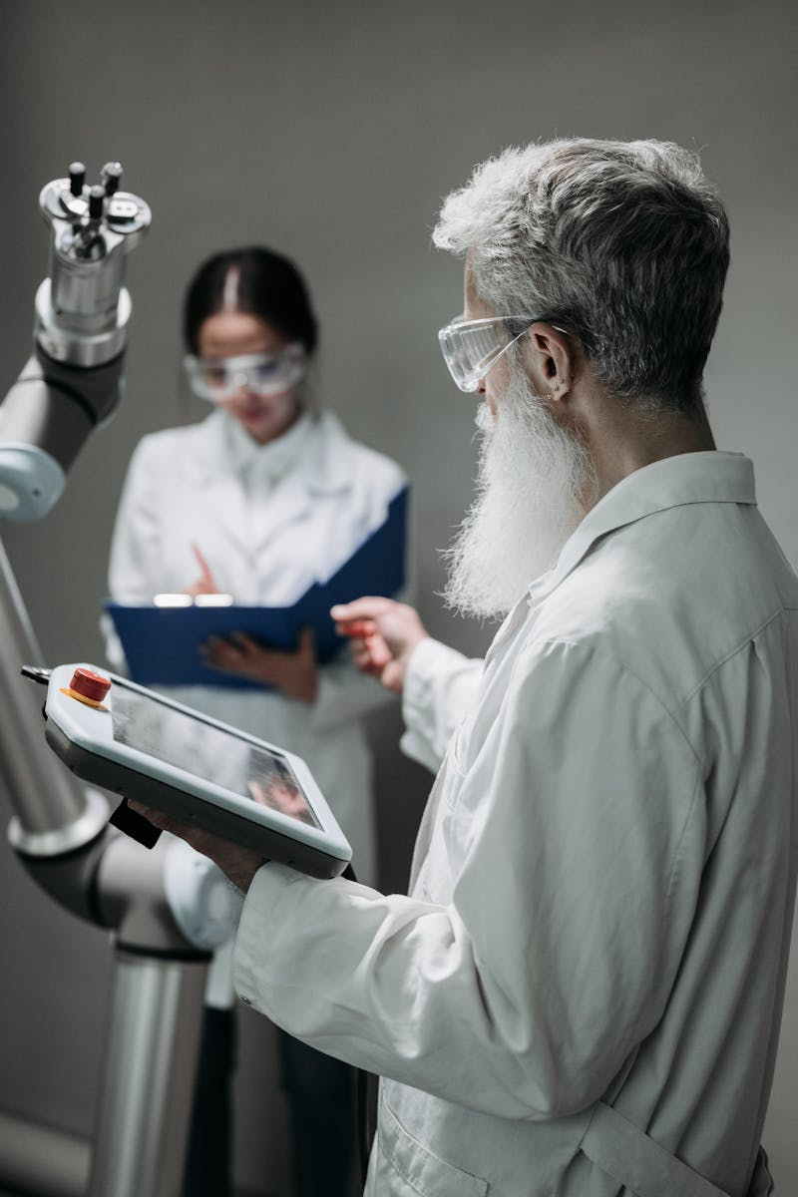
6
Testing & Validation
Ensuring Reliability
Used Vitest for unit testing and functional validation.
Performed integration testing, performance monitoring, and user acceptance testing.undefinedundefined

Slide 9
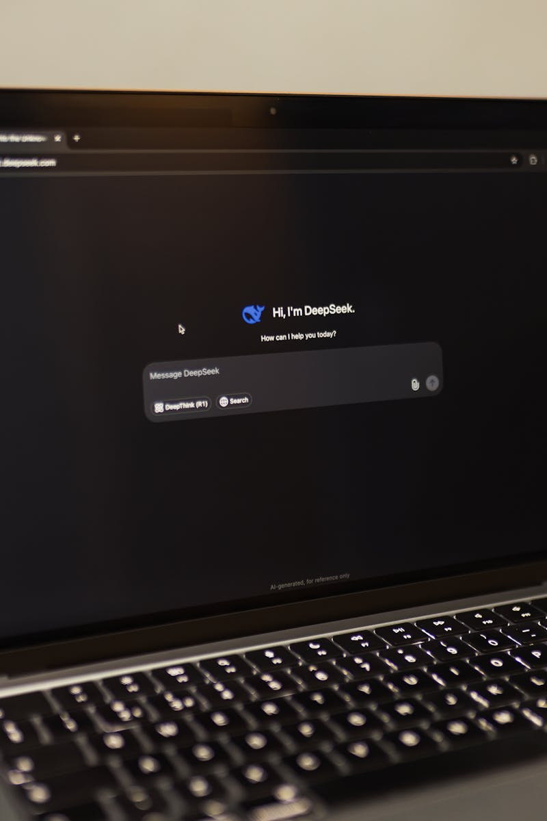
7
Screenshots & UI Flow
Visual Demonstration
Features real-time interaction with syntax highlighting and example prompts.
Intuitive navigation and contextually accurate responses enhance UX.undefinedundefined

Slide 10

8
Conclusion
Project Wrap-up
Improved documentation access, enhanced developer productivity, and reduced troubleshooting time.
Hands-on experience with RAG pipelines, AI integration, and full-stack development.undefinedundefined

Slide 11

9
Future Scope
What’s Next?
Includes code snippet generation, IDE integration, and personalized documentation suggestions.
Potential for broader framework support and multilingual documentation handling.undefinedundefined

Slide 12
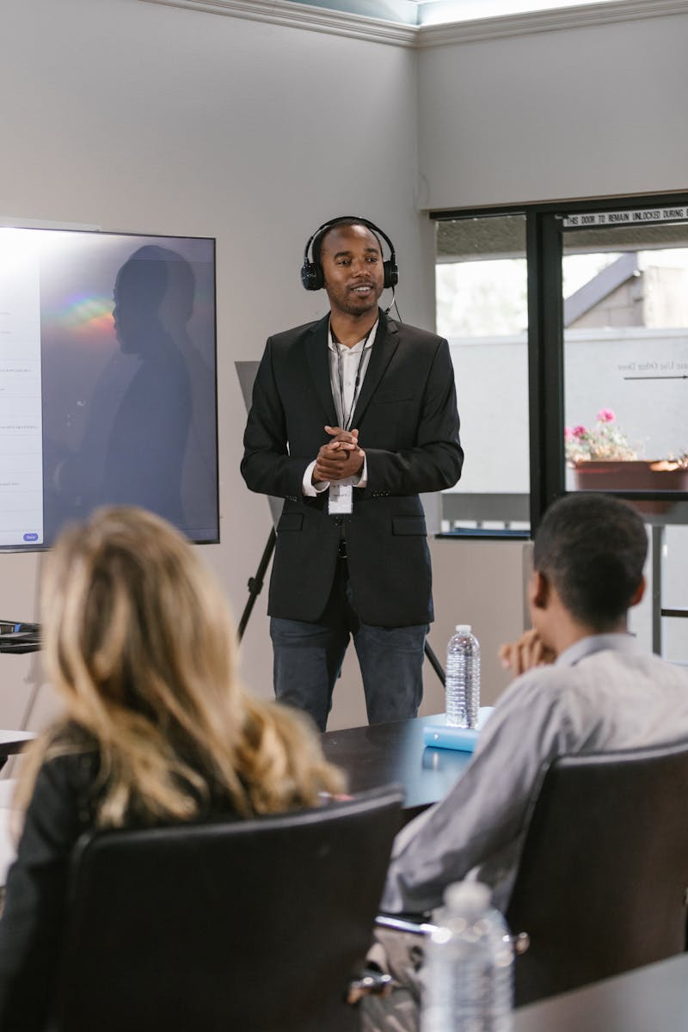
10
Acknowledgements
Gratitude and Support
Special thanks to Prof. Ritesh Upadhyay and Prof. Ravi Raval for their guidance and encouragement.
Grateful to BEE Robokids Pvt Ltd and Ganpat University for the opportunity and support.undefinedundefined

Slide 13

11
Title Slide
Fenil Nasriwala | 21012021052 | U.V. Patel College of Engineering | BEE Robokids Pvt Ltd
Internship Project Report Presentationundefinedundefinedundefined

