Slide 1


RFID Tag Creation: A Comprehensive Guide
How to Make RFID Tags with Photos and Benefits
Photo by Pexels

Slide 2




Table of Contents
01
Introduction to RFID Technology
02
Understanding RFID Tag Structure
03
Materials Needed for RFID Tag Creation
04
Step 1: Designing Your RFID Tag
05
Step 2: Fabricating the Antenna
06
Step 3: Integrating the RFID Chip
07
Step 4: Testing and Validation
08
Benefits of RFID Technology

Slide 3
Table of Contents
09
Practical Applications and Examples
10
Conclusion and Best Practices

Slide 4


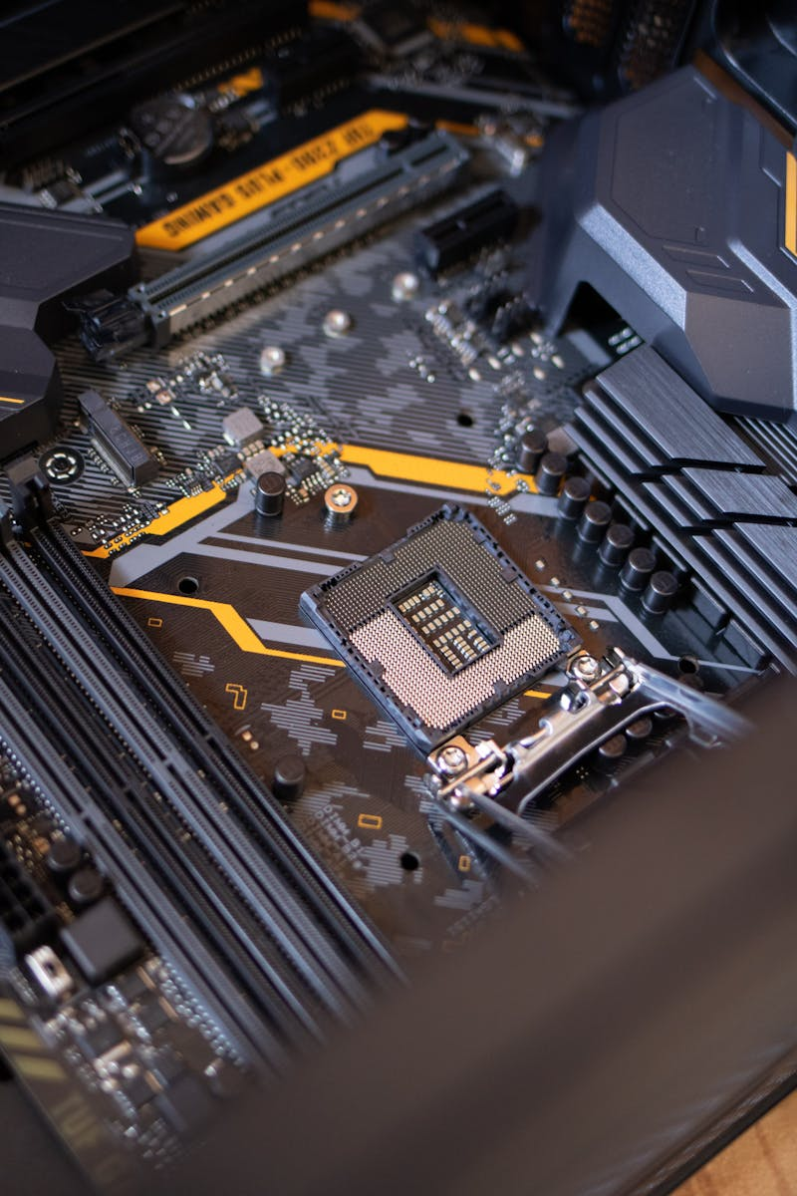
Introduction to RFID Technology
Radio Frequency Identification technology uses electromagnetic fields to automatically identify and track tags attached to objects.
RFID systems consist of tags, readers, and antennas working together to enable wireless communication and data transfer.
RFID tags come in various forms including passive, active, and semi-passive, each with different capabilities and applications.
RFID operates across different frequency bands including LF, HF, UHF, and microwave, each suited for specific use cases.
Photo by Pexels

Slide 5

Understanding RFID Tag Structure
The RFID chip stores data and processes signals, serving as the brain of the tag with varying memory capacities.
The antenna enables communication between the tag and reader, with designs optimized for different frequencies and applications.
Tag substrates include paper, plastic, fabric, and metal, each affecting durability, cost, and performance characteristics.
Protective layers range from simple laminates to ruggedized coatings, ensuring tag longevity in various environments.
Photo by Pexels

Slide 6

Materials Needed for RFID Tag Creation
Select appropriate RFID chips based on frequency requirements, memory size, and application needs for your specific project.
Copper, aluminum, or silver inks and foils are essential for creating functional antennas that can transmit and receive signals.
Choose substrates like PET, paper, or flexible materials based on durability requirements and intended application environment.
Precision tools including soldering equipment, cutting devices, and testing instruments are crucial for successful tag assembly.
Photo by Pexels

Slide 7

Step 1: Designing Your RFID Tag
Determine the optimal frequency (LF, HF, UHF) based on read range requirements, material interference, and application environment.
Design antenna patterns considering impedance matching, radiation efficiency, and compatibility with the chosen RFID chip.
Consider physical constraints, application requirements, and manufacturing capabilities when determining tag dimensions and form factor.
Factor in temperature ranges, moisture exposure, and chemical environments to ensure tag durability and performance.
Photo by Pexels

Slide 8
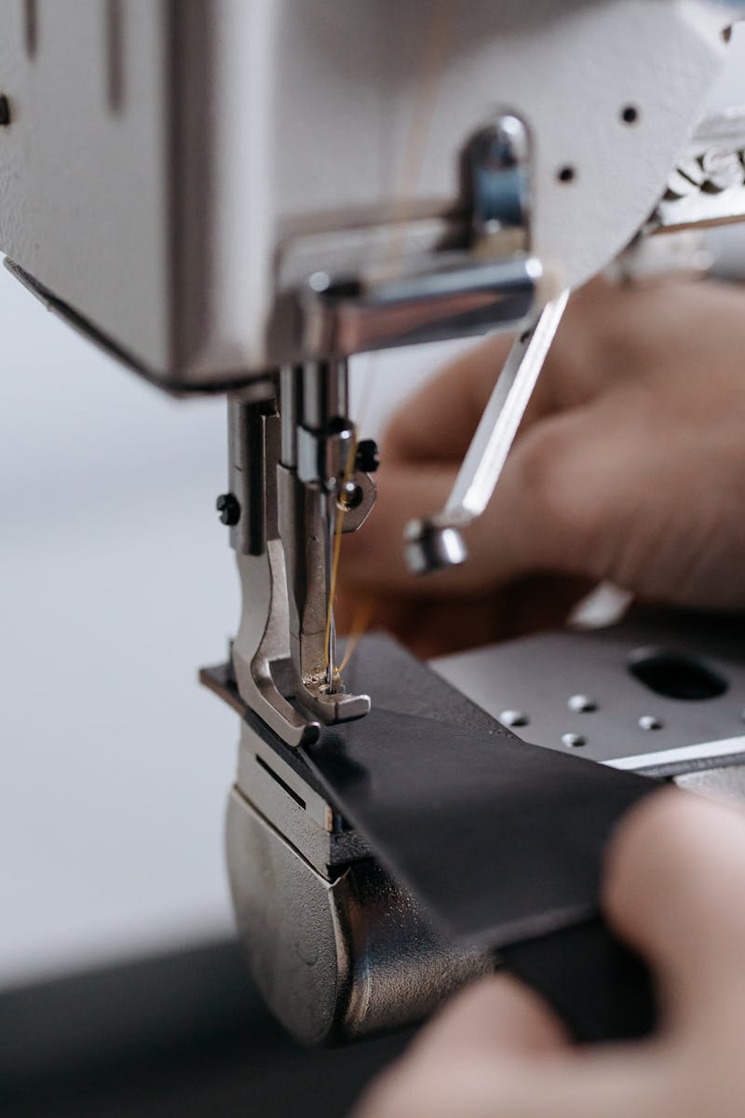
Step 2: Fabricating the Antenna
Utilize screen printing, flexography, or digital printing to apply conductive materials onto the substrate with precision.
Employ chemical etching or laser ablation to create intricate antenna patterns with high accuracy and consistency.
Apply protective layers through lamination to enhance durability and protect the antenna from environmental damage.
Conduct electrical testing to verify antenna performance, impedance matching, and signal transmission capabilities.
Photo by Pexels

Slide 9

Step 3: Integrating the RFID Chip
Use adhesive bonding, thermal bonding, or mechanical attachment to securely connect the RFID chip to the antenna.
Employ wire bonding, conductive adhesives, or flip-chip technology to establish electrical connections between chip and antenna.
Write unique identifiers and application data to the chip memory using specialized programming equipment and software.
Complete the tag assembly by adding protective coatings, laminates, or enclosures based on application requirements.
Photo by Pexels

Slide 10

Step 4: Testing and Validation
Measure and verify the maximum read distance under various conditions to ensure tag meets performance specifications.
Subject tags to temperature extremes, moisture, and mechanical stress to validate durability and reliability.
Test tag performance in the presence of metals, liquids, and other RF interference sources to ensure robust operation.
Implement comprehensive testing protocols to identify and eliminate defective tags before deployment.
Photo by Pexels

Slide 11

Benefits of RFID Technology
RFID technology enables faster data capture, reduced manual labor, and streamlined inventory management processes.
Automated identification eliminates human error, achieving near-perfect accuracy in tracking and data collection.
Long-term savings through reduced labor costs, minimized losses, and optimized inventory management workflows.
Provides instant access to location and status information, enabling better decision-making and operational control.
Photo by Pexels

Slide 12

Practical Applications and Examples
RFID tags track goods from manufacturing through distribution, providing end-to-end visibility and reducing losses.
Contactless access cards and key fobs provide secure, convenient entry control for buildings and restricted areas.
Monitor valuable equipment, tools, and inventory in real-time, preventing loss and optimizing utilization.
Track medical equipment, manage pharmaceutical inventory, and ensure patient safety through automated identification.
Photo by Pexels

Slide 13

Conclusion and Best Practices
Careful planning of frequency, materials, and environmental factors ensures optimal RFID tag performance and longevity.
Start with pilot programs, measure results, and scale gradually to ensure successful RFID technology adoption.
Regular testing, cleaning, and calibration ensure continued RFID system performance and reliability over time.
Advances in chip technology, printing methods, and integration techniques continue to expand RFID capabilities and applications.
Photo by Pexels

