Slide 1
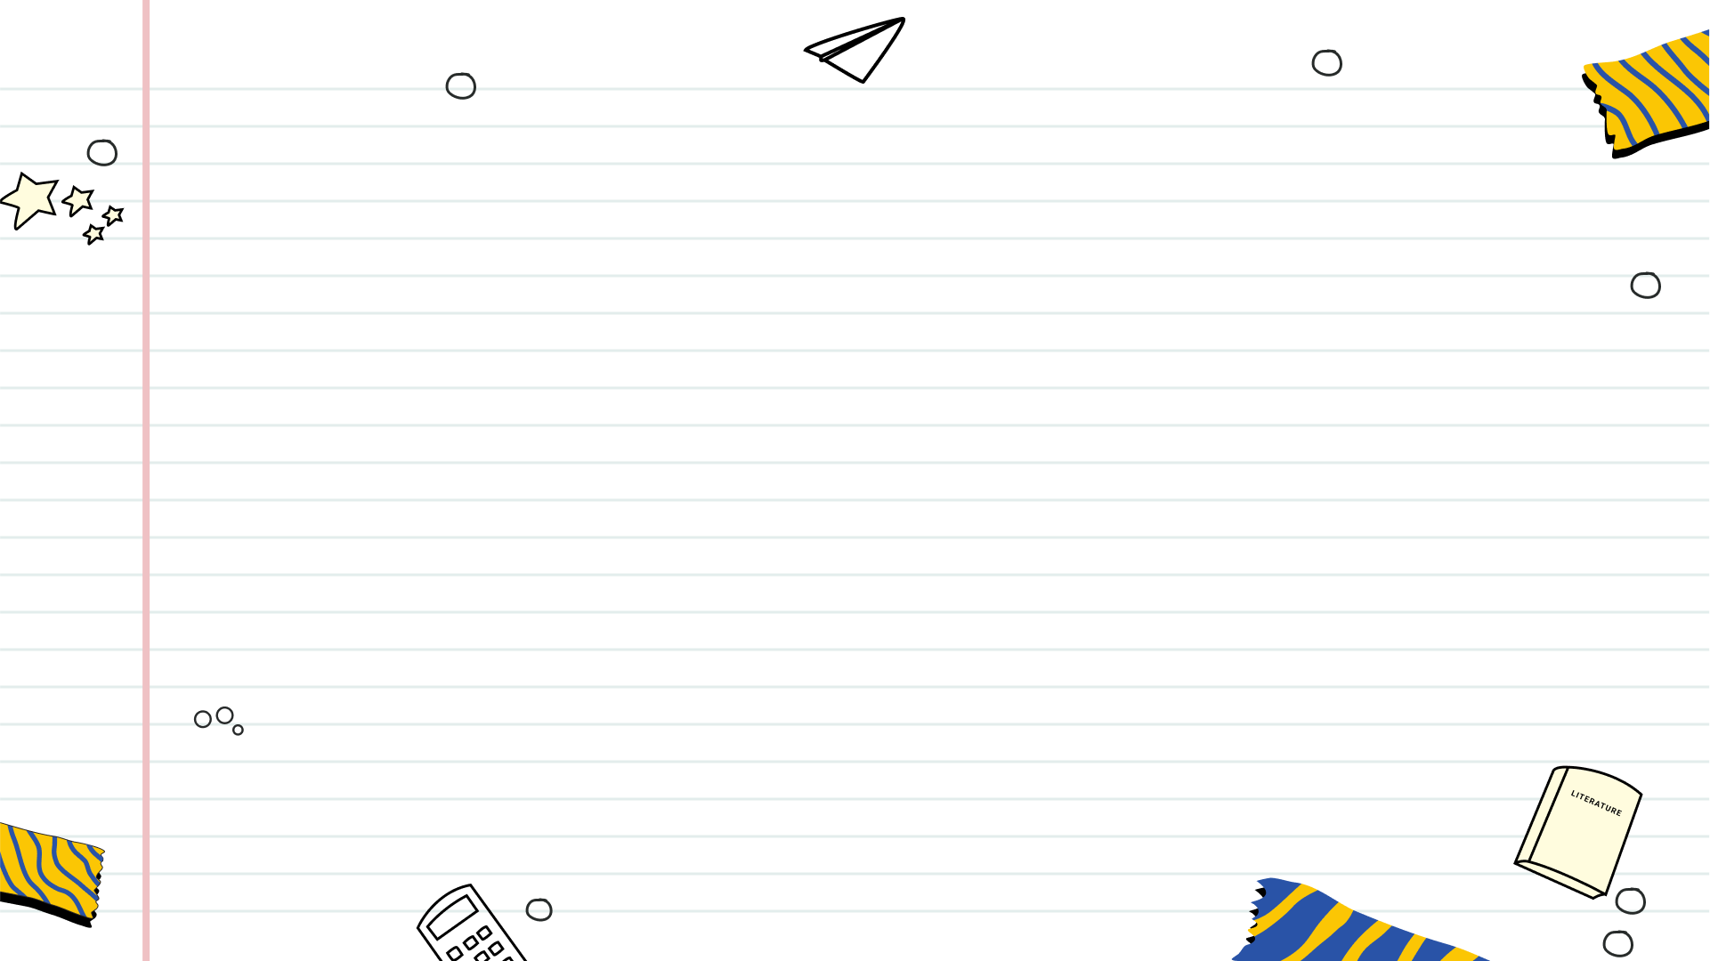

Retrieval-Augmented Generation (RAG)
Bridging Information Retrieval and Text Generation for Smarter AI

Slide 2
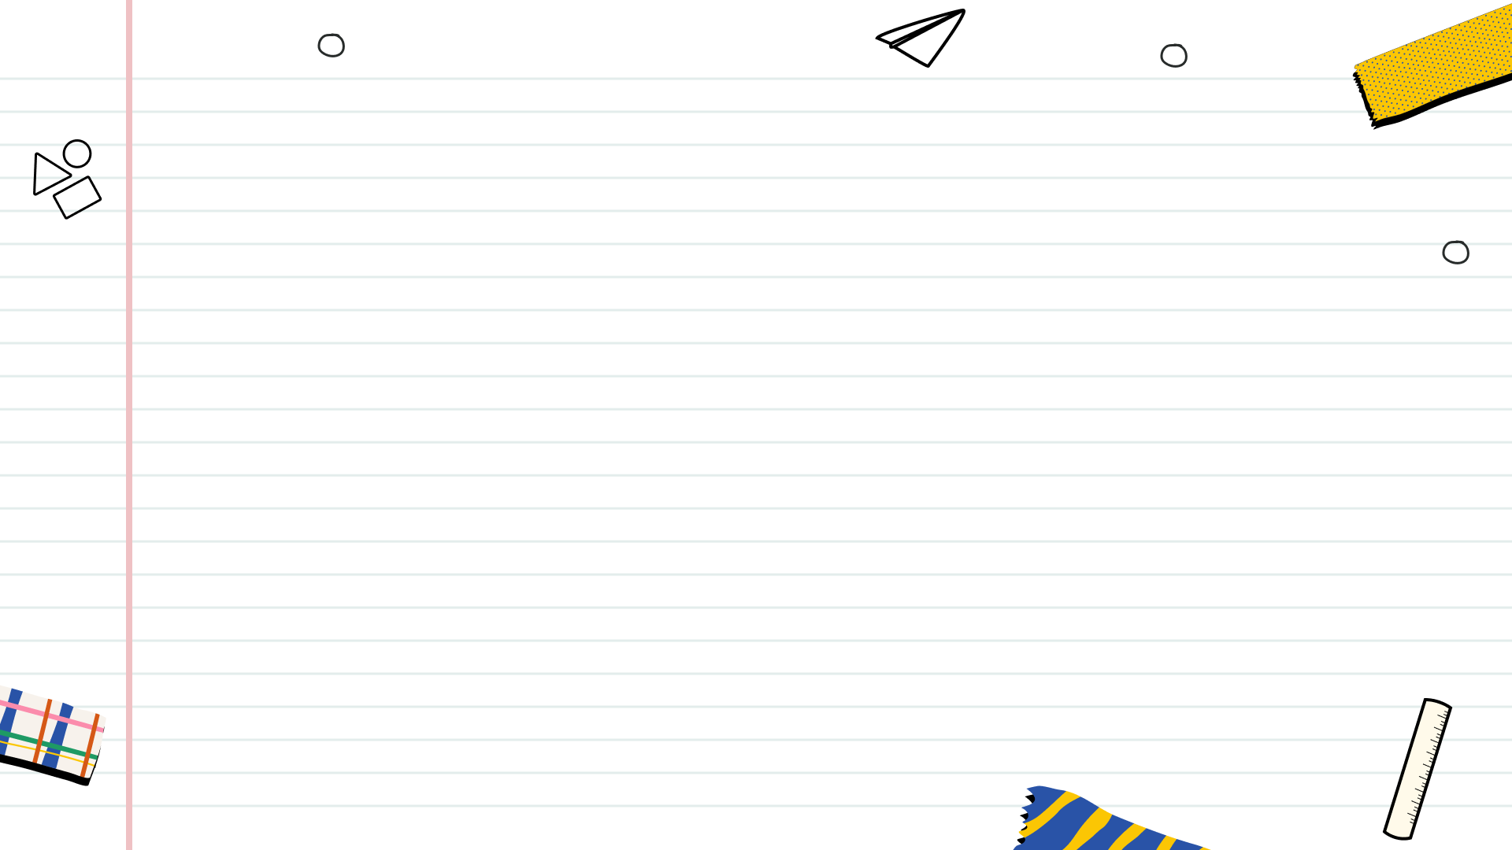

Table of Contents
1
Retrieval-Augmented Generation (RAG) in Natural Language Processing
2
What is Retrieval-Augmented Generation?
3
Architecture of RAG
4
Applications and Benefits of RAG
5
Applications and Benefits of RAG
6
Conclusion

Slide 3

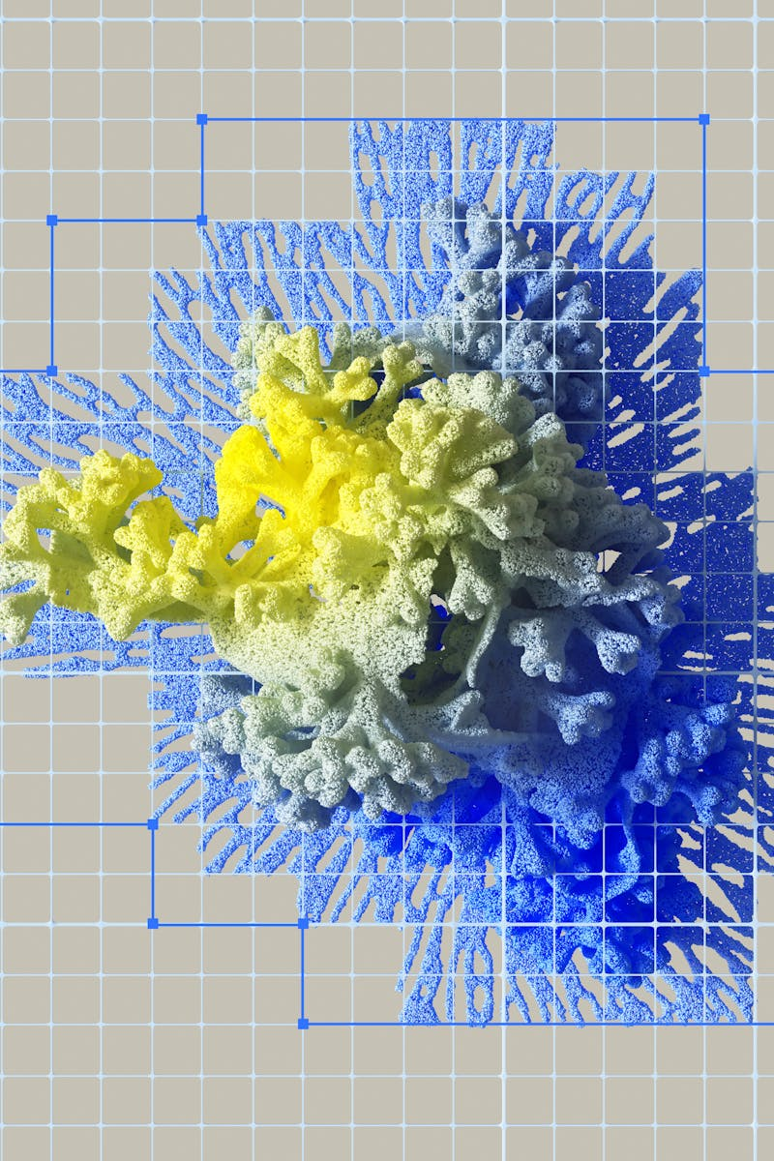
Retrieval-Augmented Generation (RAG) in Natural Language Processing
Include names of presenters
Include roll numbers of presenters
Include department and college name
Tech or AI theme – subtle blue gradients work best

Slide 4
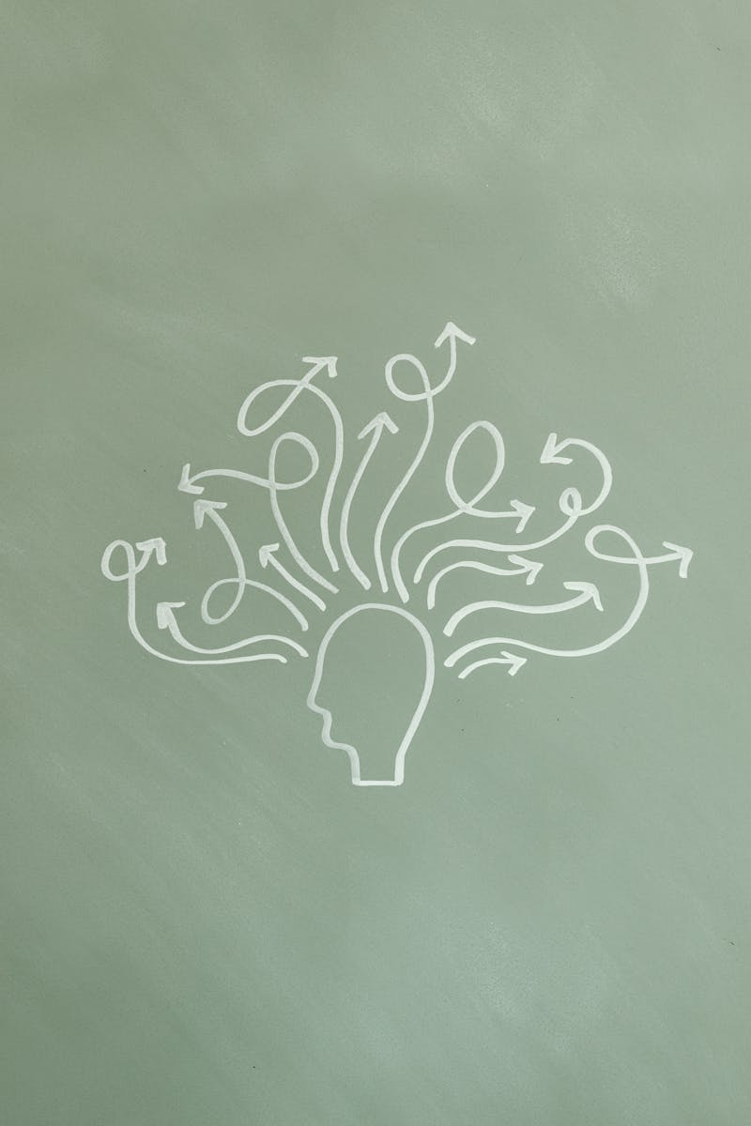
What is Retrieval-Augmented Generation?
Retrieval-Augmented Generation (RAG) is an NLP framework that combines information retrieval with text generation.
It allows large language models (like ChatGPT) to access external knowledge sources (e.g., Wikipedia, databases) to produce more accurate, factual, and up-to-date responses.
Developed by Facebook AI (Meta) in 2020.
Instead of relying only on what it was trained on, RAG can “look up” information before answering — like how humans quickly search Google before replying.

Slide 5
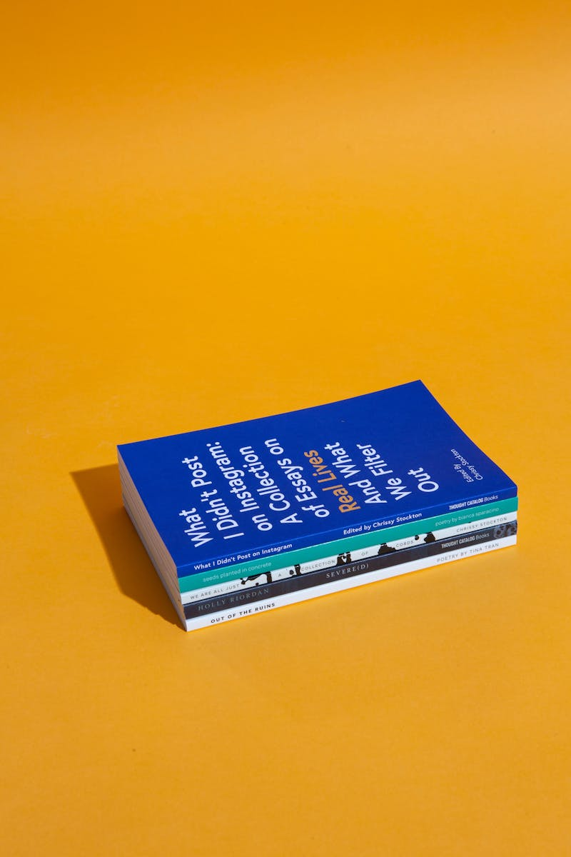
Architecture of RAG
The model receives a user question.
A retriever model (like DPR or BM25) searches external documents for relevant info.
The retrieved passages are combined with the query.
A generator model (usually a transformer like BART or T5) uses both the query and documents to generate the final answer.

Slide 6
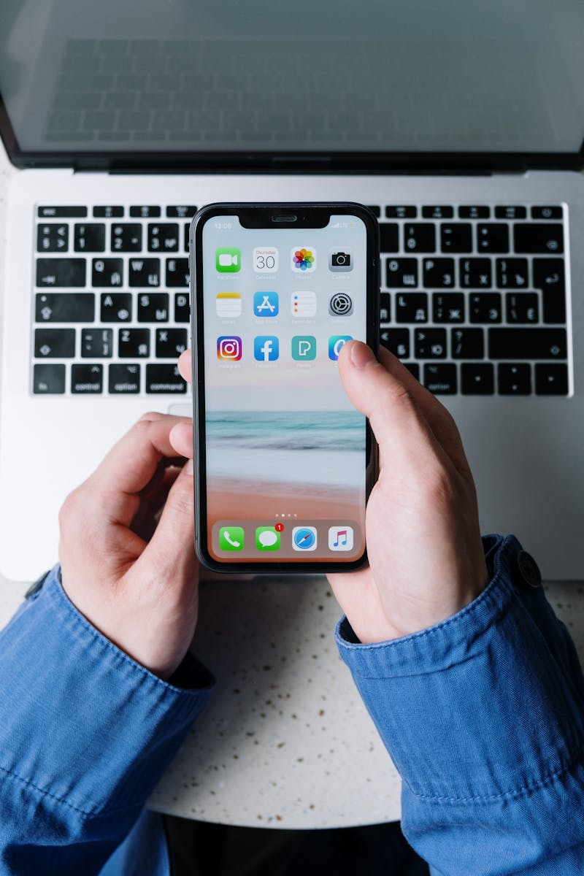
Applications and Benefits of RAG
e.g., enterprise chatbots
e.g., medical, legal domains
Summarizing large documents
Improving AI search functionality

Slide 7

Applications and Benefits of RAG
Provides more accurate and reliable responses
Enables real-time updates to the knowledge base
No need to store all data in parameters
Allows feeding specific databases for customization

Slide 8
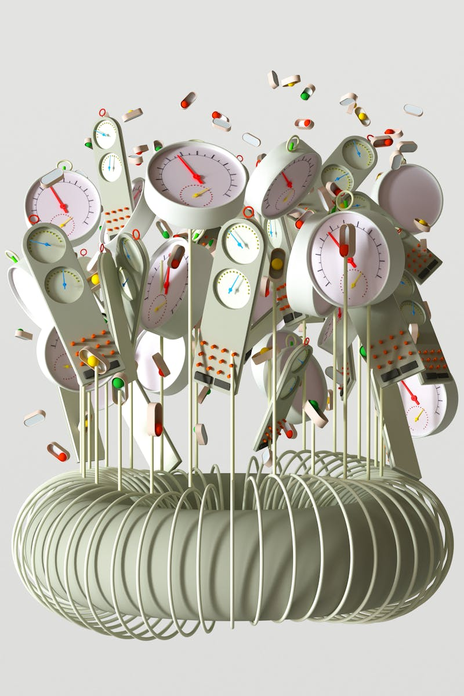
Conclusion
RAG is a powerful hybrid NLP model that merges retrieval and generation to make AI smarter, more factual, and adaptable.
It represents the next step in language model evolution, combining contextual understanding with real-time information access.
Expected to shape future AI systems for research, enterprise, and education.
Thank you for your attention. We hope this presentation helped you understand how Retrieval-Augmented Generation is transforming modern NLP.

