Slide 1


Revolutionizing Cafés: The Smart Menu & Payment Revolution
A QR Code Based System for Enhanced Customer Experience and Operational Efficiency

Slide 2
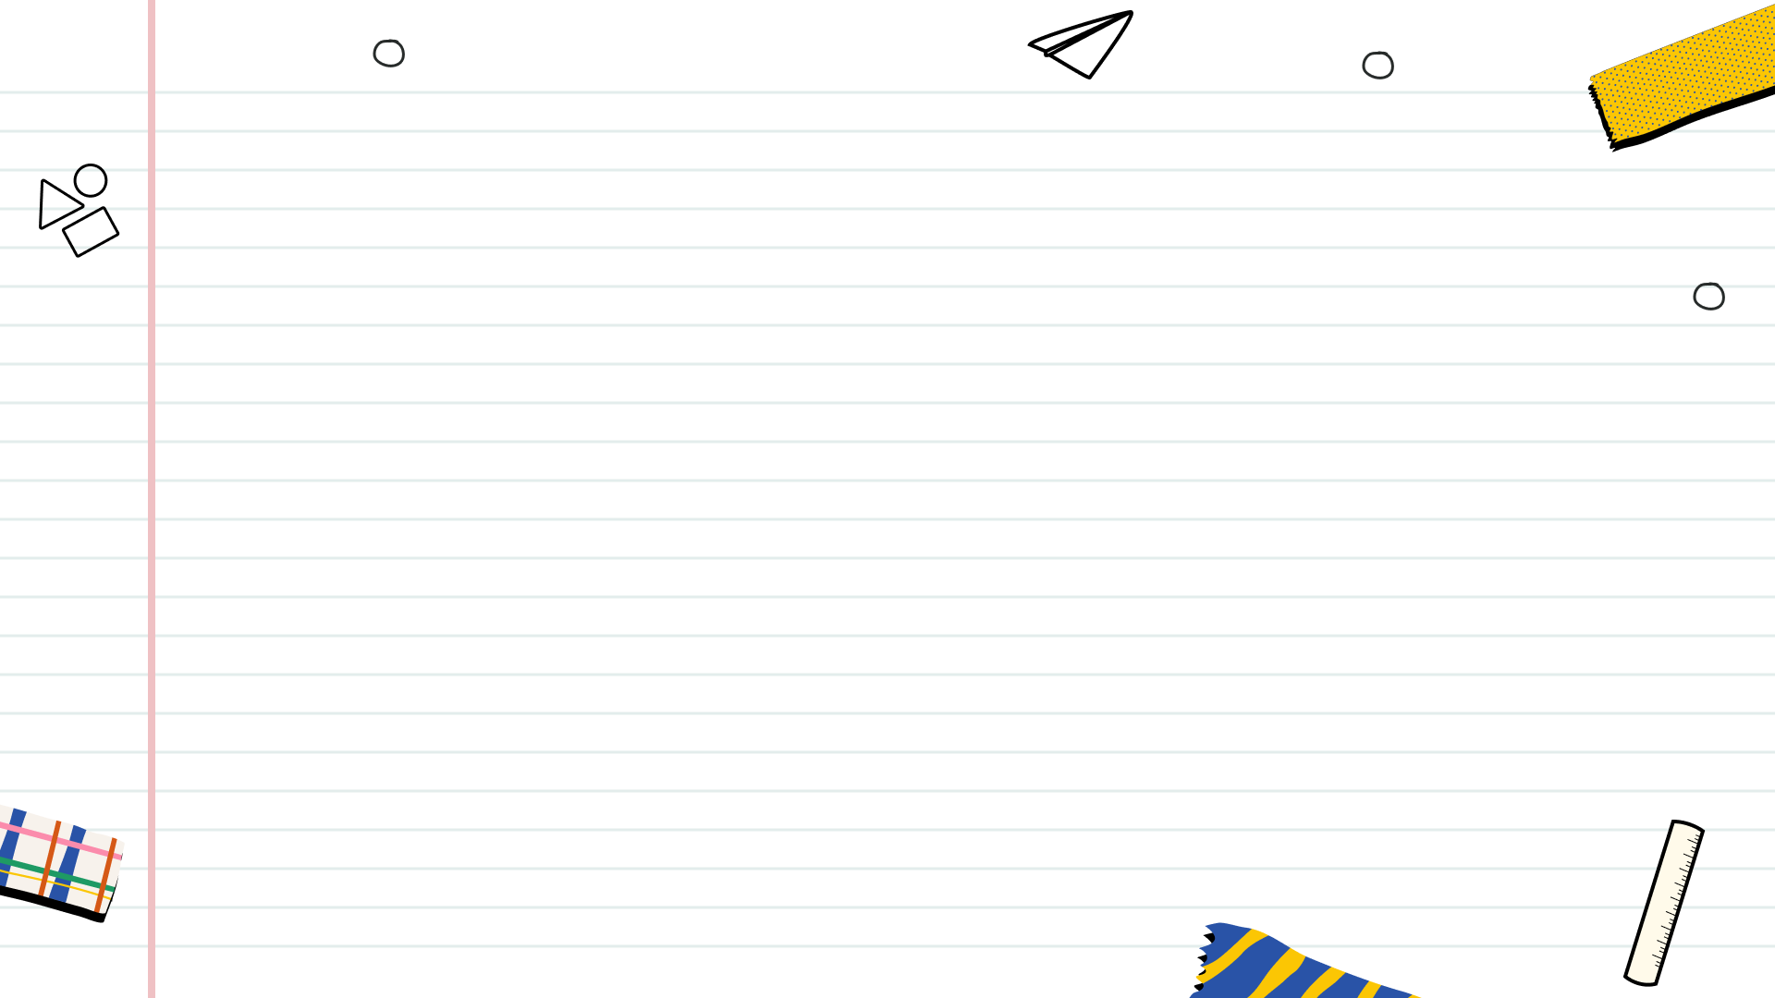

Table of Contents
1
The Future of Cafés is Here
2
Decoding the Technology
3
Elevating the Customer Experience
4
Transforming Café Operations
5
Visualizing the System
6
A Modern Café Aesthetic

Slide 3
7
Design Principles
8
Implementation Roadmap
9
Future Possibilities
10
Thank You

Slide 4

The Future of Cafés is Here
Discover how QR codes are transforming the café experience, offering speed and personalization. The method is incredibly seamless and intuitive.
Offer customers a safer, more convenient way to browse menus and place orders. It's a modern solution for modern concerns.
Cafés can streamline operations, reduce errors, and improve staff productivity. The system enhances overall workflow.
Built using robust technologies like Node.js and MySQL, ensuring future growth. The design allows easy adaptation.
Witness the tangible benefits for both customers and café owners. This innovative approach is practical and effective.

Slide 5
Decoding the Technology
Robust encryption and secure data transmission protocols protect customer data. Security is at the forefront.
Node.js and MySQL enable scalability, speed, and reliability. These technologies are the backbone of the system.
Real-time order tracking ensures efficient communication and faster service. It streamlines the entire process smoothly.
Cross-platform compatibility ensures accessibility on any device. This versatility maximizes usability for everyone.
Leveraging Firebase for real-time updates and seamless user experience. Firebase enhances overall system responsiveness.

Slide 6
Elevating the Customer Experience
Personalized recommendations, quick access, and captivating images enhance the browsing experience. The menu is now interactive.
Reduce wait times and minimize human errors for a seamless process. Speed and accuracy is prioritized to the max.
Provide a safe and hygienic environment with contactless menu browsing and payment. This feature promotes customer safety.
Offer multilingual support and adjustable font sizes for inclusive design. This improves overall user experience.
Display special offers and loyalty programs directly on the digital menu. This strategy increases customer engagement.

Slide 7
Transforming Café Operations
Streamline the order process from placement to fulfillment, reducing delays. Smooth and speedy is key.
Reduce manual tasks and free up staff to focus on customer service. This is the future of cafe management.
Monitor sales data in real-time to make informed decisions. Data-driven insights improve decision making.
Integrate inventory tracking to minimize waste and optimize stock levels. This integration will lead to high profits.
Analyze customer preferences and ordering patterns to refine menu offerings. Make informed decisions based on the data.

Slide 8
Visualizing the System
Customer scanning a QR code at a café table using a smartphone. The process is easy to repeat.
Showcase a mobile UI of the digital menu with appealing visuals. The design has been made very neat and easy to understand.
Visualize the process: scan → select → pay → notify kitchen → delivery. The process has been designed for ease of use.
Mock-up of an admin dashboard displaying key metrics and controls. The data is very important in modern management.
Icons for Flutter, Node.js, MySQL, and Firebase showcasing the technology. These technologies makes our system secure.

Slide 9
A Modern Café Aesthetic
Baristas efficiently managing orders on tablets. Efficiency is increased due to technology.
Café setting with a visible contactless ordering setup. Customers can order without contacting others.
Customers scanning QR codes at their tables. This improves overall customer experience.
Showcase a lively café atmosphere enhanced by the seamless tech integration. Innovation is visible throughout the atmosphere.
Display satisfied customers enjoying the convenience of the system. Customer satisfaction is what we strive for.

Slide 10
Design Principles
A minimalist design approach for ease of navigation and visual appeal. The design has been made simple and easy to navigate.
Consistent color palette (coffee brown, cream, black) for a cohesive brand identity. Branding creates a sense of connection.
Use readable fonts with appropriate sizes for optimal viewing on all devices. Proper fonts ensures that the information is easy to understand.
Prioritize content using clear visual cues. Organization is important to maintain customer attention.
Effective use of whitespace to improve readability and reduce visual clutter. White space ensures focus on important information.

Slide 11
Implementation Roadmap
Evaluate current systems and define project scope. Thorough planning sets the stage for success.
Develop the QR code system and conduct rigorous testing. Testing guarantees the security of the data.
Implement the system in a select café for real-world testing and feedback. Customer feedback is very important.
Deploy the system across all café locations. This is the stage of real growth.
Provide continuous support and updates to ensure optimal performance. Ensuring smooth operation of the system.

Slide 12
Future Possibilities
Personalize menu suggestions based on customer preferences using AI. The experience can be further personalized.
Integrate loyalty programs for rewards and personalized offers. This will create a strong customer base.
Automate inventory management with IoT sensors. The system is designed to connect with new technologies.
Enable voice-activated ordering through smart devices. The system grows with technology.
Promote eco-friendly options and reduce paper waste. Environmentally friendly practices helps the brand stand out.

Slide 13
Thank You
Thank you for your attention. We are glad to share the revolutionary potential of QR code based smart cafe system.
For further inquiries, please feel free to reach out to us. We are happy to assist you in any way possible.
Together, we can transform the café experience for the better. Your participation is highly valued.
We look forward to the opportunity to collaborate and innovate with you. Let's make a difference together.
We hope this presentation has inspired you to embrace the future of technology in the cafe industry. Keep innovating!

