Slide 1

Smart Navigation Bot
Revolutionizing Campus Navigation
Photo by Pexels

Slide 2
01
Smart Navigation Bot
Table of Contents
02
Project Objectives
03
Powerful Features
04
Implementation Roadmap
05
Investment & Impact

Slide 3

1
Smart Navigation Bot
Revolutionizing Campus Navigation
This proposal outlines the development and implementation of a Smart Navigation Bot to improve campus navigation, student engagement, and access to university services.
The Smart Bot will be accessible through a mobile app, website, and strategically placed kiosks across campus for maximum user convenience.
It will guide users with real-time directions to various campus locations and provide comprehensive information about academic departments, events, offices, and facilities.
The bot offers personalized assistance to students and visitors, enhancing their overall campus experience and service accessibility.

Slide 4

2
Project Objectives
Key Goals for Success
Improve on-campus navigation for students, staff, and visitors through intelligent guidance and location-based services.
Digitize and streamline access to university resources, making information readily available through automated systems.
Enhance first-year student orientation and visitor experiences with interactive and personalized navigation assistance.
Reduce dependency on human guides and printed materials while increasing efficiency of university service delivery through automation.

Slide 5
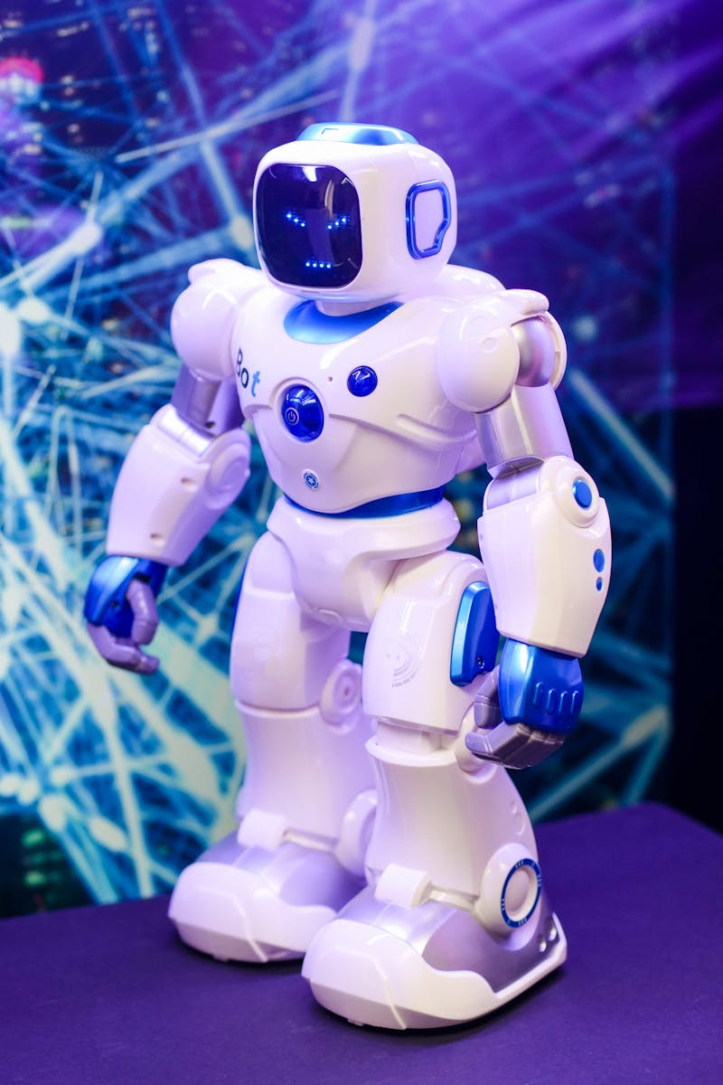
3
Powerful Features
What Makes Our Bot Smart
Interactive Campus Map with GPS Navigation providing turn-by-turn directions to lecture halls, offices, hostels, cafeterias, libraries, labs, and other campus facilities.
Voice and Chat-based Interface with conversational AI for inquiries related to academics, schedules, administration, and campus events.
Real-Time Updates to notify users about room changes, facility closures, upcoming events, and shuttle/bus service information.
Multi-Language Support for inclusiveness and Personalized Student Assistance with timetable reminders, course info, deadlines, and exam schedules.

Slide 6

4
Implementation Roadmap
5-Phase Approach
Conduct needs assessment and stakeholder consultations, identify key user journeys and campus hotspots, and design the bot architecture including UI/UX, backend integration, and AI/ML model.
Develop the core bot engine using AI/ML platforms like Dialogflow or Microsoft Bot Framework, build mobile and web interfaces, and map campus buildings with GPS tagging and 3D maps.
Pilot launch in select departments, collect user feedback, and optimize performance based on real-world usage and user experience data.
Full university-wide launch across web, app, and kiosks with staff training, followed by continuous maintenance, regular updates, new feature integration, and usage analytics.

Slide 7

5
Investment & Impact
Budget Allocation & Expected Returns
Requirement Analysis & Design allocated $3,000 for comprehensive planning and design phase of the Smart Navigation Bot development.
Integration with University Systems to connect with existing university databases, portals, and calendars for seamless information flow.
Expected long-term benefits include reduced operational costs, improved student satisfaction, enhanced campus efficiency, and modernized service delivery.
The Smart Navigation Bot represents a strategic investment in digital transformation that will position the university as innovative and student-centric.

