Slide 1


Social Learning Theory – Albert Bandura
An Overview of Key Concepts and Applications
Photo by Pexels

Slide 2




Table of Contents
01
Introduction
02
Background of the Theory
03
Core Idea: Observational Learning
04
Bandura’s Four Key Processes: Attention
05
Bandura’s Four Key Processes: Retention
06
Bandura’s Four Key Processes: Reproduction
07
Bandura’s Four Key Processes: Motivation
08
Bobo Doll Experiment

Slide 3
Table of Contents
09
Applications: Education
10
Applications: Media & Society
11
Applications: Workplace & Therapy
12
Strengths of the Theory
13
Limitations and Criticism
14
Conclusion

Slide 4



Introduction
Social Learning Theory posits that people learn from one another through observation, imitation, and modeling of behaviors.
Albert Bandura is a renowned psychologist who developed this theory, emphasizing the role of social influences in learning.
It helps explain how behaviors are acquired in social contexts, influencing education, therapy, and everyday interactions.
Children often copy adults, such as imitating aggressive behavior or learning social skills through observation.
Photo by Pexels

Slide 5

Background of the Theory
The theory was formulated by Albert Bandura in the 1960s as an evolution in psychological thought.
It emerged as a response to traditional behaviourism, incorporating cognitive and social elements.
People learn through observation, where they watch others to acquire new behaviors.
People learn through interaction, engaging with others to reinforce observed behaviors.
Photo by Pexels

Slide 6

Core Idea: Observational Learning
Individuals acquire new behaviors by observing role models in their environment.
Common examples include children learning social norms or skills by watching family members.
Live models involve real people demonstrating behaviors in person.
Verbal models use descriptions or instructions to convey behaviors for imitation.
Photo by Pexels

Slide 7

Bandura’s Four Key Processes: Attention
The learner must focus on the model to observe behaviors effectively.
The model's physical or emotional attractiveness can enhance attention.
A model's high status or authority increases the likelihood of attention.
Similarity to the learner or personal interest in the behavior affects focus.
Photo by Pexels

Slide 8

Bandura’s Four Key Processes: Retention
The ability to remember the observed behavior for future use.
Behaviors are retained as visual images in memory.
Behaviors can also be stored as verbal descriptions or codes.
Effective retention requires rehearsal to solidify the observed actions.
Photo by Pexels

Slide 9

Bandura’s Four Key Processes: Reproduction
Translating observed behavior into actual performance.
The learner needs the physical capability to replicate the behavior.
Repeated practice is essential to master the observed action.
Watching someone ride a bike and then practicing to do it oneself.
Photo by Pexels

Slide 10

Bandura’s Four Key Processes: Motivation
The learner must have the desire to imitate the observed behavior.
Potential rewards encourage the imitation of behaviors.
Expected outcomes or punishments affect motivation levels.
Seeing others rewarded for a behavior increases the learner's motivation to imitate.
Photo by Pexels

Slide 11

Bobo Doll Experiment
To demonstrate how children learn aggressive behaviors through observation and imitation.
Children observed adults interacting aggressively with a Bobo doll.
Children imitated the aggressive behavior when left alone with the doll.
It showed the impact of modeling and reinforcement on learned behaviors.
Photo by Pexels

Slide 12

Applications: Education
Teachers demonstrate behaviors that students observe and imitate.
Students learn from observing and interacting with peers in group settings.
Positive behaviors are reinforced through observational learning techniques.
Encourages collaborative activities to foster social learning.
Photo by Pexels

Slide 13

Applications: Media & Society
Influencers and media figures serve as models for behavior imitation.
Followers learn trends and attitudes by observing online personalities.
Exposure to violence in media can lead to imitative aggressive behaviors.
Shapes cultural norms through widespread observational learning.
Photo by Pexels

Slide 14

Applications: Workplace & Therapy
Employees learn skills through observing mentors and colleagues.
Leaders influence team behaviors through their actions and reinforcement.
Therapy uses modeling to build clients' confidence in their abilities.
Clients learn new behaviors by observing successful outcomes in others.
Photo by Pexels

Slide 15
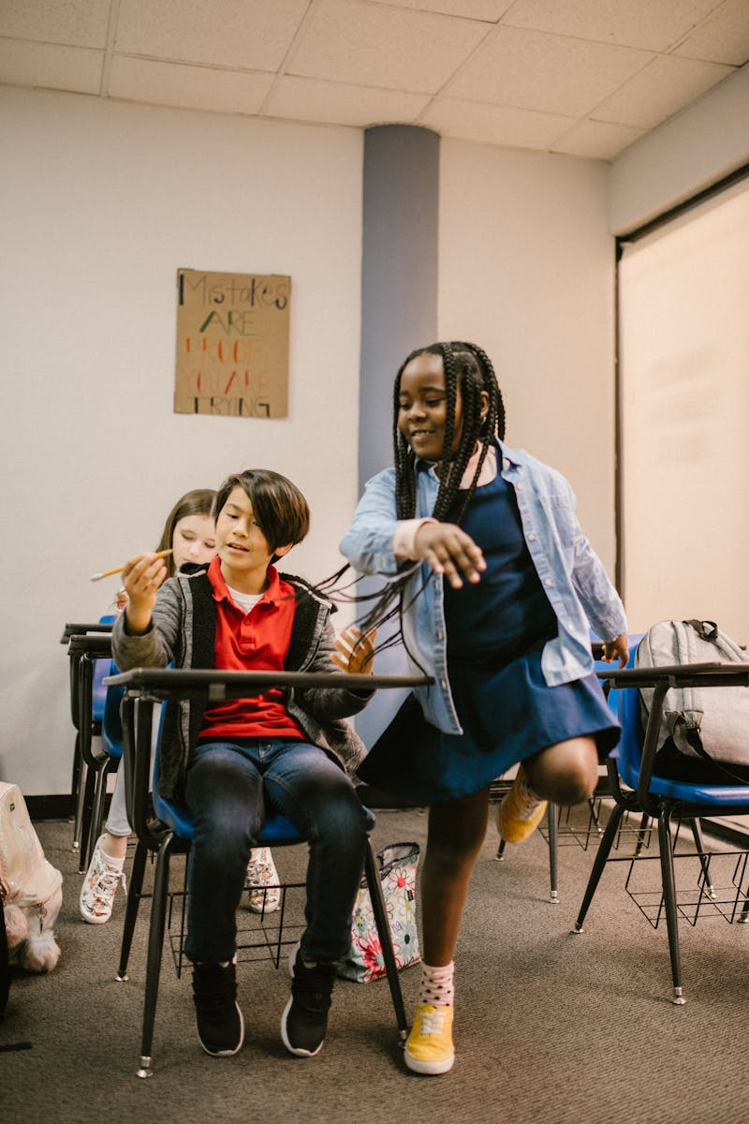
Strengths of the Theory
Integrates mental processes with observable behaviors for a comprehensive view.
Applies directly to education, media, and therapy for effective interventions.
Backed by studies like the Bobo Doll Experiment, providing empirical evidence.
Accounts for how intricate social behaviors are learned through observation.
Photo by Pexels

Slide 16

Limitations and Criticism
The theory may overlook innate biological influences on behavior.
Controlled studies might not fully reflect real-life complexities.
Some behaviors are innate or learned through direct experience.
It struggles to account for behaviors that arise without external models.
Photo by Pexels

Slide 17
Conclusion
Social Learning Theory highlights learning through observation and modeling, as developed by Albert Bandura.
It remains relevant in understanding social influences in digital and everyday contexts.
We learn not only by doing, but by watching others do.
Emphasizes the power of social observation in shaping individual and societal behaviors.
Photo by Pexels

