Slide 1

Specification and Contract Based on Max Fajardo
Photo by Pexels

Slide 2
01
Introduction
Table of Contents
02
What is a Specification?
03
Purpose of Specifications
04
Types of Specifications
05
What is a Contract?
06
Elements of a Contract
07
Types of Construction Contracts
08
Relationship of Plans, Specs, and Contract
09
Importance in Professional Practice
10
Conclusion

Slide 3
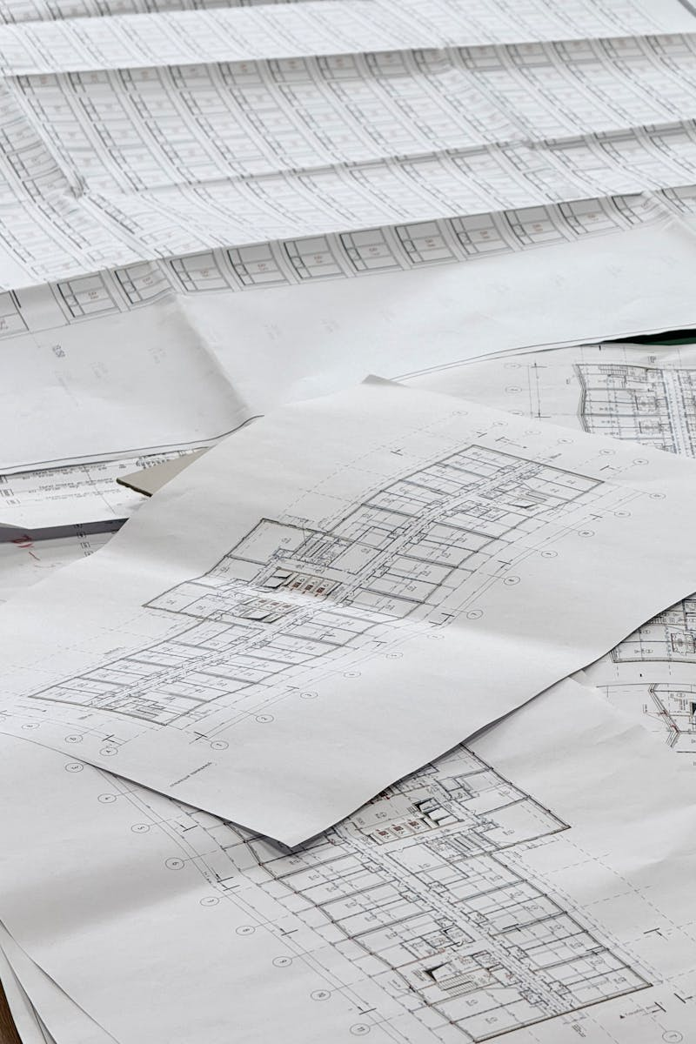
1
Introduction
Overview
Specification and Contract by Max Fajardo is a foundational reference in construction and architecture. It explains technical specifications and contractual requirements. Widely used by students and professionals.
Photo by Pexels

Slide 4

2
What is a Specification?
Definition
Written description of materials, workmanship, and standards. Complements drawings and plans. Defines quality and execution.
Photo by Pexels

Slide 5

3
Purpose of Specifications
Why it Matters
Ensures uniformity and quality. Acts as legal reference. Guides contractors during construction.
Photo by Pexels

Slide 6
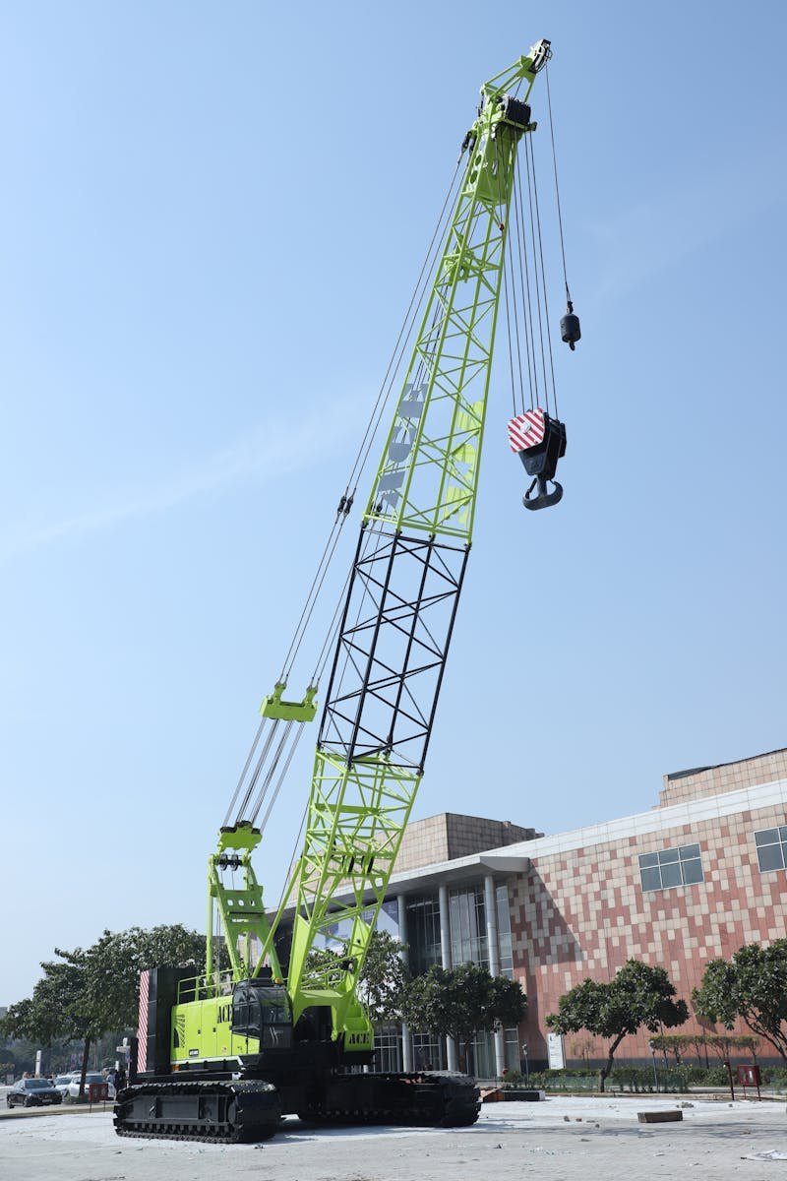
4
Types of Specifications
Classification
General specifications. Detailed specifications. Performance specifications. Proprietary specifications.
Photo by Pexels

Slide 7
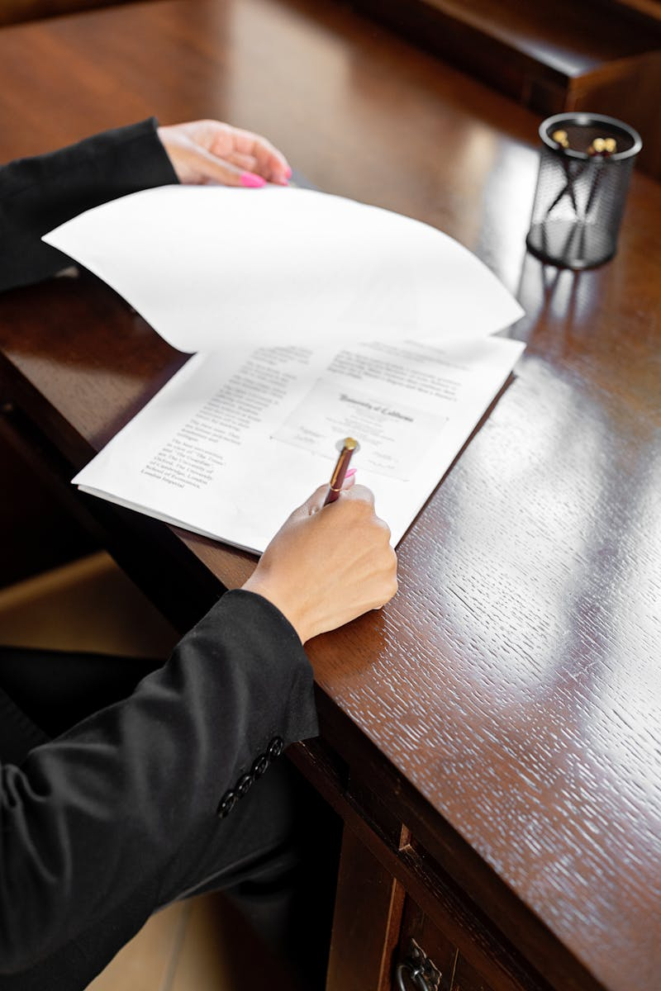
5
What is a Contract?
Construction Contract
A legal agreement between owner and contractor. Defines scope, cost, and time. Protects rights of all parties.
Photo by Pexels

Slide 8
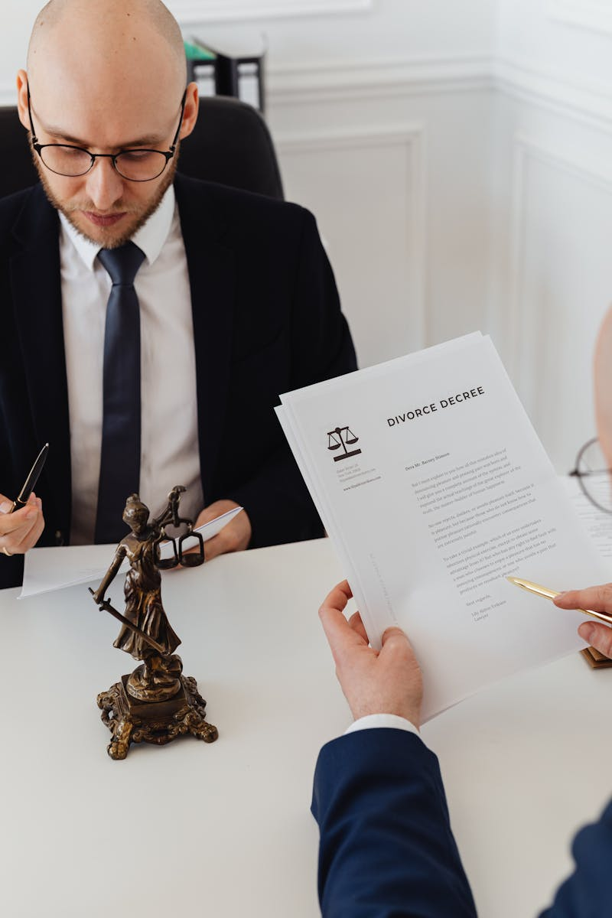
6
Elements of a Contract
Key Components
Offer and acceptance. Consideration. Competent parties. Lawful object.
Photo by Pexels

Slide 9

7
Types of Construction Contracts
Common Forms
Lump sum contract. Cost plus contract. Unit price contract. Time and material contract.
Photo by Pexels

Slide 10
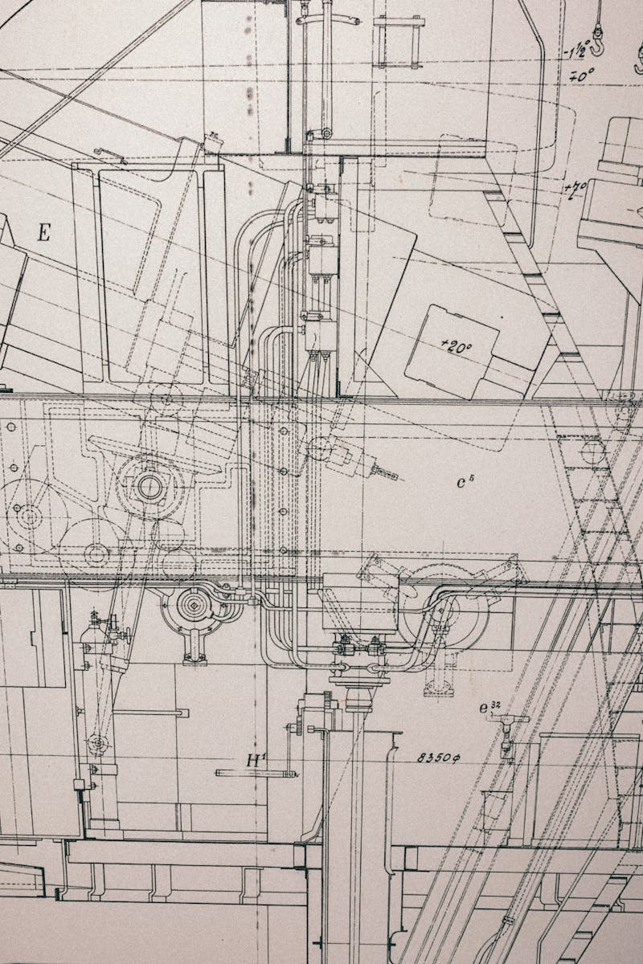
8
Relationship of Plans, Specs, and Contract
Integrated Documents
Plans show design intent. Specifications define quality. Contract binds all documents.
Photo by Pexels

Slide 11

9
Importance in Professional Practice
Applications
Prevents disputes. Ensures project success. Promotes accountability.
Photo by Pexels

Slide 12
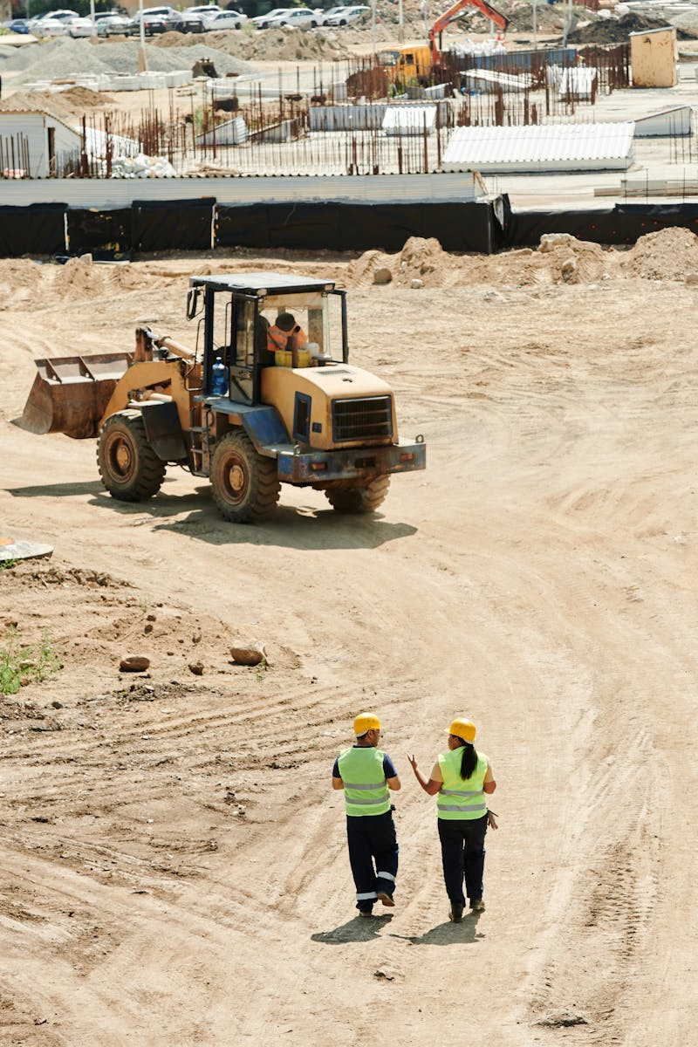
10
Conclusion
Summary
Specifications and contracts are essential. They guide, protect, and regulate construction. Mastery is vital for professionals.
Photo by Pexels

