Slide 1

States of Matter: A Fun Adventure!
Exploring Solids, Liquids, Gases, and Changes All Around Us!

Slide 2

Table of Contents
1
What is Matter?
5
Thank You!
2
Solid Adventures!
3
Liquid Fun!
4
Gas Escapades!

Slide 3
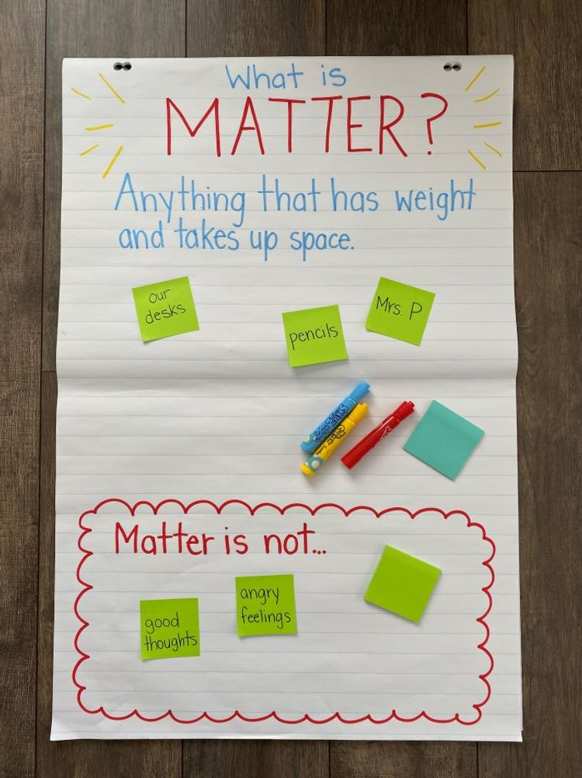
What is Matter?
Matter is everywhere! It's anything that takes up space and has weight. Think of your toys, your food, and even the air you breathe!
Matter comes in three main forms called states: solid, liquid, and gas. Each state has different properties and acts in unique ways.
Solids have a fixed shape and volume. They don't easily change their form. Examples include rocks, wood, and ice cubes.
Understanding states of matter helps us describe our world. It also helps us understand how objects behave.
Photo by Google

Slide 4
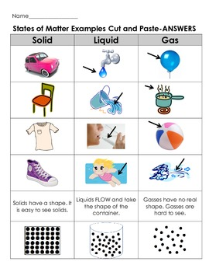
Solid Adventures!
Solids keep their shape unless a force acts upon them. A table will stay a table unless someone breaks it!
Solids take up a specific amount of space. A rock will always be the same size, no matter where you put it.
The tiny particles in solids are packed closely together. This is why they are firm and rigid.
Think about your favorite toys or furniture. These solids do not readily change shape. The structure is fixed.
Photo by Google

Slide 5
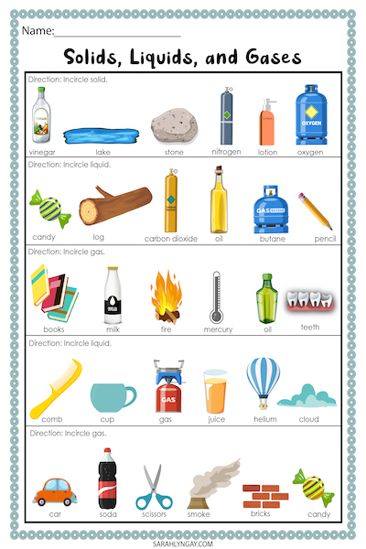
Liquid Fun!
Liquids take the shape of their container. Pour water into a glass, and it becomes the shape of the glass!
Liquids still have a fixed volume. One cup of water is always one cup, even if you pour it into a bowl.
The particles in liquids can move around more freely than in solids. That's why liquids can flow.
Water, milk, juice, and oil are all liquids. They can be poured and flow because of their properties.
Photo by Google

Slide 6
Gas Escapades!
Gases do not have a fixed shape. They spread out to fill whatever space is available, like air in a balloon.
Gases do not have a fixed volume either. They can be compressed or expanded. They can fill any size container.
The particles in gases move very quickly and are far apart from each other. They zoom around in all directions.
Air, oxygen, and helium are all gases. The atmosphere we breathe is made up of many different gases mixed together.
Photo by Google

Slide 7

Thank You!
A solid holds its shape, a liquid takes the shape of its container, and a gas spreads out to fill any space.
The properties of each state of matter are very important for understanding the world around us. Every matter has its property!
Continue to explore the world around you and ask questions about the matter you see. Keep asking questions!
Thank you for taking the time to learn about the states of matter. Keep up the curiosity! Keep the good work up!
Photo by Google

