Slide 1
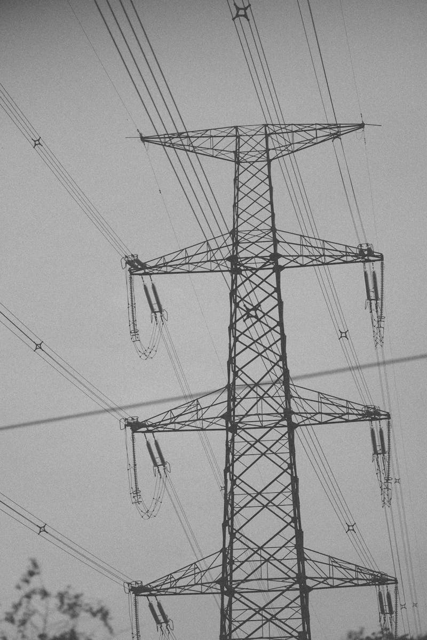
Strategic Overview of Cutting Lines and Distribution Centre Optimizing Efficiency and Logistics in Steel Plant Operations
Photo by Pexels

Slide 2
Table of Contents

