Slide 1
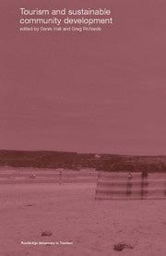
Sustainable Tourism: Empowering Communities
Unlocking the Potential of Local Culture and Economic Growth
Photo by Google

Slide 2
01
Tourism's Untapped Power
Table of Contents
02
Empowering Communities
03
Preserving Local Culture
04
Role of Tourism
05
Sustainable Practices
06
Engaging Stakeholders
07
Measuring Success
08
Challenges and Solutions
09
Case Studies
10
Thank You

Slide 3
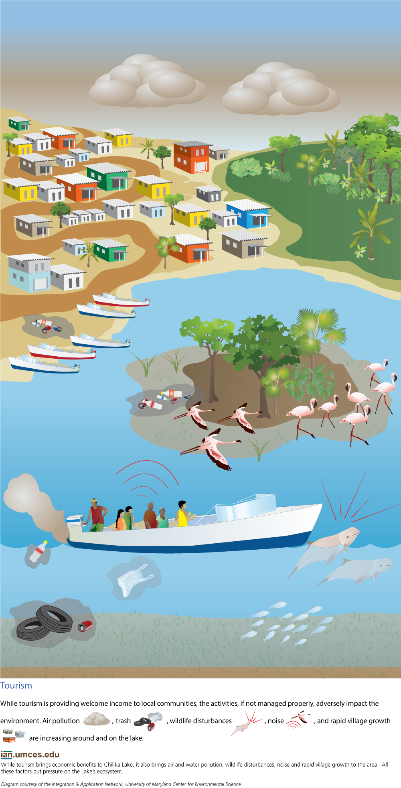
1
Tourism's Untapped Power
Transforming Communities Through Sustainable Practices
Tourism is more than just visiting places; it's a catalyst for change. It can bring positive economic, social, and environmental impacts to communities.
Let’s explore how strategic tourism can empower communities. Focusing on preserving their unique local culture and improving economic prosperity.
Sustainable tourism isn't just a trend; it's a global necessity. We have a chance to create truly sustainable, successful destinations.
When tourism thrives sustainably, the benefits ripple outwards. This helps to create a more vibrant, resilient, and equitable future for everyone.
Photo by Google

Slide 4
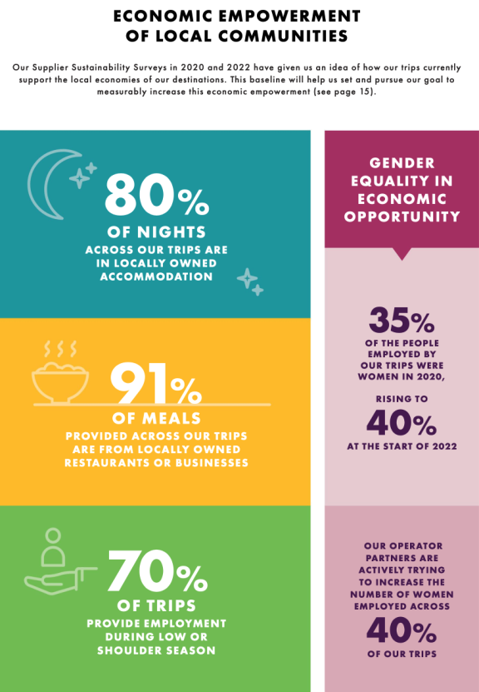
2
Empowering Communities
Tourism as a Tool for Community Development
Tourism generates revenue for local businesses. Supporting artisans, farmers, and entrepreneurs ensures economic viability.
From hospitality to guiding services, tourism creates diverse employment opportunities. Equipping communities with essential skills.
Tourism investments often lead to better infrastructure. These includes roads, sanitation, and communication networks that will benefit the entire community.
When communities own and manage tourism initiatives, benefits remain local. This avoids exploitation and ensures fairness.
Photo by Google

Slide 5
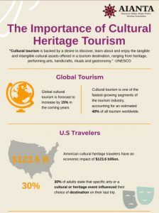
3
Preserving Local Culture
Protecting Heritage and Traditions
Sustainable tourism encourages the celebration of local culture. Protecting traditions, languages, and art forms from fading away.
Tourism facilitates meaningful exchange between visitors and locals. Raising awareness and appreciation for diverse cultures.
Travelers seek authentic experiences that immerse them in local culture. Driving demand for traditional crafts, cuisine, and performances.
When communities see value in their heritage, a sense of pride strengthens. Which motivates them to preserve it for future generations.
Photo by Google

Slide 6
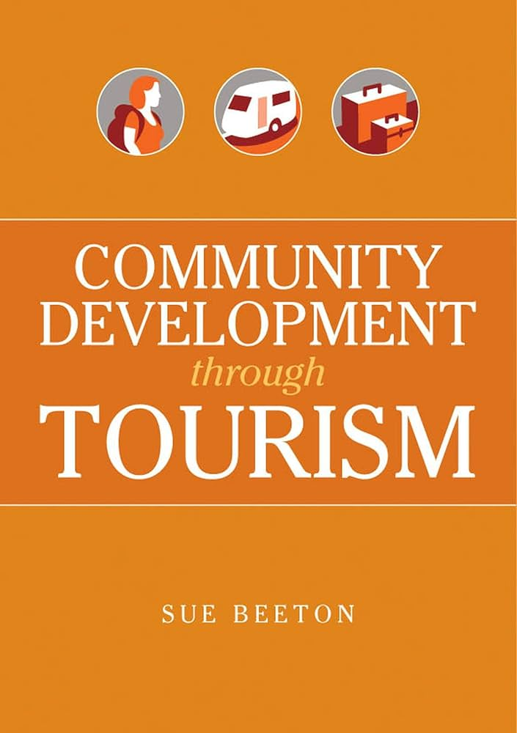
4
Role of Tourism
Tourism as a Tool for Community Development
Tourism injects capital into local economies, driving growth and reducing poverty. This creates opportunities and improves living standards.
Tourism can fund education, healthcare, and community projects. This improves the overall well-being and quality of life for residents.
Tourism revenue can support conservation efforts. Protecting natural resources and biodiversity, and ensuring sustainability.
Tourism can help communities to protect and promote their cultural heritage. Ensuring that traditions and customs are preserved for future generations.
Photo by Google

Slide 7
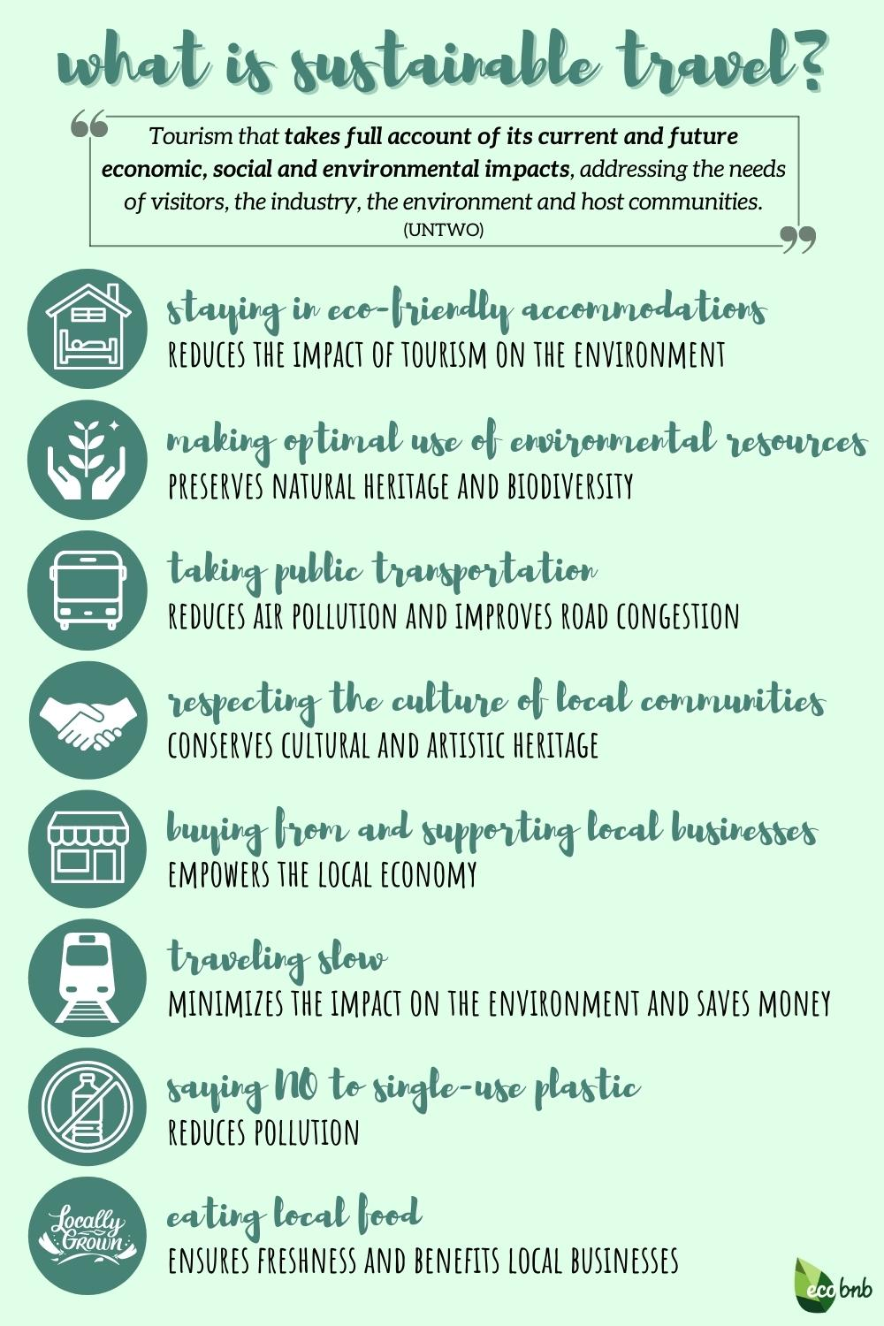
5
Sustainable Practices
Minimizing Impact, Maximizing Benefits
Promoting accommodations that prioritize energy efficiency. Focusing on waste reduction, and conservation of water to minimize environmental impact.
Encouraging the use of public transport, cycling, and walking. Minimizing carbon emissions associated with travel for environmentally safety.
Supporting local farmers, artisans, and businesses. Reducing the carbon footprint of food and goods that will be sold to other places.
Implementing effective waste reduction. Recycling programs to minimize pollution and protect natural environments for people.
Photo by Google

Slide 8
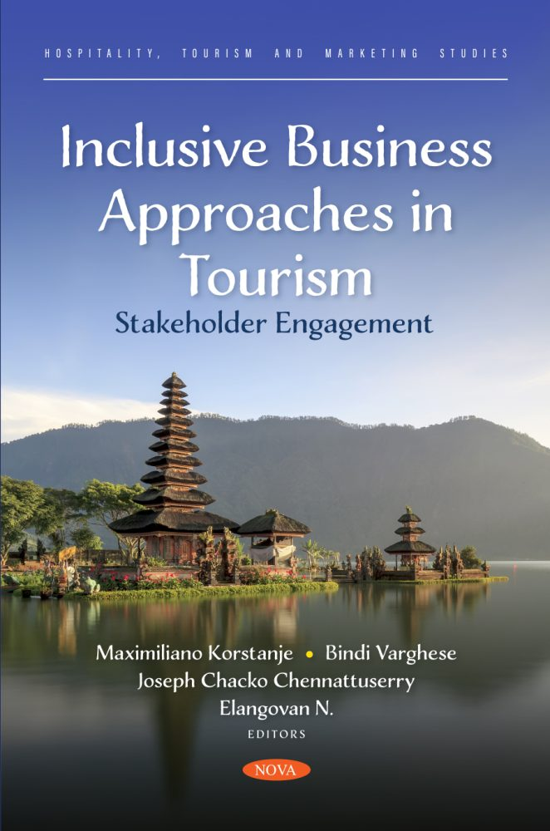
6
Engaging Stakeholders
Collaboration for Success
Involving local residents in tourism planning and decision-making. Ensuring that their voices are heard and their needs are met by the agency.
Providing policy frameworks and incentives for sustainable tourism. Fostering collaboration and ensuring responsible industry growth.
Businesses adopting sustainable practices and investing in communities. Demonstrating corporate social responsibility and value.
Educating tourists about responsible travel and cultural sensitivity. Encouraging respect for local customs, traditions, and environment.
Photo by Google

Slide 9
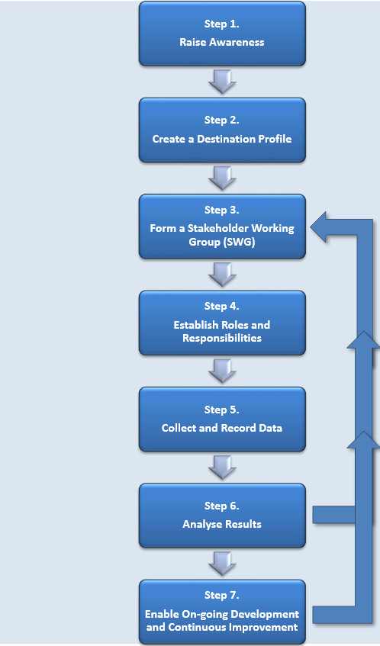
7
Measuring Success
Indicators of Sustainable Tourism
Tracking revenue generation, job creation, and poverty reduction. Assessing the economic impact of tourism on the community.
Measuring improvements in education, healthcare, and community well-being. Evaluating the social benefits of tourism projects.
Monitoring pollution levels, resource consumption, and biodiversity. Assessing the environmental impact and conservation for future.
Assessing preservation efforts, cultural vitality, and heritage protection. Ensuring tourism doesn't exploit but celebrates culture.
Photo by Google

Slide 10
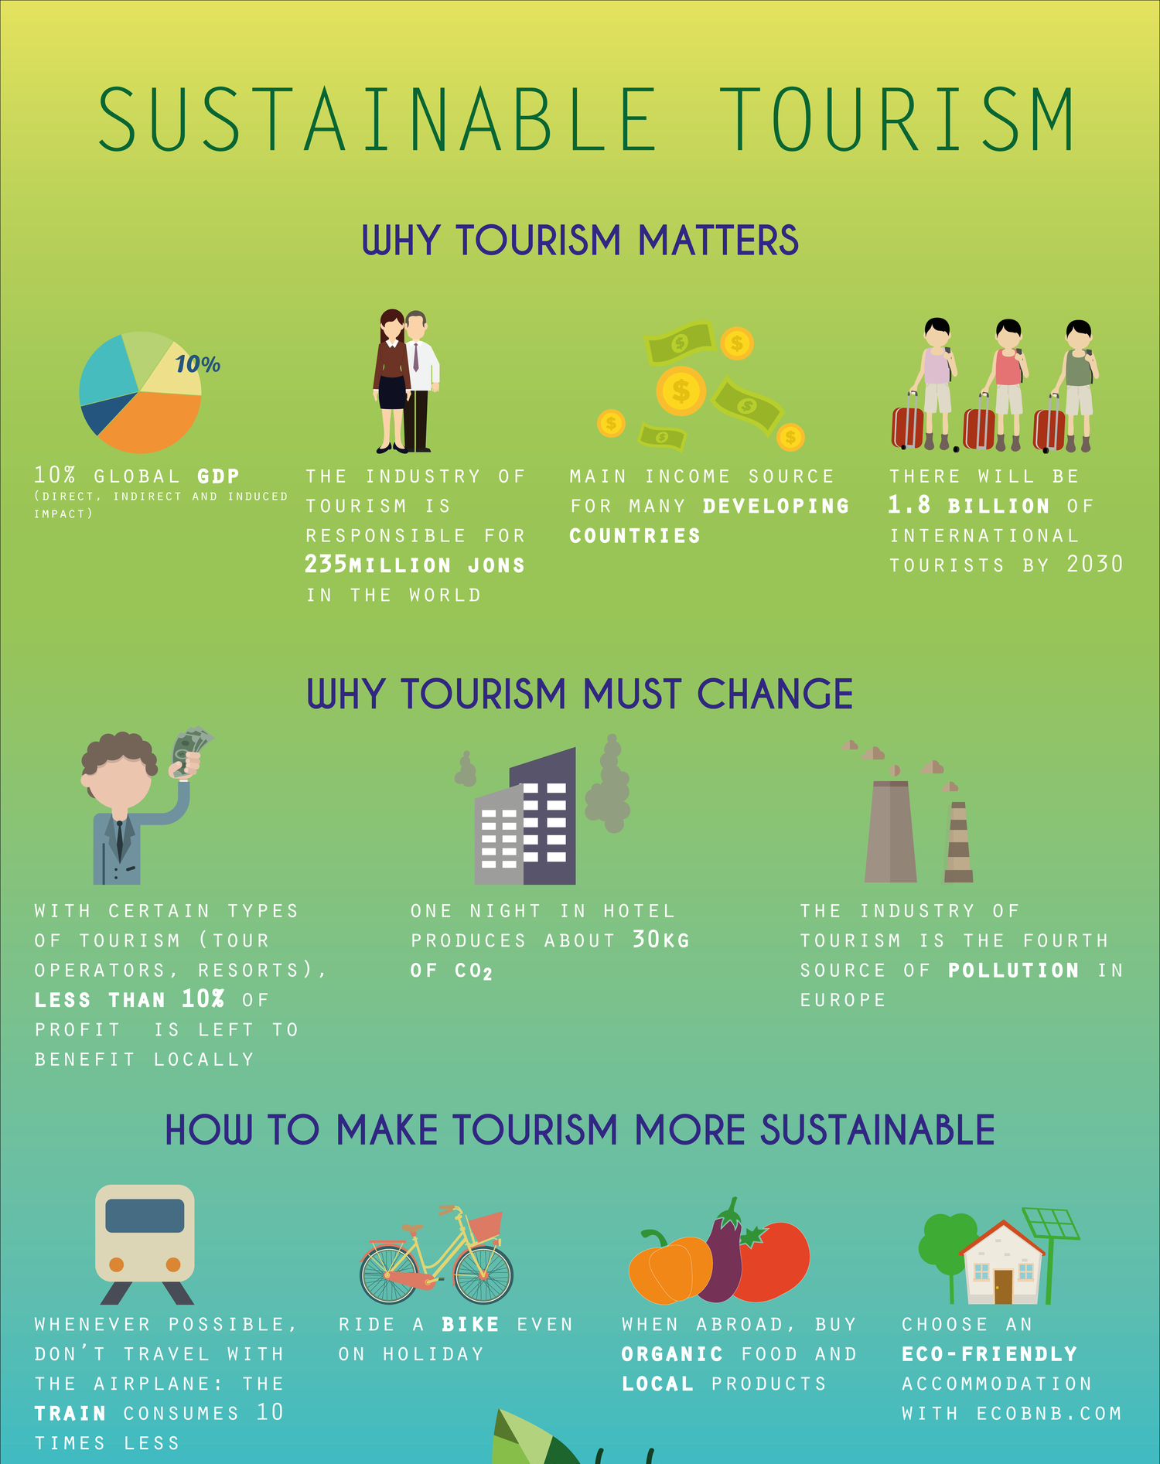
8
Challenges and Solutions
Overcoming Obstacles to Sustainability
Managing visitor numbers to minimize environmental and social impact. Implementing strategies to disperse tourists and protect sensitive sites.
Ensuring that tourism revenue stays within the local economy. Supporting local businesses, and reducing reliance on external suppliers.
Protecting cultural heritage from being exploited for commercial gain. Promoting authentic experiences and supporting local artisans.
Implementing strict environmental regulations and promoting sustainable practices. Protecting natural resources and biodiversity.
Photo by Google

Slide 11
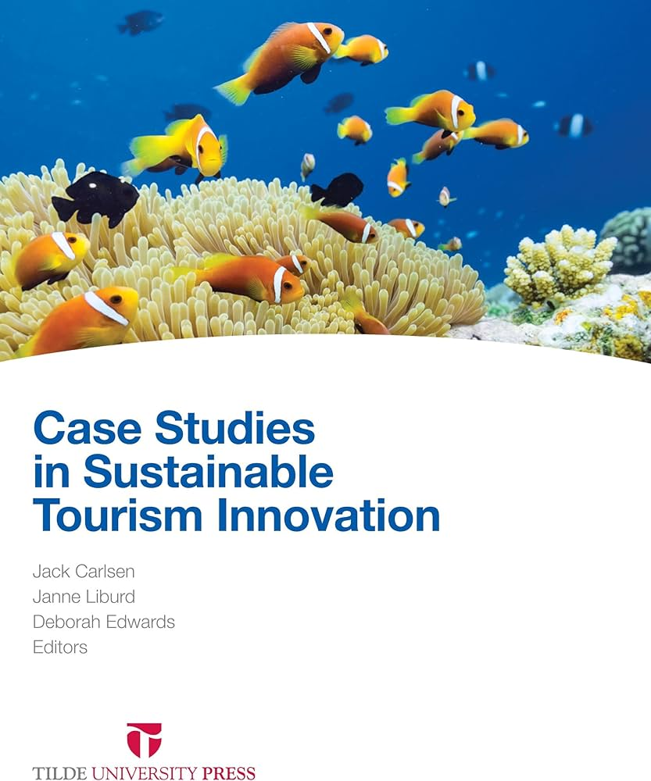
9
Case Studies
Inspiring Examples of Sustainable Tourism
Highlighting successful initiatives where communities own and manage tourism. Showcasing the benefits of local ownership and decision-making.
Featuring destinations that have successfully integrated environmental protection. Illustrating responsible resource management and conservation.
Sharing examples of tourism initiatives that support cultural heritage. Protecting traditions, languages, and art forms.
Presenting strategies for managing tourism in a sustainable manner. Showcasing examples of destinations that have achieved success.
Photo by Google

Slide 12

10
Thank You
For Your Time and Attention
Thank you for taking the time to learn about sustainable tourism. I hope this presentation has been informative and insightful.
Let's work together to promote sustainable tourism and empower local communities. Making a positive impact on the world and the community.
Together, we can build a brighter future for tourism and the communities it touches. Creating a more sustainable and equitable world.
If you have any questions or want to get involved, please reach out. Together, we can make a difference.
Photo by Google

