Slide 1

The Disturbing Reality: Understanding the Psychology of Serial Killers
Exploring the minds, motives, and warning signs – can anyone be susceptible?

Slide 2

Table of Contents
01
The Unthinkable Question
02
The Serial Killer Profile
03
The Influence of Environment
04
Warning Signs and Red Flags
05
Thank You

Slide 3





The Unthinkable Question
1.
The Seed of Doubt
The question plants a seed of unease, forcing us to confront the darkest aspects of human potential and the unsettling possibility of latent tendencies.
2.
Normalcy's Illusion
Serial killers often appear 'normal,' highlighting the deceptive nature of appearances and the challenge of identifying potential threats based on outward behavior.
3.
The Nature vs. Nurture Debate
The debate underscores the complex interplay of genetic predispositions, environmental factors, and traumatic experiences in shaping an individual's psychological development.
Photo by Google

Slide 4
The Unthinkable Question
4.
The Fragility of the Human Psyche
It emphasizes the delicate balance between sanity and madness, and the potential for even seemingly stable individuals to succumb to extreme psychological pressures.
Photo by Google

Slide 5
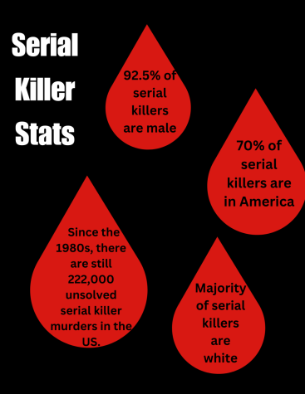
The Serial Killer Profile
1.
Childhood Trauma
Many serial killers experienced severe abuse, neglect, or abandonment, creating deep-seated emotional scars and distorted perceptions of relationships.
2.
Lack of Empathy
They demonstrate a profound inability to understand or share the feelings of others, viewing victims as objects rather than human beings with inherent value.
3.
Control and Domination
The act of killing provides a sense of power and control, satisfying a deep-seated need to dominate and manipulate others in the most extreme way possible.
Photo by Google

Slide 6
The Serial Killer Profile
4.
Fantasy and Ritual
Murders are often meticulously planned and executed according to elaborate fantasies, with each act serving as a ritualistic reenactment of their inner obsessions.
Photo by Google

Slide 7
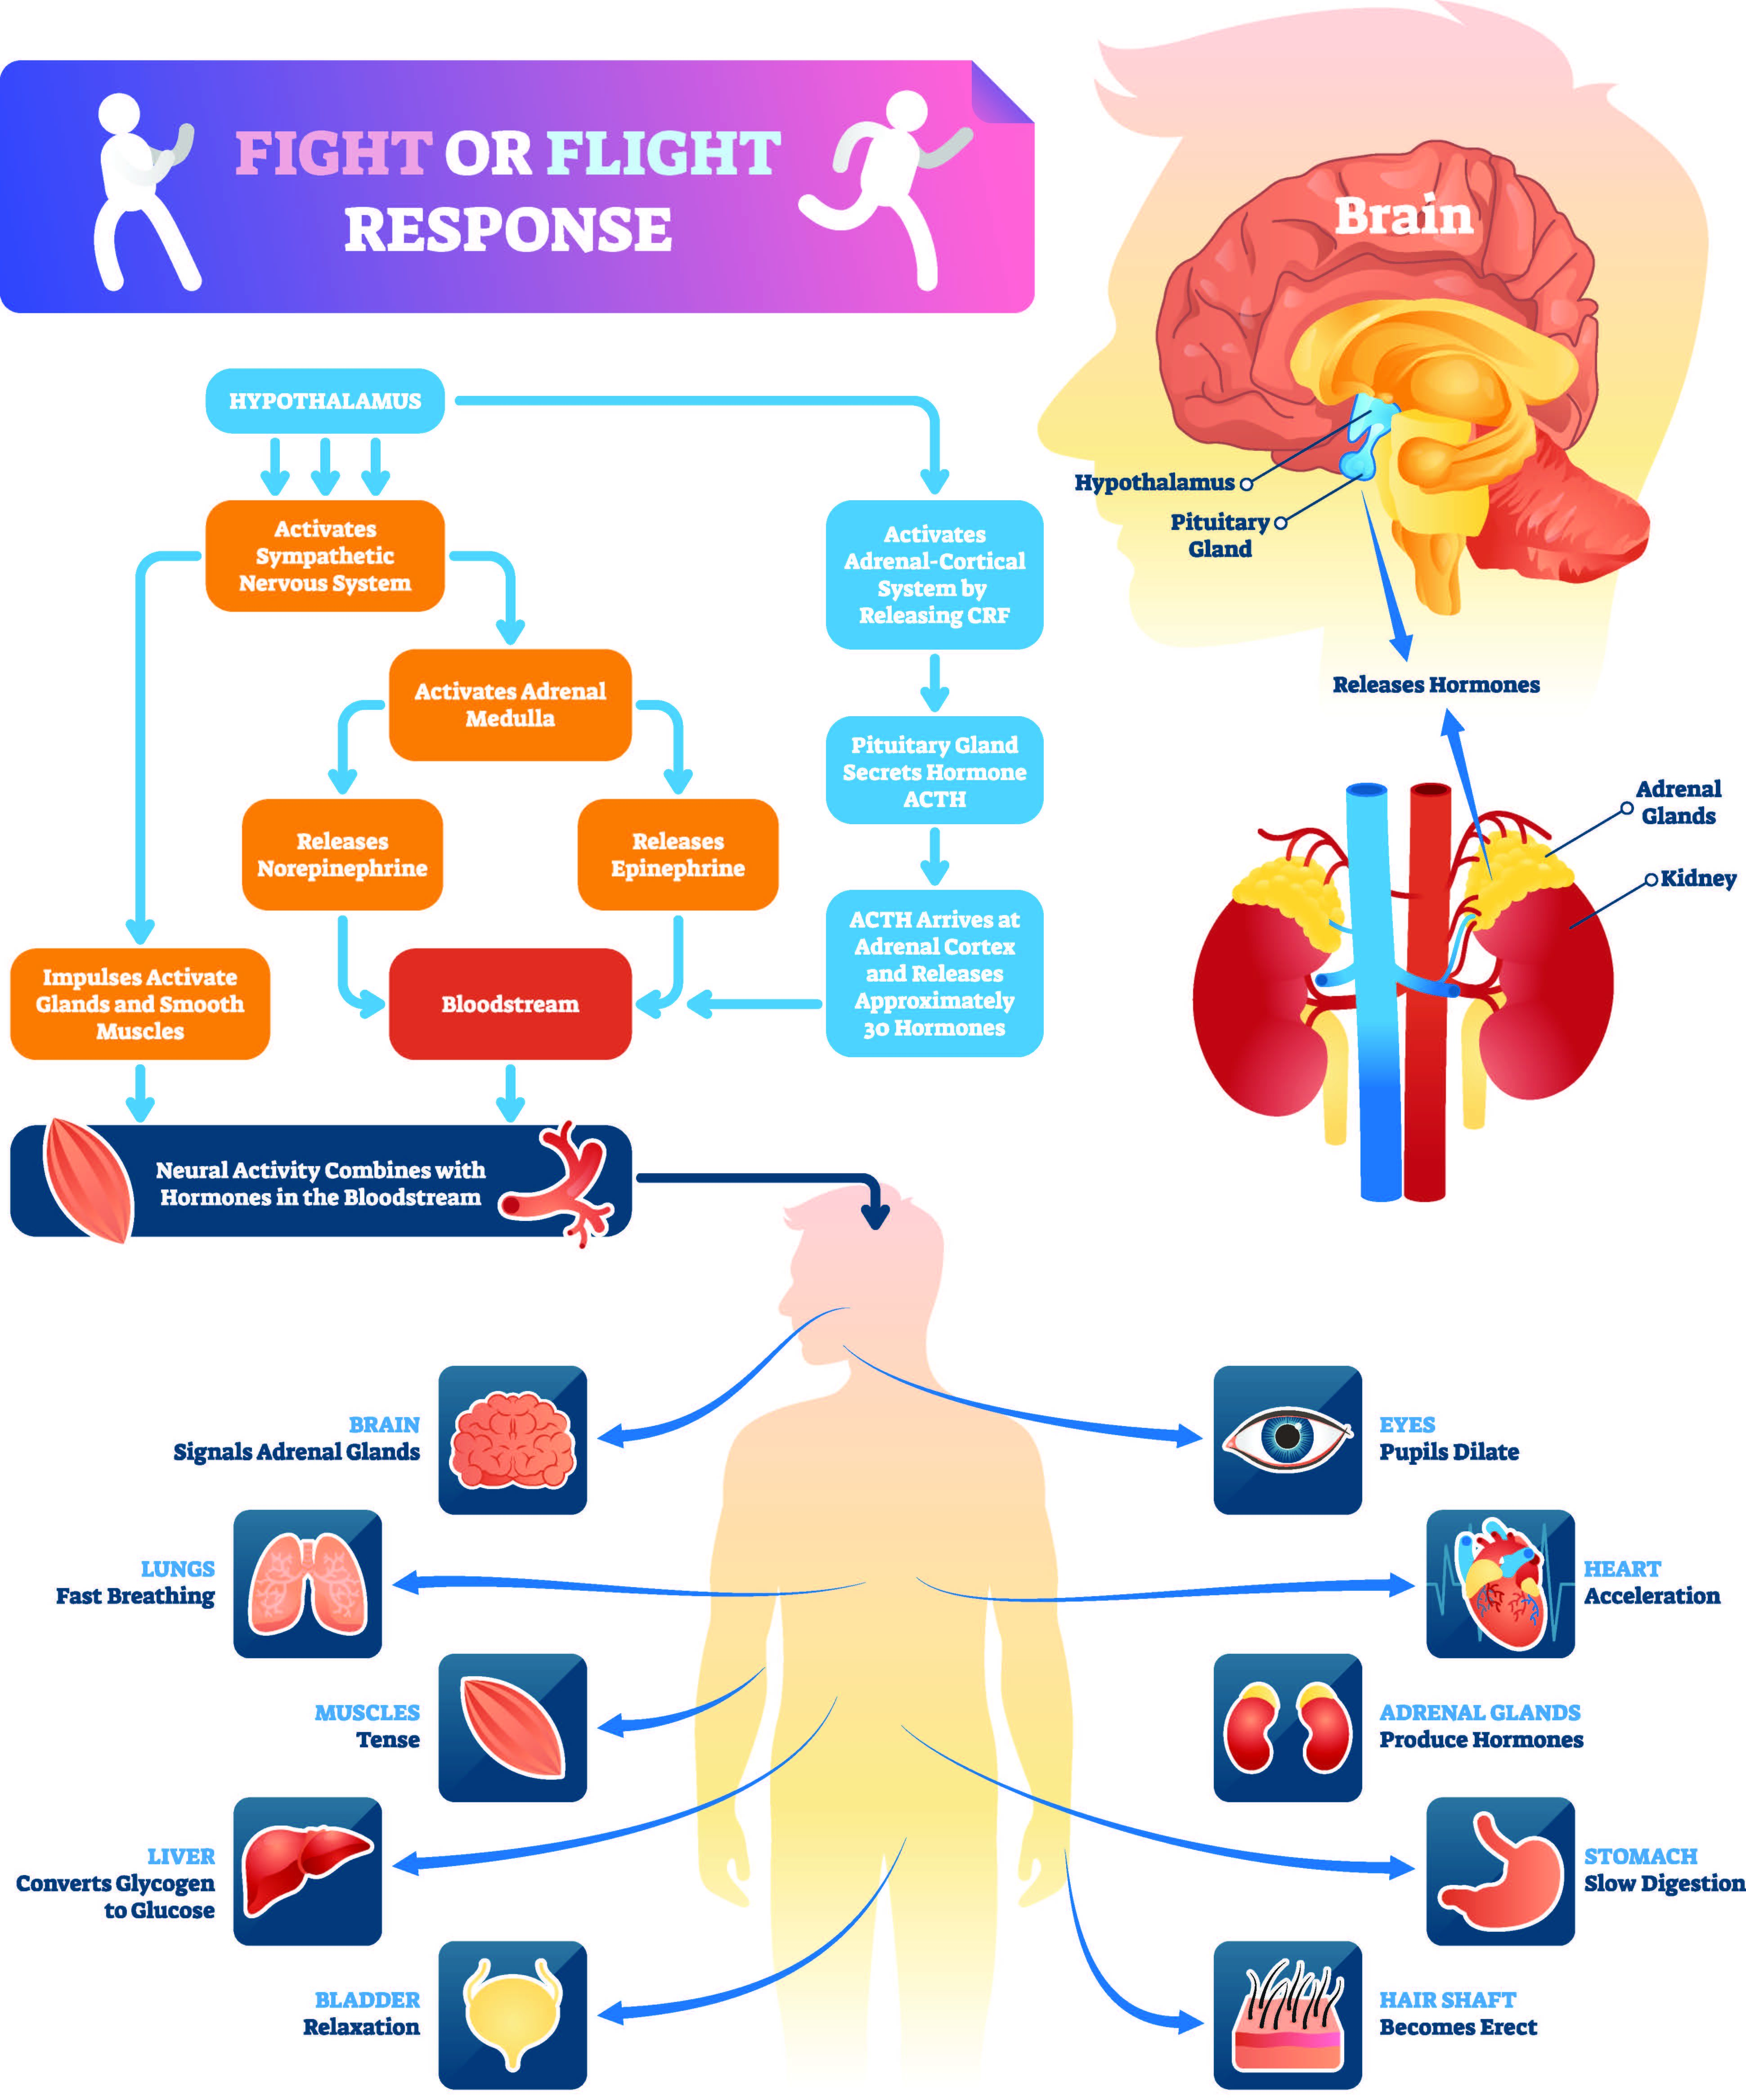
The Influence of Environment
1.
Social Isolation
Prolonged isolation can lead to distorted thinking, impaired social skills, and a detachment from societal norms, increasing the risk of deviant behavior.
2.
Exposure to Violence
Witnessing or experiencing violence, especially at a young age, can desensitize individuals to suffering and normalize aggressive behavior, fostering a cycle of brutality.
3.
Cultural Factors
Certain cultural norms or values may inadvertently contribute to the creation of environments that are conducive to the development of serial killers.
Photo by Google

Slide 8
The Influence of Environment
4.
Media Influence
Excessive exposure to violent or sexually explicit material can desensitize individuals to suffering and distort their perceptions of reality, potentially fueling fantasies.
Photo by Google

Slide 9
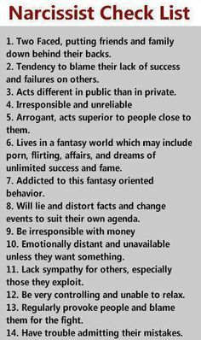
Warning Signs and Red Flags
1.
Cruelty to Animals
This may indicate a lack of empathy and a willingness to inflict pain on vulnerable creatures, reflecting a broader pattern of antisocial behavior.
2.
Fire Setting
Pyromania can be a manifestation of underlying psychological distress, a need for control, or a fascination with destruction, signaling potential instability.
3.
Bedwetting (Enuresis)
Prolonged bedwetting beyond a certain age may be a sign of emotional trauma, developmental issues, or underlying psychological disturbances, requiring attention.
Photo by Google

Slide 10
Warning Signs and Red Flags
4.
Preoccupation with Violence
Obsessive thoughts, fantasies, or behaviors related to violence, death, or inflicting harm on others may be a sign of escalating aggression and potential danger.
Photo by Google

Slide 11

Thank You
1.
Gratitude
Thank you for your time and attention. We appreciate you engaging with this complex and unsettling topic.
2.
Further Research
This presentation is just a starting point. We encourage you to explore the psychology of serial killers in greater depth through academic sources.
3.
Critical Thinking
Remember to approach this topic with a critical and discerning mind. Avoid sensationalism and focus on evidence-based information.
Photo by Google

Slide 12
Thank You
4.
Continued Discussion
Let's continue the conversation about prevention and early intervention. Understanding the factors that contribute to violent behavior is crucial.
Photo by Google

