Slide 1
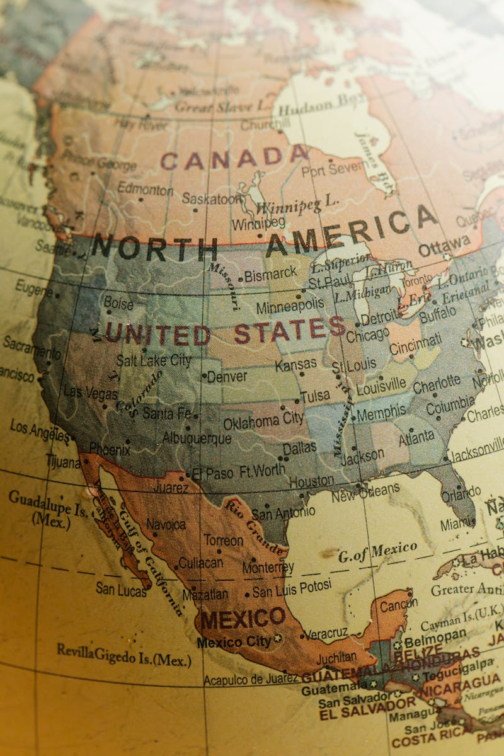
The Great Global Exchange How the Columbian Exchange forever connected and changed our entire world.

Slide 2
01
Welcome to History
Table of Contents
02
Ptolemy's Ancient Map
03
The Voyage of 1492
04
The Columbian Exchange
05
Gifts from the Americas
06
Arrivals from Europe
07
The Impact of Disease
08
The Transatlantic Slave Trade
09
Perspectives on History
10
Thank You

Slide 3
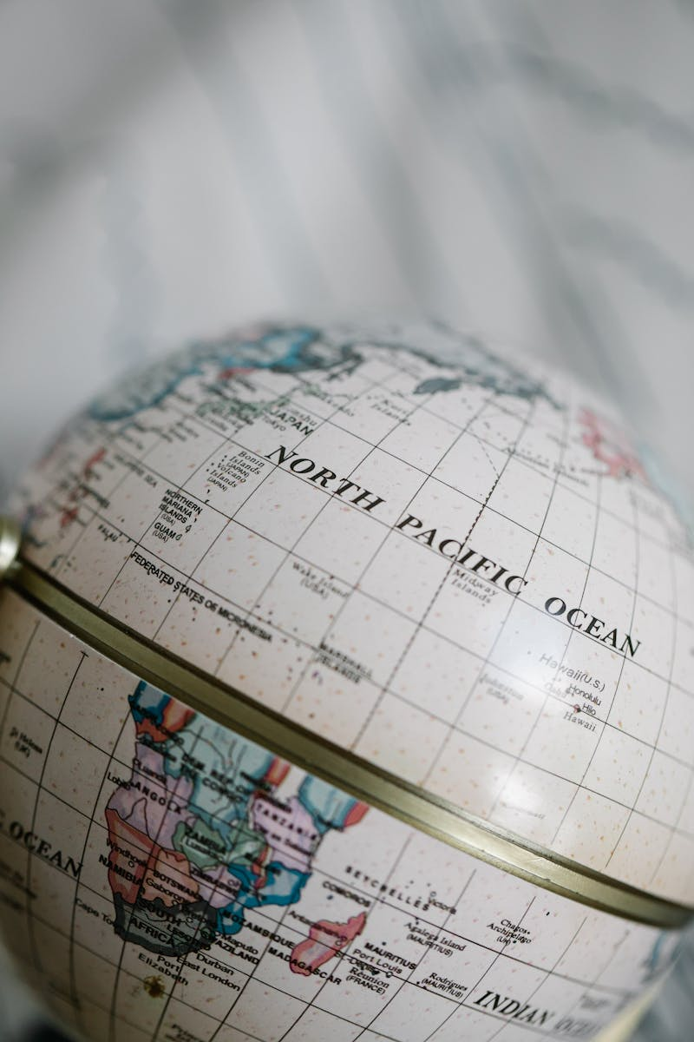
1
Welcome to History
Discovering how two worlds became one
Imagine a world where tomatoes and horses did not exist together. The Columbian Exchange changed everything by connecting two sides of the planet in a very massive way. In 1492, Christopher Columbus set sail across the Atlantic Ocean. This famous voyage was the spark that ignited the global transfer of goods, plants, and even diseases. Long before Columbus, Claudius Ptolemy created a map that mistakenly enlarged Asia. This error convinced explorers that the ocean between Europe and Asia was actually quite small. The Columbian Exchange refers to the transfer of plants, animals, and diseases. This movement between the Old World and the New World forever changed global diets and populations.

Slide 4

2
Ptolemy's Ancient Map
The guide that led to a discovery
Claudius Ptolemy was an ancient geographer who mapped the world around 150 AD. His work, known as Geographia, was used by many explorers hundreds of years after him. Ptolemy's map contained a major error that mistakenly enlarged the continent of Asia. This mistake made the ocean between Europe and Asia look much smaller than it is. Scholars in the Islamic world preserved Ptolemy's geographical work for a thousand years. Their efforts ensured that his maps and ideas remained available for future generations of explorers. Ptolemy’s work maintained a strong geographical influence for centuries. His flawed maps eventually guided Christopher Columbus on his famous voyage to find a new route to the Asian continent.

Slide 5
3
The Voyage of 1492
Columbus sets sail for Asia
In 1492, Columbus set sail to reach Asia by traveling westward. He relied on flawed maps that made the journey seem much shorter than it actually was. Columbus used Ptolemy's Geographia which had a major mapping error. This mistake reduced the ocean's size, making the explorer believe he could easily reach the Asian coast. Instead of finding Asia, Columbus arrived in the Americas and met indigenous people. This event started a new era of interaction between people from two very different worlds. For a thousand years, Ptolemy's geographical work was preserved by scholars in the Islamic world. This preservation maintained his influence on European explorers who later used his maps.

Slide 6
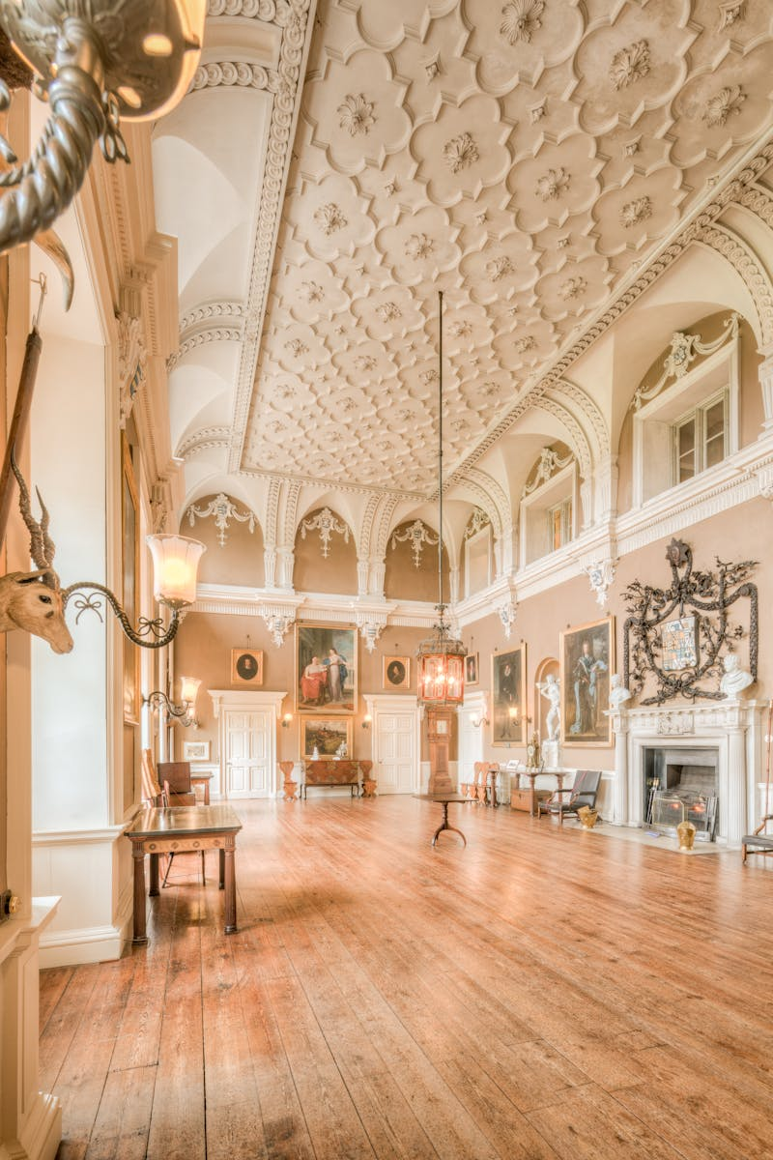
4
The Columbian Exchange
A new world of global connections
Alfred W. Crosby was the historian who coined the term Columbian Exchange. He used this phrase to describe the massive biological and cultural transfer that followed the year 1492. The Columbian Exchange is the transfer of plants, animals, and diseases between worlds. It marks the first time the Old World and the New World were permanently connected together. This exchange began after the voyages of Columbus and changed the planet. It created a global network where goods and ideas could move across the vast Atlantic Ocean daily. The transfer of life forms between continents had a permanent effect on the world. It altered the environment, changed human diets, and shifted the history of many different nations.

Slide 7
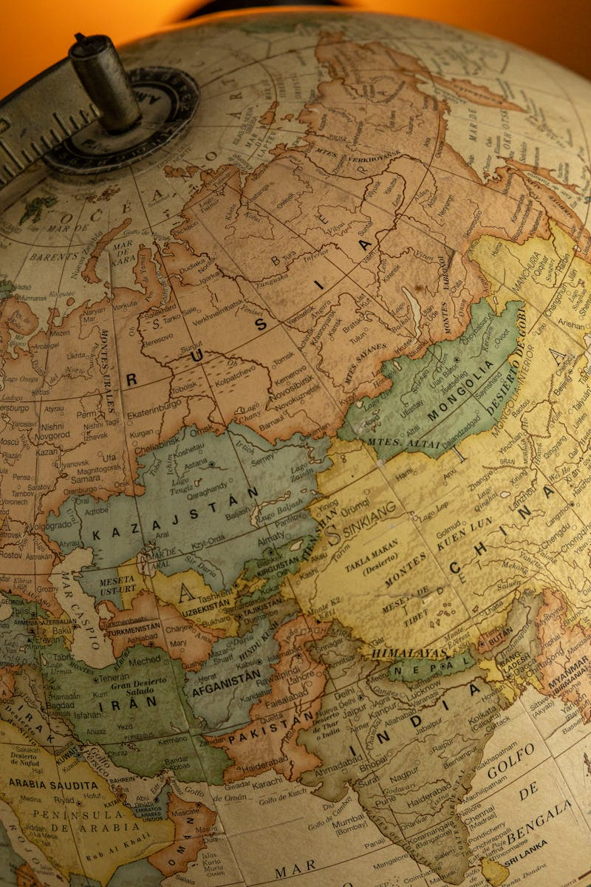
5
Gifts from the Americas
Plants that traveled to Europe
These amazing plants were originally found in the Americas before the exchange. They were brought to the Old World and eventually became essential parts of many international cuisines. Corn was transferred from the Americas to become a staple crop in the Old World. It provided a new source of nutrition for people living across Europe and Asia. Chili peppers originated in the New World and were brought back to the Old World. They added new flavors to cooking and spread quickly to many different global cultures. Many plants like corn, potatoes, and tomatoes traveled from the Americas to Europe. This transfer was a key part of the exchange that changed global food history forever.

Slide 8

6
Arrivals from Europe
Animals and crops for America
Horses were introduced to the Americas by Europeans during the Columbian Exchange. These animals changed how indigenous people traveled and hunted across the vast lands of the continent. Sugar cane was transferred from the Old World to the New World. This crop became a major part of the economy and led to significant changes in agriculture. Europeans brought various animals and plants with them to the New World. These introductions, including livestock and sugar, had a lasting impact on the environment and the economy. The exchange involved more than just food; it included the movement of livestock. These animals from the Old World transformed life for many people living in the Americas.

Slide 9

7
The Impact of Disease
The tragic side of the exchange
Smallpox was introduced to the Americas by European explorers during their early voyages. This deadly disease spread rapidly among people who had never been exposed to it before then. A virgin soil epidemic occurs when diseases devastate unexposed populations. Because indigenous people had no natural immunity, these illnesses caused a massive and tragic decline in their population. Following the arrival of Columbus, diseases from Europe caused a major demographic collapse. This means that a huge number of people died, leading to the fall of societies. The need for labor grew after the indigenous population collapsed due to disease. This tragic event was a direct result of the germs brought over during the Columbian Exchange.

Slide 10
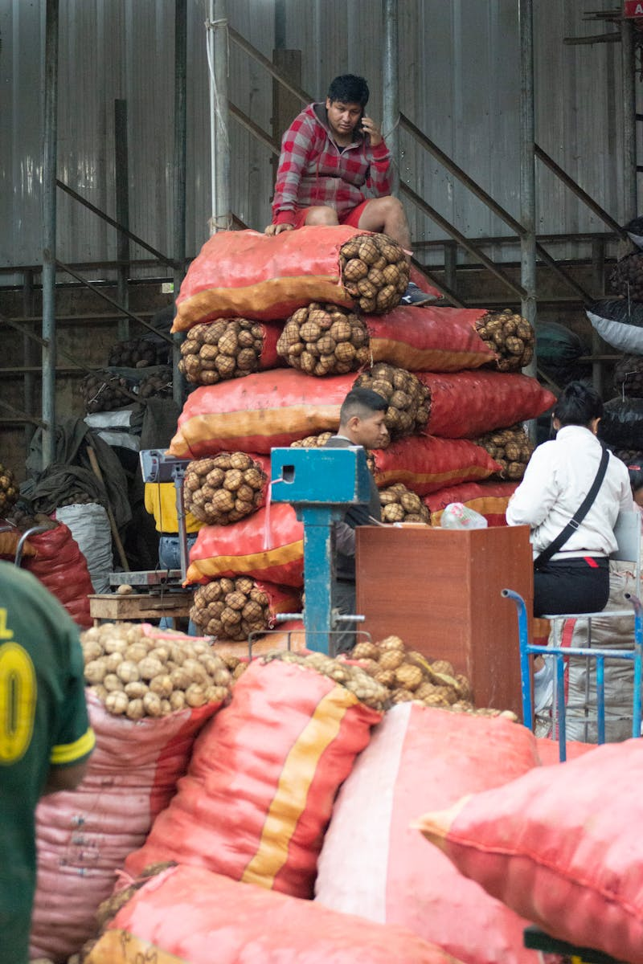
8
The Transatlantic Slave Trade
Forced labor in the New World
European colonizers initiated the slave trade after the indigenous population collapsed. They needed a new source of labor to work on the lands they had claimed in the Americas. Due to the need for labor, Europeans began importing Africans to the Americas. This forced movement of people became a central and tragic part of the transatlantic trade system. The collapse of local populations led colonizers to seek workers from elsewhere. This decision to start the slave trade had a massive and lasting impact on global history. The exchange of goods and people created a new economic system. The slave trade was a dark part of this connection that linked Europe, Africa, and the Americas.

Slide 11
9
Perspectives on History
How we remember the past
There are two competing narratives about Christopher Columbus highlighted in history. These different perspectives help us understand the complex legacy of his arrival in the Americas many years ago. These perspectives matter in today's discussions about history and memory. They influence how we choose to remember the past and how we honor the different people involved in it. Tenochtitlan was the capital of the Aztec Empire and a center of power. Understanding its history helps us appreciate the advanced civilizations that existed before the arrival of Europeans. Understanding these perspectives matters because it allows us to look at history from multiple sides. This helps us have more balanced discussions about the events that shaped our world.

Slide 12
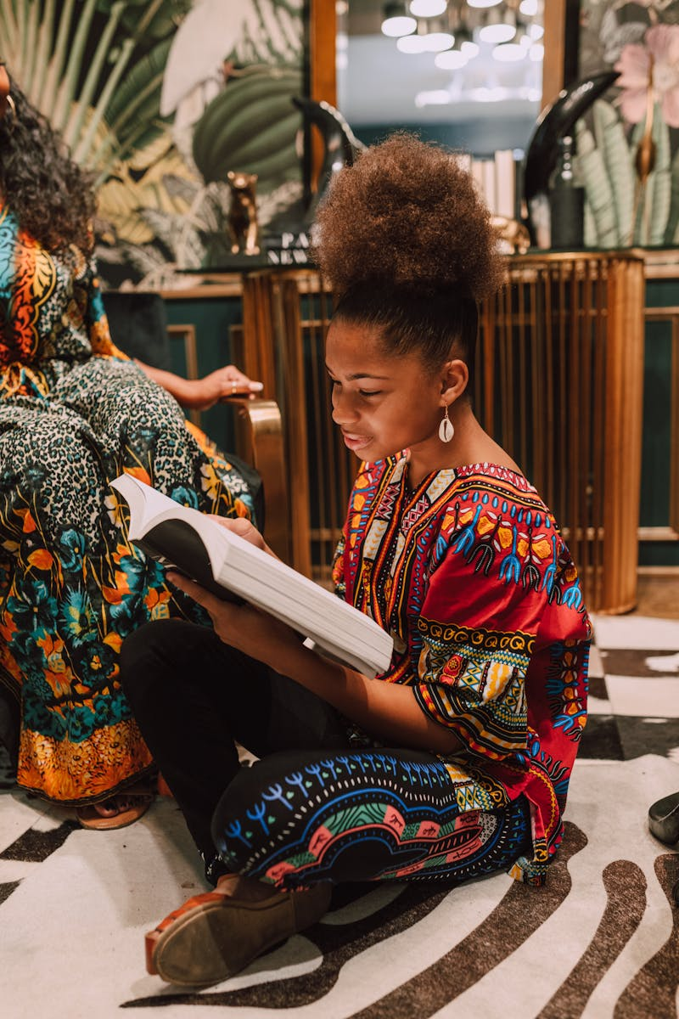
10
Thank You
Keep exploring the world's history
Thank you for joining us to learn about the Renaissance and the Columbian Exchange. We hope you feel inspired to keep exploring the history that connects our global community. History is a journey that never ends, and there is always more to discover. We encourage you to keep asking about the past and how it affects our lives. Understanding the exchange of plants, animals, and cultures helps us appreciate our diverse world. Thank you for your time and for being such an engaged and curious group today. We hope this presentation helped you understand the major events of 1492. Thank you for listening and learning about the people and ideas that changed the course of history.

