Slide 1
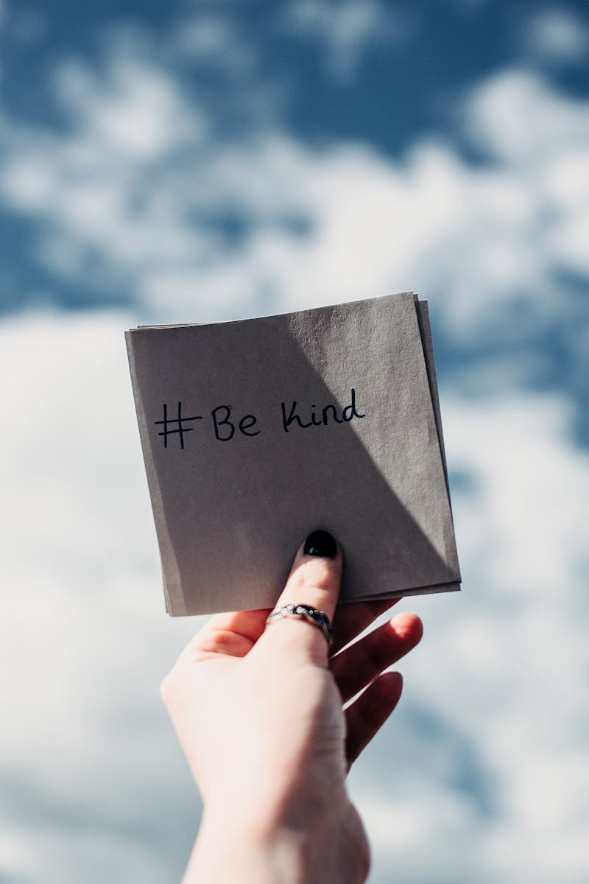
The Power of Kindness Transforming Lives Through Compassion
Photo by Pexels

Slide 2
01
What is Kindness?
Table of Contents
02
Ways to Show Kindness
03
The Ripple Effect of Kindness
04
Kindness in Business
05
Kindness in Education
06
Kindness and Mental Health
07
The Science of Kindness
08
Impacts of Kindness Globally
09
Cultivating a Kind Culture
10
Thank You!

Slide 3

1
What is Kindness?
Understanding Kindness
Kindness is the quality of being friendly, generous, and considerate towards others. It involves showing empathy and compassion, treating others with respect and care. Kindness is not merely an act; it is a way of thinking and being that nurtures human connections. It transcends cultural and geographical boundaries, uniting people through shared humanity.
Photo by Pexels

Slide 4
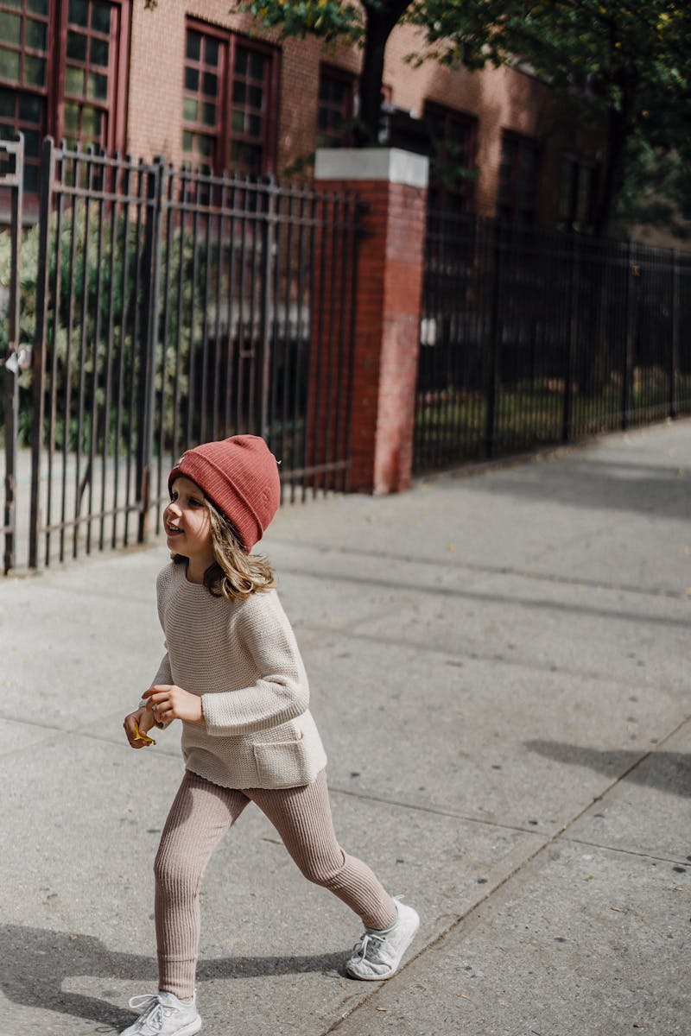
2
Ways to Show Kindness
Acts of Compassion
Simple gestures like smiling at someone can brighten their day and spread positivity. Offering help to a neighbor or volunteering for local charities shows community spirit and compassion. Small acts, such as complimenting others, can significantly impact their self-confidence. Practicing active listening fosters meaningful connections and shows people they are valued.
Photo by Pexels

Slide 5

3
The Ripple Effect of Kindness
Spreading Positivity
Kindness can create a ripple effect, inspiring others to act kindly as well. One kind act can lead to another, creating a chain reaction of generosity and goodwill. Communities that prioritize kindness often experience lower levels of conflict and stress. This culture of kindness can enhance social bonds and create a more cohesive society.
Photo by Pexels

Slide 6
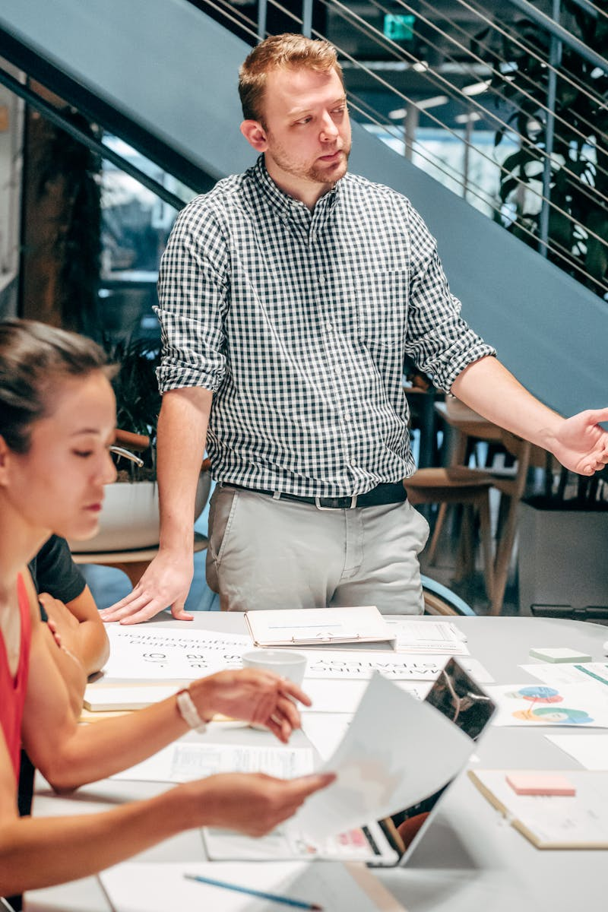
4
Kindness in Business
Boosting Morale
Incorporating kindness in the workplace enhances employee morale and job satisfaction. Kindness breeds loyalty among employees, reducing turnover rates and fostering a positive culture. Businesses that practice corporate social responsibility often gain consumer trust and loyalty. A kind workplace encourages collaboration and creativity, benefiting overall productivity.
Photo by Pexels

Slide 7
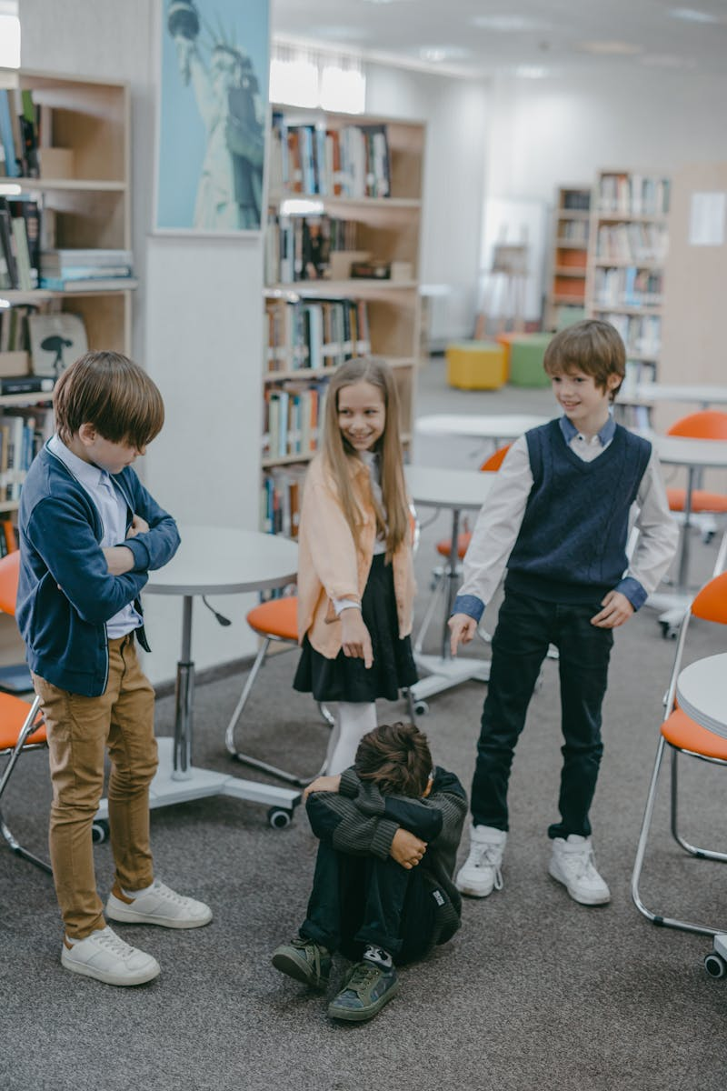
5
Kindness in Education
Nurturing Future Generations
Teaching kindness in schools fosters a caring and inclusive environment for learning. Students who practice kindness demonstrate better social skills and emotional intelligence. Educators who model kindness inspire their students to develop empathy and respect for others. A culture of kindness in educational settings leads to improved academic performance and engagement.
Photo by Pexels

Slide 8

6
Kindness and Mental Health
Healing Through Compassion
Acts of kindness can reduce anxiety and depression, promoting overall mental well-being. Giving and receiving kindness boosts the release of oxytocin, enhancing feelings of happiness. Being kind can help individuals cope with stress, leading to healthier relationships. Cultivating kindness can create a support system that encourages positive mental health practices.
Photo by Pexels

Slide 9
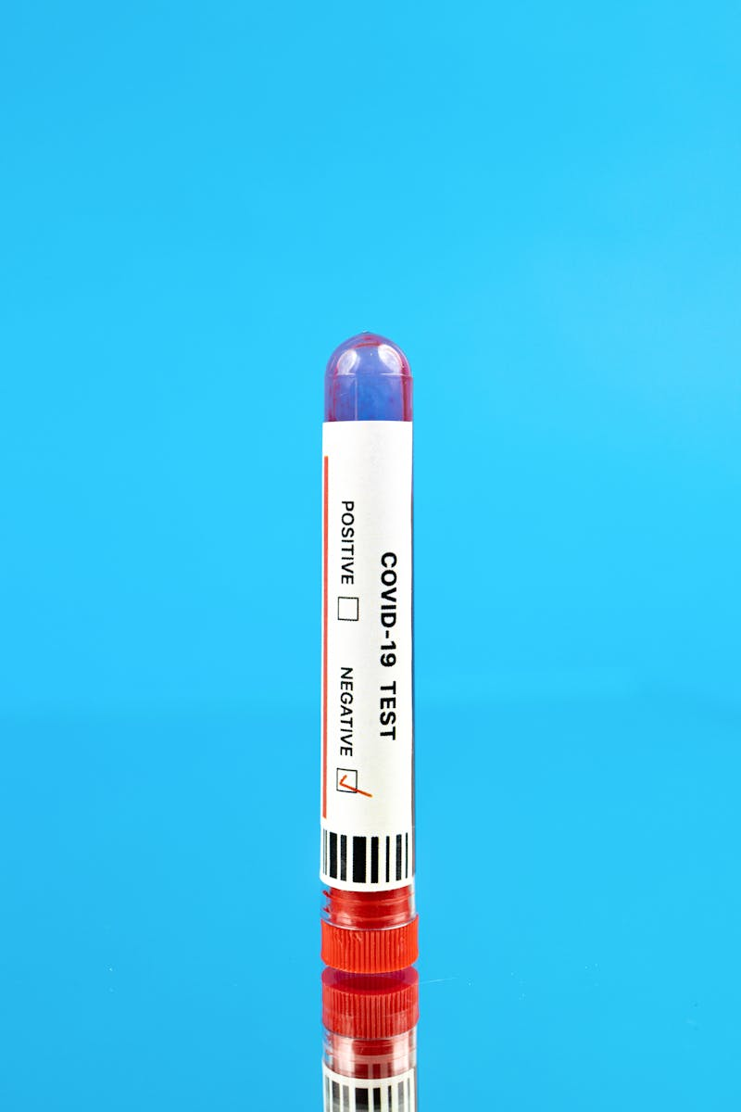
7
The Science of Kindness
Research Insights
Research shows that kindness activates brain regions associated with pleasure and reward. Being kind can increase life satisfaction and foster a sense of belonging. Studies indicate that those who practice kindness are more resilient to life's challenges. Understanding the science behind kindness can motivate people to engage in more kind acts.
Photo by Pexels

Slide 10
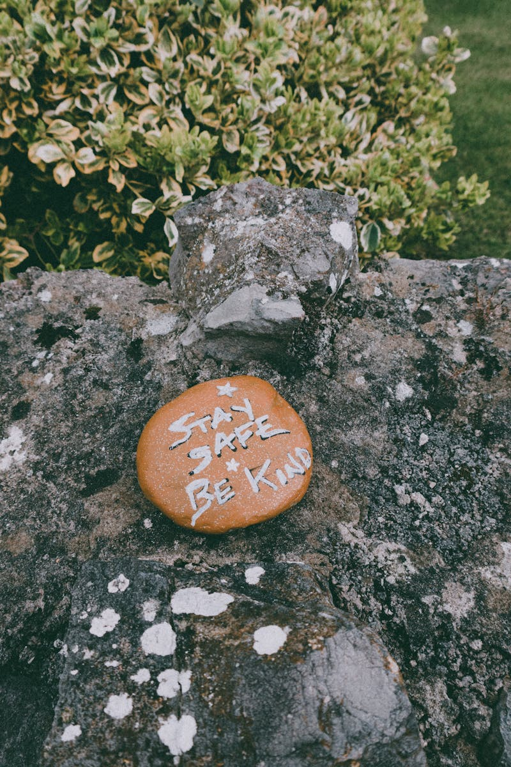
8
Impacts of Kindness Globally
A Better World
Kindness transcends borders, fostering global collaboration and understanding among diverse cultures. Communities focused on kindness experience enhanced social cohesion and harmony. Acts of kindness can contribute to global movements, driving social change and justice. The world becomes a better place as kindness spreads, uniting individuals around shared values.
Photo by Pexels

Slide 11
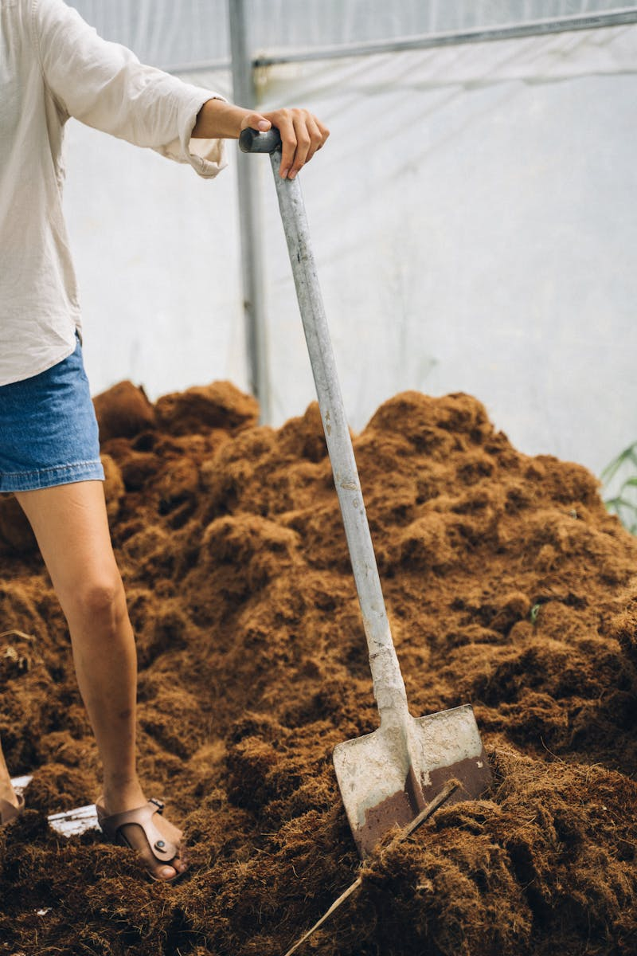
9
Cultivating a Kind Culture
Join the Movement
Creating a culture of kindness starts with small actions and personal commitment. Encourage others to share their acts of kindness, creating awareness and inspiration. Participate in community initiatives and support organizations focused on kindness. Together, we can build a legacy of kindness that impacts future generations.
Photo by Pexels

Slide 12

10
Thank You!
Spread Kindness!
Thank you for exploring the transformative power of kindness with us today. Remember, every small act of kindness counts and can change lives. Let's commit to spreading kindness in our daily lives and communities. Together, we can create a world where kindness prevails.
Photo by Pexels

