Slide 1

The Power of Words
Understanding the Impact of Our Communication
Photo by Pexels

Slide 2
01
The Transformative Power of Words
Table of Contents
02
The Positive Influence of Language
03
The Destructive Potential of Words
04
Words in Professional Settings
05
Becoming Mindful Communicators

Slide 3

1
The Transformative Power of Words
Introduction to How Language Shapes Our World
Every word we speak or write serves as a fundamental element that constructs our reality and influences those around us.
Words create instant reactions, triggering emotions, thoughts, and actions in both speakers and listeners simultaneously.
The words we use today can continue to influence others for years, creating lasting impressions and shaping future interactions.
Words transcend simple conversation, becoming tools for persuasion, healing, motivation, and transformation in various contexts.

Slide 4
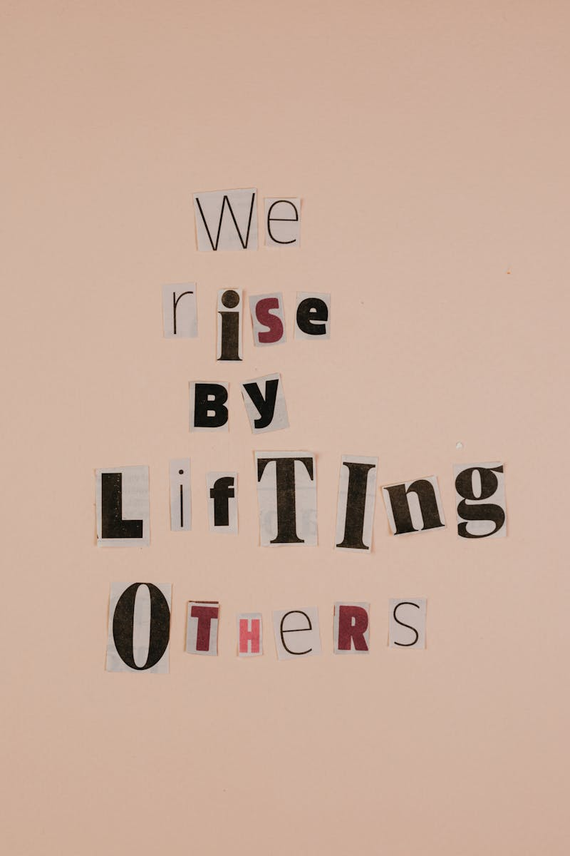
2
The Positive Influence of Language
How Words Can Inspire and Uplift Others
Positive reinforcement and supportive language can boost confidence, motivate action, and help individuals overcome challenges.
Carefully chosen words can provide comfort, support emotional healing, and create safe spaces for vulnerable conversations.
Thoughtful communication fosters trust, deepens connections, and creates lasting bonds between people in personal and professional settings.
Inspiring words can spark innovation, motivate collective action, and drive meaningful progress in communities and organizations.

Slide 5

3
The Destructive Potential of Words
Understanding the Harmful Effects of Negative Communication
Hurtful words can cause deep emotional wounds, affecting self-esteem, mental health, and overall well-being for extended periods.
Deceptive or harmful communication erodes trust, damages relationships, and creates barriers to healthy interaction between people.
Poorly chosen words can escalate disagreements, create misunderstandings, and lead to unnecessary tension in various environments.
The impact of negative words can persist long after they're spoken, affecting future interactions and shaping how others perceive us.

Slide 6
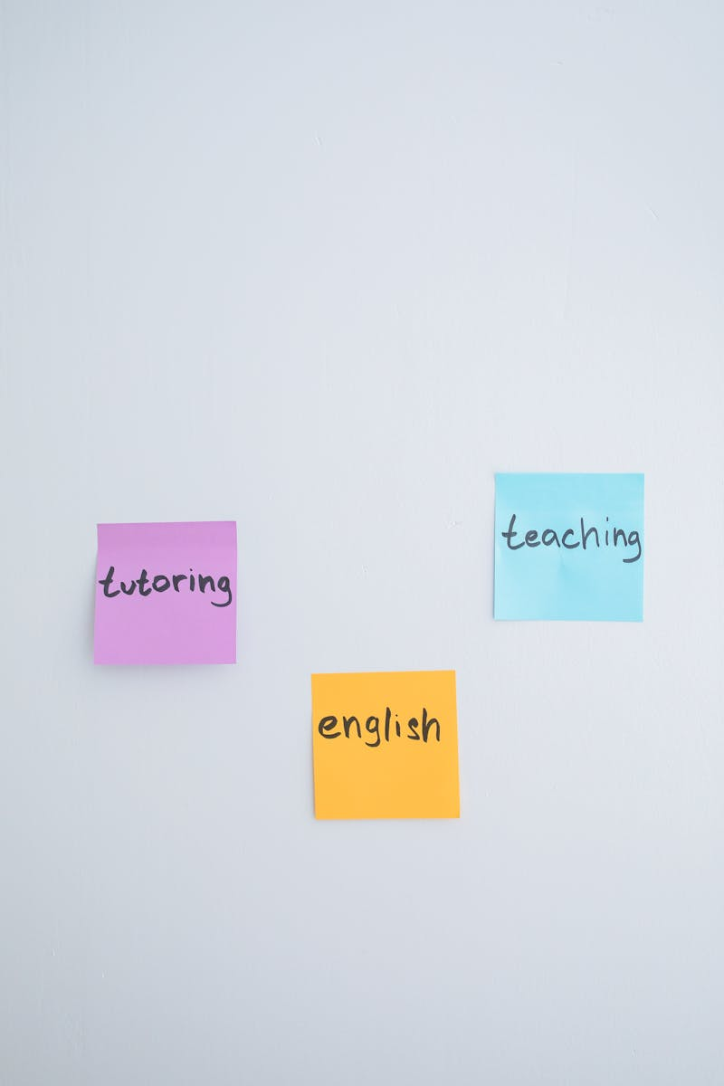
4
Words in Professional Settings
The Role of Communication in Educational Environments
Educators' words significantly influence student motivation, learning outcomes, and the overall classroom atmosphere and culture.
Constructive criticism and positive feedback shape student development, helping them understand strengths and areas for improvement.
Clear, precise language in academic settings enhances understanding, facilitates knowledge transfer, and promotes critical thinking.
Effective communication among educators and administrators drives collaboration, innovation, and continuous improvement in educational practices.

Slide 7

5
Becoming Mindful Communicators
Practical Strategies for Word Impact Awareness
Taking a moment to consider the potential impact of words before sharing them can prevent unintended harm and enhance communication effectiveness.
Selecting precise, thoughtful language that conveys intended meaning while considering the audience's perspective improves communication quality.
Being fully present and attentive to others' words demonstrates respect, builds understanding, and creates more meaningful exchanges.
Regularly reflecting on communication patterns, seeking feedback, and adapting language use leads to more effective and impactful interactions over time.

